Slide 1
Locality sensitive hashing (LSH)

Slide 2
Nearest Neighbor
Given a set P of n points in R^{d}

Slide 3
Nearest Neighbor
Want to build a data structure to answer nearest neighbor queries

Slide 4
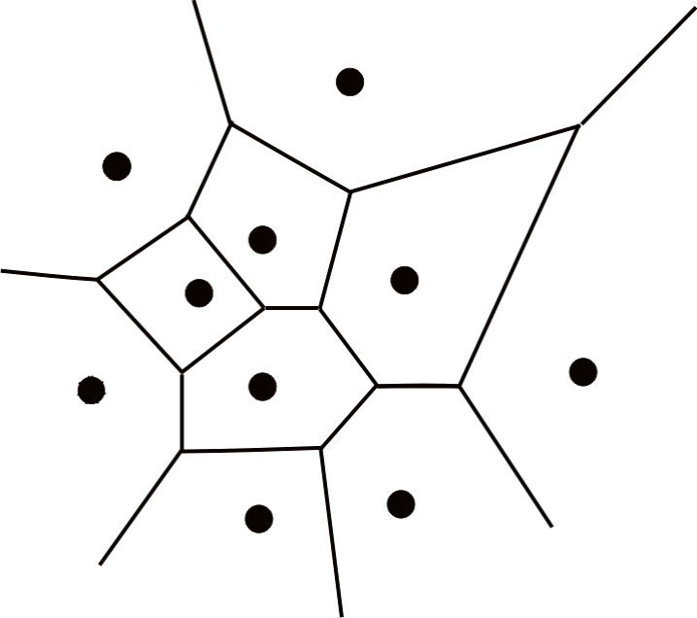
Voronoi Diagram
Build a Voronoi diagram & a point location data structure

Slide 5
Curse of dimensionality
In R² the Voronoi diagram is of size O(n)
Query takes O(logn) time
In R^{d} the complexity is O(n^{⎡d/2⎤})
Other techniques also scale bad with the dimension

Slide 6

Problem has many variants
Approximate (will talk about this soon)
k nearest neighbors
All neighbors at distance $≤r$

Slide 7
All nearest neighbors
Finding the nearest neighbors of every point in the data (near duplicate web pages)

Slide 8
Locality Sensitive Hashing
We will use a family of hash functions such that close points tend to hash to the same bucket.
Put all points of P in their buckets, ideally we want the query q to find its nearest neighbor in its bucket

Slide 9
Locality Sensitive Hashing
A family H of functions is (d₁ < d₂,p₁ > p₂)-sensitive if
d(p,q) ≤ d₁ ➔ Pr[h(p) = h(q)] ≥ p₁
d(p,q) ≥ d₂ ➔ Pr[h(p) = h(q)] ≤ p₂
d₁
d₂
p

Slide 10
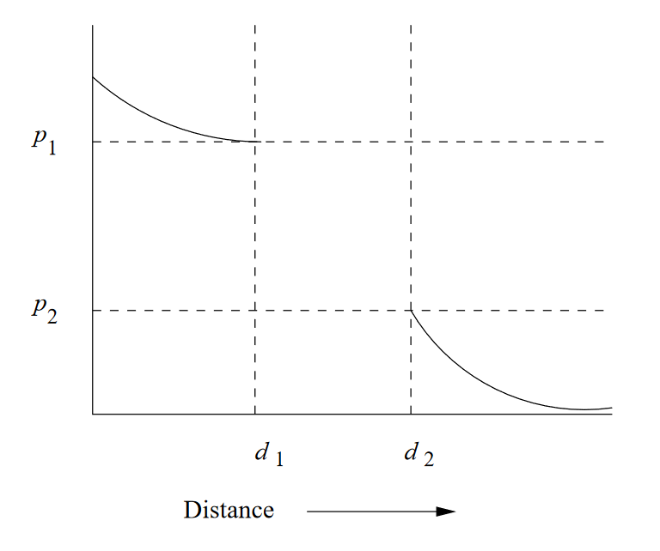



Locality Sensitive Family for a distance function $d(x,y)$
$$d_{1}$$
$$d_{2}$$

Slide 11
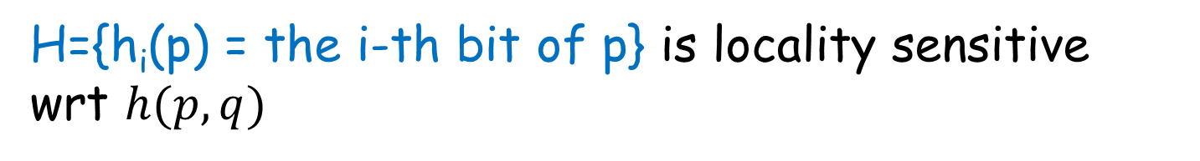

LSF for hamming distance
Think of the points as strings of m bits and consider the hamming distance $h(p,q)$
H={h_{i}(p) = the i-th bit of p} is locality sensitive wrt $h(p,q)$
Pr[h(p) = h(q)] = 1 – ham(p,q)/m
So this family is $\left(d_{1},d_{2},1−\frac{d_{1}}{m},1−\frac{d_{2}}{m}\right)$-sensitive

Slide 12

Jaacard distance and random permutations
Think of p and q as sets
jaccard(p,q) = |p∩q|/|p∪q|
Jd(p,q) = 1-jaccard(p,q) = 1 - |p∩q|/|p∪q|
H={h_{π}(p) = min in π of the items in p}
Pr[h_{π}(p) = h_{π}(q)] = jaccard(p,q)
Efficiency: Need to pick π from a min-wise ind. family of permutations
This is $(d_{1}=1−j_{1},d_{2}=1−j_{2},j_{1},j_{2})$-sensitive family

Slide 13
Jaacard distance and minhash
Think of p and q as sets
Jd(p,q) = 1-jaccard(p,q) = 1 - |p∩q|/|p∪q|
H={h_{r}(p) = min $r(x)$, $x∈p$, $r\sim U[0,1]$}
Pr[h_{r}(p) = h_{r}(q)] = jaccard(p,q)
Precision for $r$ should avoid ties
This is $(d_{1}=1−j_{1},d_{2}=1−j_{2},j_{1},j_{2})$-sensitive family

Slide 14



Cosine distance
$p$ and $q$ are vectors and $d(p,q)=θ$
$$p$$
$$θ$$
$$q$$

Slide 15
Cosine distance
H = {h_{r}(p) = 1 if r·p > 0, 0 otherwise | r is a random unit vector}
r
$$p$$
$$θ$$
$$q$$

Slide 16

Cosine distance
H = {h_{r}(p) = 1 if r·p > 0, 0 otherwise | r is a random unit vector}
r
$$p$$
$$θ$$
$$q$$
$$Pr⁡[hr(p) = hr(q)] = ?$$

Slide 17
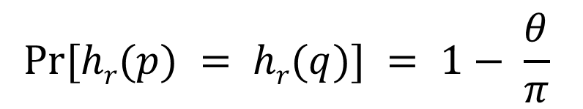
Cosine distance
H = {h_{r}(p) = 1 if r·p > 0, 0 otherwise | r is a random unit vector}
r
$$p$$
$$θ$$
$$q$$
$$Pr⁡[hr(p) = hr(q)] = 1− \frac{θ}{π}$$

Slide 18
Cosine distance
H = {h_{r}(p) = 1 if r·p > 0, 0 otherwise | r is a random unit vector}
r
$$p$$
$$θ$$
$$q$$
This is $\left(θ_{1},θ_{2}, 1−\frac{θ_{1}}{π},1−\frac{θ_{2}}{π}\right)$-sensitive family

Slide 19
Cosine distance
H = {h_{r}(p) = 1 if r·p > 0, 0 otherwise | r is a random unit vector}
For binary vectors (like term-doc) incidence vectors:
r
$$p$$
$$θ$$
$$q$$
This is $\left(θ_{1},θ_{2}, 1−\frac{θ_{1}}{π},1−\frac{θ_{2}}{π}\right)$-sensitive family

Slide 20
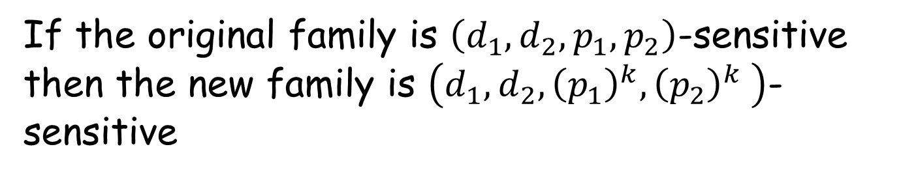
Combining by “AND”
Reduce the number of false positives by concatenating hash function to get a new family of hash functions
h(p) = h₁(p)h₂(p)h₃(p)h₄(p)……h_{k}(p) = 00101010
We get a new family of hash functions
$h(p)=h(q)$iff $h_{i}\left(p\right)=h_{i}\left(q\right) ∀i$
If the original family is $\left(d_{1},d_{2},p_{1},p_{2}\right)$-sensitive then the new family is $\left(d_{1},d_{2},{\left(p_{1}\right)}^{k},{\left(p_{2}\right)}^{k} \right)$-sensitive

Slide 21
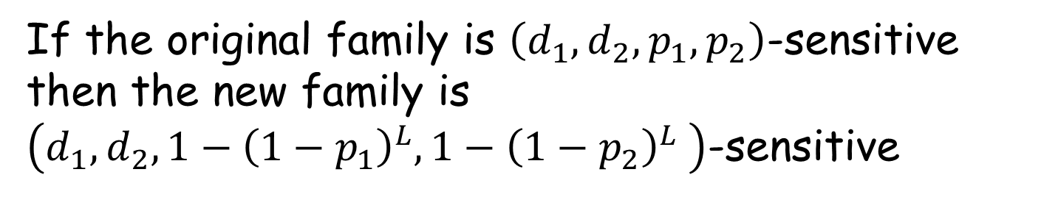
Combining by “OR”
Reduce the number of false negatives
h(p) = h₁(p),h₂(p),h₃(p),h₄(p),……,h_{L}(p) = 0,0,1,0,1,0,1,0
We get a new family of hash functions
$h(p)=h\left(q\right)$ iff ${∃i s.t. h}_{i}\left(p\right)=h_{i}\left(q\right)$
If the original family is $\left(d_{1},d_{2},p_{1},p_{2}\right)$-sensitive then the new family is
$\left(d_{1},d_{2},{1−\left(1−p_{1}\right)}^{L},{1−\left(1−p_{2}\right)}^{L} \right)$-sensitive

Slide 22
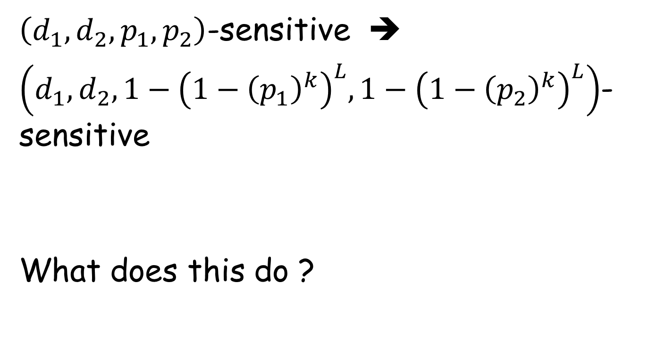
“And k” followed by “Or L”
$\left(d_{1},d_{2},p_{1},p_{2}\right)$-sensitive ➔
$\left(d_{1},d_{2},1−{\left(1−{\left(p_{1}\right)}^{k}\right)}^{L},1−{\left(1−{\left(p_{2}\right)}^{k}\right)}^{L}\right)$-sensitive
What does this do ?

Slide 23
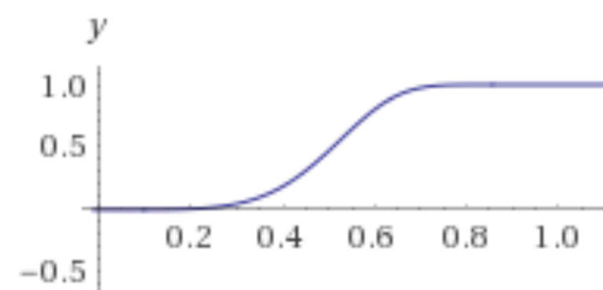
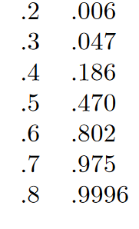

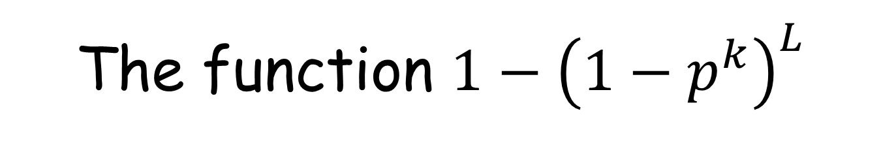


The function $1−{\left(1−p^{k}\right)}^{L}$
k=5, L=20
$$p$$
$$1−{\left(1−p^{5}\right)}^{20}$$
For example if $\left(p_{1},p_{2}\right)$ were $\left(0.6,0.4\right)$ then now they are $(0.802,0.186)$

Slide 24
A theoretical result on NN

Slide 25
(r,ε)-neighbor problem
If there is a neighbor p, such that d(p,q)≤r, return p’, s.t. d(p’,q) ≤ (1+ε)r.
r
p
(1+ε)r

Slide 26
(r,ε)-neighbor problem
Lets construct a data structure that succeeds with constant probability
Focus on the hamming distance first

Slide 27
NN using locality sensitive hashing
Take a (r₁ , r₂, p₁ , p₂) =
(r , (1+ε)r, 1-r/m , 1-(1+ε)r/m) - sensitive family
If there is a neighbor at distance r we catch it with probability p₁

Slide 28
NN using locality sensitive hashing
Take a (r₁ , r₂, p₁ , p₂) =
(r , (1+ε)r, 1-r/m , 1-(1+ε)r/m) - sensitive family
If there is a neighbor at distance r we catch it with probability p₁ so to guarantee catching it we need to “or” 1/p₁ functions..

Slide 29
NN using locality sensitive hashing
Take a (r₁ , r₂, p₁ , p₂) =
(r , (1+ε)r, 1-r/m , 1-(1+ε)r/m) - sensitive family
If there is a neighbor at distance r we catch it with probability p₁ so to guarantee catching it we need to “or” 1/p₁ functions..
But we also get false positives, how many ?

Slide 30
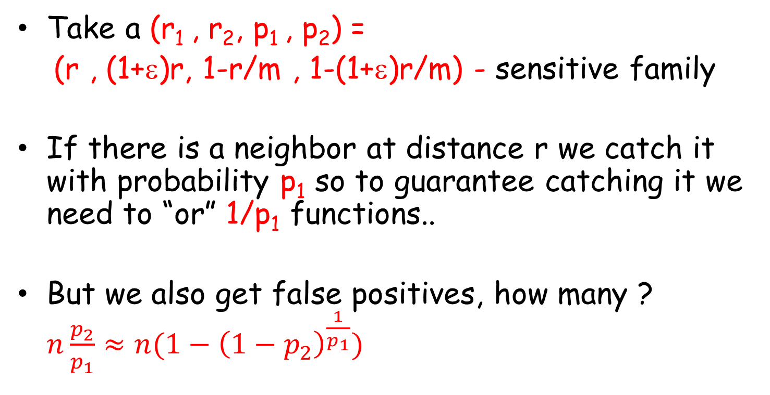
NN using locality sensitive hashing
Take a (r₁ , r₂, p₁ , p₂) =
(r , (1+ε)r, 1-r/m , 1-(1+ε)r/m) - sensitive family
If there is a neighbor at distance r we catch it with probability p₁ so to guarantee catching it we need to “or” 1/p₁ functions..
But we also get false positives, how many ? $n\frac{p_{2}}{p_{1}}≈n(1−{\left(1−p_{2}\right)}^{\frac{1}{p_{1}}})$

Slide 31
NN using locality sensitive hashing
Take a (r₁ , r₂, p₁ , p₂) = (r , (1+ε)r, 1-r/m , 1-(1+ε)r/m) - sensitive family
Make a new function by concatenating (“and”) k of these basic functions
We get a (r₁ , r₂, (p₁)^{k} , (p₂)^{k}) sensitive family
If there is a neighbor at distance r we catch it with probability (p₁)^{k} so to guarantee catching it we need L=1/(p₁)^{k} functions. We get a (r₁ , r₂, 1-(1-(p₁)^{k})^{L} , 1-(1-(p₂)^{k})^{L} ) sensitive family
But we also get false positives in our 1/(p₁)^{k} buckets, how many ? n(p₂)^{k}/(p₁)^{k}

Slide 32
(r,ε)-Neighbor with constant prob
Scan the first 4n(p₂)^{k}/(p₁)^{k} points in the buckets and return the closest
A close neighbor (≤ r₁) is in one of the buckets with probability ≥ 1-(1/e)
There are ≤ 4n(p₂)^{k}/(p₁)^{k} false positives with probability ≥ 3/4
➔ Both events happen with constant prob.

Slide 33
Analysis
Total query time:
(each op takes time prop. to the dim.)
We want to choose k to minimize this.
time
≤ 2*min
k

Slide 34
Analysis
Total query time:
(each op takes time prop. to the dim.)
We want to choose k to minimize this:
↔

Slide 35


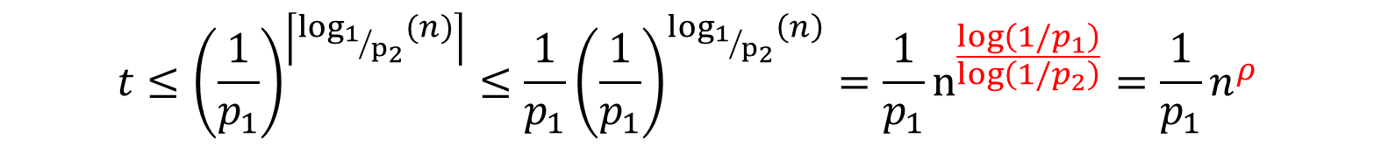
Summary
Total query time:
$$k=\left\lceil \log_{1/{p_{2}}}{(n)}\right\rceil$$
Put:
$${t≤\left(\frac{1}{p_{1}}\right)}^{\left\lceil \log_{1/{p_{2}}}{(n)}\right\rceil }≤\frac{1}{p_{1}}{\left(\frac{1}{p_{1}}\right)}^{\log_{1/{p_{2}}}\left(n\right)}=\frac{1}{p_{1}}n^{\frac{\log\left(1/p_{1}\right)}{\log\left(1/p_{2}\right)}}=\frac{1}{p_{1}}n^{ρ}$$
$$n\frac{1}{p_{1}}n^{ρ}=\frac{1}{p_{1}}n^{1+ρ}$$
space:

Slide 36
What is ρ ?

Slide 37
(1+ε)-approximate NN
Given q find p such that ∀p’≠p
d(q,p) ≤ (1+ε)d(q,p’)
We can use our solution to the (r,ε)-neighbor problem

Slide 38
(1+ε)-approximate NN vs (r,ε)-neighbor problem
If we know r_{min} and r_{max} we can find (1+ε)-approximate NN using log(r_{max}/r_{min}) (r,ε’≈ ε/2)-neighbor problems
r
p
(1+ε’)r

Slide 39
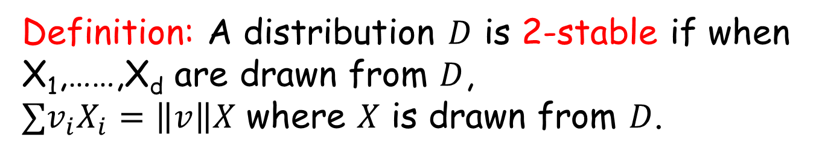
LSH using p-stable distributions
Definition: A distribution $D$ is 2-stable if when X₁,……,X_{d} are drawn from $D$,
$∑v_{i}X_{i}=\left\|v\right\|X$ where $X$ is drawn from $D$.
So what do we do with this ?
h(p) = ∑p_{i}X_{i}
h(p)-h(q) = ∑p_{i}X_{i} - ∑q_{i}X_{i} = ∑(p_{i}-q_{i})X_{i}=||p-q||X

Slide 40
LSH using p-stable distributions
So what do we do with this ?
h(p) = ⎣(pX)/r⎦
Pick r to maximize ρ…
r

Slide 41
Bibliography
M. Charikar: Similarity estimation techniques from rounding algorithms. STOC 2002: 380-388
P. Indyk, R. Motwani: Approximate Nearest Neighbors: Towards Removing the Curse of Dimensionality. STOC 1998: 604-613.
A. Gionis, P. Indyk, R. Motwani: Similarity Search in High Dimensions via Hashing. VLDB 1999: 518-529
M. R. Henzinger: Finding near-duplicate web pages: a large-scale evaluation of algorithms. SIGIR 2006: 284-291
G. S. Manku, A. Jain , A. Das Sarma: Detecting near-duplicates for web crawling. WWW 2007: 141-150

