Slide 1
Data Mining 2017: Privacy and Differential Privacy
Slides stolen from Kobbi Nissim (with permission)
Also used: The Algorithmic Foundations of
Differential Privacy by Dwork and Roth

Slide 2
Data Privacy – The Problem
Given:
  a dataset with sensitive information
    Health records, census data, financial data, …
How to:
  Compute and release functions of the dataset,
  Without compromising individual privacy.

Slide 3



Data Privacy – The Problem
Individuals
Server/agency
Users
(
)
Government,
researchers,
businesses
(or)
Malicious
adversary
queries
A
answers
Notes:
Say:
-- “background knowledge”
-- more of an issue now than it was twenty years ago
Add UT logo

Slide 4
A Real Problem
Typical examples:
Census
Civic archives
Medical records
Search information
Communication logs
Social networks
Genetic databases
…
Benefits:
New discoveries
Improved medical care
National security
discoveries
med care
privacy
security

Slide 5
The Anonymization Dream
Database
Anonymized Database
Trusted curator:
  Removes identifying information (name, address, ssn, …).
  Replaces identities with random identifiers.
Idea hard wired into practices, regulations, …, thought.
  Many uses.
Reality: series failures.
  Pronounced both in academic and public literature.

Slide 6







Data Privacy
Studied (at least) from the 60s
Approaches: De-identification, redaction, auditing, noise addition, synthetic datasets …
  Focus on how to provide privacy, not on what privacy protection is
  May have been suitable for the pre-internet era
Re-identification [Sweeney ’00, …]
  GIS data, health data, clinical trial data, DNA, Pharmacy data, text data, registry information, …
Blatant non-privacy [Dinur, Nissim ‘03], …
Auditors [Kenthapadi, Mishra, Nissim ’05]
AOL Debacle ‘06
Genome-Wide association studies (GWAS) [Homer et al. ’08]
Netflix award [Narayanan, Shmatikov ‘09]
  Netflix canceled second contest
Social networks [Backstrom, Dwork, Kleinberg ‘11]
Genetic research studies [Gymrek, McGuire, Golan, Halperin, Erlich ‘11]
Microtargeted advertising [Korolova 11]
Recommendation Systems [Calandrino, Kiltzer, Naryanan, Felten, Shmatikov 11]
Israeli CBS [Mukatren, Nissim, Salman, Tromer ’14]
Attack on statistical aggregates [Homer et al.’08] [Dwork, Smith, Steinke, Vadhan ‘15]
…
Slide idea stolen shamelessly from Or Sheffet

Slide 7
Linkage Attacks [Sweeney 2000]
GIC
Group Insurance
Commission
patient specific data
(≈ 135,000 patients)
  ≈100 attributes
  per encounter
    Anonymized
Voter registration
of Cambridge MA
  “Public records”
  open for inspection by anyone
Name
Address
Date registered
Party affiliation
Date last voted
Ethnicity
visit date
Diagnosis
Procedure
Medication
Total Charge
ZIP
Birth date
Sex
ZIP
Birth date
Sex
Anonymized GIC data
Voter registration

Slide 8
Linkage Attacks [Sweeney 2000]
Quasi identifiers → re-identification
  Not a coincidence:
    dob+5zip → 69%
    dob+9zip → 97%
William Weld (governor of Massachusetts at the time)
  According to the Cambridge Voter list:
    Six people had his particular birth date
    Of which three were men
    He was the only one in his 5-digit ZIP code!
Notes:
Idea is recurring, probably rediscovered every few years (there;s a paper by Dalenius from 86). What’s interesting here is that this really works and in masses.

Slide 9
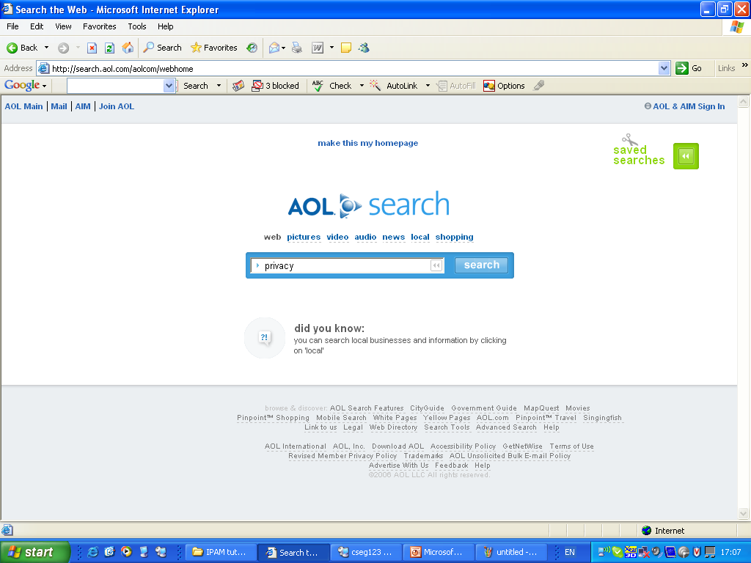

Slide 10
AOL Data release (2006)
AOL released search data
  A sample of ~20M web queries collected from ~650k users over three months
Goal: provide real query log data that is based on real users
  “It could be used for personalization, query reformulation or other types of search research”
The data set:
AnonID
Query
QueryTime
ItemRank
ClickURL

Slide 11
4417749 best dog for older owner 3/6/2006 11:48:24 1 http://www.canismajor.com
4417749 best dog for older owner 3/6/2006 11:48:24 5 http://dogs.about.com
4417749 landscapers in lilburn ga. 3/6/2006 18:37:26
4417749 effects of nicotine 3/7/2006 19:17:19 6 http://www.nida.nih.gov
4417749 best retirement in the world 3/9/2006 21:47:26 4 http://www.escapeartist.com
4417749 best retirement place in usa 3/9/2006 21:49:37 10 http://www.clubmarena.com
4417749 best retirement place in usa 3/9/2006 21:49:37 9 http://www.committment.com
4417749 bi polar and heredity 3/13/2006 20:57:11
4417749 adventure for the older american 3/17/2006 21:35:48
4417749 nicotine effects on the body 3/26/2006 10:31:15 3 http://www.geocities.com
4417749 nicotine effects on the body 3/26/2006 10:31:15 2 http://health.howstuffworks.com
4417749 wrinkling of the skin 3/26/2006 10:38:23
4417749 mini strokes 3/26/2006 14:56:56 1 http://www.ninds.nih.gov
4417749 panic disorders 3/26/2006 14:58:25
4417749 jarrett t. arnold eugene oregon 3/23/2006 21:48:01 2 http://www2.eugeneweekly.com
4417749 jarrett t. arnold eugene oregon 3/23/2006 21:48:01 3 http://www2.eugeneweekly.com
4417749 plastic surgeons in gwinnett county 3/28/2006 15:04:23 1 http://www.wedalert.com
4417749 plastic surgeons in gwinnett county 3/28/2006 15:04:23 4 http://www.implantinfo.com
4417749 plastic surgeons in gwinnett county 3/28/2006 15:31:00
4417749 60 single men 3/29/2006 20:11:52 6 http://www.adultlovecompass.com
4417749 60 single men 3/29/2006 20:14:14
4417749 clothes for 60 plus age 4/19/2006 12:44:03
4417749 clothes for age 60 4/19/2006 12:44:41 10 http://www.news.cornell.edu
4417749 clothes for age 60 4/19/2006 12:45:41
4417749 lactose intolerant 4/21/2006 20:53:51 2 http://digestive.niddk.nih.gov
4417749 lactose intolerant 4/21/2006 20:53:51 10 http://www.netdoctor.co.uk
4417749 dog who urinate on everything 4/28/2006 13:24:07 6 http://www.dogdaysusa.com
4417749 fingers going numb 5/2/2006 17:35:47

Slide 12
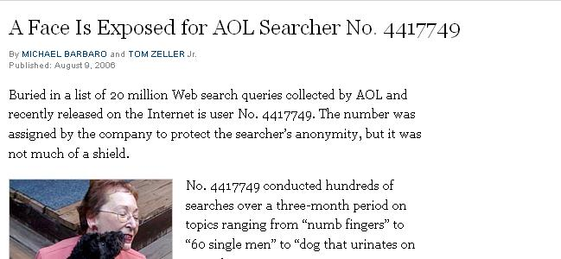
Name: Thelma Arnold
Age: 62
Widow
Residence: Lilburn, GA

Slide 13
Other Re-Identification Examples
[partial and unordered list]
Netflix award [Narayanan, Shmatikov 08].
Social networks [Backstrom, Dwork, Kleinberg 07, NS 09].
Computer networks [Coull, Wright, Monrose, Collins, Reiter ’07, Ribeiro, Chen, Miklau, Townsley 08].
Genetic data (GWAS) [Homer, Szelinger, Redman, Duggan, Tembe, Muehling, Pearson, Stephan, Nelson, Craig 08, ...].
Microtargeted advertising [Korolova 11].
Recommendation Systems [Calandrino, Kiltzer, Naryanan, Felten, Shmatikov 11].
Israeli CBS [Mukatren, N, Salman, Tromer].
…
Notes:
Add references

Slide 14
k-Anonymity [SS98,S02]
Prevent re-identification:
  Make every individual’s identity unidentifiable from other k-1 individuals
Disease | sex | Age | ZIP
Heart | Female | 55 | 23456
Heart | Male | 30 | 12345
Heart | Male | 33 | 12346
Breast Cancer | Female | 45 | 13144
Hepatitis | Male | 42 | 13155
Viral | Male | 42 | 23456
Disease | sex | Age | ZIP
Heart | * | ** | 23456
Heart | Male | 3* | 1234*
Heart | Male | 3* | 1234*
Breast Cancer | * | 4* | 131**
Hepatitis | * | 4* | 131**
Viral | * | ** | 23456
Both guys from zip 1234* that are in their thirties have heart problems
Bugger! I Cannot tell which disease for the patients from zip 23456
My (male) neighbor from zip 13155 has hepatitis!

Slide 15
Auditing
Here’s the answer
OR
Query denied (as the answer would cause privacy loss)
Here’s a new query: q_{i+1}
Statistical
database
Auditor
Query log
q₁,…,q_{i}

Slide 16
Example 1: Sum/Max auditing
  d_{i} real, sum/max queries, privacy breached if some d_{i} learned
q1 = sum(d1,d2,d3)
sum(d1,d2,d3) = 15
q2 = max(d1,d2,d3)
Denied (the answer would cause privacy loss)
Oh well…
Auditor

Slide 17
… After Two Minutes …
  d_{i} real, sum/max queries, privacy breached if some d_{i} learned
q1 = sum(d1,d2,d3)
sum(d1,d2,d3) = 15
q2 = max(d1,d2,d3)
Denied (the answer would cause privacy loss)
There must be a reason for the denial…
q2 is denied iff d1=d2=d3 = 5
I win!
Oh well…
Auditor

Slide 18
Example 2: Interval Based Auditing
  d_{i} ∈ [0,100], sum queries, error ε =1
q1 = sum(d1,d2)
Sorry, denied
q2 = sum(d2,d3)
sum(d2,d3) = 50
d1,d2 ∈ [0,1]
d3 ∈ [49,50]
Denial → d1,d2∈[0,1] or [99,100]
Auditor

Slide 19
Max Auditing
d1
d2
d3
d4
d5
d6
d7
d8
…
d_{n-1}
d_{n}
  d_{i} real
q1 = max(d1,d2,d3,d4)
M₁₂₃₄
q2 = max(d1,d2,d3)
M₁₂₃ / denied
If denied: d4=M₁₂₃₄
q2 = max(d1,d2)
M₁₂ / denied
If denied: d3=M₁₂₃
Auditor

Slide 20
Adversary’s Success
q1 = max(d1,d2,d3,d4)
q2 = max(d1,d2,d3)
If denied: d4=M₁₂₃₄
Denied with probability 1/4
q2 = max(d1,d2)
If denied: d3=M₁₂₃
Denied with probability 1/3
Success probability: 1/4 + (1- 1/4)·1/3 = 1/2
Recover 1/8 of the database!
Auditor

Slide 21
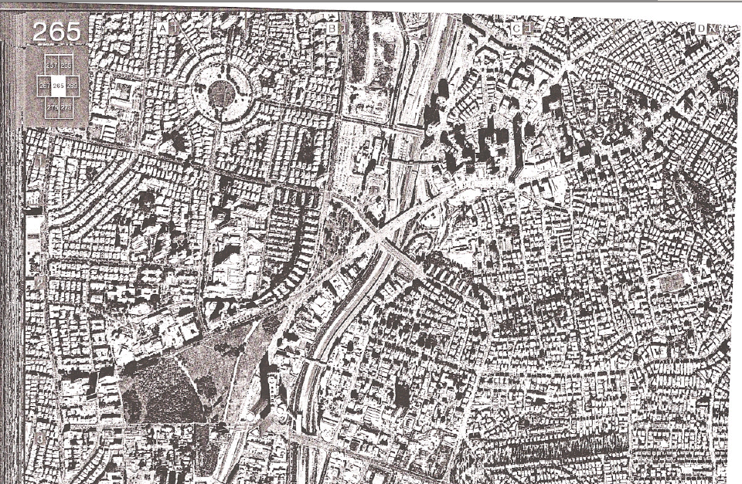
מגדלי עזריאלי
Thanks to Miri Regev

Slide 22
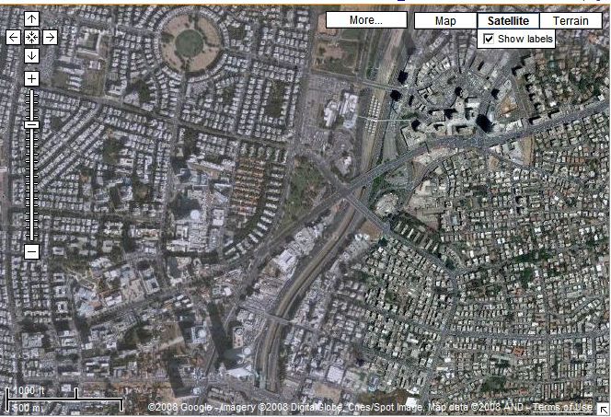
מגדלי עזריאלי
Thanks to Google

Slide 23
Randomization

Slide 24
The Scenario
Users provide modified values of sensitive attributes
Dataminer develops models about aggregated data
Dataminer
Can we develop accurate models without access to precise individual information?

Slide 25
Preserving Privacy
Value distortion – return x_{i}+r_{i}
  Uniform noise: r_{i} ∼ U(-a,a)
  Gaussian noise: r_{i} ∼ N(0,stdev)
  Perturbation of an entry is fixed
    So that repeated queries do not reduce noise
Privacy quantification: interval of confidence [AS 2000]
  With c% confidence x_{i} is in the interval [a₁, a₂]. a₂-a₁ define the amount of privacy at c% confidence level
  Examples:
  Intuition: the larger the interval is, the better privacy is preserved.
 | 50% | 95% | 99.9%
Uniform | 0.5 x 2a | 0.95 x 2a | 0.999 x 2a
Gaussian | 1.34 stdev | 3.92 stdev | 6.8 stdev

Slide 26
Prior knowledge affects privacy
Let X=age r_{i} ∼ U(-50,50)
[AS]: Privacy 100 at 100% confidence
Seeing a measurement -10
  Facts of life: Bob’s age is between 0 and 40
Assume you also know Bob has two children
  Bob’s age is between 15 and 40
a-priori information may be used in attacking individual data

Slide 27
Privacy in Computation – The Problem
Data
Can be
Distributed!
Analysis
(Computation)
Outcome
Health, social n/w,
location, communication, …
Given a dataset with sensitive personal information
How to compute and release functions of the dataset
While protecting individual privacy
Academic research,
informed policy,
national security, …

Slide 28





SMPC!
How many Trump fans in class?
UC!
Sensitive information …
Great!
Hooray!
Yay!

Slide 29

3 Trump fans in class

Slide 30
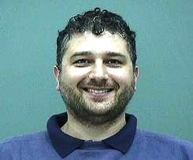
A survey!
How many Trump fans
A few minutes later –
Kobbi join the class
Using SMPC!
What are you doing?
Me too!

Slide 31

3 Trump fans
Aha!
Kobbi is TF w.p. 4/100
(after @Kobbi joins): 4 Trump fans

Slide 32

Composition
Differencing attack:
  How is my privacy affected when an attacker sees analysis before and after I join/leave?
More generally: Composition
  How is my privacy affected when an attacker combines results from two or more privacy preserving analyses?
Fundamental law of information: the more information we extract from our data, the more is learned about individuals!
  So, privacy will deteriorate as we use our data more and more
  Best desiderata:
    Deterioration is quantifiable and controllable
    Deterioration not abrupt

Slide 33
My Privacy Desiderata
Real world:
My ideal world:
Data
Analysis
(Computation)
Kobbi’s data
Outcome
same outcome
Data
w/my info removed
Analysis
(Computation)
Outcome

Slide 34
Things to Note
We only consider the intended outcome of analyses
  Security flaws, hacking, implementation errors, human factors, …
    Very important but very different questions
My ideal world would hide whether I’m Trump fan
  Resilient to differencing attacks
Does not mean I’m fully protected
  I’m only protected to the extent I’m protected in my ideal world
  Some harm could happen to me even in my ideal world
    Bob smokes in public
    Study teaches that smoking causes cancer
    Bob’s health insurer raises his premium
    Bob is harmed even if he does not participate in the study!

Slide 35
Our Privacy Desiderata
Should ignore Kobbi’s info
Real world:
My ideal world:
Data
Analysis
(Computation)
Outcome
same outcome
Data
w/my info removed
Analysis
(Computation)
Outcome

Slide 36
Our Privacy Desiderata
Should ignore Kobbi’s info
Real world:
Gert’s ideal world:
and Gertrude’s!
Data
Analysis
(Computation)
Outcome
same outcome
Data
w/Gert’s info removed
Analysis
(Computation)
Outcome

Slide 37
Our Privacy Desiderata
Should ignore Kobbi’s info
Real world:
Mark’s ideal world:
and Gertrude’s!
and Mark’s!
Data
Analysis
(Computation)
Outcome
same outcome
Data
w/Mark’s info removed
Analysis
(Computation)
Outcome

Slide 38
Our Privacy Desiderata
Should ignore Kobbi’s info
Real world:
☺’s ideal world:
and Gertrude’s!
and Mark’s!
Data
… and everybody’s!
Analysis
(Computation)
Outcome
same outcome
Data
w/☺’s info removed
Analysis
(Computation)
Outcome

Slide 39

A Realistic Privacy Desiderata
Real world:
☺’s ideal world:
Data
Analysis
(Computation)
Outcome
same outcome
$(ε,δ)$-”similar”
Data
w/☺’s info removed
Analysis
(Computation)
Outcome

Slide 40
Differential Privacy [Dwork McSherry N Smith 06]
Real world:
☺’s ideal world:
Data
Analysis
(Computation)
Outcome
$(ε,δ)$-”similar”
Data
w/☺’s info removed
Analysis
(Computation)
Outcome

Slide 41
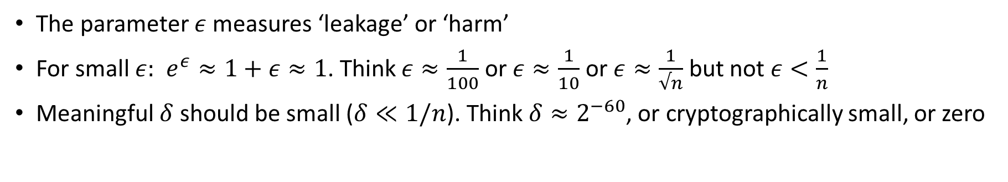
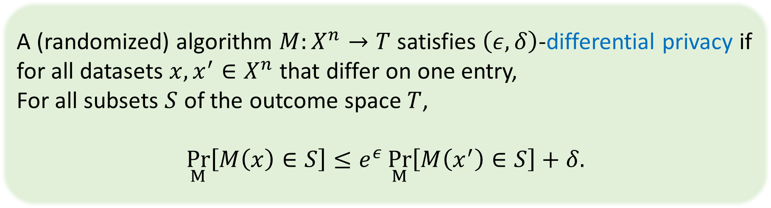
Differential Privacy [Dwork McSherry N Smith 06][DKMMN’06]
A (randomized) algorithm $M:X^{n}→T$ satisfies $\left(ε,δ\right)$-differential privacy if
for all datasets $x,x^{′}∈X^{n}$ that differ on one entry,
For all subsets $S$ of the outcome space $T$,
$$\underset{M}{Pr}\left[M\left(x\right)∈S\right]≤e^{ε}\underset{M}{Pr}\left[M\left(x^{′}\right)∈S\right]+δ.$$
The parameter $ε$ measures ‘leakage’ or ‘harm’
For small $ε:$ $e^{ε}≈1+ε≈1$. Think $ε≈\frac{1}{100}$ or $ε≈\frac{1}{10}$ or $ε≈\frac{1}{√n}$ but not $ε<\frac{1}{n}$
Meaningful $δ$ should be small ($δ≪1/n$). Think $δ≈2^{−60}$, or cryptographically small, or zero
$δ≪1/n$ (usually cryptographically small; “pure” differential privacy: $δ=0$)

Slide 42
Why Differential Privacy?
DP: Strong, quantifiable, composable mathematical privacy guarantee
A definition/standard/requirement, not a specific algorithm
  Opens door to algorithmic development
Provably resilient to known and unknown attack modes!
Has a natural interpretation: I am protected (almost) to the extent I’m protected in my privacy-ideal scenario
Theoretically, DP enables many computations with personal data while preserving personal privacy
  Practicality in first stages of validation

Slide 43
Interpreting Differential Privacy
A naïve hope: Your beliefs about me are the same after you see the output as they were before.
Suppose I smoke in public
  A public health study could teach that I am at risk for cancer.
  But it didn’t matter whether or not my data was part of it.

Slide 44
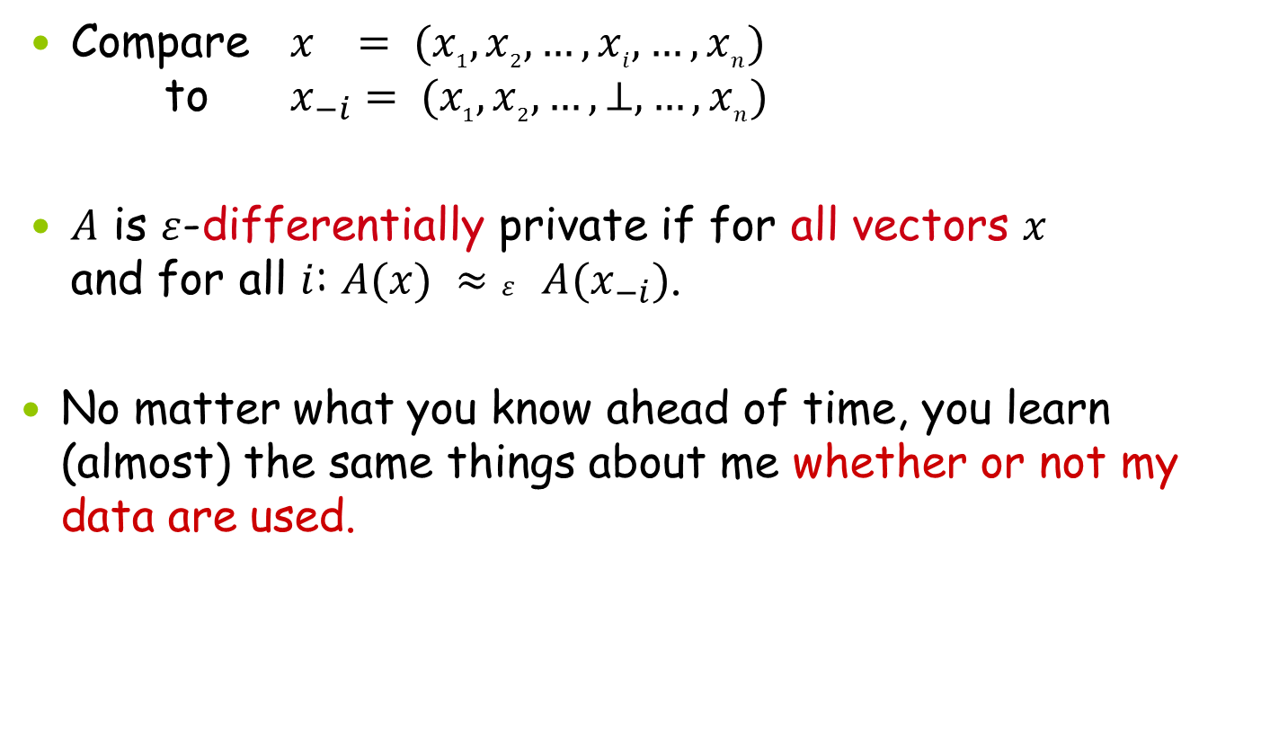
Interpreting Differential Privacy
Compare $x = (x_{1}, x_{2}, …, x_{i}, …, x_{n})$
to $x_{−i}= (x_{1}, x_{2}, …,⊥, …, x_{n})$
$A$ is $ε$-differentially private if for all vectors $x$
and for all $i$: $A(x) ≈ε A(x_{−i})$.
No matter what you know ahead of time, you learn (almost) the same things about me whether or not my data are used.

Slide 45
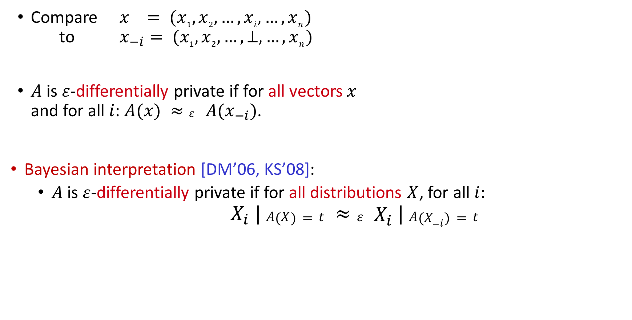
Interpreting Differential Privacy
Compare $x = (x_{1}, x_{2}, …, x_{i}, …, x_{n})$
to $x_{−i}= (x_{1}, x_{2}, …,⊥, …, x_{n})$
$A$ is $ε$-differentially private if for all vectors $x$
and for all $i$: $A(x) ≈ε A(x_{−i})$.
Bayesian interpretation [DM’06, KS’08]:
  $A$ is $ε$-differentially private if for all distributions $X$, for all $i$:
  $X_{i} | A(X)=t ≈ε X_{i} | A(X_{−i})=t$
Under any reasonable distance metric

Slide 46
Are you HIV positive?
Toss Coin
  If heads tell the truth
  If tails, toss another coin:
    If heads say yes
    If tails say no

Slide 47
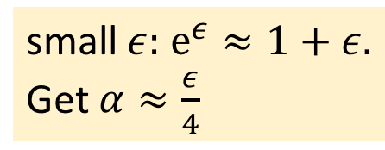

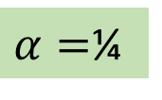
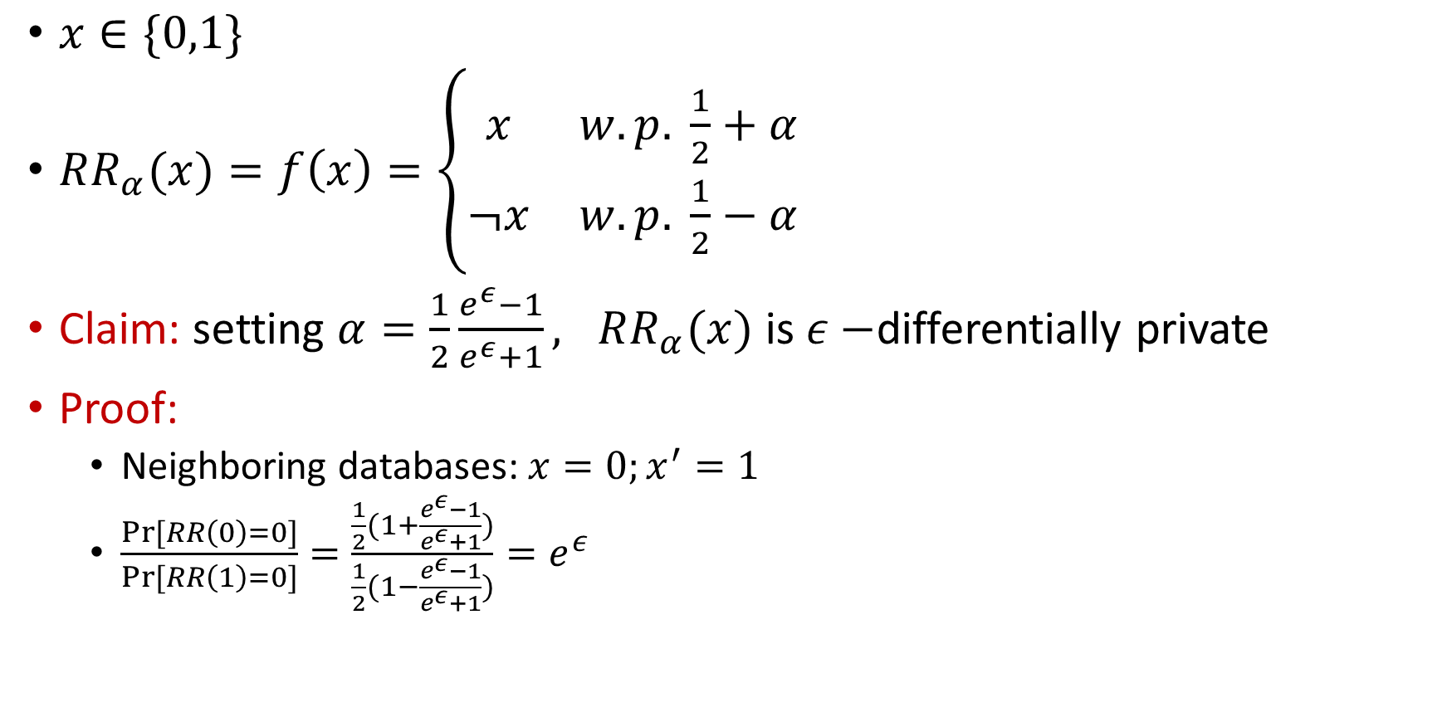
Randomized response [Warner 65]
$α=$¼
$x∈\{0,1\}$
$RR_{α}(x)=f\left(x\right)=\left\{\begin{matrix}x & w.p. \frac{1}{2}+α \\ ¬x & w.p. \frac{1}{2}−α\end{matrix}\right.$
Claim: setting $α=\frac{1}{2}\frac{e^{ε}−1}{e^{ε}+1}, RR_{α}(x)$ is $ε−$differentially private
Proof:
  Neighboring databases: $x=0;x^{′}=1$
  $\frac{Pr⁡[RR\left(0\right)=0]}{Pr⁡[RR\left(1\right)=0]}=\frac{\frac{1}{2}(1+\frac{e^{ε}−1}{e^{ε}+1})}{\frac{1}{2}(1−\frac{e^{ε}−1}{e^{ε}+1})}=e^{ε}$
w.p. ¾
w.p. ¼
small $ε:$ $e^{ε}≈1+ε.$
Get $α≈\frac{ε}{4}$
$$ε=\ln{3}$$

Slide 48
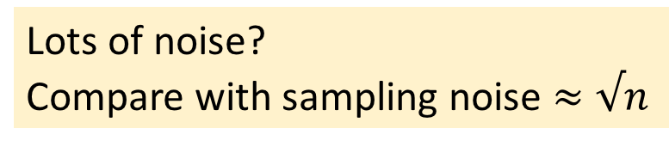
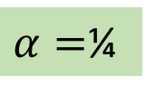


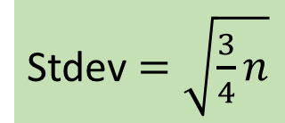
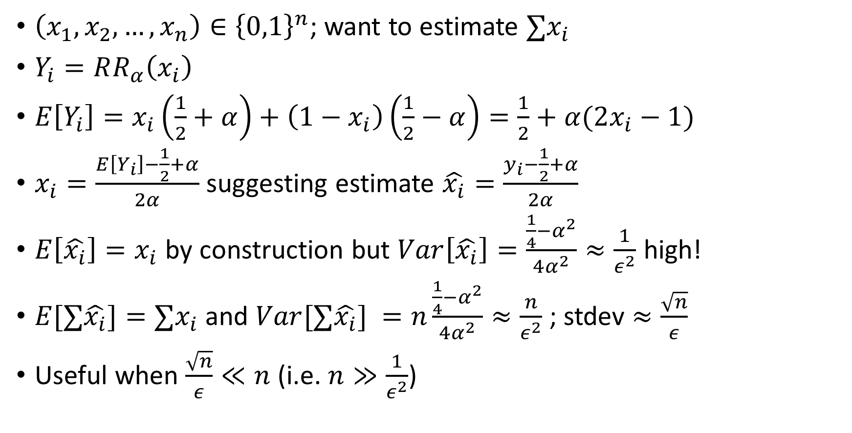
Can we make use of randomized response?
$\left(x_{1},x_{2},…,x_{n}\right)∈{\left\{0,1\right\}}^{n}$; want to estimate $∑x_{i}$
$Y_{i}=RR_{α}\left(x_{i}\right)$
$E\left[Y_{i}\right]=x_{i}\left(\frac{1}{2}+α\right)+\left(1−x_{i}\right)\left(\frac{1}{2}−α\right)=\frac{1}{2}+α(2x_{i}−1)$
$x_{i}=\frac{E\left[Y_{i}\right]−\frac{1}{2}+α}{2α}$ suggesting estimate $\hat{x_{i}}=\frac{y_{i}−\frac{1}{2}+α}{2α}$
$E\left[\hat{x_{i}}\right]=x_{i}$ by construction but $Var\left[\hat{x_{i}}\right]=\frac{\frac{1}{4}−α^{2}}{4α^{2}}≈\frac{1}{ε^{2}}$ high!
$E[∑\hat{x_{i}}]={∑x}_{i}$ and $Var[∑\hat{x_{i}}] =n\frac{\frac{1}{4}−α^{2}}{4α^{2}}≈\frac{n}{ε^{2}}$ ; stdev $≈\frac{\sqrt{n}}{ε}$
Useful when $\frac{\sqrt{n}}{ε}≪n$ (i.e. $n≫\frac{1}{ε^{2}}$)
$α=$¼
$$E\left[Y_{i}\right]=\frac{1}{4}+\frac{x_{i}}{2}$$
$$\hat{x_{i}}=2y_{i}−\frac{1}{2}$$
Stdev $=\sqrt{\frac{3}{4}n}$
Lots of noise?
Compare with sampling noise $≈√n$

Slide 49
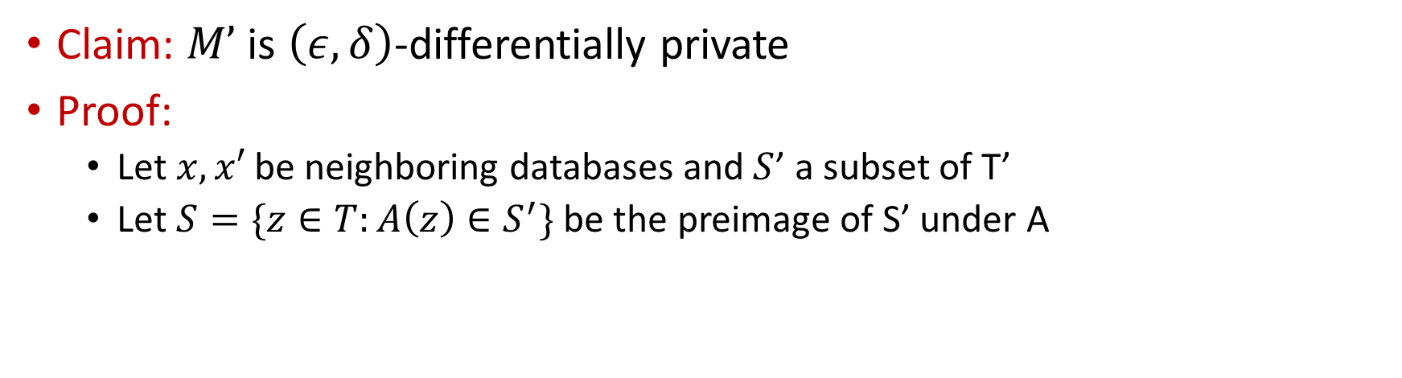







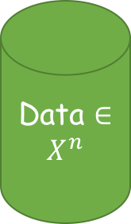

Basic properties of differential privacy: post processing
Data $∈X^{n}$
$$M:X^{n}→T$$
$$A:T→T′$$
M
$$\left(ε,δ\right)−DP$$
A
$$M’$$
Claim: $M’$ is $\left(ε,δ\right)$-differentially private
Proof:
  Let $x,x′$ be neighboring databases and $S$’ a subset of T’
  Let $S=\{z∈T:A\left(z\right)∈S^{′}\}$ be the preimage of S’ under A
$$\operatorname{Pr}\left[M^{′}\left(x\right)∈S^{′}\right]$$
$$=Pr\left[M\left(x\right)∈S\right]$$
$$≤e^{ε}\operatorname{Pr}\left[M\left(x^{′}\right)∈S\right]+δ$$
$$=e^{ε}\operatorname{Pr}\left[M^{′}\left(x^{′}\right)∈S′\right]+δ$$

Slide 50

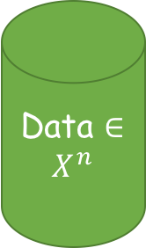

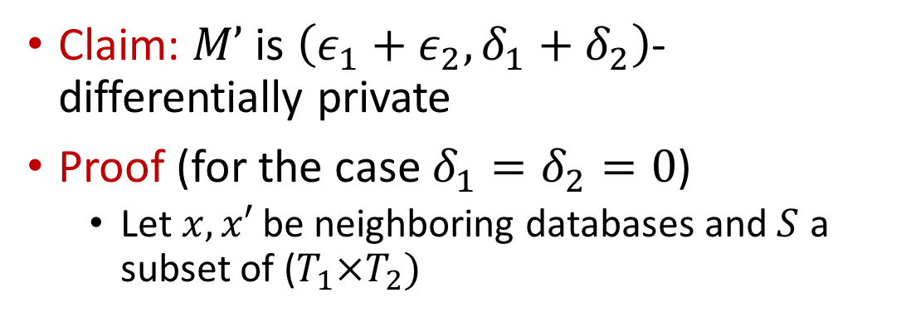


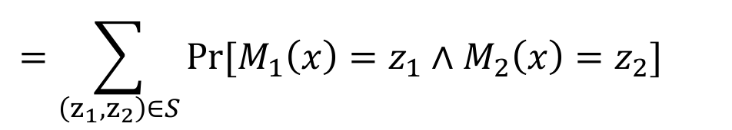

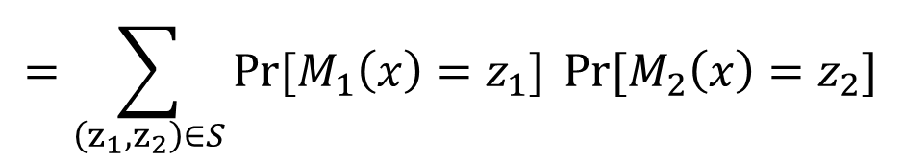
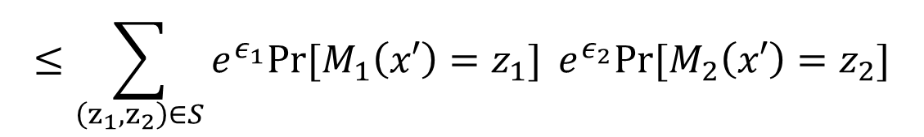

Basic properties of differential privacy: Basic composition [DMNS06, DKMMN06, DL09]
Data $∈X^{n}$
Claim: $M’$ is $\left(ε_{1}+ε_{2},δ_{1}+δ_{2}\right)$-differentially private
Proof (for the case $δ_{1}=δ_{2}=0$)
  Let $x,x′$ be neighboring databases and $S$ a subset of ($T_{1}×T_{2})$
M1
$$\left(ε,δ\right)−DP$$
M2
$$\left(ε_{2},δ_{2}\right)−DP$$
$$=\sum_{\left(z_{1},z_{2}\right)∈S}{Pr⁡[M_{1}\left(x\right)=z_{1}∧M_{2}\left(x\right)=z_{2}]}{}$$
$$\operatorname{Pr}\left[M^{′}\left(x\right)∈S\right]$$
$$M’$$
$$M_{i}:X^{n}→T_{i}$$
$$=\sum_{\left(z_{1},z_{2}\right)∈S}{Pr⁡[M_{1}\left(x\right)=z_{1}]}{Pr⁡[M_{2}\left(x\right)=z_{2}]}$$
$$≤\sum_{\left(z_{1},z_{2}\right)∈S}{e^{ε_{1}}Pr⁡[M_{1}\left(x′\right)=z_{1}]}{e^{ε_{2}}Pr⁡[M_{2}\left(x′\right)=z_{2}]}$$
$$=e^{ε_{1}+ε_{2}}Pr\left[M^{′}\left(x′\right)∈S\right]$$

Slide 51
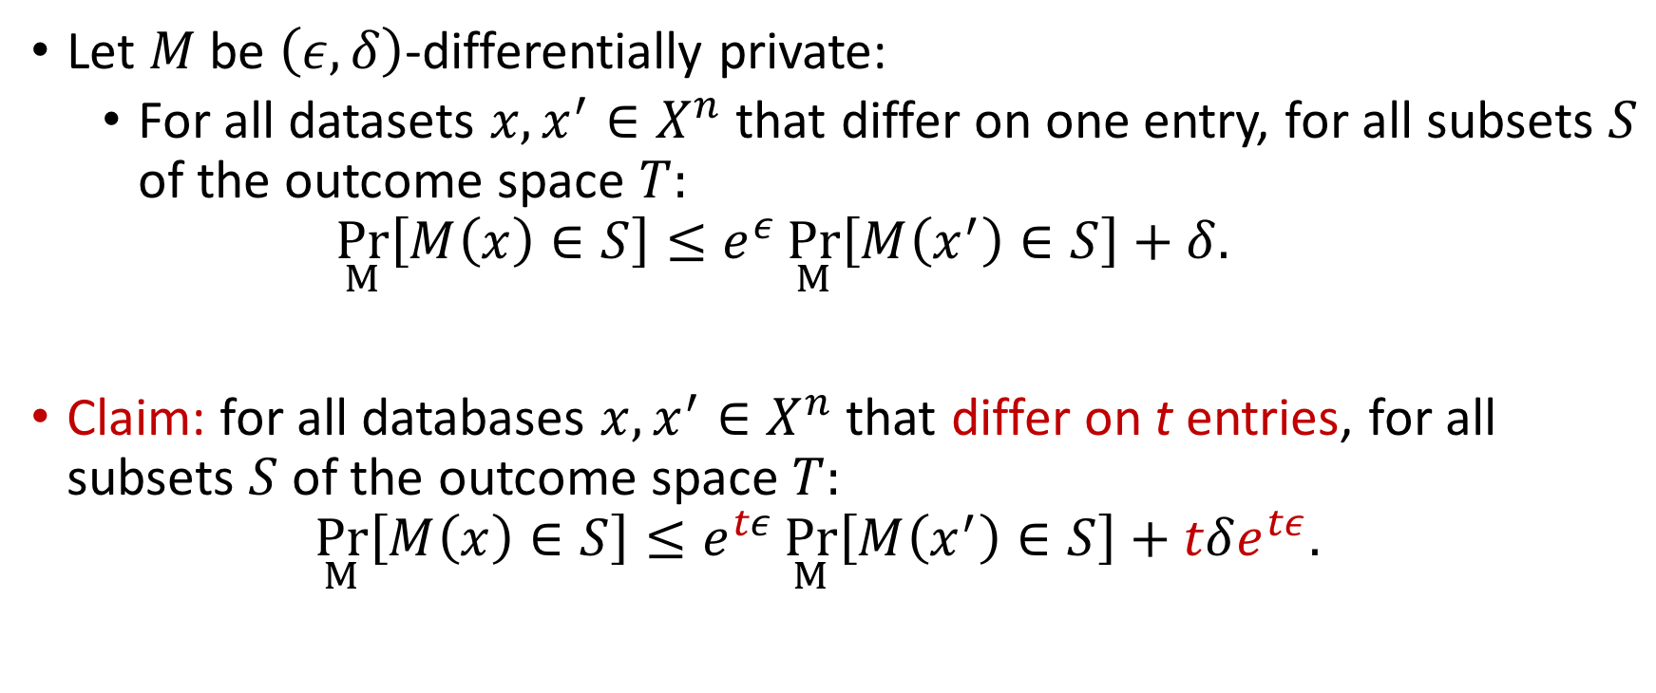
Basic properties of DP: Group privacy
Let $M$ be $\left(ε,δ\right)$-differentially private:
  For all datasets $x,x^{′}∈X^{n}$ that differ on one entry, for all subsets $S$ of the outcome space $T:$
  $\underset{M}{Pr}\left[M\left(x\right)∈S\right]≤e^{ε}\underset{M}{Pr}\left[M\left(x^{′}\right)∈S\right]+δ.$
Claim: for all databases $x,x^{′}∈X^{n}$ that differ on t entries, for all subsets $S$ of the outcome space $T:$
$\underset{M}{Pr}\left[M\left(x\right)∈S\right]≤e^{tε}\underset{M}{Pr}\left[M\left(x^{′}\right)∈S\right]+tδe^{tε}.$

Slide 52



Neighboring Inputs
[What Should Be Protected?]
Inputs are neighboring if they differ on the data of a single individual
  Record privacy: Databases X, X’ neighboring if differ on one record
A
A(X)
A
A(X’)

Slide 53
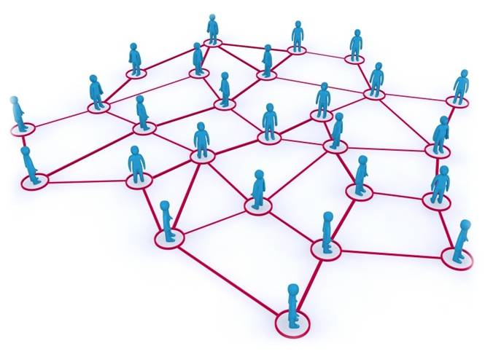
Neighboring Inputs
[What Should Be Protected?]
Inputs are neighboring if they differ on the data of a single individual
  Record privacy: Databases X, X’ neighboring if differ on one record
  Edge privacy: graphs G, G’ neighboring if differ on one edge
A
A(G)
A
A(G’)
Image credit: www.perey.com

Slide 54
Neighboring Inputs
[What Should Be Protected?]
Inputs are neighboring if they differ on the data of a single individual
  Record privacy: Databases X, X’ neighboring if differ on one record
  Edge privacy: graphs G, G’ neighboring if differ on one edge
  Node privacy: graphs G, G’ neighboring if differ on one node and its adjacent edges
A
A(G)
A
A(G’)
Image credit: www.perey.com

Slide 55
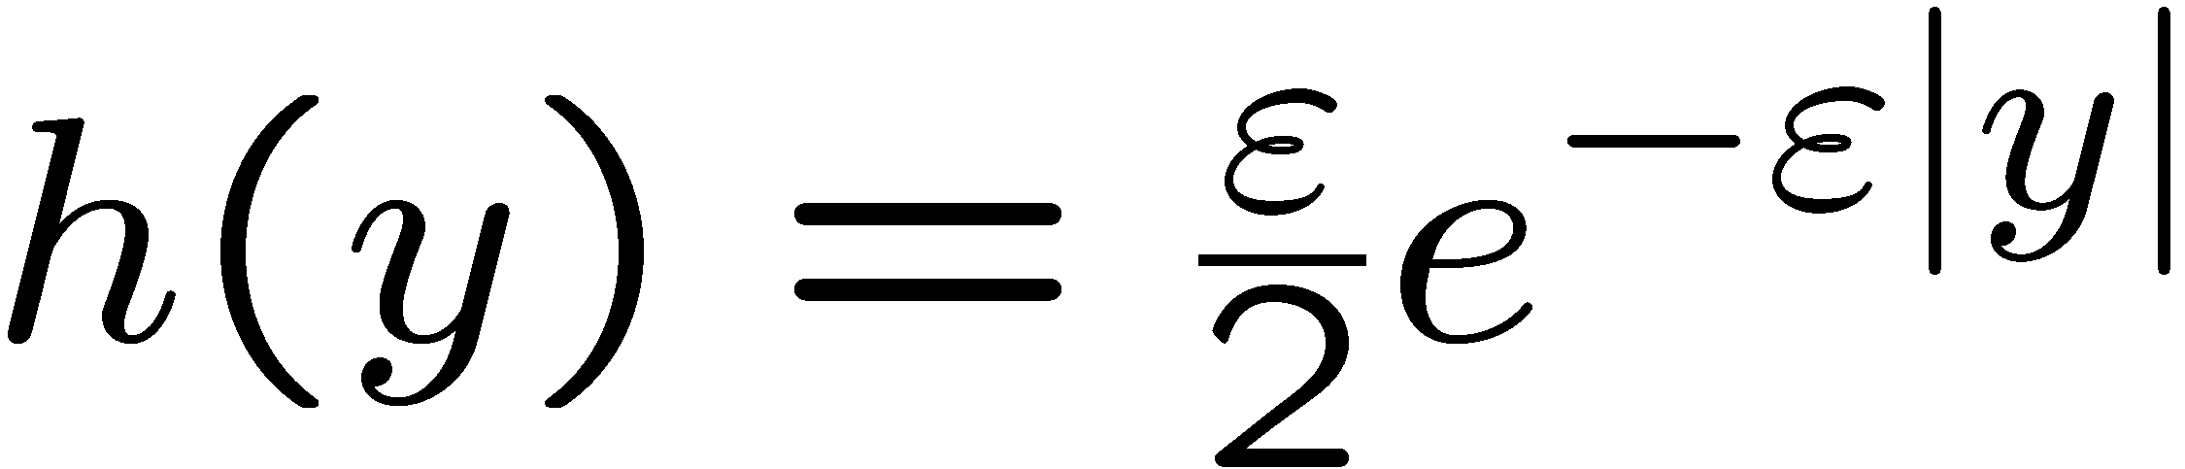
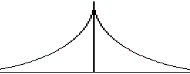
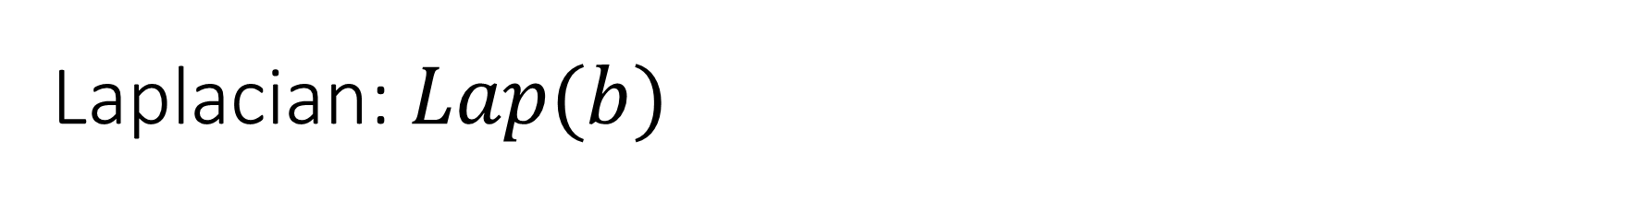

Laplacian:$Lap(b)$
$Lap\left(b\right)$ is a distribution over the reals with density function
  $h\left(x\right)=\frac{1}{2b}\exp{(−\frac{\left|x\right|}{b})}$
  Expectation zero
  Variance $2b^{2}$
  $Lap\left(1/ε\right)$:

Slide 56

Laplacian:$Lap(b)$
$Lap\left(b\right)$ is a distribution over the reals with density function
  $h\left(x\right)=\frac{1}{2b}\exp{(−\frac{\left|x\right|}{b})}$
  Expectation zero
  Variance $2b^{2}$
  if $Y\sim Lap\left(b\right)$ then $\operatorname{Pr}\left(\left|Y\right|>t⋅b\right)=\exp\left(−t\right)$

Slide 57

Example: Counting Edges
[the basic technique]
function$f(G)= eij$ where $eij∈\{0,1\}$

Slide 58

Example: Counting Edges
[the basic technique]
$f(G)= eij$ where $eij∈\{0,1\}$
Algorithm: On input $G$ return $f(G) + Y$, where $Y∼Lap(\frac{1}{ε})$
  $E\left[Y\right]= 0;σ[Y] =\sqrt{2}/ε$
0

Slide 59

Example: Counting Edges
[the basic technique]
$f(G)= eij$ where $eij∈\{0,1\}$
Algorithm: On input $G$ return $f(G) + Y$, where $Y∼Lap(\frac{1}{ε})$
Laplace Distribution:
  $E\left[Y\right]= 0;σ[Y] =\sqrt{2}/ε$
  Sliding property: $\frac{h\left(y\right)}{h\left(y+1\right)}≤e^{ε}$
0
∆

Slide 60
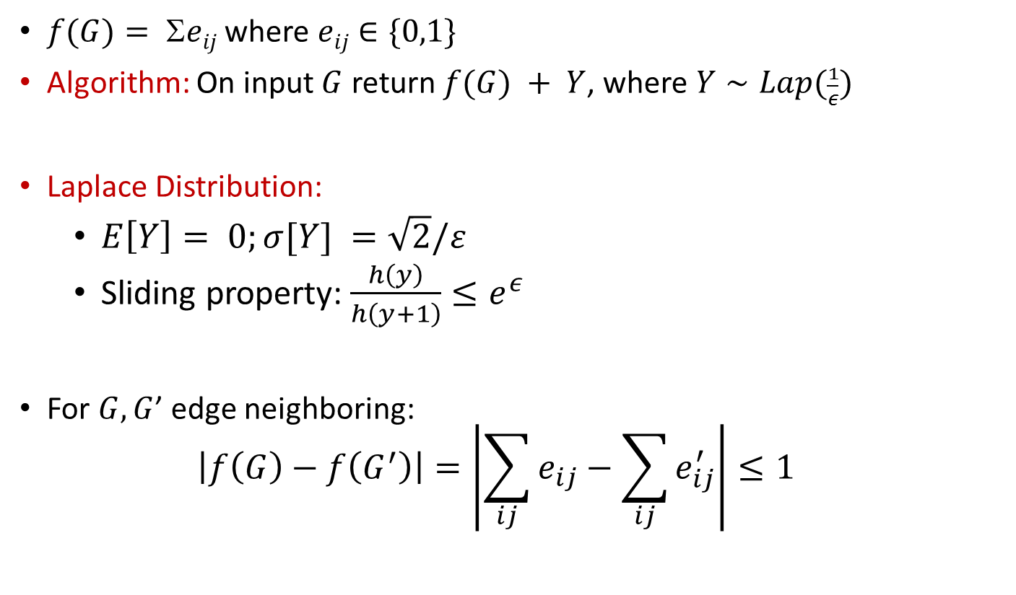

Example: Counting Edges
[the basic technique]
$f(G)= eij$ where $eij∈\{0,1\}$
Algorithm: On input $G$ return $f(G) + Y$, where $Y∼Lap(\frac{1}{ε})$
Laplace Distribution:
  $E\left[Y\right]= 0;σ[Y] =\sqrt{2}/ε$
  Sliding property: $\frac{h\left(y\right)}{h\left(y+1\right)}≤e^{ε}$
For $G, G$’ edge neighboring:
  $$\left|f\left(G\right)−f\left(G^{′}\right)\right|=\left|\sum_{ij}{e_{ij}}−\sum_{ij}{e_{ij}^{′}}\right|≤1$$
0
∆
Neighboring: $ℓ_{1}$ distance at most one

Slide 61
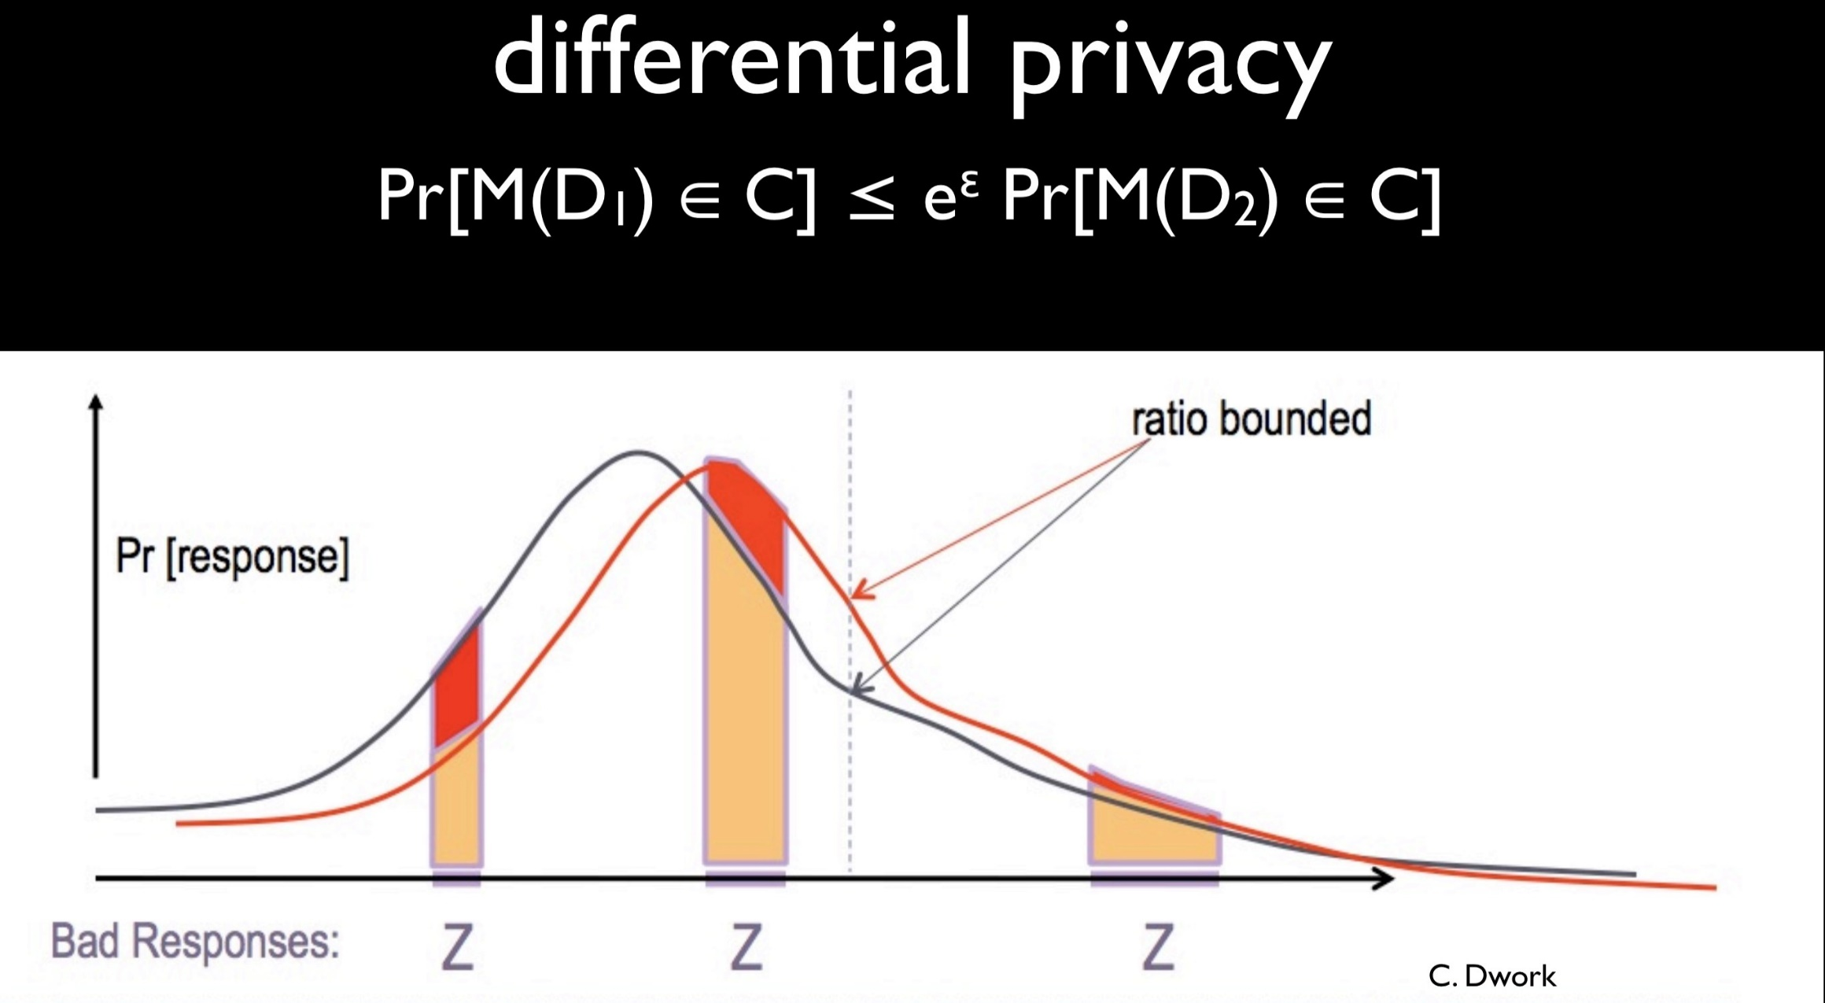

Slide 62

Framework of Global Sensitivity
  $$GS_{f}=\max{|f\left(G\right)−f\left(G^{′}\right)|_{1}}\text{taken} \text{over} \text{neighboring} G,G’$$
  $$A\left(G\right)=f\left(G\right)+Lap^{d}(\frac{GS_{f}}{ε})$$
Many natural functions have low global sensitivity
  e.g., histogram, mean,
  Histogram: split input into bins, count how many in bin

Slide 63



The Laplace Mechanism [DMNS06]
$GS_{f}=\max{|f\left(G\right)−f\left(G^{′}\right)|_{1}}$taken over neighboring $G,G’$
Theorem [DMNS06]:
  $A\left(G\right)=f\left(G\right)+Lap^{d}(\frac{GS_{f}}{ε})$ is ε-differentially private
function $f:G→ℝ^{d}$
A
$$A\left(G\right)=f\left(G\right)+noise$$
local random coins

Slide 64
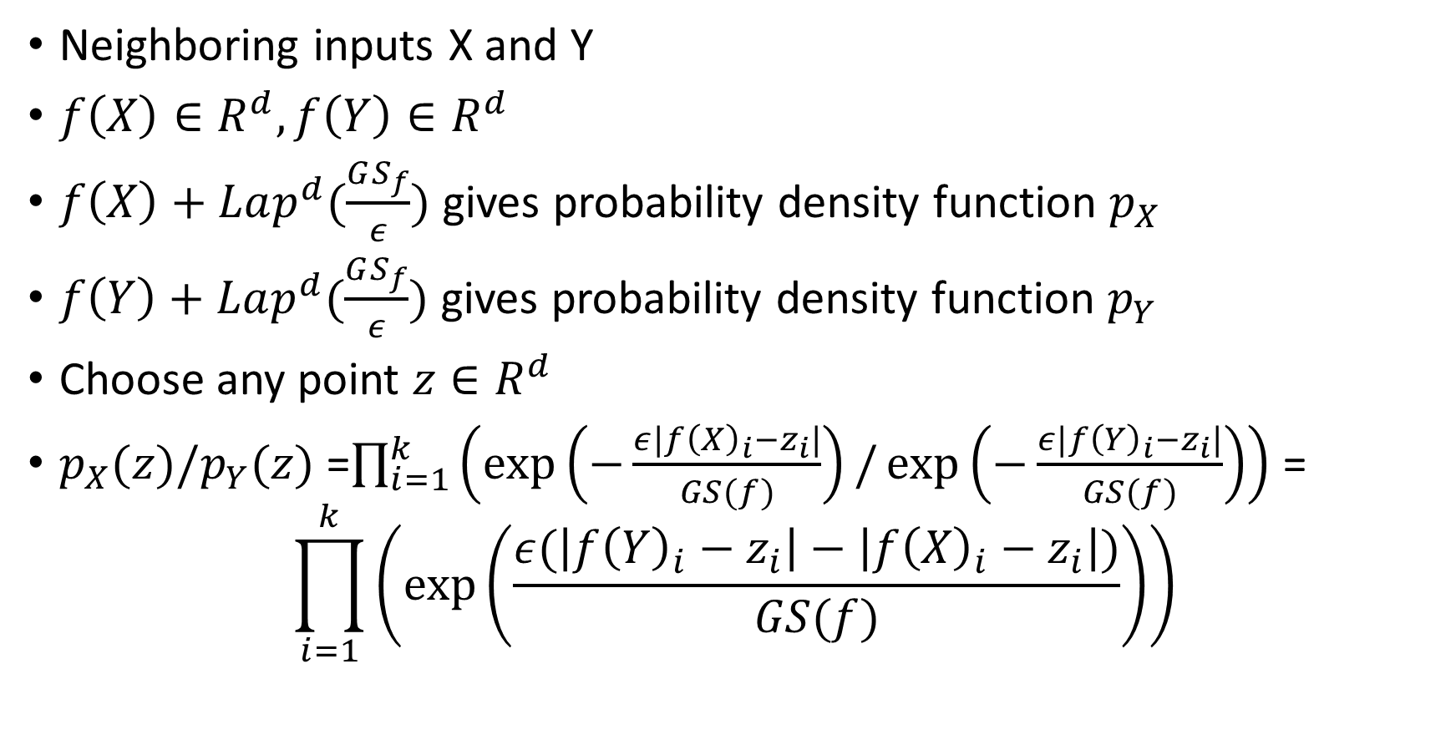

The Laplace Mechanism: Proof
Density for Lap(b): $h\left(x\right)=\frac{1}{2b}\exp{(−\frac{\left|x\right|}{b})}$
Neighboring inputs X and Y
$f\left(X\right)∈R^{d}, f\left(Y\right)∈R^{d}$
$f\left(X\right)+Lap^{d}(\frac{GS_{f}}{ε})$ gives probability density function $p_{X}$
$f\left(Y\right)+Lap^{d}(\frac{GS_{f}}{ε})$ gives probability density function $p_{Y}$
Choose any point $z∈R^{d}$
$p_{X}(z)/p_{Y}(z)$ =$\prod_{i=1}^{k}{\left(\exp\left(−\frac{ε|f{\left(X\right)}_{i}−z_{i}|}{GS(f)}\right)/\exp\left(−\frac{ε|f{\left(Y\right)}_{i}−z_{i}|}{GS(f)}\right)\right)}$ =
$$\prod_{i=1}^{k}{\left(\exp\left(\frac{ε(\left|f{\left(Y\right)}_{i}−z_{i}\right|−\left|f{\left(X\right)}_{i}−z_{i}\right|)}{GS(f)}\right)\right)}$$

Slide 65
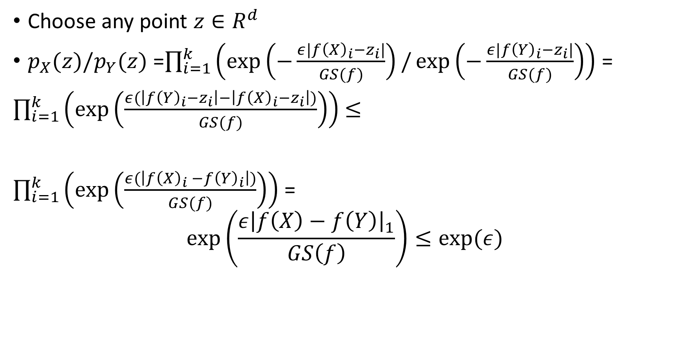
The Laplace Mechanism: Proof
Density for Lap(b): $h\left(x\right)=\frac{1}{2b}\exp{(−\frac{\left|x\right|}{b})}$
Choose any point $z∈R^{d}$
$p_{X}(z)/p_{Y}(z)$ =$\prod_{i=1}^{k}{\left(\exp\left(−\frac{ε|f{\left(X\right)}_{i}−z_{i}|}{GS(f)}\right)/\exp\left(−\frac{ε|f{\left(Y\right)}_{i}−z_{i}|}{GS(f)}\right)\right)}$ =
$\prod_{i=1}^{k}{\left(\exp\left(\frac{ε(\left|f{\left(Y\right)}_{i}−z_{i}\right|−\left|f{\left(X\right)}_{i}−z_{i}\right|)}{GS(f)}\right)\right)}$ $≤$
$\prod_{i=1}^{k}{\left(\exp\left(\frac{ε(\left|f{\left(X\right)}_{i} −f{\left(Y\right)}_{i}\right|)}{GS(f)}\right)\right)}$ =
$$\exp\left(\frac{ε{\left|f\left(X\right)−f\left(Y\right)\right|}_{1}}{GS\left(f\right)}\right)≤exp⁡(ε)$$

Slide 66
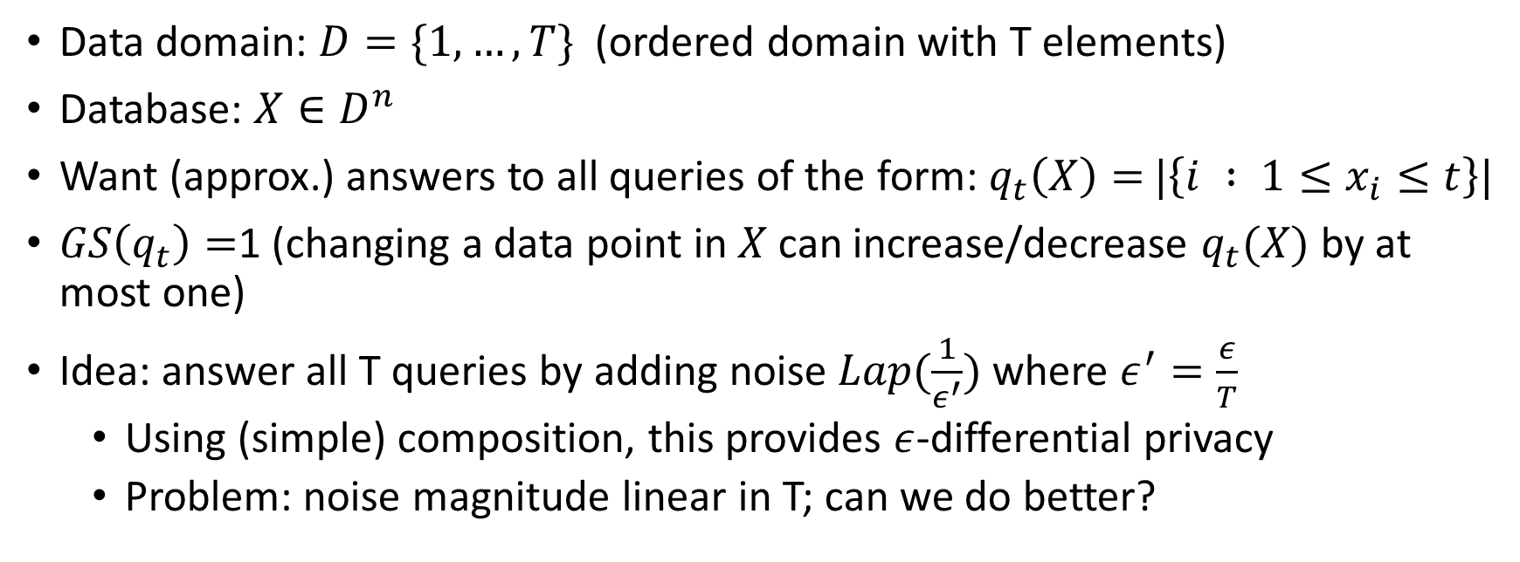
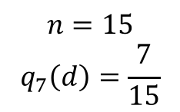
Better Composition: Answering all threshold queries
Data domain: $D=\{1,…,T\}$ (ordered domain with T elements)
Database: $X∈D^{n}$
Want (approx.) answers to all queries of the form: $q_{t}\left(X\right)=$ $|\left\{i : {1≤x}_{i}≤t\right\}|$
$GS\left(q_{t}\right)=$1 (changing a data point in $X$can increase/decrease $q_{t}(X)$ by at most one)
Idea: answer all T queries by adding noise $Lap(\frac{1}{ε^{′}})$ where $ε^{′}=\frac{ε}{T}$
  Using (simple) composition, this provides $ε$-differential privacy
  Problem: noise magnitude linear in T; can we do better?
$$n=15$$
$$q_{7}\left(d\right)=\frac{7}{15}$$
1
7
T

Slide 67
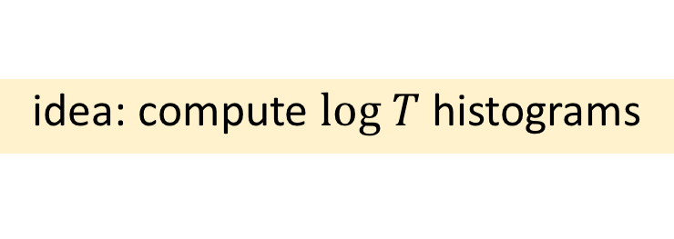
Answering all threshold queries
15
idea: compute $log T$ histograms
7
8
3
4
6
2
1
2
3
1
3
3
2
1
2
3
1
3
1
2
2
1
7
T

Slide 68
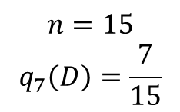
Answering all threshold queries
15
7
8
3
4
6
2
1
2
3
1
3
3
2
1
2
3
1
3
1
2
2
$$n=15$$
$$q_{7}\left(D\right)=\frac{7}{15}$$
1
7
T

Slide 69
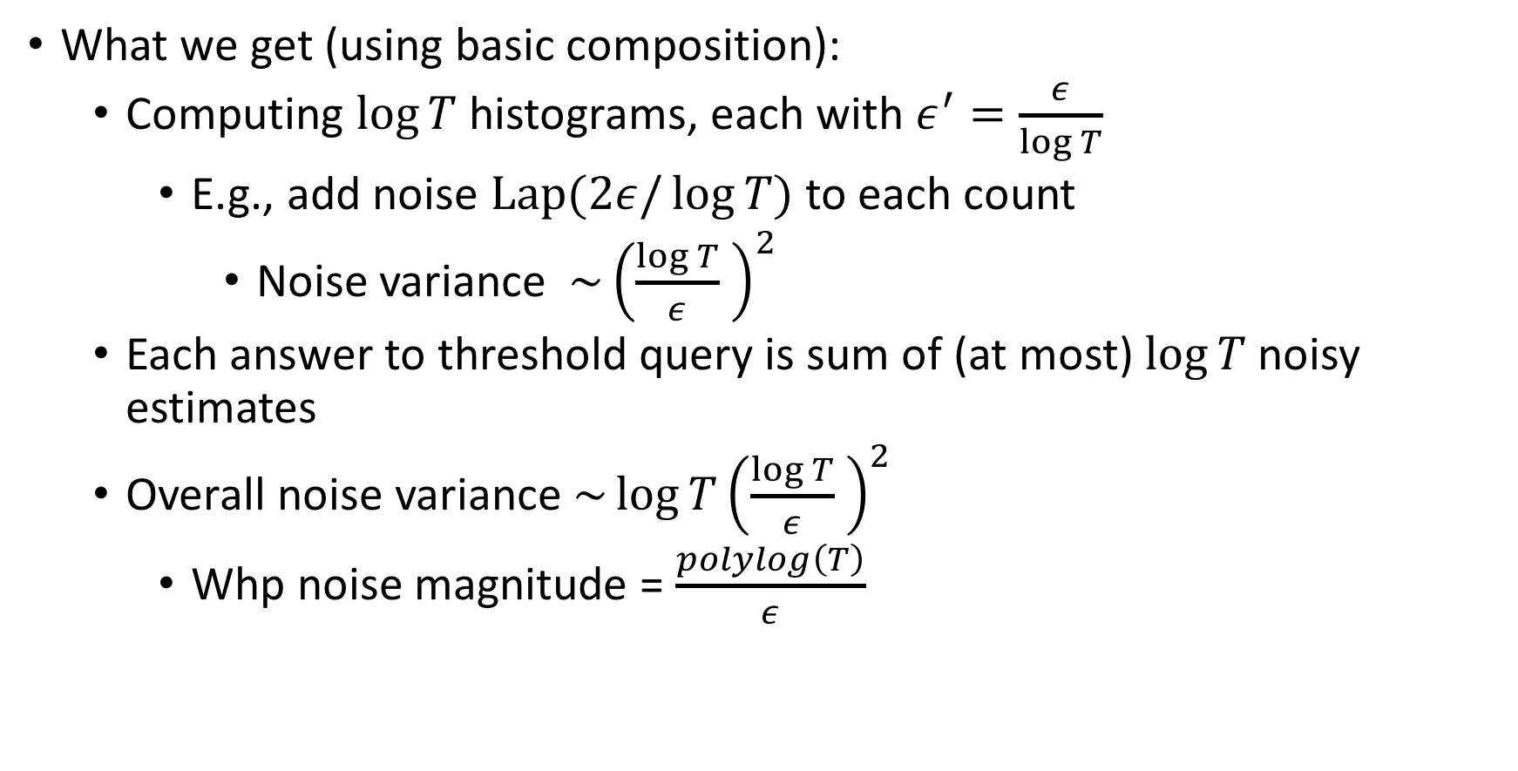
Answering all threshold queries
What we get (using basic composition):
  Computing $\log{T}$ histograms, each with $ε^{′}=\frac{ε}{\log{T}}$
    E.g., add noise $Lap(2ε/\log{T)}$ to each count
      Noise variance $\sim {\left(\frac{\log{T}}{ε} \right)}^{2}$
  Each answer to threshold query is sum of (at most) $\log{T}$ noisy estimates
  Overall noise variance $\sim {\log{T}\left(\frac{\log{T}}{ε} \right)}^{2}$
    Whp noise magnitude = $\frac{polylog\left(T\right)}{ε}$

Slide 70
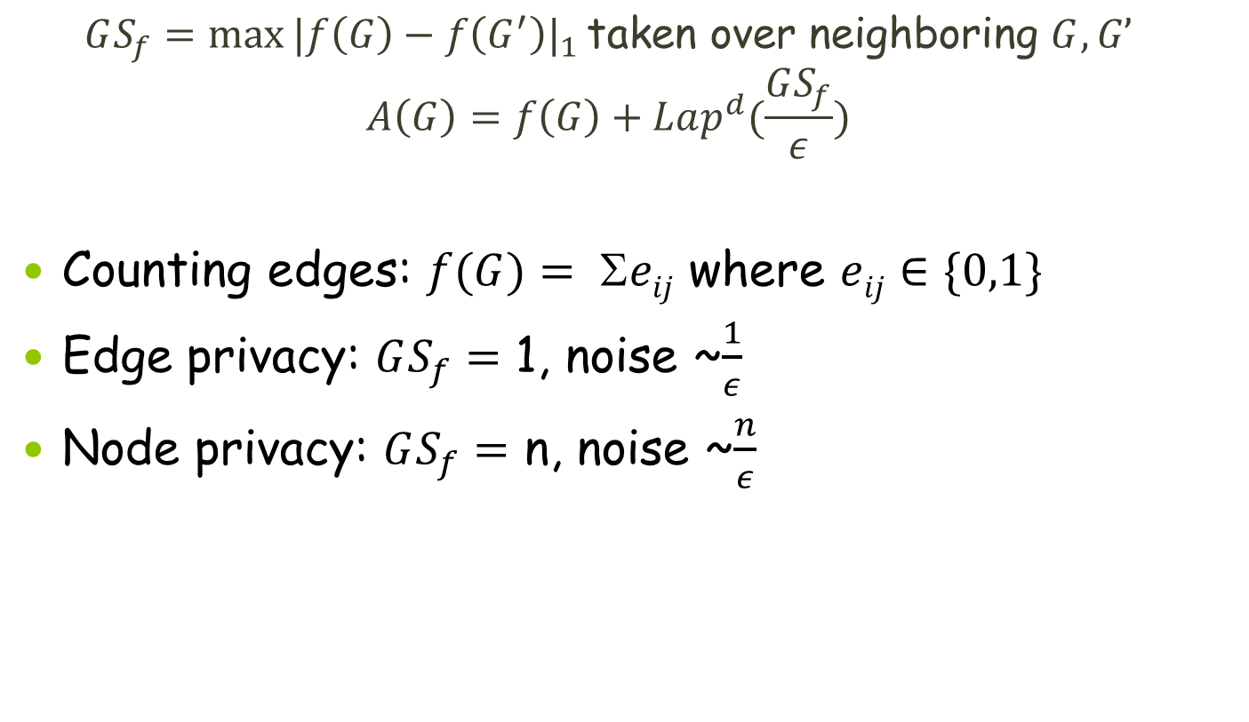
Edge vs. Node Privacy - Counting Edges
  $$GS_{f}=\max{|f\left(G\right)−f\left(G^{′}\right)|_{1}}\text{taken} \text{over} \text{neighboring} G,G’$$
  $$A\left(G\right)=f\left(G\right)+Lap^{d}(\frac{GS_{f}}{ε})$$
Counting edges: $f(G)= eij$ where $eij∈\{0,1\}$
Edge privacy: $GS_{f}=$ 1, noise ~$\frac{1}{ε}$
Node privacy: $GS_{f}=$ n, noise ~$\frac{n}{ε}$

Slide 71

Exponential Sampling [MT07]
$x_{i}$= {books read by i this year}, $Y$ = {book names}
“Score” of $y∈Y$: $q\left(y,x\right)=\#\{i:y∈x_{i}\}$
Goal: output book read by most
Mechanism: given $x$, output book name y with probability prop to
  exp$(ε⋅q(y,x))$
Claim: Mechanism is ε-differentially private
Claim: If most popular website has score $T=\max_{y∈Y}{q(y,x)}$, then $E\left[q\left(y_{0},x\right)\right]≥T−O(\frac{\log\left|Y\right|}{ε})$

Slide 72

Exponential Sampling
Database X, function values in R, utility function from database and function value to the reals
X=who reads what
R=names of books
u(X,r) – the closer to the real max the better
$∆u=\max_{r∈R}{\max_{X,Y:{\left|X−Y\right|}_{1}≤1}\left|u\left(X,r\right)−u\left(Y,r\right)\right|}$
Output each possible $r∈R$with probability proportional to
  $exp⁡(εu(X,r)/$ $∆u$)
$\exp\left(\frac{εu(X,r)}{∆u}\right)/\exp\left(\frac{εu(Y,r)}{∆u}\right)$= $\exp\left(\frac{ε(u\left(X,r\right)−u\left(Y,r\right))}{∆u}\right)$
Wrong!!

Slide 73





The correct proof

Slide 74

Exponential mechanism gives good utility
Prob$($utility of exp mechanism $≤Opt utility −\left(\frac{2∆u}{ε}\right)\left(\ln\left(\left|R\right|\right)+t\right)≤\exp\left(−t\right)$

Slide 75
Next week: Uri Stemmer
Will talk about practical local differential privacy
Local? “users retain their data and only send the server randomizations that are safe for publication.
The random response could be viewed as local differential privacy
Talk will be in the context of heavy hitters : items that appear many times.

