Slide 1
Lecture 4: Linear sketeches: Estimating the second moment, dimension reduction, applications

Slide 2



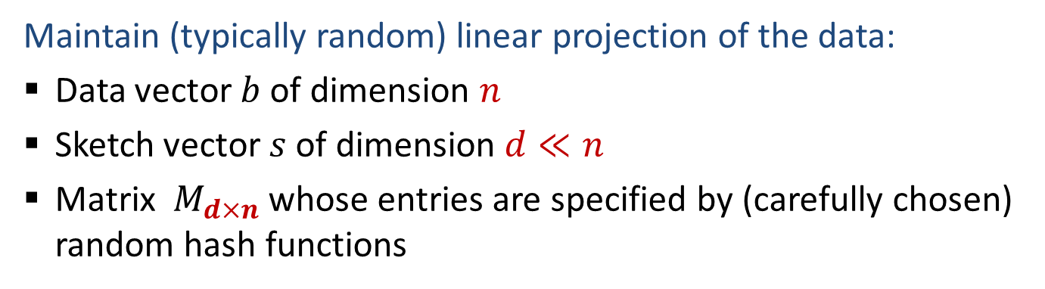




Linear sketches
Maintain (typically random) linear projection of the data:
Data vector $b$ of dimension $n$
Sketch vector $s$ of dimension $d≪n$
Matrix $M_{d×n}$ whose entries are specified by (carefully chosen) random hash functions
$$d$$
$$M$$
$$=$$
$$s$$
$$d$$
$$b$$
$$n$$

Slide 3
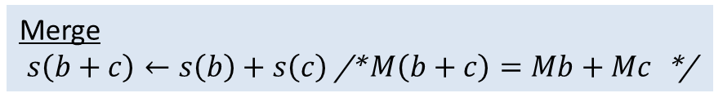
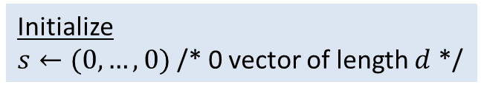
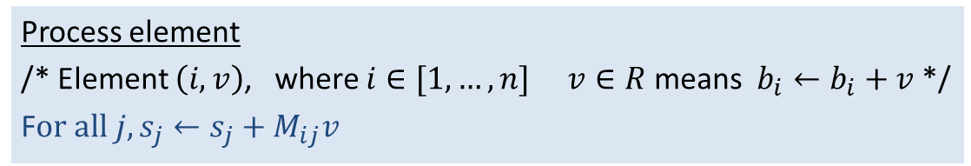
Maintainin a linear sketch
We maintain the sketch $s=Mb$ without explicitly keeping $b$
Initialize
$s←(0,…,0)$ /* 0 vector of length $d$ */
Process element
/* Element $\left(i,v\right)$, where $i∈[1,…,n]$ $v∈R$ means $b_{i}←b_{i}+v$ */
F$or all j, s_{j}←s_{j}+M_{ij}v$
Merge
$s\left(b+c\right)←s\left(b\right)+s\left(c\right)$ /* $M\left(b+c\right)=Mb+Mc$ */

Slide 4
A warmup
Design linear sketches for:
“Exactly1?” : Determine if there is exactly one nonzero entry (special case of distinct count, but allowing for negative updates)
“Sample1”: Obtain the index and value of a (random) nonzero entry

Slide 5

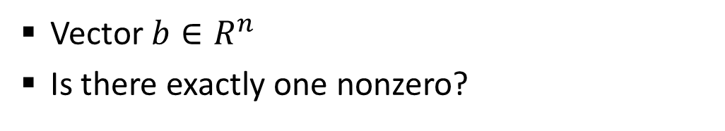

Exactly1?
Vector $b∈R^{n}$
Is there exactly one nonzero?
$b=(0,3,0,−2,0,0,0,5)$
No (3 nonzeros)
$b=(0,3,0,0,0,0,0,0)$
Yes

Slide 6

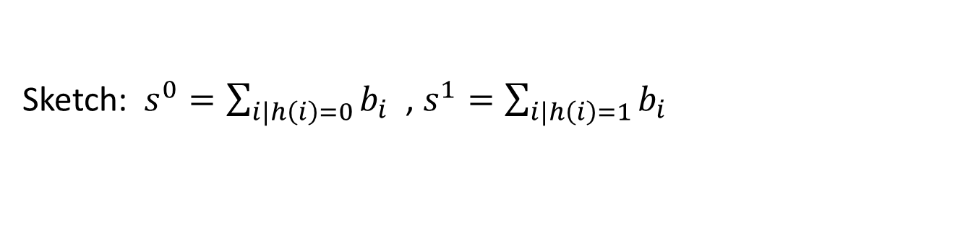








Using a hash function
Random hash function $h:\left[n\right]→\{0,1\}$
$$\begin{matrix}h(1) & h\left(2\right)\end{matrix}$$
$$\begin{matrix}⋯ & h\left(n\right)\end{matrix}$$
$$s^{0}$$
$$=$$
$$\begin{matrix}1−h(1) & 1−h\left(2\right)\end{matrix}$$
$$\begin{matrix}⋯ & 1−h\left(n\right)\end{matrix}$$
$$s^{1}$$
$$b$$
Sketch: $s^{0}=\sum_{i|h\left(i\right)=0}{b_{i}}$ , $s^{1}=\sum_{i|h\left(i\right)=1}{b_{i}}$
If exactly one of $s^{0},s^{1}$ is 0, return yes.

Slide 7

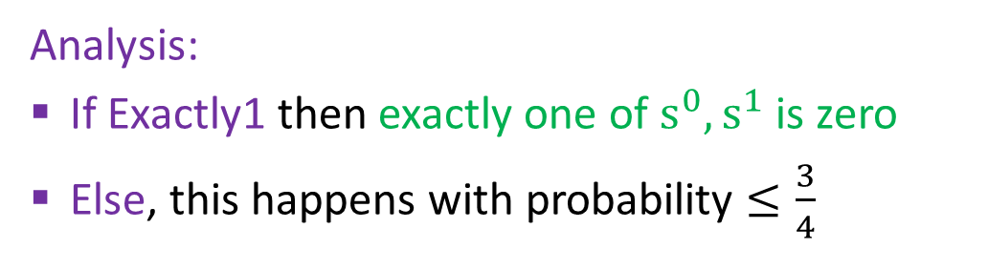







Analysis
$$\begin{matrix}h(1) & h\left(2\right)\end{matrix}$$
$$\begin{matrix}⋯ & h\left(n\right)\end{matrix}$$
$$s^{0}$$
$$=$$
$$\begin{matrix}1−h(1) & 1−h\left(2\right)\end{matrix}$$
$$\begin{matrix}⋯ & 1−h\left(n\right)\end{matrix}$$
$$b$$
$$s^{1}$$
Analysis:
If Exactly1 then exactly one of $s^{0},s^{1}$ is zero
Else, this happens with probability $≤\frac{3}{4}$
How to boost this ?
Notes:
If entries were not signed, this would be ½. But in general, sum of non-zeros can cancel out.
Vector (-1,1,1) gives 3/4 . In general, look at all non zeros and put aside 2 of them. Now fix the hash on the rest.
At least one of the 4 possibilities for placing the remaining two items, does not make exactly one of s1 and s0 zero.
Assume the items you hold out are x and y. Let c and d be the sums without x and y. Consider the cases where both c and d are zero, only c is zero, only d is zero, both c and d are not zero. In the last case we win if c ≠ -(x+y) or d ≠ -(x+y) so both c = d = -(x+y) but then we win by putting both x and y in different bins

Slide 8


















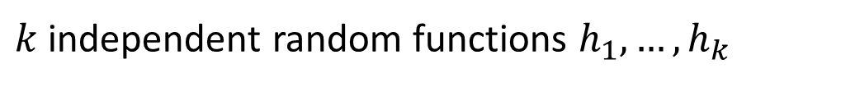



Use many ind. hash functions
$k$ independent random functions $h_{1},…,h_{k}$
$$\begin{matrix}h_{1}(1) & h_{1}\left(2\right)\end{matrix}$$
$$\begin{matrix}⋯ & h_{1}\left(n\right)\end{matrix}$$
$$s_{1}^{0}$$
$$\begin{matrix}{1−h}_{1}(1) & 1−h_{1}\left(2\right)\end{matrix}$$
$$\begin{matrix}⋯ & {1−h}_{1}\left(n\right)\end{matrix}$$
$$s_{1}^{1}$$
$$\begin{matrix}h_{2}(1) & { h}_{2}\left(2\right)\end{matrix}$$
$$\begin{matrix}⋯ & h_{2}\left(n\right)\end{matrix}$$
$$s_{2}^{0}$$
$$b$$
$$=$$
$$\begin{matrix}{1−h}_{2}(1) & {1−h}_{2}\left(2\right)\end{matrix}$$
$$\begin{matrix}⋯ & {1−h}_{2}\left(n\right)\end{matrix}$$
$$s_{2}^{1}$$
$$⋮$$
$$⋮$$
$$⋮$$
$$\begin{matrix}{1−h}_{k}(1) & {1−h}_{k}\left(2\right)\end{matrix}$$
$$\begin{matrix}⋯ & 1−h_{k}\left(n\right)\end{matrix}$$
$$s_{k}^{1}$$
Sketch: $s_{j}^{0}=\sum_{i|h_{j}\left(i\right)=0}{b_{i}}$ , $s_{j}^{1}=\sum_{i|h_{j}\left(i\right)=1}{b_{i}}$
If $∀j$exactly one of $s_{j}^{0},s_{j}^{1}$ is 0, return yes.

Slide 9
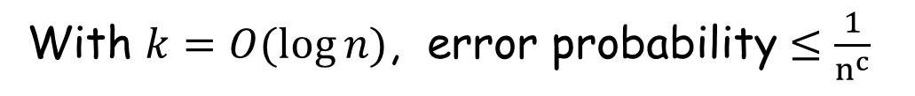

Analysis
Error probability to $≤{\left(\frac{3}{4}\right)}^{k}$:
With $k=O(\log{n)}$, error probability $≤\frac{1}{n^{c}}$

Slide 10
The AMS sketch
Alon, Matias, Szegedy 1996
(Gödel Prize 2005)

Slide 11
The frequency vector
A,B,A,C,D,D,A,A,E,B,E,E,F,…
b=f(x) | x
4 | A
2 | B
1 | C
3 | D
3 | E
1 | F

Slide 12
The frequency vector
A,B,A,C,D,D,A,A,E,B,E,E,F,…
(1,1), (2,1), (1,1), (3,1),…
b=f(x) | x
4 | A
2 | B
1 | C
3 | D
3 | E
1 | F

Slide 13
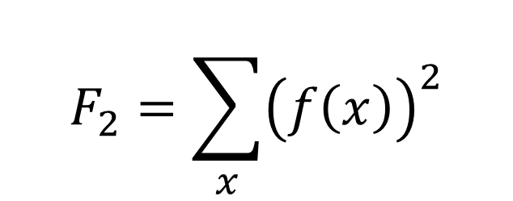
The second moment
A,B,A,C,D,D,A,A,E,B,E,E,F,…
(1,1), (2,1), (1,1), (3,1),…
b=f(x) | x
4 | A
2 | B
1 | C
3 | D
3 | E
1 | F
The second moment:
$$F_{2}=\sum_{x}{{\left(f\left(x\right)\right)}^{2}}$$
Want a linear sketch from which we can estimate the second moment ?

Slide 14
The sketch
A,B,A,C,D,D,A,A,E,B,E,E,F,…
h(x) | f(x) | x
-1 | 4 | A
1 | 2 | B
-1 | 1 | C
1 | 3 | D
-1 | 3 | E
-1 | 1 | F
Z = -1 + 1+ -1 + -1 + 1 + 1 + -1 + -1 + -1 + 1 + -1 + -1 + -1 …
Maintain:

Slide 15
Alon, Matias, Szegedy 96
A,B,A,C,D,D,A,A,E,B,E,E,F,…
h(x) | f(x) | x
-1 | 4 | A
1 | 2 | B
-1 | 1 | C
1 | 3 | D
-1 | 3 | E
-1 | 1 | F
Maintain:

Slide 16
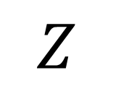
Recap
$$\left(\begin{matrix}−1 & 1 & −1 & 1 & 1 & 1 & −1 & 1 & −1 & 1 & 1 & 1 & −1 & −1 & 1\end{matrix}\right)$$
$$Z$$
=

Slide 17
AMS Analysis

Slide 18
Draw h from 2-wise ind. family
Z² is an unbiased estimator for F₂ !

Slide 19


Recap
$$\left(\begin{matrix}−1 & 1 & −1 & 1 & 1 & 1 & −1 & 1 & −1 & 1 & 1 & 1 & −1 & −1 & 1\end{matrix}\right)$$
$$Z$$
=
$$Z=M(f\left(x\right))$$
$$E\left[Z^{2}\right]= {\left\|f(x)\right\|}_{2}^{2}$$

Slide 20

Random hash functions
Do we really need fully random hash functions ?
Do we really need that $h\left(x_{1}\right),$ $h\left(x_{2}\right),$ …., $h(x_{n})$ are independent ?

Slide 21
2-wise independent hash family
Suppose h : [k] → [T]
Fix 2 values t₁ and t₂ in the range of h
Fix 2 values x₁ ≠ x₂ in the domain of h
What is the probability that
h(x₁) = t₁ and h(x₂) = t₂ ?
x₁
t₁
?
x₂
t₂

Slide 22
2-wise independent hash family
H, a family of hash functions h, is 2-wise independent iff
∀ x₁≠x₂ t₁ t₂
Pr_{h∈H} (h(x₁) = t₁ and h(x₂) = t₂) = 1/|T|²
x₁
t₁
?
x₂
t₂

Slide 23
2-wise independent hash family
H={(ax+b) mod T | 0 ≤ a,b < T}
is 2-wise independent if T is a prime > k
H={2((ax+b) mod T mod 2) - 1| 0 ≤ a,b < T}
is approximately 2-wise independent from [d] to {-1,1}
Can get an exact 2-wise ind. Family..

Slide 24

Recap
$$\left(\begin{matrix}−1 & 1 & −1 & 1 & 1 & 1 & −1 & 1 & −1 & 1 & 1 & 1 & −1 & −1 & 1\end{matrix}\right)$$
$$Z$$
=
A
$$Z=A(f\left(x\right))$$
$$E\left[Z^{2}\right]= {\left\|f(x)\right\|}_{2}^{2}$$

Slide 25
What is the variance of Z² ?
Here we will assume that h is drawn from a 4-wise inde. family H

Slide 26
What is the variance of Z² ?

Slide 27
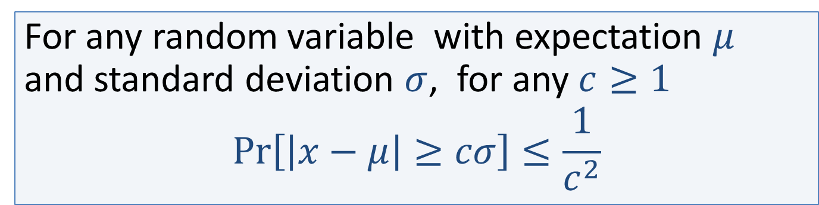
Chebyshev’s Inequality
➔
➔

Slide 28
Chebyshev’s Inequality
If ε is small this is meaningless…
We need to reduce the variance
How ?

Slide 29
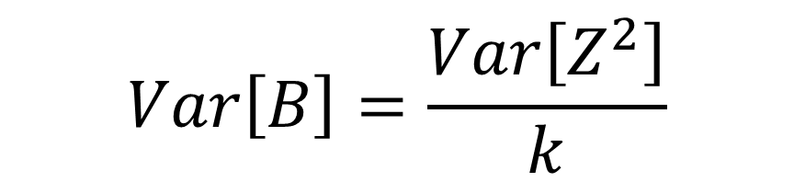
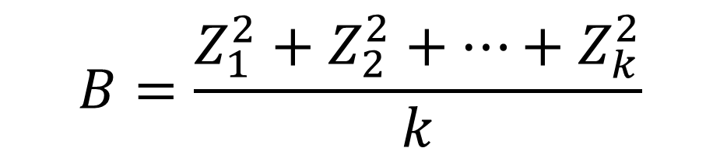
Averaging
Draw k ind. hash functions h₁, h₂, …. , h_{k}
$$B=\frac{Z_{1}^{2}+Z_{2}^{2}+…+Z_{k}^{2}}{k}$$
Use
$$Var\left[B\right]=\frac{Var\left[Z^{2}\right]}{k}$$

Slide 30

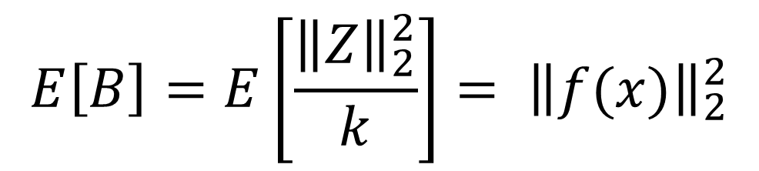
Recap
=
$$Z=A(f\left(x\right))$$
$$E\left[B\right]=E\left[\frac{{\left\|Z\right\|}_{2}^{2}}{k}\right]= {\left\|f(x)\right\|}_{2}^{2}$$

Slide 31
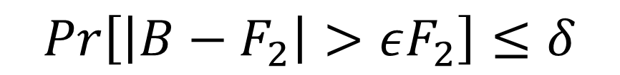
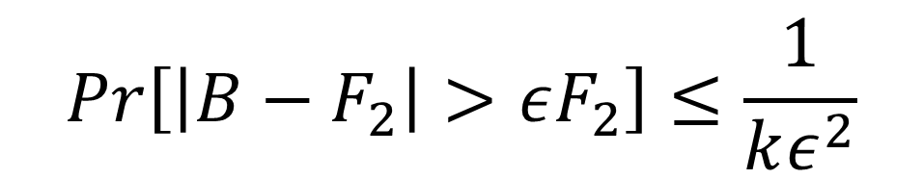
Chebyshev’s Inequality
$$Pr\left[\left|B−F_{2}\right|>εF_{2}\right]≤\frac{1}{kε^{2}}$$
Pick
$$Pr\left[\left|B−F_{2}\right|>εF_{2}\right]≤δ$$

Slide 32
For example
$$Pr\left[\left|B−F_{2}\right|>εF_{2}\right]≤\frac{1}{kε^{2}}$$
Pick
1/4
1/4
$$Pr\left[\left|B−F_{2}\right|>εF_{2}\right]≤δ$$

Slide 33
Boosting the confidence – using the median
Now duplicate the construction on the previous slide s = O(log(1/δ)) times
We get B₁,…..,B_{s} (assume they are sorted)
Return their median
Why is this good ?

Slide 34
Analysis
Each of B₁,…..,B_{s} is bad ((1 ± ε) far from F₂) with probability ≤ ¼
The median is bad ➔ more than ½ of B₁,…..,B_{s} are bad
B₁, B₂ , ……. ,B_{s-1},B_{s}
If the median is too large ➔ all the ones that are larger than the median are bad

Slide 35
Use chernoff bounds
What is the probability that more than ½ are bad ?
Chernoff: Let X = X₁ + …..+ X_{s} where each X_{i} is Bernoulli with p = ¼ then
➔
s = O(log(1/δ)) with a large enough constant

Slide 36

Summary AMS
With a sketch of size $O\left(\frac{1}{ε^{2}}\log{\frac{1}{δ}}\right)$ we get
$$Pr\left[\left|median(B_{1},..,B_{s})−F_{2}\right|>εF_{2}\right]≤δ$$

Slide 37
Lets back up a bit
To the point right before we did the median trick

Slide 38
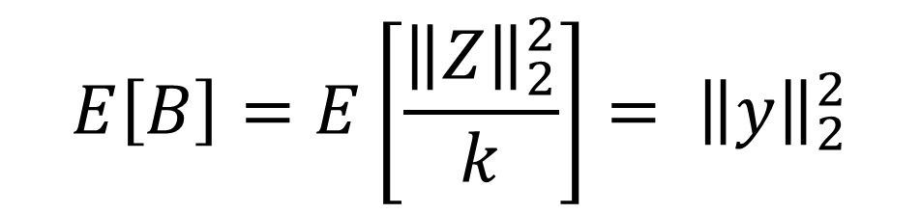
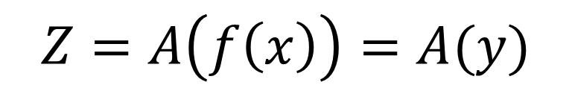
We had
y
=
$$Z=A\left(f\left(x\right)\right)=A(y)$$
$$E\left[B\right]=E\left[\frac{{\left\|Z\right\|}_{2}^{2}}{k}\right]= {\left\|y\right\|}_{2}^{2}$$

Slide 39
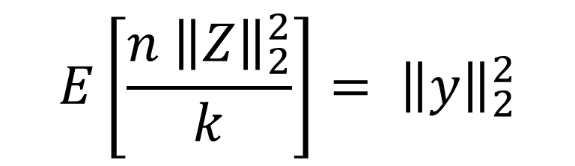

Lets normalize the rows of A
y
$$\frac{1}{\sqrt{n}}$$
=
We project y along k random directions and get that:
$$E\left[\frac{{n \left\|Z\right\|}_{2}^{2}}{k}\right]= {\left\|y\right\|}_{2}^{2}$$

Slide 40

Lets normalize the rows of A
y
$$\frac{1}{\sqrt{n}}$$
=
We project y along k random directions and get that:
$$E\left[\frac{{ \left\|Z\right\|}_{2}^{2}}{{\left\|y\right\|}_{2}^{2}}\right]= \frac{k}{n}$$

Slide 41
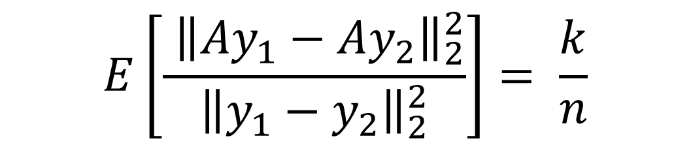

Random projections
We see that a vector of random projections preserves norms
So it preserves distances
$$E\left[\frac{{ \left\|Z\right\|}_{2}^{2}}{{\left\|y\right\|}_{2}^{2}}\right]= \frac{k}{n}$$
$$E\left[\frac{{ \left\|Ay_{1}−Ay_{2}\right\|}_{2}^{2}}{{\left\|y_{1}−y_{2}\right\|}_{2}^{2}}\right]= \frac{k}{n}$$

Slide 42
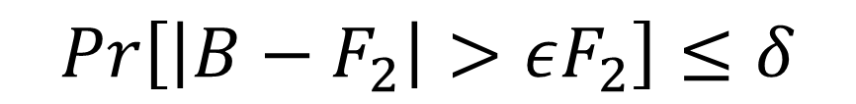
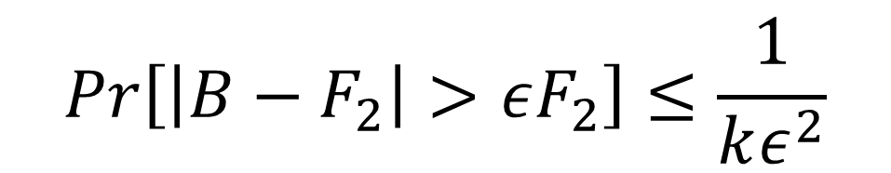

Recall
$$Pr\left[\left|B−F_{2}\right|>εF_{2}\right]≤\frac{1}{kε^{2}}$$
Pick
$$Pr\left[\left|B−F_{2}\right|>εF_{2}\right]≤δ$$
To preserve pairwise distances between m points we need $δ≤1/m^{2}$

Slide 43

Johnson & Lindenstraus
(A random orthonormal k × n)
=
We project into a random k-dim. subspace
$$E\left[\frac{{ \left\|Z\right\|}_{2}^{2}}{{\left\|y\right\|}_{2}^{2}}\right]= \frac{k}{n}$$

Slide 44
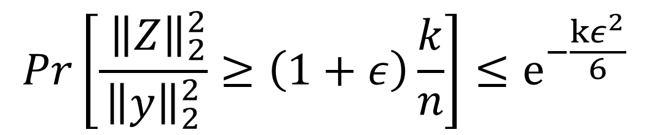
Dimension reduction
(A random orthonormal k × n)
=
We project into a random k-dim. subspace
$$Pr\left[\frac{{ \left\|Z\right\|}_{2}^{2}}{{\left\|y\right\|}_{2}^{2}}≥\left(1+ε\right)\frac{k}{n}\right]≤e^{−\frac{kε^{2}}{6}}$$
JL:
∀ε∈[0,1]

Slide 45
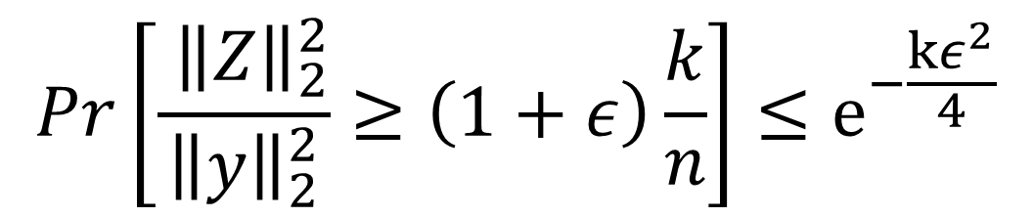
Dimension reduction
(A random orthonormal k × n)
=
We project into a random k-dim. subspace
$$Pr\left[\frac{{ \left\|Z\right\|}_{2}^{2}}{{\left\|y\right\|}_{2}^{2}}≥\left(1+ε\right)\frac{k}{n}\right]≤e^{−\frac{kε^{2}}{4}}$$
JL:
∀ε∈[0,1]

Slide 46
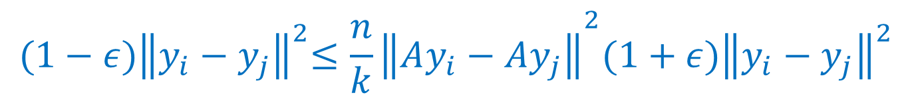
Johnson-Lindenstrauss
JL: Project the vectors y₁,….,y_{m} into a random k-dimensional subspace for k=O(log(m)/ε²) then with probability 1-1/m^{c} :
$${(1−ε)\left\|y_{i}−y_{j}\right\|}^{2}≤{\frac{n}{k}\left\|Ay_{i}−Ay_{j}\right\|}^{2}{(1+ε)\left\|y_{i}−y_{j}\right\|}^{2}$$

Slide 47
Extensions
Don’t need the directions to be orthogonal – random directions do
Can also project with sparser matrices

Slide 48
Bibliography
Noga Alon, Yossi Matias, Mario Szegedy: The Space Complexity of Approximating the Frequency Moments. J. Comput. Syst. Sci. 58(1) (1999), 137-147
W. B. Johnson and J. Lindenstrauss, Extensions of Lipschitz maps into a Hilbert space, Contemp Math 26 (1984), 189–206.
Jirí Matousek: On variants of the Johnson-Lindenstrauss lemma. Random Struct. Algorithms 33(2): 142-156 (2008)

