Slide 1


Foundations of Data Mining
http://www.cohenwang.com/edith/dataminingclass2017
Instructors:
Edith Cohen
Haim Kaplan
Amos Fiat
Lecture 1

Slide 2
Course logistics
Tuesdays 16:00-19:00, Sherman 002
Slides for (most or all) lectures will be posted on the course web page: http://www.cohenwang.com/edith/dataminingclass2017
Office hours: Email instructors to set a time
Grade: 70% final exam, 30% on 5 problem sets

Slide 3
Data
Collected: network activity, people activity, measurements, search/assistant queries, location, online interactions and transactions, text, media,
Generated (processed) data: parameters in large scale model, partly curated raw data,
Scale: petabytes -> exabytes -> …
Diverse formats: relational, logs, text, media, measurements
Location: distributed, streamed,
Notes:
Sometimes more parameters in the model than in the data

Slide 4
Data to Information
Mining and learning from data
  Aggregates, statistics, properties
  Models that allow us to generalize/predict
Scalable (efficient, fast) computation:
    Data available as streamed or distributed (limit data movement for efficiency/privacy)
    Platforms that use computation resources (Map-reduce, Tensor-Flow,… ) across scales:
    GPUs, multi-core CPUs, Data Center, wide area, federated (on device) computing
  Algorithm design:
    “linear” processing on large data,
    trade-off accuracy and computation cost
Social issues:
  Privacy, Fairness

Slide 5
Topics for this course
Selection criteria of topics:
Broad demonstrated applicability
Promote deeper understanding of concepts
Simplicity, elegance, principled
Instructor bias
Topics:
Data modeled as: key value pairs, metric (vectors, sets), graphs
Properties, features, statistics of interest
Summary structures for efficient storage/movement/computation
Algorithms for distributed/parallel/streamed computation
Data representations that support generalization (recover missing relations, identify spurious ones)
Data privacy

Slide 6
Today
Key-value pairs data
Intro to summary structures (sketches)
Computation over streamed/distributed data
Frequent keys: The Misra Gries structure
Set membership: Bloom Filters
Counting: Morris counters

Slide 7
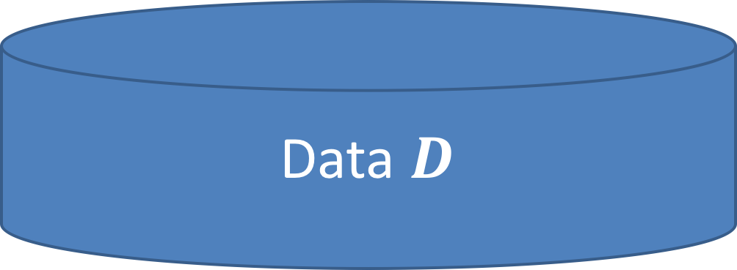
Key-Value pairs
8
Data element $e∈D$ has key and value (e.key,e.value)
7
10
4
5
3
Example data
Search queries
IP network packets/flow records
Online interactions
Parameter updates (training ML model)
2
2
1
Data $D$
Notes:
Often e.value=1 uniformly, still relevant
The statistics depend on the desnity function of

Slide 8
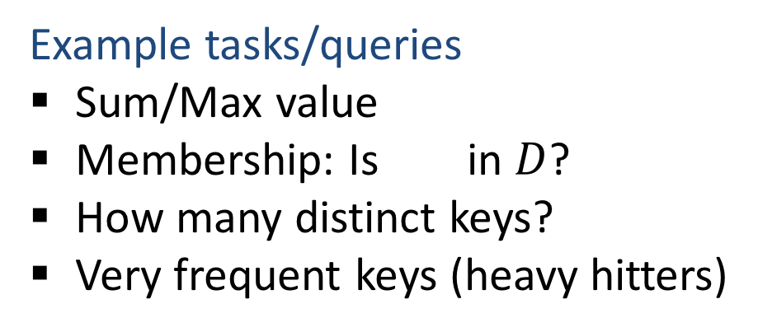
Key-Value pairs
8
Data element $e∈D$ has key and value (e.key,e.value)
7
10
4
5
3
Example tasks/queries
Sum/Max value
Membership: Is in $D$?
How many distinct keys?
Very frequent keys (heavy hitters)
2
2
1
Data $D$
Notes:
Often e.value=1 uniformly, still relevant
The statistics depend on the desnity function of

Slide 9
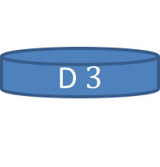

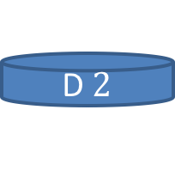


Data access
Distributed data/parallel computation
D $1$
D$2$
D$3$
GPUs, CPUs, VMs, Servers, wide area, devices
Distributed data sources
Distribute for faster/scalable computation
D $4$
D$5$
Challenges: Limit data movement, Support updates to D
Data streams
Data read in one (or few) sequential passes
Can not be revisited (IP traffic)
I/O efficiency (sequential access is cheaper than random access)
Challenges: ”State” must be much smaller than data size, Support updates to D

Slide 10
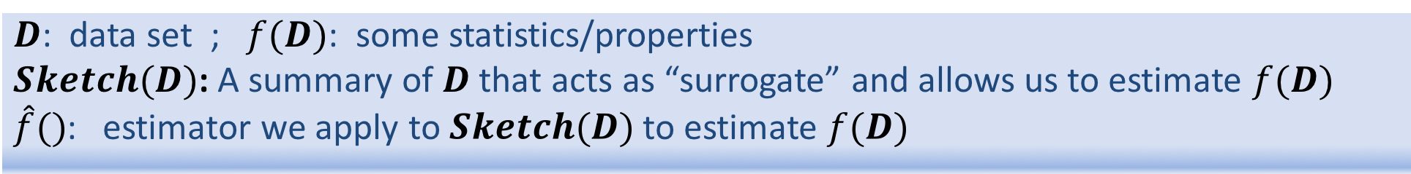

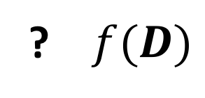

Summary Structures (Sketches)
$D$: data set ; $f(D)$: some statistics/properties
$Sketch(D)$: A summary of $D$ that acts as “surrogate” and allows us to estimate $f(D)$
$\hat{f}()$: estimator we apply to $Sketch(D)$ to estimate $f(D)$
Examples: random samples, projections, histograms, …
Data $D$
Why sketch?
Data can be too large to:
  Store in full for long or even short term
  Transmit
Slow/costly processing of exact queries
Data updates do not necessitate full recomputation
Sketch(D)
? $f(D)$
$$\hat{f}(Sketch(D))$$
  Multi-objective $f(q,D)$ , $\hat{f}(q,Sketch(D))$ sketch supports multiple query types
Notes:
Sketch is usually tailored for f. Can be muti-objective.

Slide 11


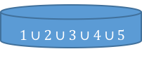



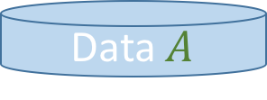









Composable sketches
Distributed data/parallelize computation
Sketch$(A∪B)$ from Sketch$(A)$ and Sketch$(B)$
Data $A$
Sketch $1$
S$ketch 2$
Sketch$(A)$
Sketch$3$
Sketche $4$
Data $B$
Sketch($B)$
S$ketch 5$
S. $1∪2$
Data $A∪B$
S. $3∪4$
Sketch(A$∪B)$
S. $1∪2∪5$
$1∪2∪3∪4∪5$
Only sketch structure moves between locations
Suffices to specify merging two sketches
Notes:
We want to get the same result if sketching the union of the data sets or from merging the two sketches.
If we can merge two sketches to a sketch of the union, we can do sketching, adding elements, merging, in any order and get the same result.

Slide 12



Streaming sketches
Sketch$(A∪\{e\})$ from Sketch$(A)$ and element $\{e\}$
Data $A$
Weaker requirement than fully composable
Sketch$(A)$
element $e$
element $e$
Only “state” maintained is the sketch structure
Data $A∪\{e\}$
Sketch(A$∪\{e\})$
Streamed data
Sketch
Sketch
Sketch
Sketch
Sketch
Sketch
Notes:
We want to get the same result if sketching the union of the data sets or from merging the two sketches.
If we can merge two sketches to a sketch of the union, we can do sketching, adding elements, merging, in any order and get the same result.

Slide 13
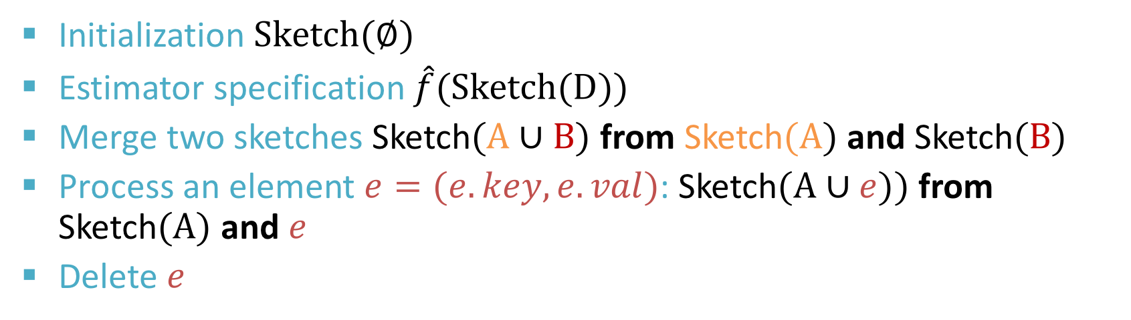





Sketch API
Data $D$
Sketch $(D)$
Q: $f(D)$ ?
$$\hat{f}(Sketch(D))$$
Initialization $Sketch(∅)$
Estimator specification $\hat{f}(Sketch(D))$
Merge two sketches Sketch$(A∪B)$ from Sketch$(A)$ and Sketch$(B)$
Process an element $e=(e.key,e.val)$: Sketch$(A∪e))$ from Sketch$(A)$ and $e$
Delete $e$
$$≻$$
optional
Seek to optimize sketch-size vs. estimate quality
Notes:
A sketch is a lossy summary of data elements, so that we can estimate our statistics of the data by simply applying an estimator to its sketch
We want our sketches to be very small, much smaller than the table (distinct keys) and provide optimal quality for size.
We want our sketches to be composable: sketch of union of data sets can be recovered from sketch of each part without revisiting the full data.
Composability is critical for parallel, distributed, and streamed processing.
Sketch can be computed locally on device or server or processing unit, then communicated.

Slide 14
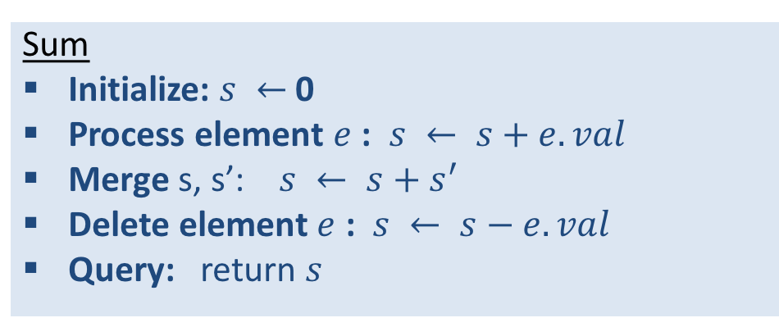
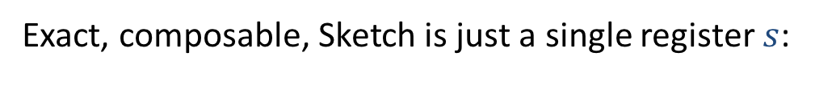
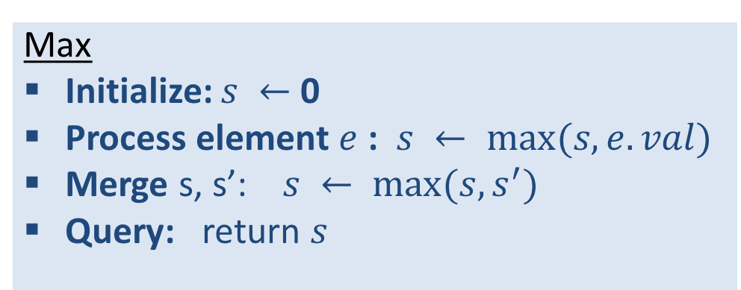
Easy sketches: min, max, sum, …
Element values:
32,
112,
14,
9,
37,
83,
115,
2,
Exact, composable, Sketch is just a single register $s$:
Sum
Initialize: $s ←$ 0
Process element $e$ : $s ← s+e.val$
Merge s, s’: $s ← s+s^{′}$
Delete element $e$ : $s ← s−e.val$
Query: return $s$
Max
Initialize: $s ←$ 0
Process element $e$ : $s ← max(s,e.val)$
Merge s, s’: $s ← max(s,s^{′})$
Query: return $s$
No delete support
Notes:
Application when we need to count many things (network flows) at the same time. Want to use smaller registers.

Slide 15
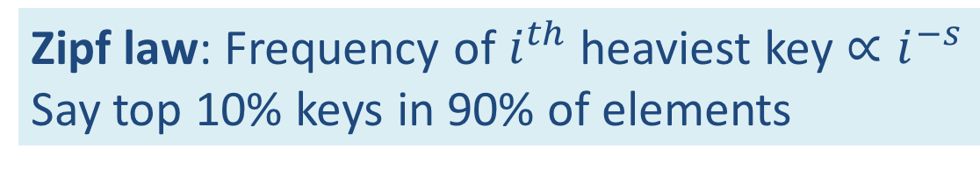
Frequent Keys
wikipedia
Data is streamed or distributed
Very large #distinct keys, huge #elements
Find the keys that occur very often
Occur in 3/11 elements
Example Applications:
Networking: Find “elephant” IP flows
Search engines: Find the most frequent queries
Text analysis: Frequent terms
Zipf law: Frequency of $i^{th}$ heaviest key $∝i^{−s}$
Say top 10% keys in 90% of elements
https://brenocon.com/blog/2009/05
Notes:
Size of cities, number of likes to NBA teams. The data elements/keys are people/their city, likes2NBAteams/team. The key is

Slide 16
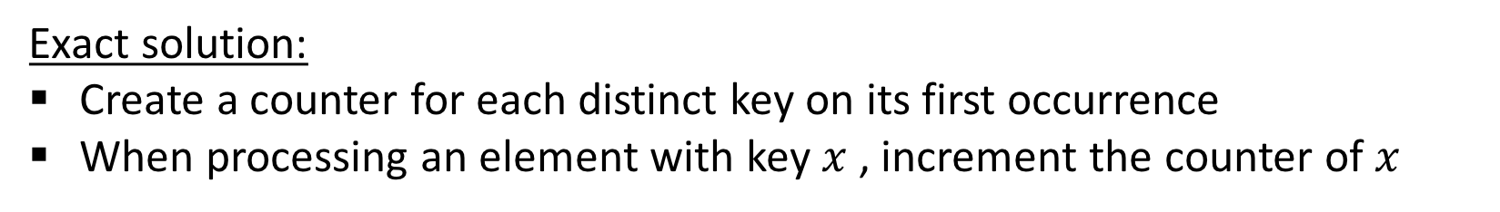
Frequent Keys: Exact Solution
Exact solution:
Create a counter for each distinct key on its first occurrence
When processing an element with key $x$ , increment the counter of $x$
Properties: Fully composable, exact, even supports deletions, recovers all frequencies
Problem: Structure size is $n=$ number of distinct keys. What can we do with size $k≪n$?
Solution: Sketch that got re-discovered many times [MG1982,DLM2002,KSP2003,MAA2006]

Slide 17

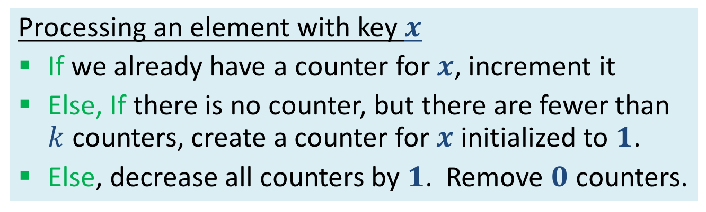
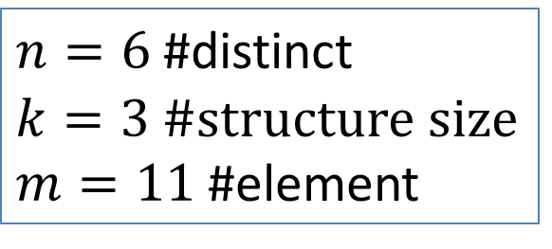
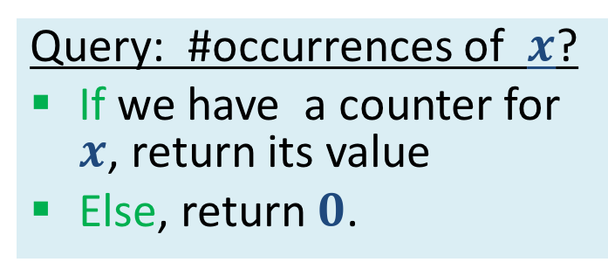
Frequent Keys: Streaming sketch [Misra Gries 1982]
Sketch size parameter $k$: Use (at most) $k$ counters indexed by keys. Initially, no counters
Processing an element with key $x$
If we already have a counter for $x$, increment it
Else, If there is no counter, but there are fewer than $k$ counters, create a counter for $x$ initialized to $1$.
Else, decrease all counters by $1$. Remove $0$ counters.
Query: #occurrences of $x$?
If we have a counter for $x$, return its value
Else, return $0$.
Clearly an under-estimate.
What can we say precisely?
$n=6$ #distinct
$k=3$ #structure size
$m=11$ #element
Notes:
What we can hope to do if we can only use counters for k keys?

Slide 18
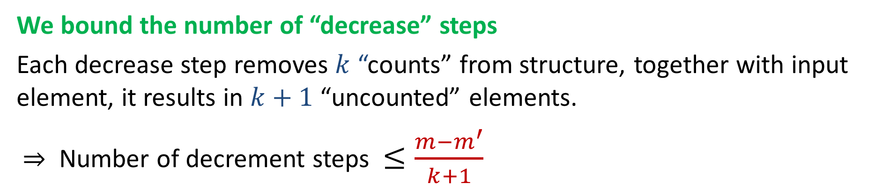
MG sketch: Analysis
Lemma: Estimate is smaller than true count by at most $\frac{{m−m}^{′}}{k+1}$
$m′$: Sum of counters in structure; $m$: #elements in stream; $k$: structure size
We charge each “missed count” to a “decrease” step:
If key in structure, any decrease in count is due to “decrease” step.
Element processed and not counted results in decrease step.
We bound the number of “decrease” steps
Each decrease step removes $k$ “counts” from structure, together with input element, it results in $k+1$ “uncounted” elements.
$⇒$ Number of decrement steps $≤\frac{{m−m}^{′}}{k+1}$

Slide 19
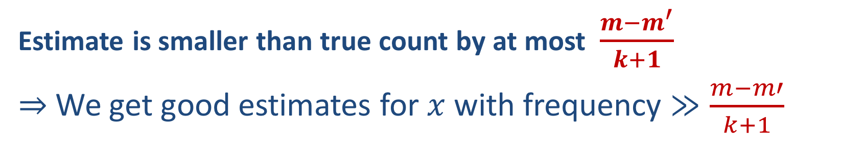
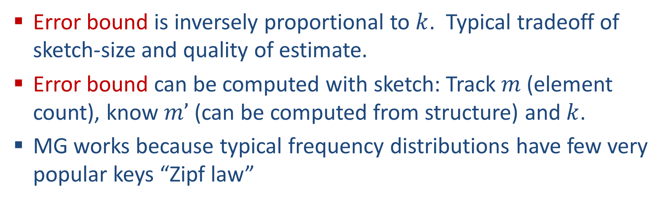
MG sketch: Analysis (contd.)
Estimate is smaller than true count by at most $\frac{{m−m}^{′}}{k+1}$
$⇒$ We get good estimates for $x$ with frequency $≫\frac{m−m′}{k+1}$
Error bound is inversely proportional to $k$. Typical tradeoff of sketch-size and quality of estimate.
Error bound can be computed with sketch: Track $m$ (element count), know $m’$ (can be computed from structure) and $k$.
MG works because typical frequency distributions have few very popular keys “Zipf law”

Slide 20
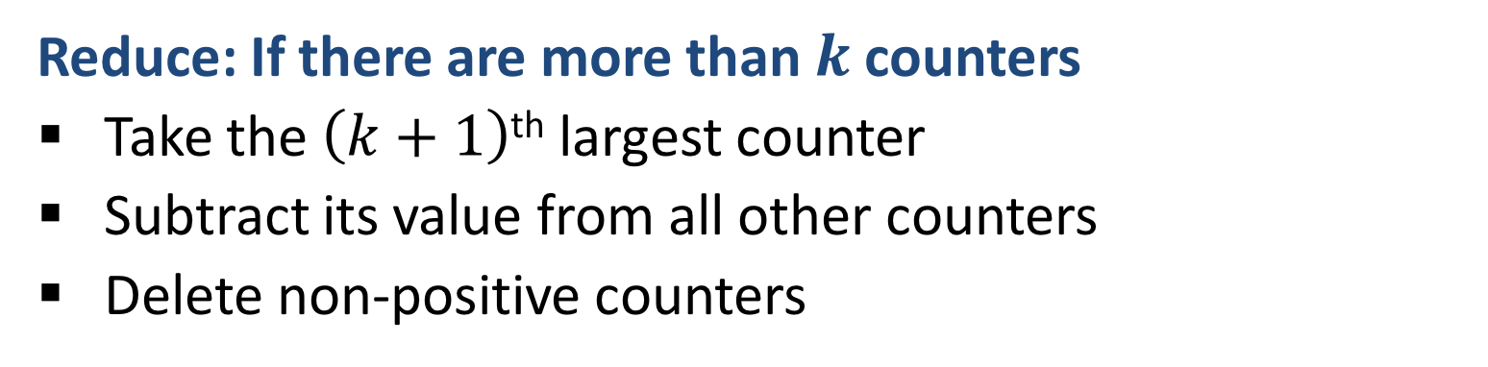
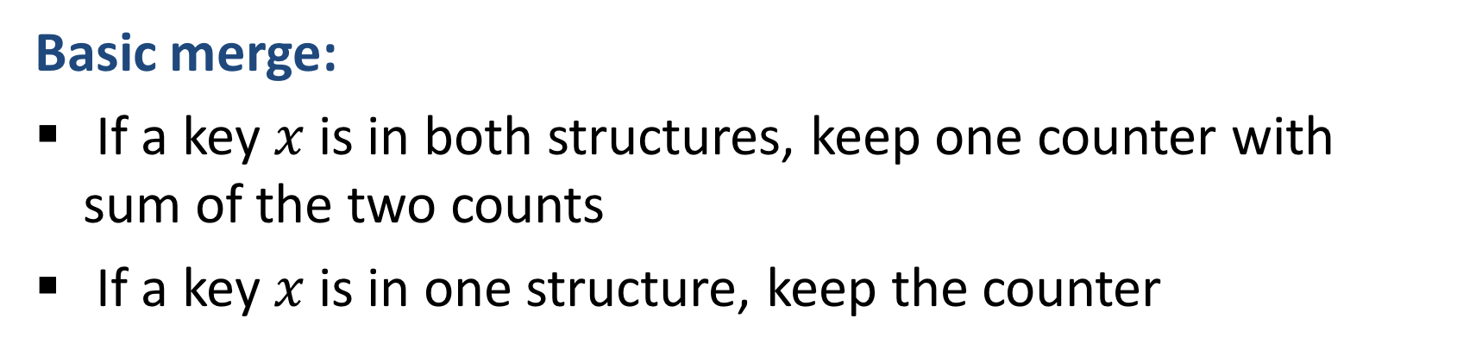
Making MG fully Composable:
Merging two MG sketches [MAA 2006, ACHPWY 2012]
Basic merge:
If a key $x$ is in both structures, keep one counter with sum of the two counts
If a key $x$ is in one structure, keep the counter
Reduce: If there are more than $k$ counters
Take the $\left(k+1\right)$^{th} largest counter
Subtract its value from all other counters
Delete non-positive counters

Slide 21
Merging two Misra Gries Sketches
Basic Merge:

Slide 22
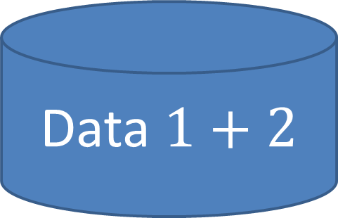
Merging two Misra Gries Summaries
4th largest
Reduce since there are more than $k=3$ counters :
Take the $\left(k+1\right)$^{th} = 4th largest counter
Subtract its value (2) from all other counters
Delete non-positive counters

Slide 23
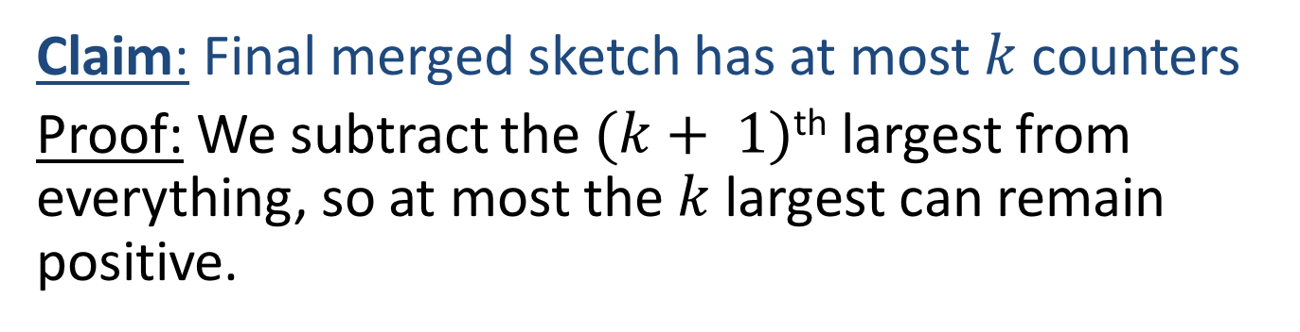

Merging MG Summaries: Correctness
Claim: Final merged sketch has at most $k$ counters
Proof: We subtract the $(k+ 1)$^{th} largest from everything, so at most the $k$ largest can remain positive.
Claim: For each key, merged sketch count is smaller than true count by at most $\frac{m−m′}{k+1}$

Slide 24
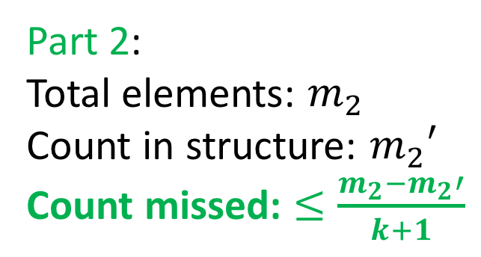
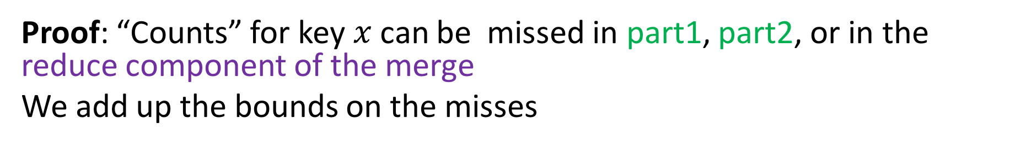
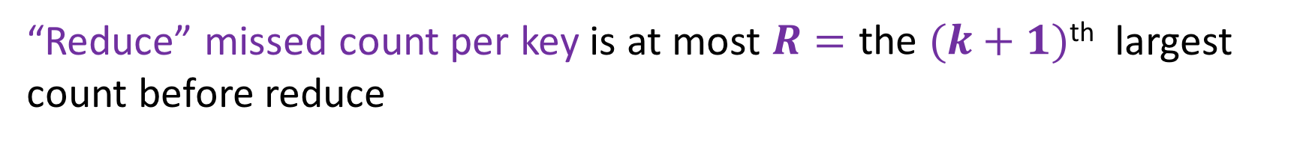

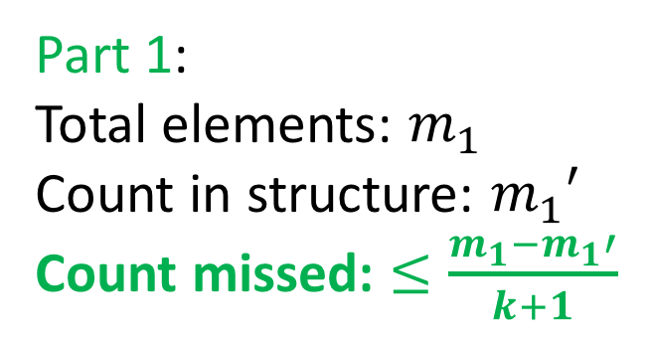
Merging MG Summaries: Correctness
Claim: For each key, merged sketch count is smaller than true count by at most $\frac{m−m′}{k+1}$
Proof: “Counts” for key $x$ can be missed in part1, part2, or in the reduce component of the merge
We add up the bounds on the misses
Part 1:
Total elements: $m_{1}$
Count in structure: $m_{1}′$
Count missed: $≤\frac{m_{1}−m_{1}′}{k+1}$
Part 2:
Total elements: $m_{2}$
Count in structure: $m_{2}′$
Count missed: $≤\frac{m_{2}−m_{2}′}{k+1}$
“Reduce” missed count per key is at most $R=\text{the}$ $(k+1)$^{th} largest count before reduce

Slide 25
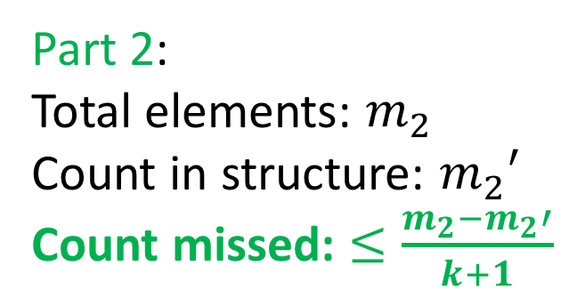
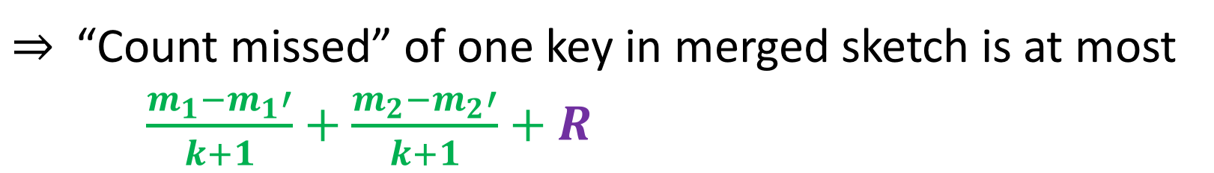
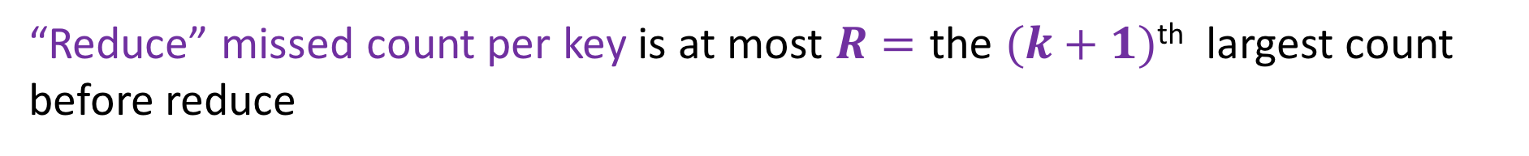

Merging MG Summaries: Correctness
$⇒$“Count missed” of one key in merged sketch is at most
$\frac{m_{1}−m_{1}′}{k+1}+$ $\frac{m_{2}−m_{2}′}{k+1}+R$
Part 1:
Total elements: $m_{1}$
Count in structure: $m_{1}′$
Count missed: $≤\frac{m_{1}−m_{1}′}{k+1}$
Part 2:
Total elements: $m_{2}$
Count in structure: $m_{2}′$
Count missed: $≤\frac{m_{2}−m_{2}′}{k+1}$
“Reduce” missed count per key is at most $R=\text{the}$ $(k+1)$^{th} largest count before reduce

Slide 26
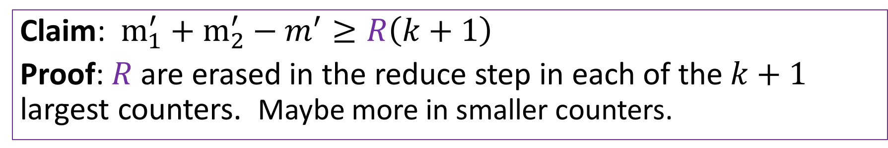
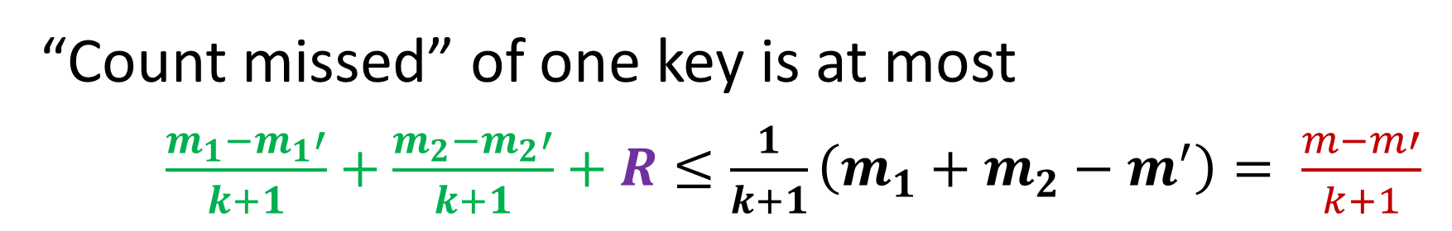
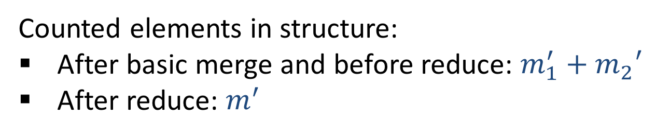
Merging MG Summaries: Correctness
Counted elements in structure:
After basic merge and before reduce: ${m_{1}^{′}+m}_{2}′$
After reduce: $m^{′}$
Claim: $m_{1}^{′}+m_{2}^{′}−m^{′}≥R\left(k+1\right)$
Proof: $R$ are erased in the reduce step in each of the $k+1$ largest counters. Maybe more in smaller counters.
“Count missed” of one key is at most
$\frac{m_{1}−m_{1}′}{k+1}+$ $\frac{m_{2}−m_{2}′}{k+1}+R≤\frac{1}{k+1}\left(m_{1}+m_{2}−m^{′}\right)= \frac{m−m′}{k+1}$

Slide 27

Probabilistic structures
Misra Gries is a deterministic structure
The outcome is determined uniquely by the input
Probabilistic structures/algorithms can be much more powerful
  Provide privacy/robustness to outliers
  Provide efficiency/size

Slide 28

Set membership
Data $D$
Data is streamed or distributed
Very large #distinct keys, huge #elements, large representation of keys
Structure that supports membership queries: Is in $D$?
Example applications:
Spell checker: Insert a corpus of words. Check if word is in corpus.
Web crawler: Insert all urls that were visited. Check if current url was explored.
Distributed caches: Maintain a ”summary” of keys of cached resources. Send requests to a cache that has the resource.
Blacklisted IP addresses: Intercept traffic from blacklisted sources
Exact solution: Dictionary (hash map) structure. Problem: stores representation of all keys

Slide 29
Set membership: Bloom Filters [Bloom 1970]
Very popular in many applications
Probabilistic data structure
Reduces representation size to few bits (8) per key
False positives possible, no false negatives
Tradeoff between size and false positive rate
Composable
Analysis relies on having independent random hash functions (practice work well, theoretical issues)

Slide 30


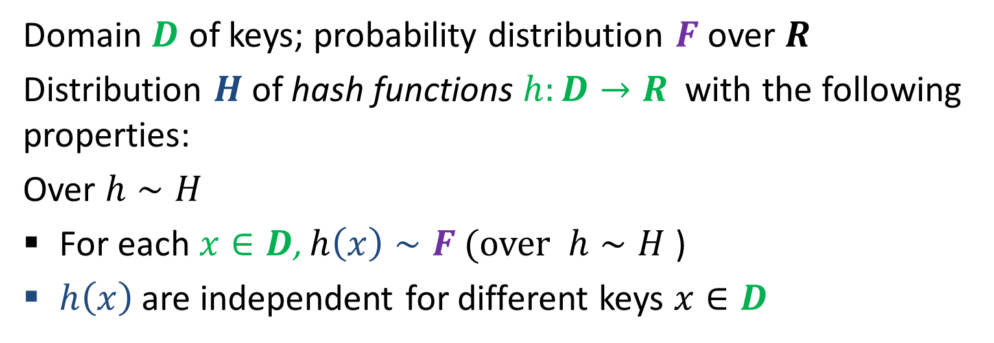
Independent Random Hash Functions
Simplified and Idealized
Domain $D$ of keys; probability distribution $F$ over $R$
Distribution $H$of hash functions $h:D→R$ with the following properties:
Over $h∼H$
  For each $x∈D$, $h\left(x\right)∼F$ (over $h∼H$ )
$h\left(x\right)$ are independent for different keys $x∈D$
We use random hash functions as a way to have random draws with “memory”: Attach a “permanent” random value to a key

Slide 31
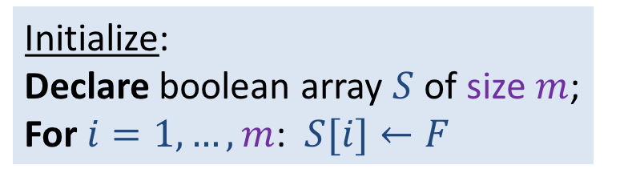
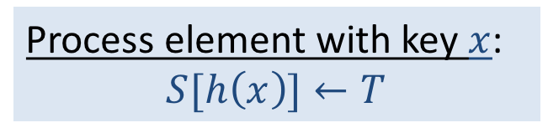


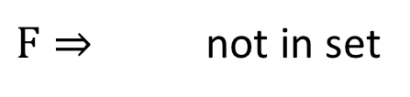
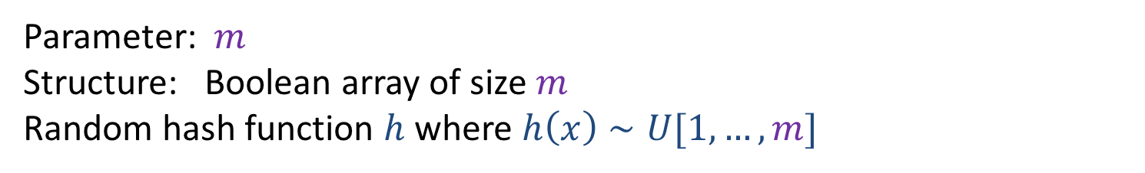
Set membership warmup: Hash solution
Parameter: $m$
Structure: Boolean array of size $m$
Random hash function $h$ where $h\left(x\right)∼U[1,…,m]$
Initialize:
Declare boolean array $S$ of size $m$;
For $i=1,…,m$: $S[i]←F$
$$m=10$$
Process element with key $x$:
$$S[h\left(x\right)]←T$$
T
T
1
2
3
4
5
6
7
8
9
10
Membership query for $x$:
Return $S[h\left(x\right)]$
$F⇒$ not in set
Merge: Two structures of same size and same hash function. Take bitwise OR

Slide 32
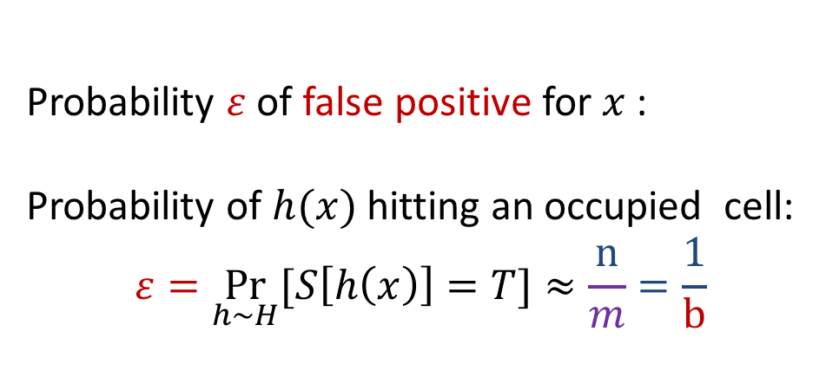


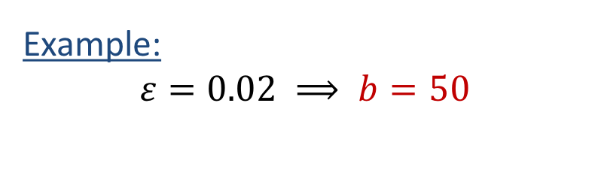
Hash solution: Probability of a false positive
$m$: Structure size; $n$ number of distinct keys inserted
$b=\frac{m}{n}$ , number of bits we use in structure per distinct key in data
$$m=10$$
Probability $ε$ of false positive for $x$:
Probability of $h(x)$ hitting an occupied cell:
$$ε=\underset{h∼H}{Pr}{[S\left[h\left(x\right)\right]=T}]≈\frac{n}{m}=\frac{1}{b}$$
T
T
1
2
3
4
5
6
7
8
9
10
Example:
$$ε=0.02 ⟹ b=50$$
Too high for many applications!! (IP address is 32 bits…)
Can we get a better tradeoff between $ε$ and $b$ ?

Slide 33

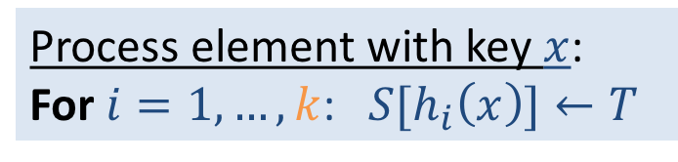
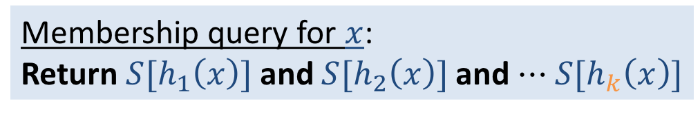
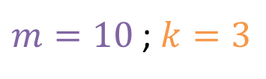
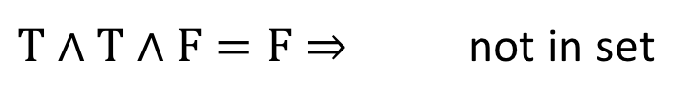
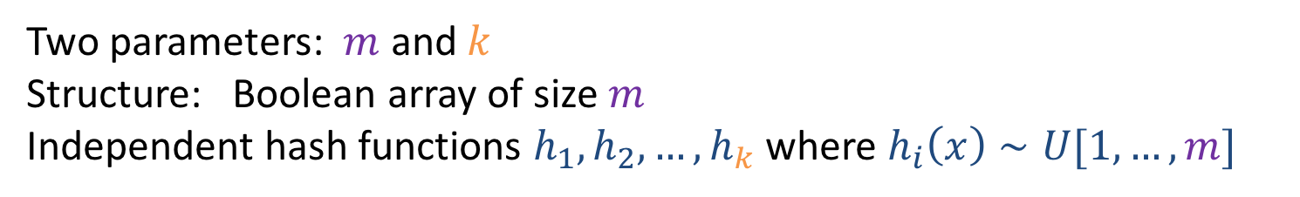
Set membership: Bloom Filters [Bloom 1970]
Two parameters: $m$ and $k$
Structure: Boolean array of size $m$
Independent hash functions $h_{1},h_{2},…,h_{k}$ where $h_{i}\left(x\right)∼U[1,…,m]$
Initialize:
Declare boolean array $S$ of size $m$;
For $i=1,…,m$: $S[i]←F$
$m=10$ ; $k=3$
Process element with key $x$:
For $i=1,…,k$: ${S[h}_{i}\left(x\right)]←T$
T
T
T
T
T
1
2
3
4
5
6
7
8
9
10
Membership query for $x$:
Return ${S[h}_{1}\left(x\right)]$ and ${S[h}_{2}\left(x\right)]$ and $⋯$ ${S[h}_{k}\left(x\right)]$
$T∧T∧F=F⇒$ not in set
Merge: Two structures of same size and same set of hash functions. Take bitwise OR

Slide 34
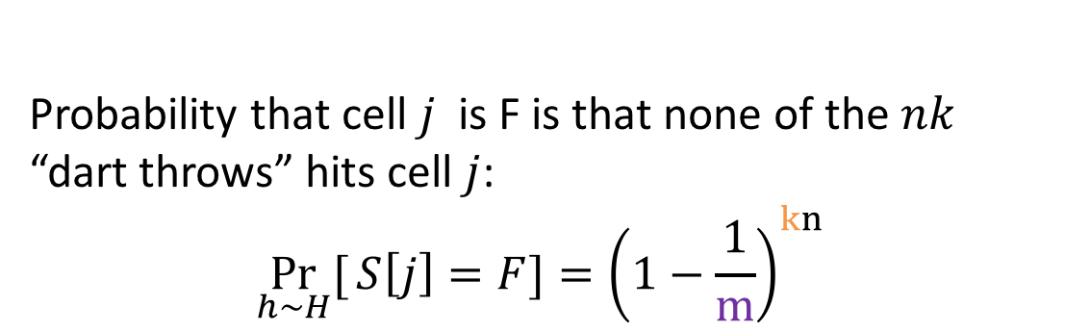

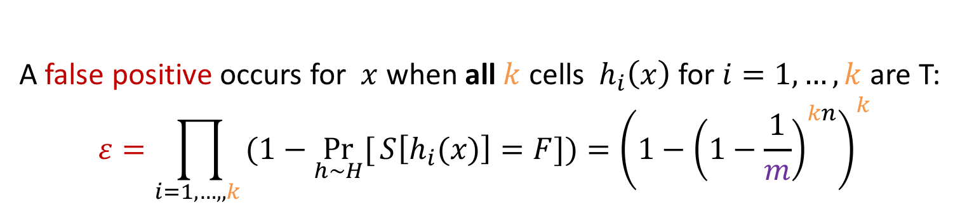
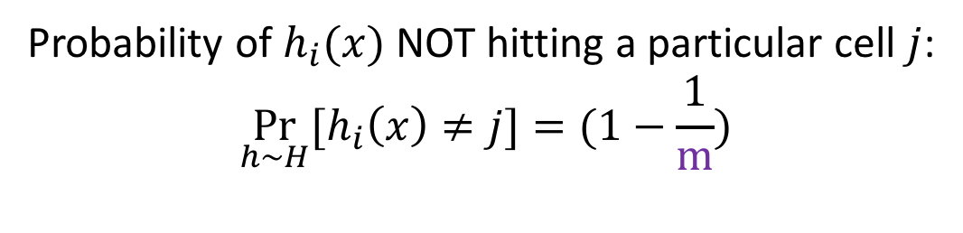
Bloom Filters Analysis: Probability of a false positive
$m$: Structure size ; $k$: number of hash functions ; $n$ number of distinct keys inserted
Probability of $h_{i}(x)$ NOT hitting a particular cell $j$:
$$\underset{h∼H}{Pr}{{[h}_{i}\left(x\right)≠j}]=(1−\frac{1}{m})$$
$m=10$ ; $k=3$
Probability that cell $j$ is F is that none of the $nk$ “dart throws” hits cell $j$:
$$\underset{h∼H}{Pr}[{S\left[j\right]=F}]={\left(1−\frac{1}{m}\right)}^{kn}$$
T
T
T
T
T
1
2
3
4
5
6
7
8
9
10
$T∧T∧F=F⇒$ not in set
A false positive occurs for $x$ when all $k$ cells ${ h}_{i}\left(x\right)$ for $i=1,…,k$ are T:
$$ε=\prod_{i=1,…,,k }{(1−\underset{h∼H}{Pr}[{S\left[h_{i}(x)\right]=F]}})={\left(1−{\left(1−\frac{1}{m}\right)}^{kn}\right)}^{k}$$
* Assume $k≪m$ so $h_{i}(x)$ for different $i=1,…,k$ are very likely to be distinct
Notes:
Assume k<<m and thus the hash functions applied to x are very likely to be k different cells

Slide 35








Bloom Filters: Probability of a false positive (contd)
$m$: Structure size ; $k$: number of hash functions ; $n$ number of distinct keys inserted
False positive probability:
$$ε≤{\left(1−{\left(1−\frac{1}{m}\right)}^{kn}\right)}^{k}$$
$$≈{\left(1−e^{−\frac{kn}{m}}\right)}^{k}$$
$$={\left(1−e^{−\frac{k}{b}}\right)}^{k}$$
$$\lim_{i→∞}{\left(1−\frac{1}{i}\right)}^{i}=\frac{1}{e}$$
$${\left(1−\frac{1}{m}\right)}^{kn}={\left({\left(1−\frac{1}{m}\right)}^{m}\right)}^{\frac{kn}{m}}$$
$$≈ {\left(\frac{1}{e}\right)}^{\frac{kn}{m}}=e^{− \frac{kn}{m} }$$
We can see that FP probability decreases with $m$
!! FP probability depends on $b=\frac{m}{n}$ , number of bits we use per distinct key
Given $b$, which $k$ minimizes the FP probability $ε$?
Notes:
Assume k<<m and thus the hash functions applied to x are very likely to be k different cells

Slide 36










Bloom Filters: Probability of a false positive (contd)
$k$: number of hash functions
$m$: Structure size
$n:$ number of distinct keys inserted
$b=\frac{m}{n}$: bits per key
False positive probability $ε$ (upper bound):
$${ε≤\left(1−e^{− \frac{k}{b}}\right)}^{k}$$
Given $b$, which $k$ minimizes the FP probability?
$k≈\ln\left(2\right)b$ $≈$ 0.7 $b$
Compute $b$ for desired FP error $ε$:
$${ε≈\left(\frac{1}{2}\right)}^{b ln 2}$$
$$b≈1.44 \log_{2}\frac{1}{ε}$$
!! FP error decreases exponentially in $b$
(recall $ε=\frac{1}{b}$ for $k=$1)
Example:
$$b=8;k=6 ;ε≈0.02$$
Notes:
Assume k<<m and thus the hash functions applied to x are very likely to be k different cells

Slide 37

Quick review: Random Variables
Random variable $X$
Probability Density Function (PDF) $f(x)$ :
    Properties: $f\left(x\right)≥0 \int_{−∞}^{∞}{f\left(x\right)}dx=1$
Cumulative Distribution Function (CDF)
$F\left(t\right)=\int_{−∞}^{t}{f\left(x\right)}dx$: probability that $X≤t$
  Properties: $F∈[0,1]$ monotone non-decreasing

Slide 38

Quick review: Expectation
Expectation: “average” value of $X$:
$μ_{X}≡E\left[X\right]=\int_{−∞}^{∞}{xf\left(x\right)}dx$
Linearity of Expectation:
$$E[aX+b]=aE[X]+b$$
For random variables $X_{1}\text{, }X_{2}\text{,}{ X}_{3}\text{, }\text{. . . ,} X_{k}$
$$E\left[\sum_{i=1}^{k}{X_{i}}\right]=\sum_{i=1}^{k}{{E[X}_{i}]}$$

Slide 39

Quick review: Variance
Variance
$$Var\left[X\right]≡σ_{X}^{2}=E[\left(X−{μ)}^{2}\right]=\int_{−∞}^{∞}{{\left(x−μ\right)}^{2}f\left(x\right)dx}$$
Useful relations: $σ_{X}^{2}=E\left[X^{2}\right]−μ_{X}^{2}$
$Var[aX+b]=a^{2}Var[X]$
The standard deviation is $σ_{X}= \sqrt{Var[X]}$
Coefficient of Variation $\frac{σ}{μ}$ (normalized s.d.)

Slide 40

Quick review: Covariance
Measure of joint variability of two random variables) $X,Y$
Cov$\left[X,Y\right]=σ_{XY}= E\left[\left(X−μ_{X}\right) \left(Y−μ_{Y}\right)\right]$
$$=E\left[XY\right]−μ_{X}μ_{Y}$$
$X,Y$ are independent $⟹ σ_{XY}=0$
Variance of the sum of $X_{1}$, $X_{2}$,…, $X_{k}$
$$Var\left[\sum_{i=1}^{k}{X_{i}}\right]=\sum_{i=1}^{k}{\sum_{j=1}^{k}{{Cov[X}_{i},X_{j}]}}=\sum_{i=1}^{k}{{Var[X}_{i}]}+ \sum_{i≠j}^{k}{{Cov[X}_{i},X_{j}]}$$
When (pairwise) independent
Notes:
Shonut meshutefet mention pairwise independence for “ linearity of variance”

Slide 41


Quick Review: Estimators
A function $\hat{f}(S)$ applied to a probabilistic sketch $S$ of data $D$
to estimate a property/statistics $f(D)$ of the data $D$
Error (random variable) $err\left(\hat{f}\right)=\hat{f}\left(S\right)−f(D)$ ; Relative Error $\frac{err\left(\hat{f}\right)}{f\left(D\right)}$
Bias $Bias[\hat{f}]=E[err\left(\hat{f}\right)]=E[\hat{f}] −f(D)$
  When $Bias = 0$estimator is unbiased
Mean Square Error (MSE):
$E\left[{err\left(\hat{f}\right)}^{2}\right]=Var\left[\hat{f}\right]+Bias{\left[\hat{f}\right]}^{2}$
Root Mean Square Error (RMSE): $\sqrt{MSE}$
Normalized Root Mean Square Error (NRMSE): $\frac{\sqrt{MSE}}{f\left(D\right)}$

Slide 42


Simple Counting (revisited)
1,
1,
1,
1,
1,
1,
1,
1,
Initialize: $s ←$ 0
Process element: $s ← s+1$
Merge s, s’: $s ← s+s^{′}$
Exact count: Size (bits) is $⌈\log_{2} n⌉$ where $n$ is the current count.
Can we count with fewer bits ?
Have to settle for an approximate count…
Applications: We have very many quantities to count, and fast memory is scarce (say, inside a backbone router, ) or bandwidth is scarce (distributed training of a large ML model)
Notes:
Application when we need to count many things (network flows) at the same time. Want to use smaller registers.
Also distributed training of a model with billions of parameters.

Slide 43















Morris Counter [Morris 1978]
Probabilistic stream counter: Maintain e “$log n$” instead of $n,$ use $log log n$ bits
Initialize: $s=0$
Increment: Increment $s$with probability $2^{−s}$
Query: Return $2^{s}−1$
$n={10}^{9}$,
Exact: $\log_{2}{10}^{9}≈30$bits
$\log_{2}{ \log_{2}10}^{9}≈5$bits
Stream:
1,
1,
1,
1,
1,
1,
1,
1,
Count $n$:
1,
2,
3,
4,
5,
6,
7,
8,
1
$\frac{1}{2}$
$\frac{1}{2}$
$\frac{1}{4}$
$\frac{1}{4}$
$\frac{1}{4}$
$\frac{1}{4}$
$\frac{1}{8}$
$\frac{1}{8}$
$p=2^{−x}$:
Counter $x$:
0
1
1
2
2
2
2
3
3
Estimate $\hat{n}$:
0
1
1
3
3
3
3
7
7

Slide 44


Morris Counter: Unbiasedness
Initialize: $s=0$
Increment: $s←s+1$ with probability $2^{−s}$
Query: Return $2^{s}−1$
When $n=0$, $s =0$, estimate is ${\hat{n}=2}^{0}−1=0$
When $n=1$, $s =1$, estimate is ${\hat{n}=2}^{1}−1=1$
When $n=2$,
with $p=\frac{1}{2}$ , $s =1$ , $\hat{n}=1$
with $p=\frac{1}{2}$ , $s =2$ , $\hat{n}=2^{2}−1=3$
Expectation: $E\left[\hat{n}\right]=\frac{1}{2}∗1+\frac{1}{2}∗3=2$
$n=3,4,5…$ by induction….

Slide 45


Morris Counter: Unbiasedness (contd)
Initialize: $s=0$
Increment: $s←s+1$ with probability $2^{−s}$
Query: Return $2^{s}−1$
It suffices to show that the expected increase of the estimate is always $1$
Suppose the counter value is $s$
We increase with probability $2^{−s}$
The expected increase in the estimate is
$${2^{−s}((2}^{s+1}−1) −{(2}^{s}−1))+(1−2^{−s})0={2^{−s} 2}^{s}=1$$

Slide 46

Morris Counter: Variance
How good is our estimate?
$X_{n}$ : random variable of counter with input $n$
Our estimate is the random variable $\hat{n}=2^{X_{n}}−1$
$$Var\left[\hat{n}\right]=Var\left[\hat{n}+1\right]=E\left[{\left(\hat{n}+1\right)}^{2}\right]−E{\left[\hat{n}+1\right]}^{2}$$
$$=E\left[2^{{2X}_{n}}\right]−{(n+1)}^{2}$$
We can show by induction $E\left[2^{{2X}_{n}}\right]=\frac{3}{2}n^{2}+\frac{3}{2}n+1$
This means $Var\left[\hat{n}\right]≈\frac{1}{2}n^{2}$ and CV $=\frac{σ}{μ} ≈\frac{1}{\sqrt{2}}$ (=NRMSE since unbiased)
How to reduce the error ?

Slide 47

Reducing variance by averaging
$k$ (pairwise) independent unbiased estimates $Z_{i}$ with expectation $μ$ and variance $σ^{2}$.
The average estimator $\hat{n′}=\frac{\sum_{i=1}^{k}{{Z_{i}}_{ }}}{k}$
Expectation: $E\left[\hat{n^{′}}\right]=\frac{1}{k}\sum_{i=1}^{k}{E\left[Z_{i}\right]=\frac{1}{k}kμ=μ}$
Variance:${ \left(\frac{1}{k}\right)}^{2}\sum_{i=1}^{k}{Var\left[Z_{i}\right]={\left(\frac{1}{k}\right)}^{2}kσ^{2}=\frac{σ^{2}}{k}}$ ($×k$ decrease)
CV : $\frac{σ}{μ}$ ( $×\sqrt{k}$ decrease)

Slide 48


Morris Counter: Reducing variance (generic method)
Morris counter: $Var\left[\hat{n}\right]=σ^{2}≈\frac{1}{2}n^{2}$ and CV $=\frac{σ}{μ}≈\frac{1}{\sqrt{2}}$
Use $k$ independent counters $y_{1},y_{2},…,y_{k}$
Compute estimates ${Z_{i}=2}^{y_{i}}−1$
Average the estimates $\hat{n′}=\frac{\sum_{i=1}^{k}{{Z_{i}}_{ }}}{k}$
NRMSE=CV $=\frac{σ}{μ} ≈\frac{1}{\sqrt{2k}}=ε$
Sketch size (bits): $k log log n={\frac{1}{2}ε}^{−2} log log n$
Can we get a better tradeoff of sketch size and NRMSE $ε$ ?

Slide 49

Morris Counter: Reducing variance (dedicated method) base change [Morris 1978+Flajolet 1985]
Morris counter: $Var\left[\hat{n}\right]=σ^{2}≈\frac{1}{2}n^{2}$ and CV $=\frac{σ}{μ}≈\frac{1}{\sqrt{2}}$
Single counter with base change –
  IDEA: Change base $2$(count $\log_{2}{n}$) to $1+b$ (count $\log_{1+b}{n}$)
  Estimate: Return ${\left(1+b\right)}^{s}−1$
  Increment:
    Increase counter $s$by maximum amount so estimate increase $=1−Δ$ $≤1.$
    Increment $s$with probability ${Δ b}^{−1}(1+{b)}^{−s}$
  For $b$ closer to 0, we increase accuracy but also increase counter size.
We analyze a more general method

Slide 50




Weighted Morris Counter [C’15]
5,
14,
1,
7,
18,
9,
121,
17,
weighted values, composable, size/quality tuned by base parameter $b$
Initialize: $s←0$
Estimate: return ${\left(1+b\right)}^{s}−1$
Add V or merge with a Morris sketch $s_{2}≤s$ $({V=\left(1+b\right)}^{s_{2}}−1)$:
  Increase $s$ by max amount so that estimate increase by $Z≤V$
  $Δ←V−Z$ ; Increment $s$ with probability $\frac{Δ}{{b\left(1+b\right)}^{s}}$
We can show $Var\left[\hat{n}\right]≤bn(n+1)$ $⟹$ CV $≤\sqrt{b}\sqrt{1+\frac{1}{n}}$ $⟹$ Choose $b=ε^{2}$
Sketch size: ${\log_{2} log}_{1+b}{n}≈\log_{2}\left(\frac{\log_{2} n}{b \log_{2}e}\right)≤ \log_{2} \log_{2} n+2 \log_{2} \frac{1}{ε}$
$n={10}^{9}$, $ε=0.1$
Exact: $\log_{2}{10}^{9}≈30$bits
Ave Morris: $≈250$ bits
W-Morris: $≈$ 12 bits
!! Much better than the averaging structure ${\frac{1}{2}ε}^{−2} log log n$
Notes:
Application when we need to count many things (network flows) at the same time. Want to use smaller registers.

Slide 51




Weighted Morris Counter: Unbiasedness
Initialize: $s←0$
Estimate: return ${\left(1+b\right)}^{s}−1$
Add V or merge with a Morris sketch $s_{2}≤s$ $({V=\left(1+b\right)}^{s_{2}}−1)$:
  Increase $s$ by max amount so that estimate increase by $Z≤V$
  $Δ←V−Z$ ; Increment $s$ with probability $\frac{Δ}{{b\left(1+b\right)}^{s}}$
We show that the expected increase in the estimate when adding V is equal to $V$.
The increase has two components, deterministic, and probabilistic:
Deterministic: We set $s←$ $s+max\{i≥0 | {\left(1+b\right)}^{s+i }−{\left(1+b\right)}^{s}≤V\}$. This step increased the estimate by $Z={\left(1+b\right)}^{s+i }−{\left(1+b\right)}^{s}$
We then probabilistically increment $s$ to account for $Δ=V−Z$: The estimate increase is ${\left(1+b\right)}^{s+1 }−{\left(1+b\right)}^{s}=b{\left(1+b\right)}^{s}$ with probability $p=\frac{Δ}{{b\left(1+b\right)}^{s}}$ and is $0$ otherwise. Therefore, the expectation is $pb{\left(1+b\right)}^{s}=Δ$.
Notes:
.

Slide 52




Weighted Morris Counter: Variance bound
Estimate: ${\left(1+b\right)}^{s}−1$
Add $Δ$: Increment $s$ with probability $\frac{Δ}{{b\left(1+b\right)}^{s}}$
Consider all data values $V_{i}$ and the corresponding random variables $A_{i} \text{that} \text{is} \text{the} \text{increase} \text{in} \text{the} \text{estimate}$. Note that by definition $n=\sum_{i}{V_{i}}$.
Lemma1: Consider value $V$ and variable $A$. Then $Var\left[A\right]≤Δb(n+1)$
Lemma2: For any $i≠j. Cov\left[A_{i},A_{j}\right]=0.$
Combining, we have that $Var\left[\hat{n} \right]=\sum_{i}{Var\left[A_{i}\right]≤\sum_{i}{V_{i}b\left(n+1\right)≤} }bn(n+1)$
It remains to prove the Lemmas…
Notes:
.

Slide 53


Weighted Morris Counter: Variance bound, Lemma1
Estimate: ${\left(1+b\right)}^{s}−1$
Add $Δ$: Increment $s$ with probability $\frac{Δ}{{b\left(1+b\right)}^{s}}$
Consider all data values $V_{i}$ and the corresponding random variables $A_{i} \text{that} \text{is} \text{the} \text{increase} \text{in} \text{the} \text{estimate}$. Note that by definition $n=\sum_{i}{V_{i}}$.
Lemma1: Consider value $V$ and variable $A$. Then $Var\left[A\right]≤Vb(n+1)$
Proof: The variance, conditioned on the state of the counter $s$ , only depends on the “probabilistic” part which is $Δ≤V.$
$Var\left[A \right| s]=\left(\frac{1}{p}−1\right)Δ^{′2}≤\frac{b{\left(1+b\right)}^{s}}{Δ}Δ^{2}=Δb$ ${\left(1+b\right)}^{s}$
The value of $s$ at the time the element is processed is at most the final value $s^{′}≥s$ of the counter. So $Var\left[A \right| s]≤ Δb$ ${\left(1+b\right)}^{s′}$
The unconditioned variance is bounded by the expectation over the distribution of $s′$.
Note that $E\left[{\left(1+b\right)}^{s′}\right]=n+1.$ Therefore
${Var\left[A\right]=E}_{s}[Var\left[A \right| s]]≤ Δb$ $E_{s′}\left[{\left(1+b\right)}^{s′}\right]=Δb \left(n+1\right)≤Vb(n+1)$
Notes:
.

Slide 54


Weighted Morris Counter: Variance bound, Lemma2
Estimate: ${\left(1+b\right)}^{s}−1$
Add $Δ$: Increment $s$ with probability $\frac{Δ}{{b\left(1+b\right)}^{s}}$
Consider all data values $V_{i}$ and the corresponding random variables $A_{i} \text{that} \text{is} \text{the} \text{increase} \text{in} \text{the} \text{estimate}$. Note that by definition $n=\sum_{i}{V_{i}}$.
Lemma2: For any $i≠j. Cov\left[A_{i},A_{j}\right]=0.$
Proof:
Suppose $V_{1}$ is processed first. We have $E\left[A_{1}\right]=V_{1}$. We now consider $A_{2}$ Conditioned on $A_{1}.$ Recall that the expectation of $A_{2}$ conditioned on any value of the counter when $V_{2}$ is processed is $E\left[A_{2} \right| s]=V_{2}=E[A_{2}]$. Therefore, for any $a$ ,
$E\left[A_{2} \right| A_{1}=a]=V_{2}$.
$$E\left[A_{1}A_{2}\right]=\sum_{a}{aPr⁡[A_{1}=a]}E\left[A_{2} \right| A_{1}=a]=V_{2}E\left[A_{1}\right]={E\left[A_{2}\right]E\left[A_{1}\right]=V}_{1}V_{2}$$
Notes:
.

Slide 55

Preview: Counting Distinct Keys
Same keys can occur in multiple data elements, we want to count the number of distinct keys.
Number of distinct keys is $n$ ($=6$ in example)
Number of data elements in this example is 11

Slide 56
Counting Distinct Keys: Example Applications
Networking:
  Packet or request streams: Count the number of distinct source IP addresses
  Packet streams: Count the number of distinct IP flows (source+destination IP, port, protocol)
Search Engines: Find how many distinct search queries were issued to a search engine each day

Slide 57
Bibliography
Misra Gries Summaries
J. Misra and David Gries, Finding Repeated Elements. Science of Computer Programming 2, 1982
  http://www.cs.utexas.edu/users/misra/scannedPdf.dir/FindRepeatedElements.pdf
Merging: Agarwal, Cormode, Huang, Phillips, Wei, and Yi, Mergeable Summaries, PODS 2012
Bloom filters:
Bloom, Burton H. (1970), "Space/Time Trade-offs in Hash Coding with Allowable Errors", Communications of the ACM, 13 (7)
https://en.wikipedia.org/wiki/Bloom_filter
  Approximate counting (Morris Algorithm)
Robert Morris. Counting Large Numbers of Events in Small Registers. Commun. ACM, 21(10): 840-842, 1978
  http://www.inf.ed.ac.uk/teaching/courses/exc/reading/morris.pdf
Philippe Flajolet Approximate counting: A detailed analysis. BIT 25 1985
  http://algo.inria.fr/flajolet/Publications/Flajolet85c.pdf
Merging Morris counters: these slides

