Slide 1
Big Data
Lecture 6: Locality Sensitive Hashing (LSH)

Slide 2
Nearest Neighbor
Given a set P of n points in R^{d}

Slide 3
Nearest Neighbor
Want to build a data structure to answer nearest neighbor queries

Slide 4
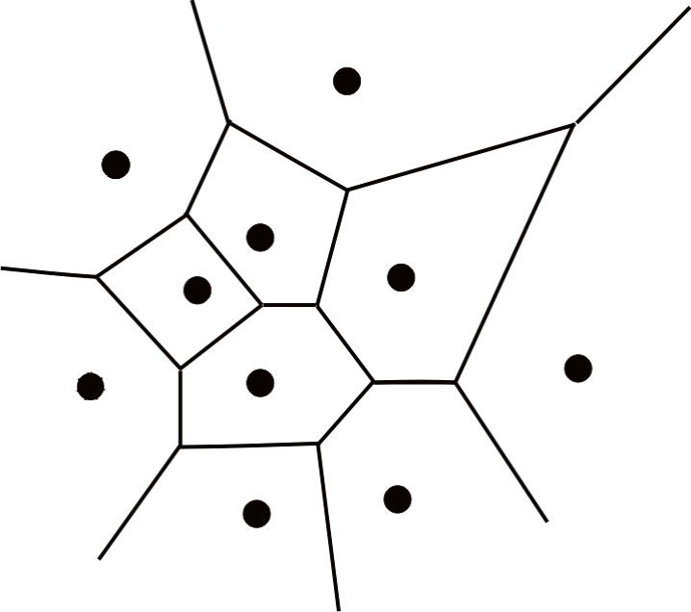
Voronoi Diagram
Build a Voronoi diagram & a point location data structure

Slide 5
Curse of dimensionality
In R² the Voronoi diagram is of size O(n)
Query takes O(logn) time
In R^{d} the complexity is O(n^{⎡d/2⎤})
Other techniques also scale bad with the dimension

Slide 6
Locality Sensitive Hashing
We will use a family of hash functions such that close points tend to hash to the same bucket.
Put all points of P in their buckets, ideally we want the query q to find its nearest neighbor in its bucket

Slide 7
Locality Sensitive Hashing
Def (Charikar):
A family H of functions is locality sensitive with respect to a similarity function 0 ≤ sim(p,q) ≤ 1 if
Pr[h(p) = h(q)] = sim(p,q)

Slide 8
Example – Hamming Similarity
Think of the points as strings of m bits and consider the similarity sim(p,q) = 1-ham(p,q)/m
H={h_{i}(p) = the i-th bit of p} is locality sensitive wrt sim(p,q) = 1-ham(p,q)/m
Pr[h(p) = h(q)] = 1 – ham(p,q)/m
1-sim(p,q) = ham(p,q)/m

Slide 9
Example - Jaacard
Think of p and q as sets
sim(p,q) = jaccard(p,q) = |p∩q|/|p∪q|
H={h_{π}(p) = min in π of the items in p}
Pr[h_{π}(p) = h_{π}(q)] = jaccard(p,q)
Need to pick π from a min-wise ind. family of permutations

Slide 10
Map to {0,1}
Draw a function b to 0/1 from a pairwise ind. family B
So: h(p) ≠ h(q) ➔ b(h(p)) = b(h(q)) = 1/2
H’={b(h()) | h∈H, b∈B}

Slide 11
Another example (“simhash”)
H = {h_{r}(p) = 1 if r·p > 0, 0 otherwise | r is a random unit vector}
r

Slide 12
Another example
H = {h_{r}(p) = 1 if r·p > 0, 0 otherwise | r is a random unit vector}
Pr[h_{r}(p) = h_{r}(q)] = ?

Slide 13
Another example
H = {h_{r}(p) = 1 if r·p > 0, 0 otherwise | r is a random unit vector}
θ

Slide 14
Another example
H = {h_{r}(p) = 1 if r·p > 0, 0 otherwise | r is a random unit vector}
θ

Slide 15
Another example
H = {h_{r}(p) = 1 if r·p > 0, 0 otherwise | r is a random unit vector}
θ
For binary vectors (like term-doc) incidence vectors:

Slide 16
How do we really use it?
Reduce the number of false positives by concatenating hash function to get new hash functions (“signature”)
sig(p) = h₁(p)h₂(p) h₃(p)h₄(p)…… = 00101010
Very close documents are hashed to the same bucket or to ‘’close” buckets (ham(sig(p),sig(q)) is small)
See papers on removing almost duplicates…

Slide 17
A theoretical result on NN

Slide 18
Locality Sensitive Hashing
Thm: If there exists a family H of hash functions such that
Pr[h(p) = h(q)] = sim(p,q)
then d(p,q) = 1-sim(p,q) satisfies the triangle inequality

Slide 19
Locality Sensitive Hashing
Alternative Def (Indyk-Motwani):
A family H of functions is (r₁ < r₂,p₁ > p₂)-sensitive if
d(p,q) ≤ r₁ ➔ Pr[h(p) = h(q)] ≥ p₁
d(p,q) ≥ r₂ ➔ Pr[h(p) = h(q)] ≤ p₂
r₁
r₂
p
If d(p,q) = 1-sim(p,q) then this holds with p₁ = 1-r₁ and p₂=1-r₂ ∀ r₁, r₂

Slide 20
Locality Sensitive Hashing
Alternative Def (Indyk-Motwani):
A family H of functions is (r₁ < r₂,p₁ > p₂)-sensitive if
d(p,q) ≤ r₁ ➔ Pr[h(p) = h(q)] ≥ p₁
d(p,q) ≥ r₂ ➔ Pr[h(p) = h(q)] ≤ p₂
r₁
r₂
p
If d(p,q) = ham(p,q) then this holds with p₁ = 1-r₁/m and p₂=1-r₂/m ∀ r₁, r₂

Slide 21
(r,ε)-neighbor problem
If there is a neighbor p, such that d(p,q)≤r, return p’, s.t. d(p’,q) ≤ (1+ε)r.
If there is no p s.t. d(p,q)≤(1+ε)r return nothing.
((1) is the real req. since if we satisfy (1) only, we can satisfy (2) by filtering answers that are too far)

Slide 22
(r,ε)-neighbor problem
1) If there is a neighbor p, such that d(p,q)≤r, return p’, s.t. d(p’,q) ≤ (1+ε)r.
r
p
(1+ε)r

Slide 23
(r,ε)-neighbor problem
2) Never return p such that d(p,q) > (1+ε)r
r
p
(1+ε)r

Slide 24
(r,ε)-neighbor problem
We can return p’, s.t. r ≤ d(p’,q) ≤ (1+ε)r.
r
p
(1+ε)r

Slide 25
(r,ε)-neighbor problem
Lets construct a data structure that succeeds with constant probability
Focus on the hamming distance first

Slide 26
NN using locality sensitive hashing
Take a (r₁ < r₂, p₁ > p₂) =
(r < (1+ε)r, 1-r/m > 1-(1+ε)r/m) - sensitive family
If there is a neighbor at distance r we catch it with probability p₁

Slide 27
NN using locality sensitive hashing
Take a (r₁ < r₂, p₁ > p₂) =
(r < (1+ε)r, 1-r/m > 1-(1+ε)r/m) - sensitive family
If there is a neighbor at distance r we catch it with probability p₁ so to guarantee catching it we need 1/p₁ functions..

Slide 28
NN using locality sensitive hashing
Take a (r₁ < r₂, p₁ > p₂) =
(r < (1+ε)r, 1-r/m > 1-(1+ε)r/m) - sensitive family
If there is a neighbor at distance r we catch it with probability p₁ so to guarantee catching it we need 1/p₁ functions..
But we also get false positives in our 1/p₁ buckets, how many ?

Slide 29
NN using locality sensitive hashing
Take a (r₁ < r₂, p₁ > p₂) =
(r < (1+ε)r, 1-r/m > 1-(1+ε)r/m) - sensitive family
If there is a neighbor at distance r we catch it with probability p₁ so to guarantee catching it we need 1/p₁ functions..
But we also get false positives in our 1/p₁ buckets, how many ? np₂/p₁

Slide 30
NN using locality sensitive hashing
Take a (r₁ < r₂, p₁ > p₂) =
(r < (1+ε)r, 1-r/m > 1-(1+ε)r/m) - sensitive family
Make a new function by concatenating k of these basic functions
We get a (r₁ < r₂, (p₁)^{k} > (p₂)^{k})
If there is a neighbor at distance r we catch it with probability (p₁)^{k} so to guarantee catching it we need 1/(p₁)^{k} functions..
But we also get false positives in our 1/(p₁)^{k} buckets, how many ? n(p₂)^{k}/(p₁)^{k}

Slide 31
(r,ε)-Neighbor with constant prob
Scan the first 4n(p₂)^{k}/(p₁)^{k} points in the buckets and return the closest
A close neighbor (≤ r₁) is in one of the buckets with probability ≥ 1-(1/e)
There are ≤ 4n(p₂)^{k}/(p₁)^{k} false positives with probability ≥ 3/4
➔ Both events happen with constant prob.

Slide 32
Analysis
Total query time:
(each op takes time prop. to the dim.)
We want to choose k to minimize this.
time
≤ 2*min
k

Slide 33
Analysis
Total query time:
(each op takes time prop. to the dim.)
We want to choose k to minimize this:
↔

Slide 34
Summary
Total query time:
Put:
Total space:

Slide 35
What is ρ ?
Query time:
Total space:

Slide 36
(1+ε)-approximate NN
Given q find p such that ∀p’≠p
d(q,p) ≤ (1+ε)d(q,p’)
We can use our solution to the (r,ε)-neighbor problem

Slide 37
(1+ε)-approximate NN vs (r,ε)-neighbor problem
If we know r_{min} and r_{max} we can find (1+ε)-approximate NN using log(r_{max}/r_{min}) (r,ε’≈ ε/2)-neighbor problems
r
p
(1+ε)r

Slide 38
LSH using p-stable distributions
Definition: A distribution D is 2-stable if when X₁,……,X_{d} are drawn from D, ∑v_{i}X_{i} = ||v||X where X is drawn from D.
So what do we do with this ?
h(p) = ∑p_{i}X_{i}
h(p)-h(q) = ∑p_{i}X_{i} - ∑q_{i}X_{i} = ∑(p_{i}-q_{i})X_{i}=||p-q||X

Slide 39
LSH using p-stable distributions
Definition: A distribution D is 2-stable if when X₁,……,X_{d} are drawn from D, ∑v_{i}X_{i} = ||v||X where X is drawn from D.
So what do we do with this ?
h(p) = ⎣(pX+b)/r⎦
Pick r to maximize ρ…
r

Slide 40
Bibliography
M. Charikar: Similarity estimation techniques from rounding algorithms. STOC 2002: 380-388
P. Indyk, R. Motwani: Approximate Nearest Neighbors: Towards Removing the Curse of Dimensionality. STOC 1998: 604-613.
A. Gionis, P. Indyk, R. Motwani: Similarity Search in High Dimensions via Hashing. VLDB 1999: 518-529
M. R. Henzinger: Finding near-duplicate web pages: a large-scale evaluation of algorithms. SIGIR 2006: 284-291
G. S. Manku, A. Jain , A. Das Sarma: Detecting near-duplicates for web crawling. WWW 2007: 141-150

