Slide 1
Clustering Big Data: Lecture 4
Emphasis on Streaming
http://www.cohenwang.com/edith/bigdataclass2013
Instructors:
Edith Cohen
Amos Fiat
Haim Kaplan
Tova Milo
TexPoint fonts used in EMF.
Read the TexPoint manual before you delete this box.: AAAAAAAAA

Slide 2
Credit to Evimaria Terzi, Moses Charikar
  Many slides from http://www.cs.bu.edu/~evimaria/
  Also from presentation of Moses Charikar
  http://www.aladdin.cs.cmu.edu/workshops../integrated_wshp/logistics-cmu.pdf

Slide 3
What is clustering?
A grouping of data objects such that the objects within a group are similar (or related) to one another and different from (or unrelated to) the objects in other groups
Inter-cluster distances are maximized
Intra-cluster distances are minimized

Slide 4
The clustering task
Group observations into groups so that the observations belonging in the same group are similar, whereas observations in different groups are different
Basic questions:
  What does “similar” mean
  What is a good partition of the objects? I.e., how is the quality of a solution measured
  How to find a good partition of the observations

Slide 5
Types of Clustering
k-center
k-means
k-median/mediods
k-sum of pairwise distances
Facility location (not typically considered clustering)
Correlation clustering, etc.

Slide 6
Observations to cluster
Usually data objects consist of a set of attributes (also known as dimensions)
J. Smith, 20, 200K
If all d dimensions are real-valued then we can visualize each data point as points in a d-dimensional space
If all d dimensions are binary then we can think of each data point as a binary vector

Slide 7
Data types
Real-value attributes/variables
  e.g., salary, height
Binary attributes
  e.g., gender (M/F), has_cancer(T/F)
Nominal (categorical) attributes
  e.g., religion (Christian, Muslim, Buddhist, Hindu, etc.)
Ordinal/Ranked attributes
  e.g., military rank (soldier, sergeant, lutenant, captain, etc.)
Variables of mixed types
  multiple attributes with various types

Slide 8
Distance functions
The distance d(x, y) between two objects x and y is a metric if
  d(x,y) ≥ 0 (non-negativity)
  d(x,x) = 0 (isolation)
  d(x, y)= d(y, x) (symmetry)
  d(x,y) ≤ d(x, w)+d(w, y) (triangular inequality)
The definitions of distance functions are usually different for real, boolean, categorical, and ordinal variables.

Slide 9
Distance functions for binary vectors
Jaccard similarity between binary vectors X and Y
Jaccard distance between binary vectors X and Y
Jdist(X,Y) = 1- JSim(X,Y)
Example:
  JSim = 1/6
  Jdist = 5/6
 | Q1 | Q2 | Q3 | Q4 | Q5 | Q6
X | 1 | 0 | 0 | 1 | 1 | 1
Y | 0 | 1 | 1 | 0 | 1 | 0

Slide 10
Distance functions for real-valued vectors
L_{p} norms or Minkowski distance:
  where p is a positive integer
If p = 1, L₁ is the Manhattan (or city block) distance:

Slide 11
Data Structures
attributes/dimensions
data matrix
Distance matrix
tuples/objects
objects
objects

Slide 12
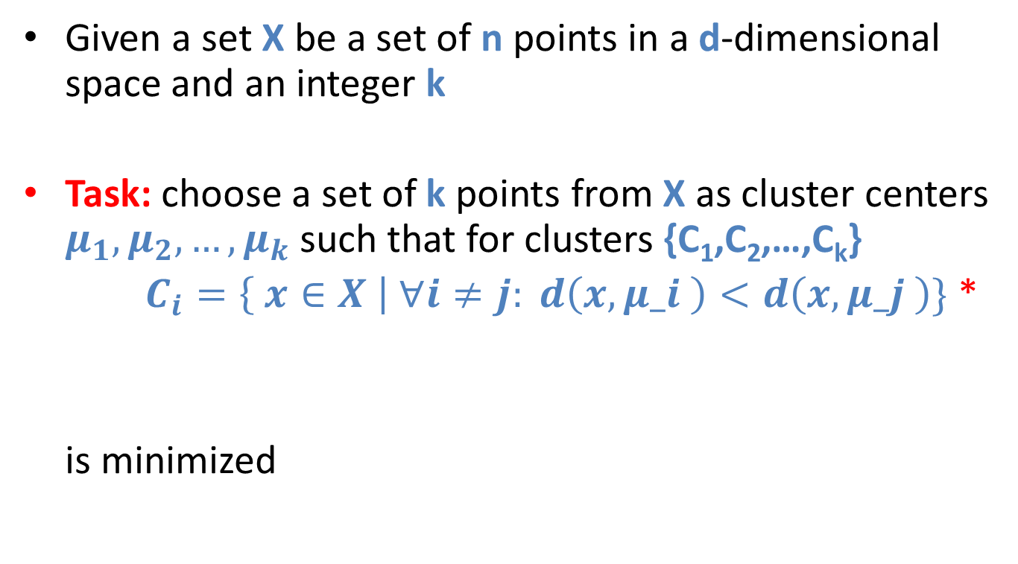
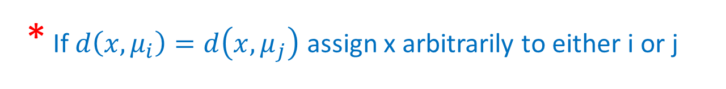
The k-center problem
Given a set X be a set of n points in a d-dimensional space and an integer k
Task: choose a set of k points from X as cluster centers $μ_{1}, μ_{2}, …, μ_{k}$ such that for clusters {C₁,C₂,…,C_{k}}
$C_{i}=\left\{ x∈X \right| ∀i≠j: d\left(x,μ_i \right)<d\left(x,μ_j \right)\}$ *
is minimized
* If $d\left(x,μ_{i}\right)=d\left(x,μ_{j}\right)$ assign x arbitrarily to either i or j

Slide 13
Some properties
NP-hard if the dimensionality of the data is at least 2 (d>=2)
For d=1 the problem is solvable in polynomial time
A simple combinatorial algorithm works well in practice

Slide 14
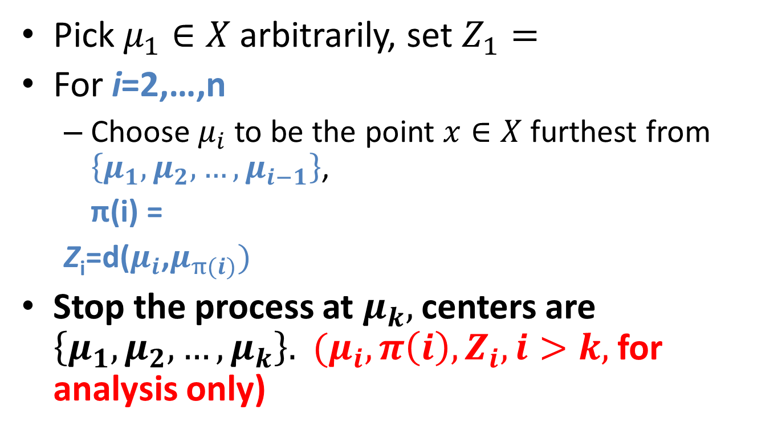
The furthest first k center algorithm
Pick $μ_{1}∈X$arbitrarily, set $Z_{1}=$
For i=2,…,n
  Choose $μ_{i}$to be the point $x∈X$furthest from $\left\{μ_{1},μ_{2},…,μ_{i−1}\right\}$,
  π(i) =
  Z_{i}=d($μ_{i}$,$μ_{π(i)})$
Stop the process at $μ_{k},$centers are $\left\{μ_{1}, μ_{2}, …, μ_{k}\right\}.$ ${(μ}_{i}, {π\left(i\right), Z}_{i}, i>k,$for analysis only)

Slide 15
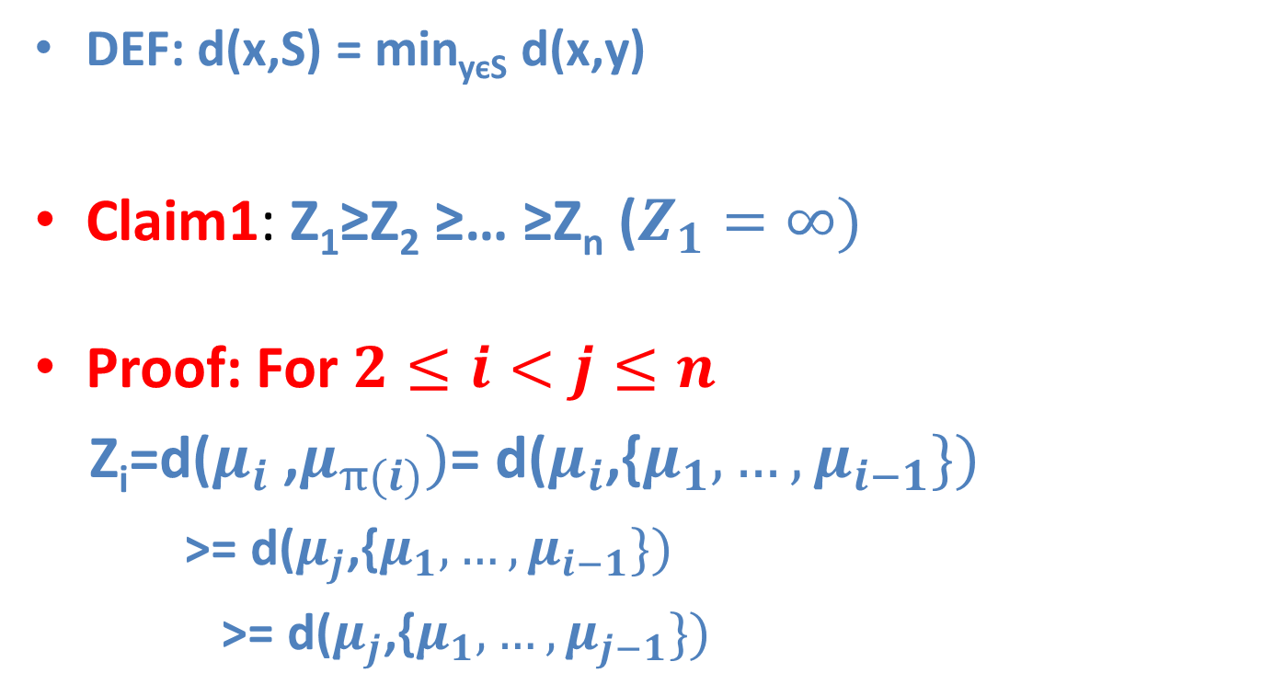
Furthest first gives a 2-approximation to the max radius
  DEF: d(x,S) = min_{yєS} d(x,y)
Claim1: Z₁≥Z₂ ≥… ≥Z_{n} ($Z_{1}=∞)$
Proof: For $2≤i<j≤n$
Z_{i}=d($μ_{i}$ ,$μ_{π(i)})$= d($μ_{i}$,{$μ_{1}, …, μ_{i−1}\})$
  >= d($μ_{j}$,{$μ_{1}, …, μ_{i−1}\})$
  >= d($μ_{j}$,{$μ_{1}, …, μ_{j−1}\})$

Slide 16
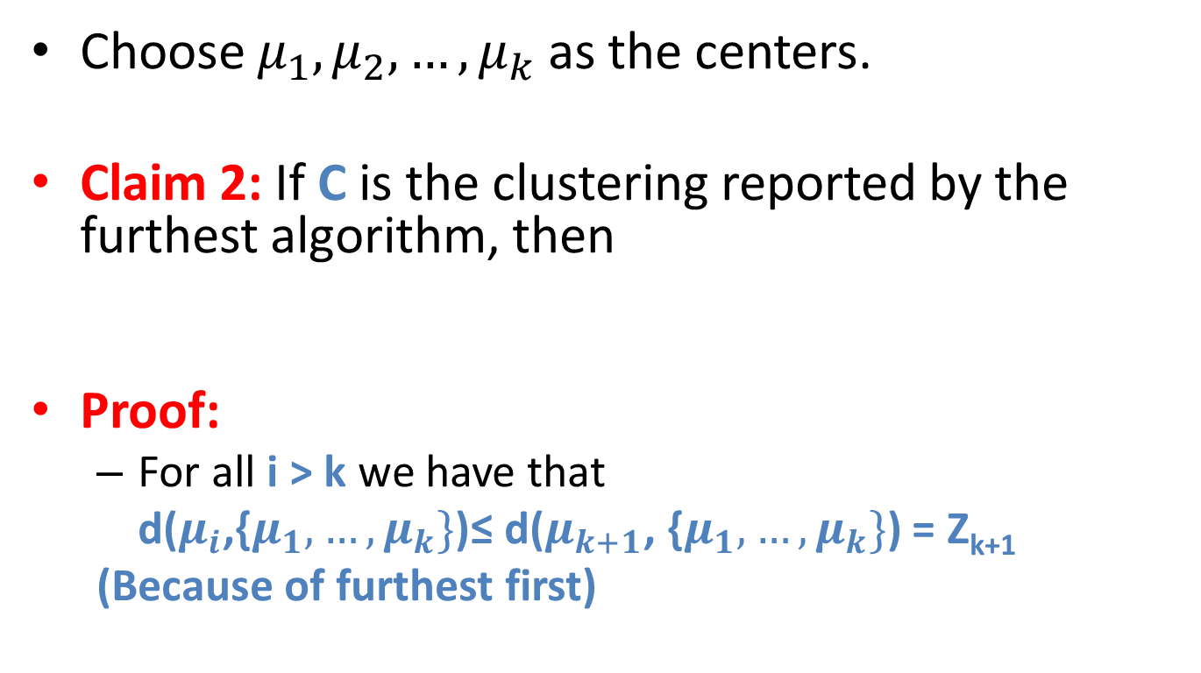
Furthest first gives a 2-approximation to the max radius
Choose $μ_{1},μ_{2},…, μ_{k}$as the centers.
Claim 2: If C is the clustering reported by the furthest algorithm, then
Proof:
  For all i > k we have that
  d($μ_{i}$,{$μ_{1}, …, μ_{k}\}$)≤ d($μ_{k+1}$, {$μ_{1}, …, μ_{k}\}$) = Z_{k+1}
  (Because of furthest first)

Slide 17
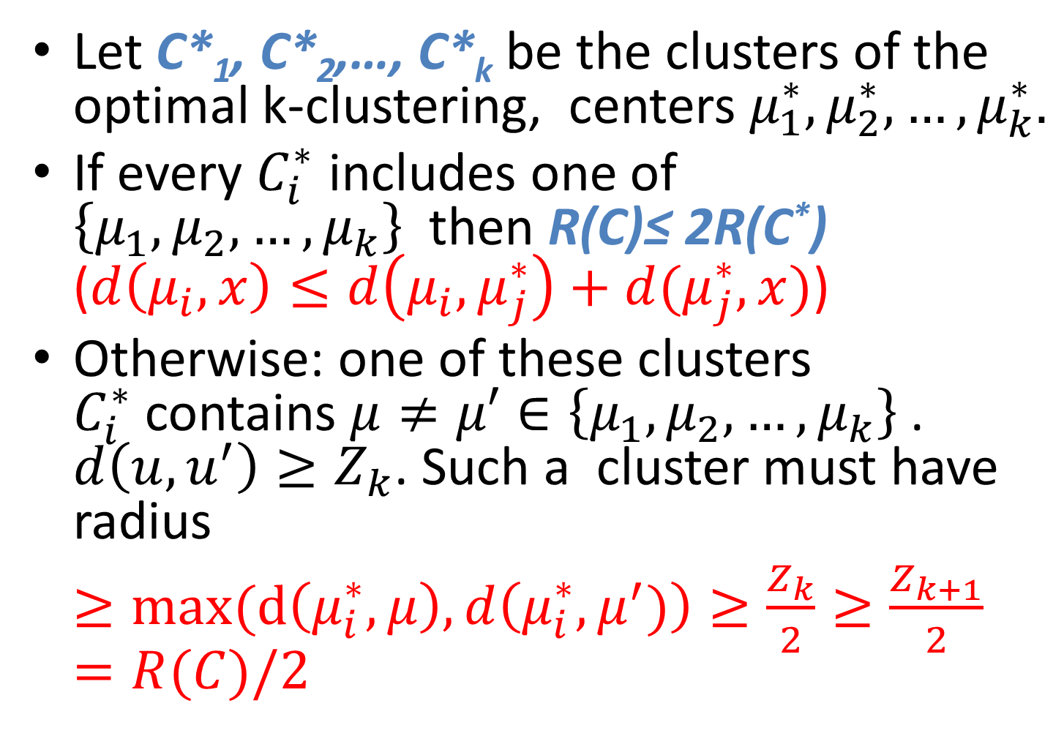
Proof
Let C*₁, C*₂,…, C*_{k} be the clusters of the optimal k-clustering, centers $μ_{1}^{∗}, μ_{2}^{∗}, …, μ_{k}^{∗}.$
If every $C_{i}^{∗}$ includes one of $\left\{μ_{1},μ_{2},…, μ_{k}\right\}$then R(C)≤ 2R(C*) ($d\left(μ_{i},x\right)≤d\left(μ_{i}, μ_{j}^{∗}\right)+d(μ_{j}^{∗},x)$)
Otherwise: one of these clusters $C_{i}^{∗}$contains $μ≠μ′∈\left\{μ_{1},μ_{2},…, μ_{k}\right\}$. $d\left(u,u^{′}\right)≥Z_{k}$. Such a cluster must have radius
$≥max(d\left(μ_{i}^{∗},μ\right), d\left(μ_{i}^{∗},μ^{′})\right)≥\frac{Z_{k}}{2}≥\frac{Z_{k+1}}{2}=R(C)/2$

Slide 18
Next: A k center Streaming Algorithm
The furthest algorithm needed to go through the points of X multiple times (compute the furthest point repeatedly)
We now give a streaming algorithm for k center that does only one pass through the data
Needs only O(k) memory

Slide 19
If you knew the optimal radius (OPT)
Process points sequentially
Maintain set of centers S (Initially S = {first point})
Consider next point x
  If x is within distance 2OPT of some center in S, add to corresponding cluster
   Else, add x as new center in S
One pass through data, O(k) memory

Slide 20
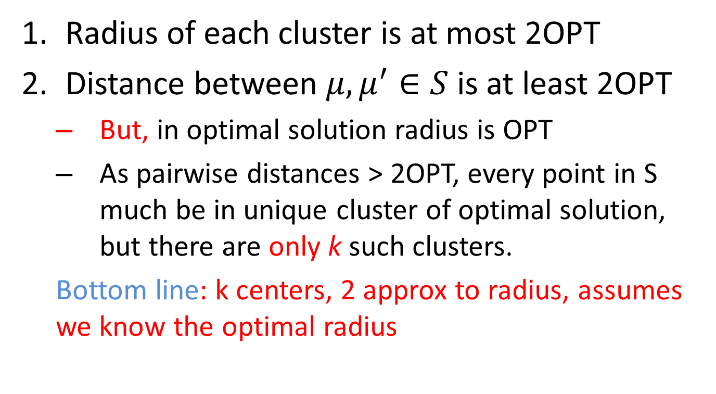
Analysis
Radius of each cluster is at most 2OPT
Distance between $μ, μ^{′}∈S$ is at least 2OPT
  But, in optimal solution radius is OPT
  As pairwise distances > 2OPT, every point in S much be in unique cluster of optimal solution, but there are only k such clusters.
  Bottom line: k centers, 2 approx to radius, assumes we know the optimal radius

Slide 21
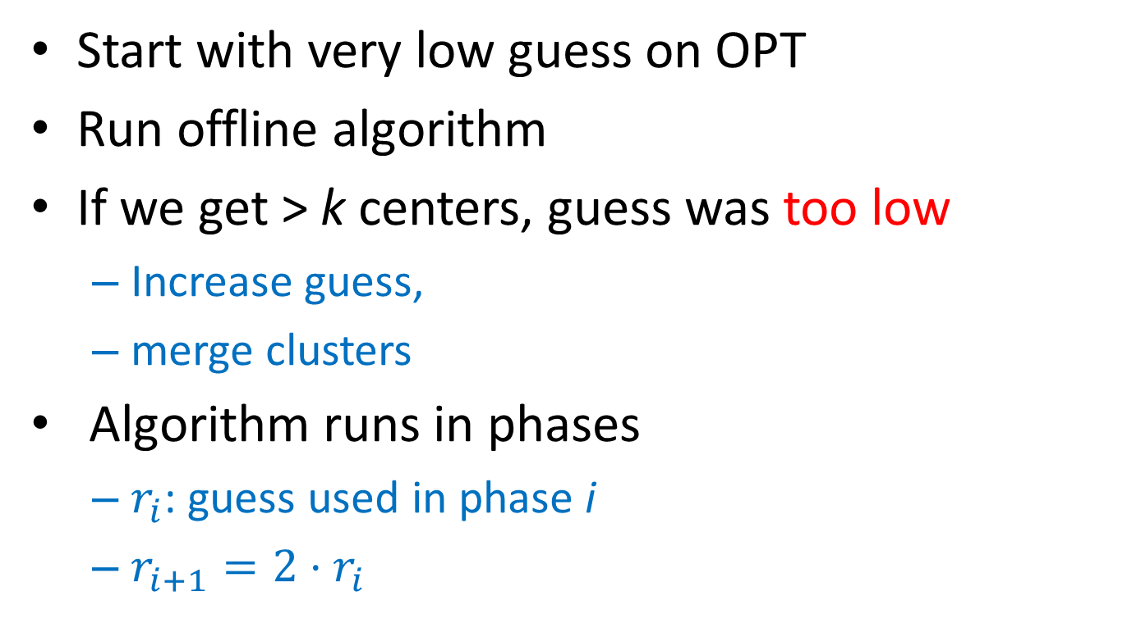
Overview: k center streaming
Start with very low guess on OPT
Run offline algorithm
If we get > k centers, guess was too low
  Increase guess,
  merge clusters
Algorithm runs in phases
  $r_{i}$: guess used in phase i
  $r_{i+1}=2⋅r_{i}$

Slide 22
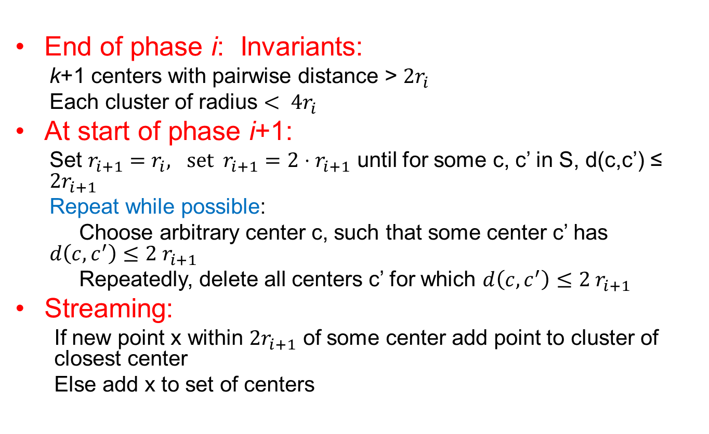
Phases of k center streaming
End of phase i: Invariants:
  k+1 centers with pairwise distance > $2r_{i}$
  Each cluster of radius $< 4r_{i}$
At start of phase i+1:
  Set $r_{i+1}=r_{i}, \text{set} r_{i+1}=2⋅r_{i+1}$ until for some c, c’ in S, d(c,c’) ≤ $2r_{i+1}$
  Repeat while possible:
  Choose arbitrary center c, such that some center c’ has $d\left(c,c^{′}\right)≤2 r_{i+1}$
  Repeatedly, delete all centers c’ for which $d\left(c,c^{′}\right)≤2 r_{i+1}$
Streaming:
  If new point x within $2r_{i+1}$ of some center add point to cluster of closest center
  Else add x to set of centers

Slide 23
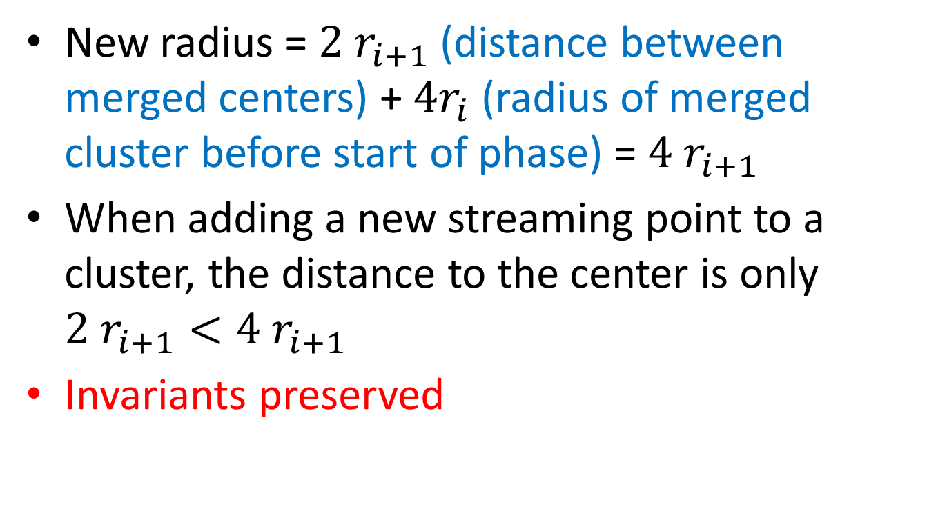
Analysis: Invariants
New radius = $2 r_{i+1}$(distance between merged centers) + $4r_{i}$ (radius of merged cluster before start of phase) = $4 r_{i+1}$
When adding a new streaming point to a cluster, the distance to the center is only $2 r_{i+1}<4 r_{i+1}$
Invariants preserved

Slide 24
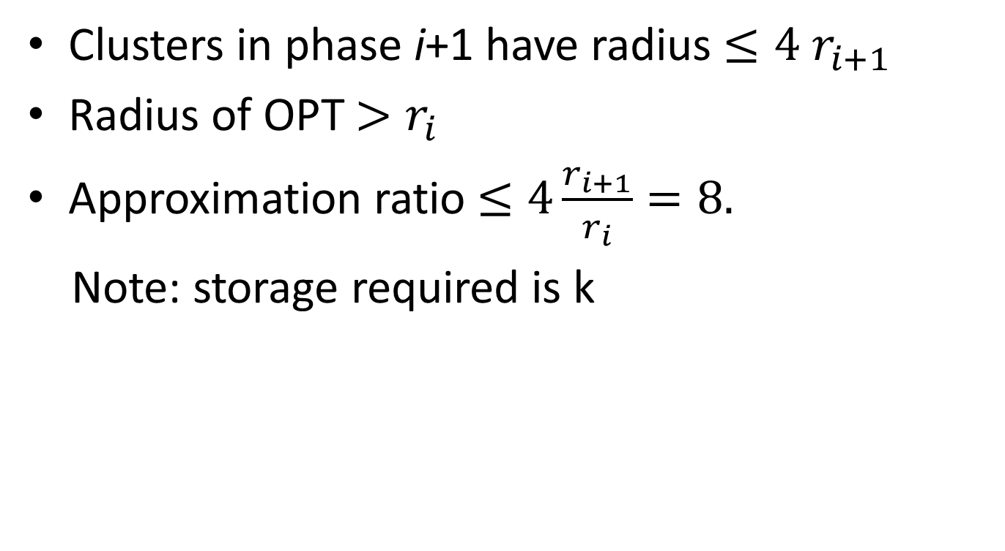
Analysis: Approximations
Clusters in phase i+1 have radius $≤4 r_{i+1}$
Radius of OPT $>r_{i}$
Approximation ratio $≤4\frac{r_{i+1}}{r_{i}}=8.$
Note: storage required is k

Slide 25
Generational model
What type of clustering depends on how (we think) the data was generated
Generational models:
  Some “centers” are chosen
  Points are chosen about the center(s)
  The points are chosen from some distributions
    Gaussian about the centers – max likelyhood k means
    Exponential – max likelyhood k median L₁ norm
    Etc.

Slide 26
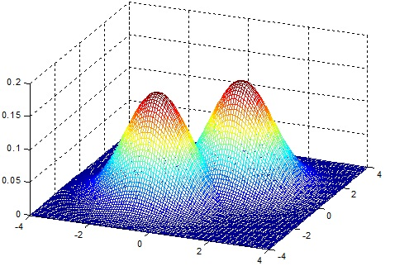

Mixture of Gaussians
Variance = 1
$$μ\left(x\right)−\text{closest} \text{center} \text{to} x$$

Slide 27
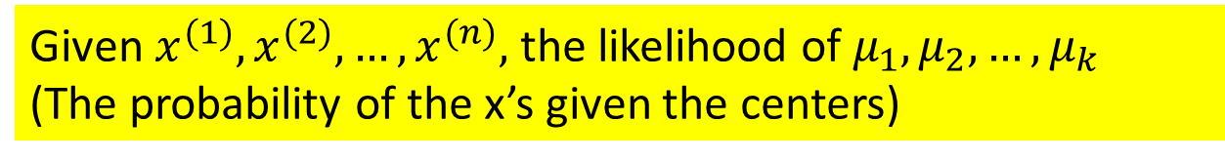

If mixture of Gaussians
Max likelihood: Find centers $μ_{1},μ_{2},…, μ_{k}$that minimize sum of squares = $\sum{d{\left(x,μ\left(x\right)\right)}^{2}}$
Given $x^{(1)}, x^{(2)}, …, x^{(n)},$the likelihood of $μ_{1},μ_{2},…, μ_{k}$
(The probability of the x’s given the centers)

Slide 28
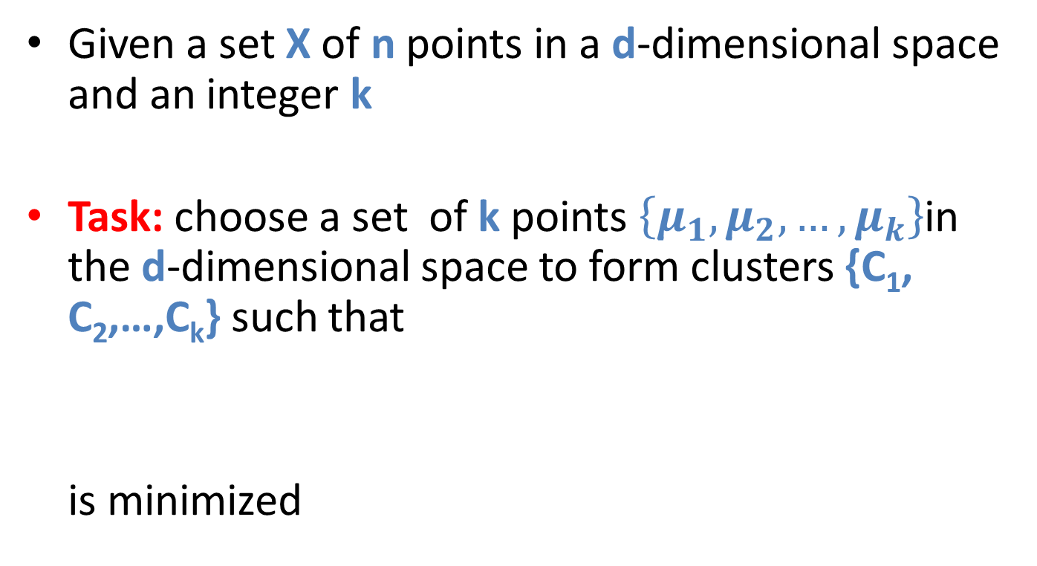
The k-means problem
Given a set X of n points in a d-dimensional space and an integer k
Task: choose a set of k points $\left\{μ_{1}, μ_{2}, …, μ_{k}\right\}$in the d-dimensional space to form clusters {C₁, C₂,…,C_{k}} such that
is minimized

Slide 29
Algorithmic properties of the k-means problem
NP-hard if the dimensionality of the data is at least 2 (d>=2)
For d=1 the problem is solvable in polynomial time
A simple iterative algorithm works quite well in practice

Slide 30
EM Algorithm
Initialize k distribution parameters (θ₁,…, θ_{k}); Each distribution parameter corresponds to a cluster center
Iterate between two steps
  Expectation step: (probabilistically) assign points to clusters
  Maximation step: estimate model parameters that maximize the likelihood for the given assignment of points

Slide 31
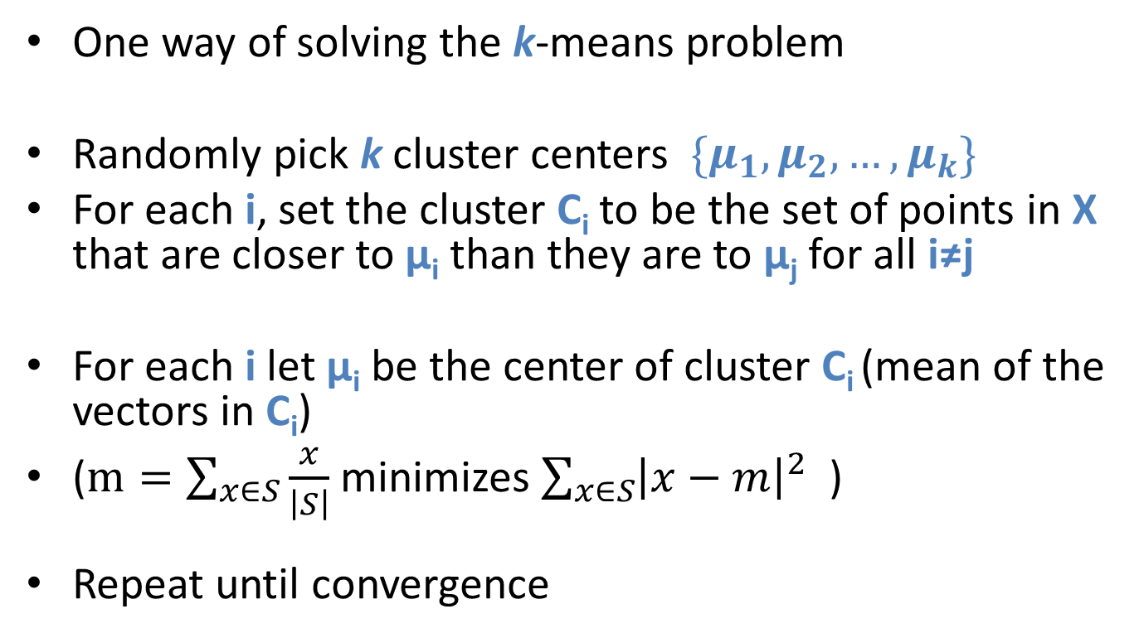
The EM k-means algorithm
One way of solving the k-means problem
Randomly pick k cluster centers $\{μ_{1}, μ_{2}, …, μ_{k}\}$
For each i, set the cluster C_{i} to be the set of points in X that are closer to μ_{i} than they are to μ_{j} for all i≠j
For each i let μ_{i} be the center of cluster C_{i} (mean of the vectors in C_{i})
($m=\sum_{x∈S}{\frac{x}{\left|S\right|}}$ minimizes $\sum_{x∈S}{{\left|x−m\right|}^{2} }$)
Repeat until convergence

Slide 32
Main Techniques (1)
Partitioning Clustering (K-Means) step.1
initial center
initial center
initial center
Notes:
Given the number of clusters, chose the initial centers randomly

Slide 33
K-Means Example
Step.2
new center after 1st iteration
x
x
new center after 1st iteration
x
new center after 1st iteration
Notes:
Assign every data instance to the closest cluster based on the distance between the data and the center of the cluster and compute the new centers of the k clusters

Slide 34
K-Means Example
Step.3
new center after 2nd iteration
new center after 2nd iteration
new center after 2nd iteration

Slide 35
Properties of the EM k-means algorithm
Finds a local optimum
Converges often quickly (but not always)
The choice of initial points can have large influence in the result
Not a streaming algorithm

Slide 36
Two different K-means Clusterings
Original Points
Optimal Clustering
Sub-optimal Clustering

Slide 37

Exponential probability distribution to generate points
L$et μ=\left(μ\left[1\right], μ\left[2\right], …, μ\left[d\right]\right)$ be the closest center to $x=(x\left[1\right],x\left[2\right], …, x\left[d\right])$

Slide 38
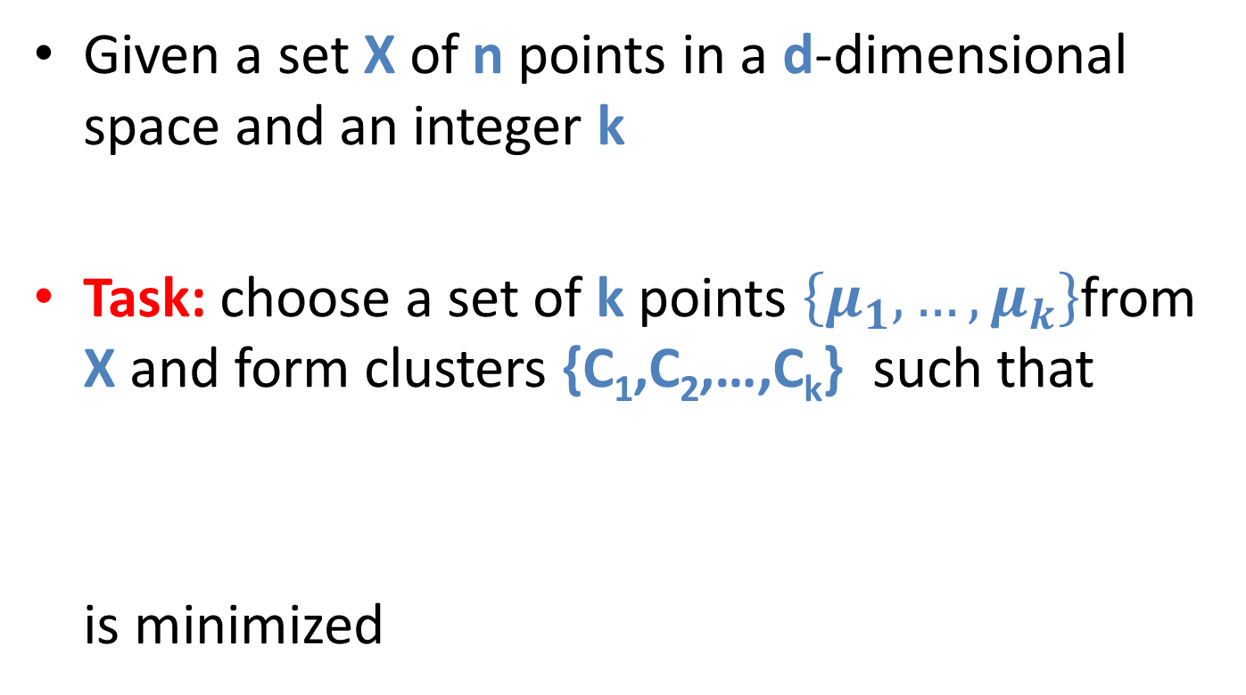
The k-median problem
Given a set X of n points in a d-dimensional space and an integer k
Task: choose a set of k points $\left\{μ_{1}, …, μ_{k}\right\}$from X and form clusters {C₁,C₂,…,C_{k}} such that
is minimized
The sum of L₁ distances is the right thing if the
generation process is an exponential dist

Slide 39
The k-medoids algorithm
Or … PAM (Partitioning Around Medoids, 1987)
  Choose randomly k medoids from the original dataset X
  Assign each of the n-k remaining points in X to their closest medoid
  iteratively replace one of the medoids by one of the non-medoids if it improves the total clustering cost

Slide 40
Discussion of PAM algorithm
The algorithm is very similar to the k-means algorithm
It has the same advantages and disadvantages
Not a streaming algorithm

Slide 41
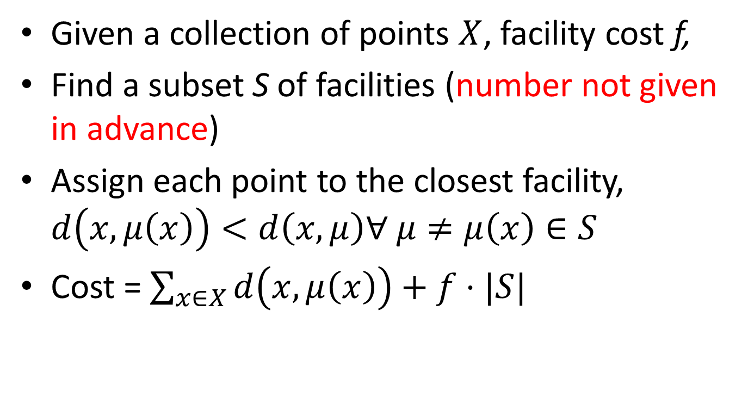
Facility location problem
Given a collection of points $X$, facility cost f,
Find a subset S of facilities (number not given in advance)
Assign each point to the closest facility, $d\left(x,μ\left(x\right)\right)<d\left(x,μ\right)∀ μ≠μ\left(x\right)∈S$
Cost = $\sum_{x∈X}{d\left(x,μ\left(x\right)\right)+f⋅|S|}$

Slide 42
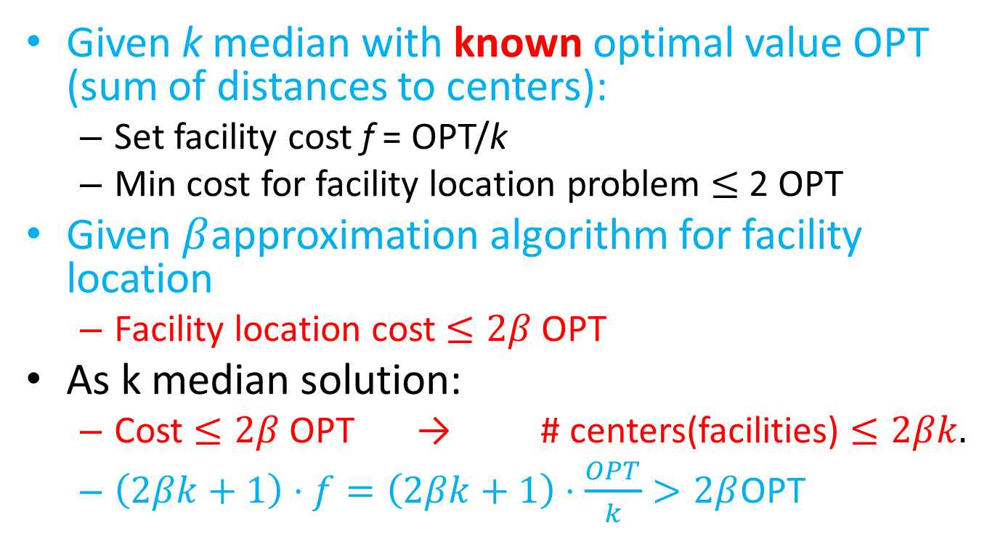
Facility Location and k median
Given k median with known optimal value OPT (sum of distances to centers):
  Set facility cost f = OPT/k
  Min cost for facility location problem $≤$2 OPT
Given $β$approximation algorithm for facility location
  Facility location cost $≤2β$ OPT
As k median solution:
  Cost $≤2β$ OPT → # centers(facilities) $≤2βk.$
  $\left(2βk+1\right)⋅f=\left(2βk+1\right)⋅\frac{OPT}{k}>2β$OPT

Slide 43
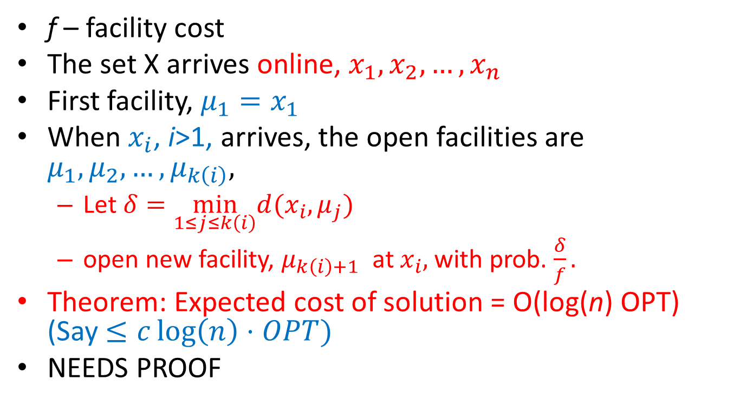
Myerson Online facility location
f – facility cost
The set X arrives online, $x_{1},x_{2},…, x_{n}$
First facility, ${μ_{1}=x}_{1}$
When $x_{i}$, i>1, arrives, the open facilities are $μ_{1},μ_{2},…, μ_{k\left(i\right)},$
  Let $δ=\min_{1≤j≤k\left(i\right)}d(x_{i},μ_{j})$
  open new facility, $μ_{k\left(i\right)+1}$ at $x_{i},$ with prob. $\frac{δ}{f}.$
Theorem: Expected cost of solution = O(log(n) OPT) (Say $≤c\log\left(n\right)⋅OPT)$
NEEDS PROOF

Slide 44
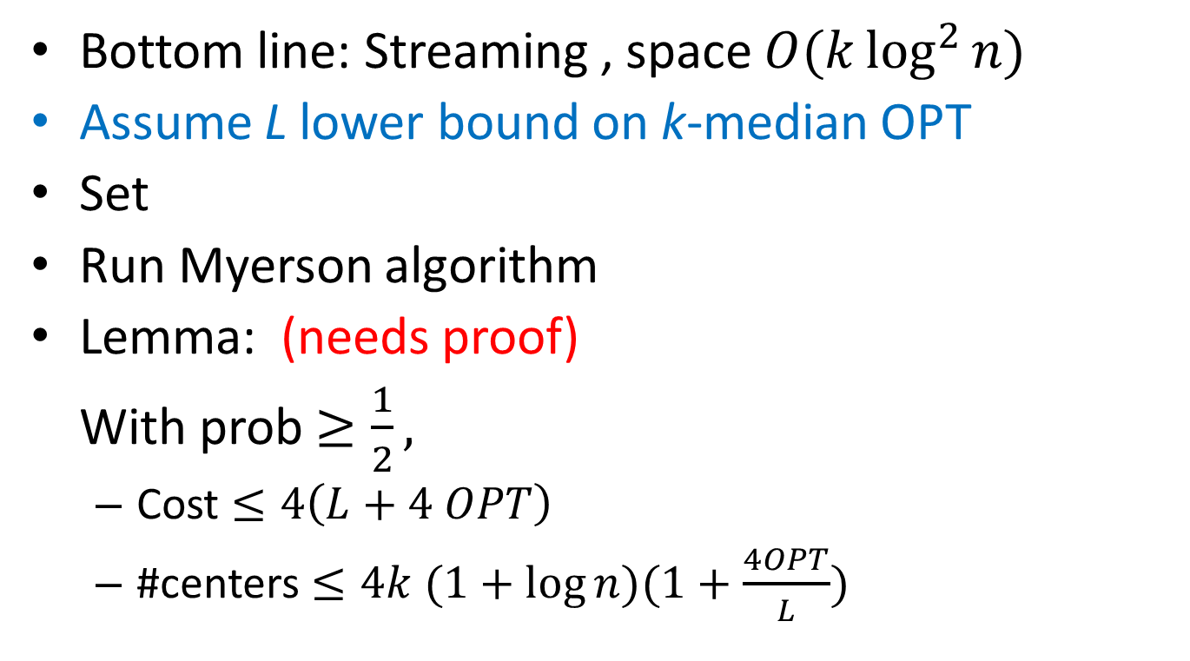
Charikar, O´Callaghan, Panigrahy
Bottom line: Streaming , space $O(k\log^{2}{n)}$
Assume L lower bound on k-median OPT
Set
Run Myerson algorithm
Lemma: (needs proof)
With prob $≥\frac{1}{2},$
  Cost $≤4\left(L+4 OPT\right)$
  #centers $≤4k (1+\log{n)(1+\frac{4OPT}{L})}$

Slide 45
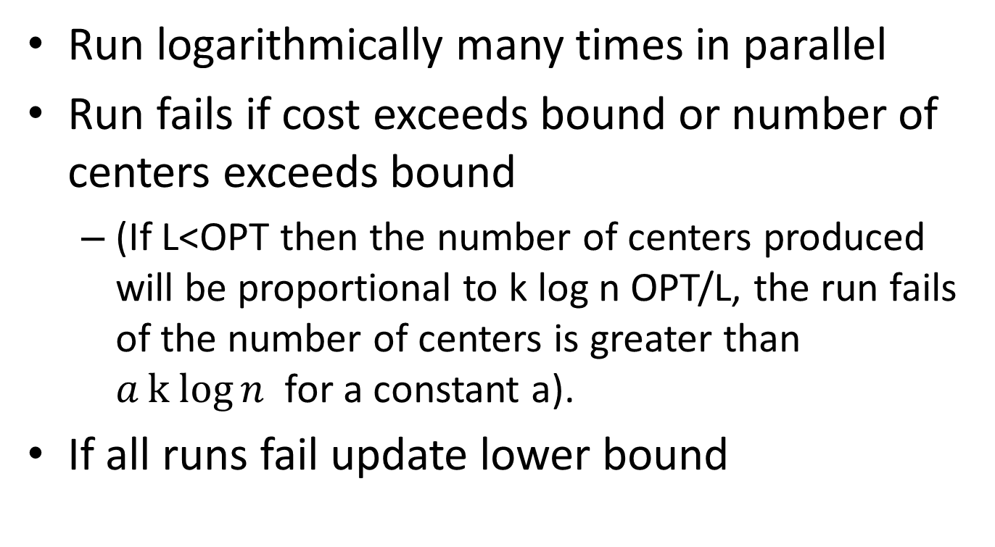
Updating the lower bound
Run logarithmically many times in parallel
Run fails if cost exceeds bound or number of centers exceeds bound
  (If L<OPT then the number of centers produced will be proportional to k log n OPT/L, the run fails of the number of centers is greater than $ak log{n }$for a constant a).
If all runs fail update lower bound

Slide 46
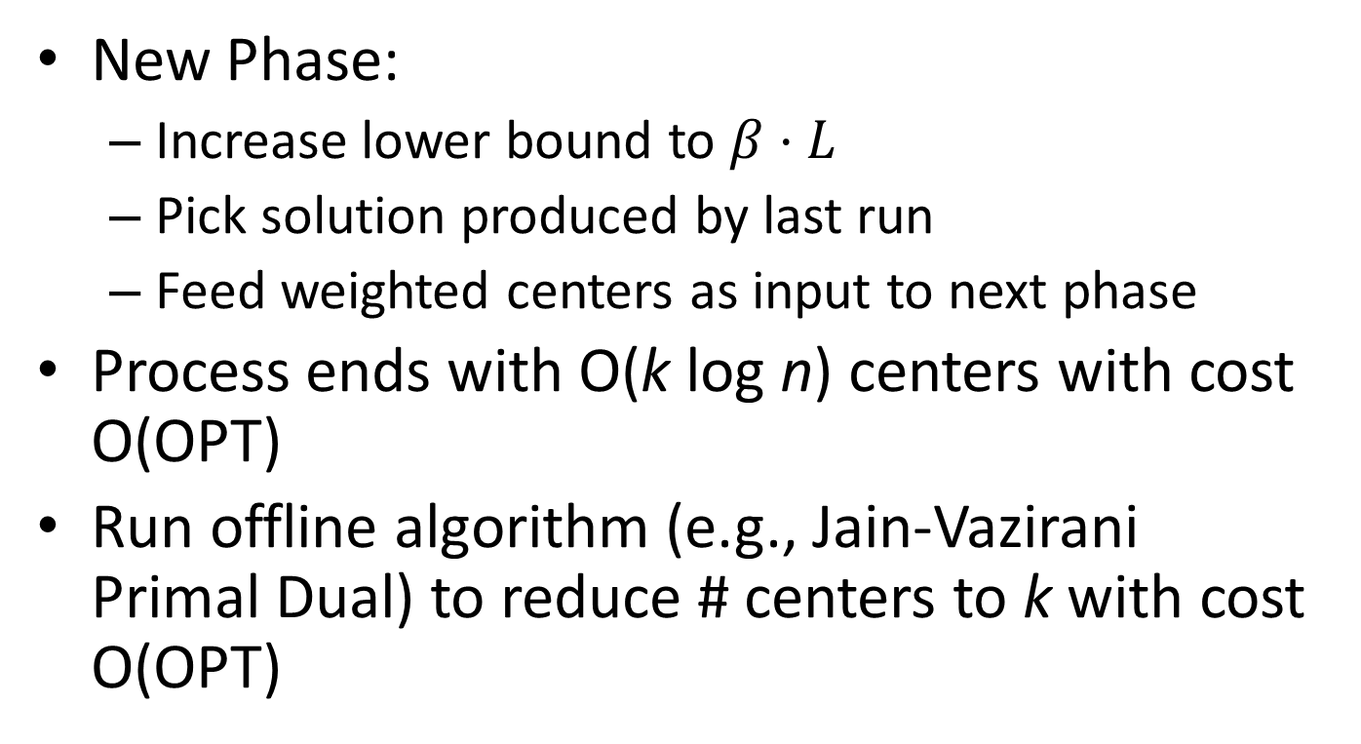
Repeated phases
New Phase:
  Increase lower bound to $β⋅L$
  Pick solution produced by last run
  Feed weighted centers as input to next phase
Process ends with O(k log n) centers with cost O(OPT)
Run offline algorithm (e.g., Jain-Vazirani Primal Dual) to reduce # centers to k with cost O(OPT)

