Slide 1
Leveraging Big Data: Lecture 2
http://www.cohenwang.com/edith/bigdataclass2013
Instructors:
Edith Cohen
Amos Fiat
Haim Kaplan
Tova Milo

Slide 2
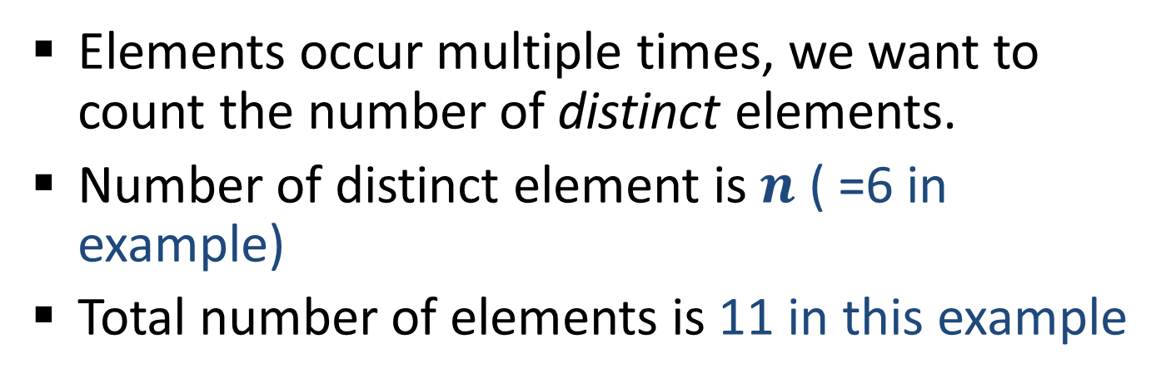
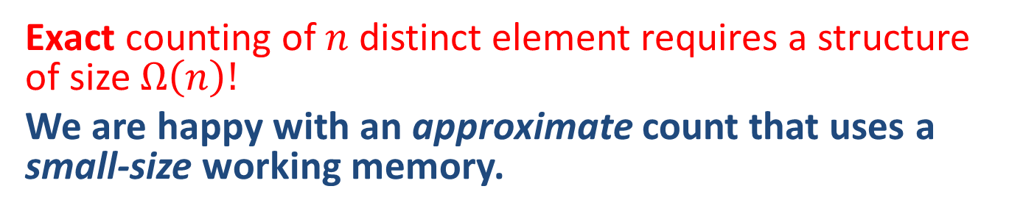
Counting Distinct Elements
32,
12,
14,
32,
7,
12,
32,
7,
6,
12,
4,
Elements occur multiple times, we want to count the number of distinct elements.
Number of distinct element is $n$ ( =6 in example)
Total number of elements is 11 in this example
Exact counting of $n$distinct element requires a structure of size $Ω\left(n\right)!$
We are happy with an approximate count that uses a small-size working memory.
Notes:
Important problem: counting source IPs at Web servers, IP flows at routers, Distinct search queries by search engines

Slide 3
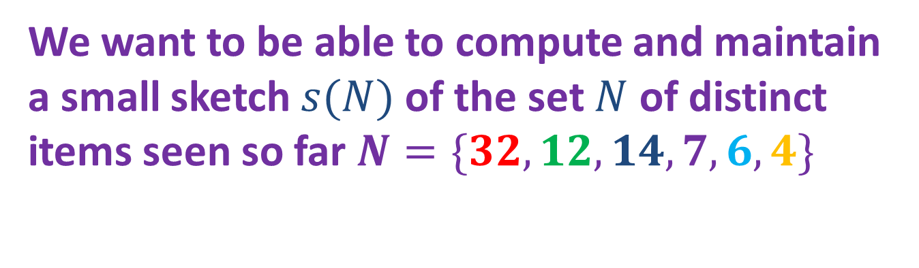
Distinct Elements: Approximate Counting
32,
12,
14,
32,
7,
12,
32,
7,
6,
12,
4,
We want to be able to compute and maintain a small sketch $s(N)$ of the set $N$ of distinct items seen so far $N=\{32,12,14,7,6,4\}$
Notes:
Important problem: counting source IPs at Web servers, IP flows at routers, Distinct search queries by search engines

Slide 4
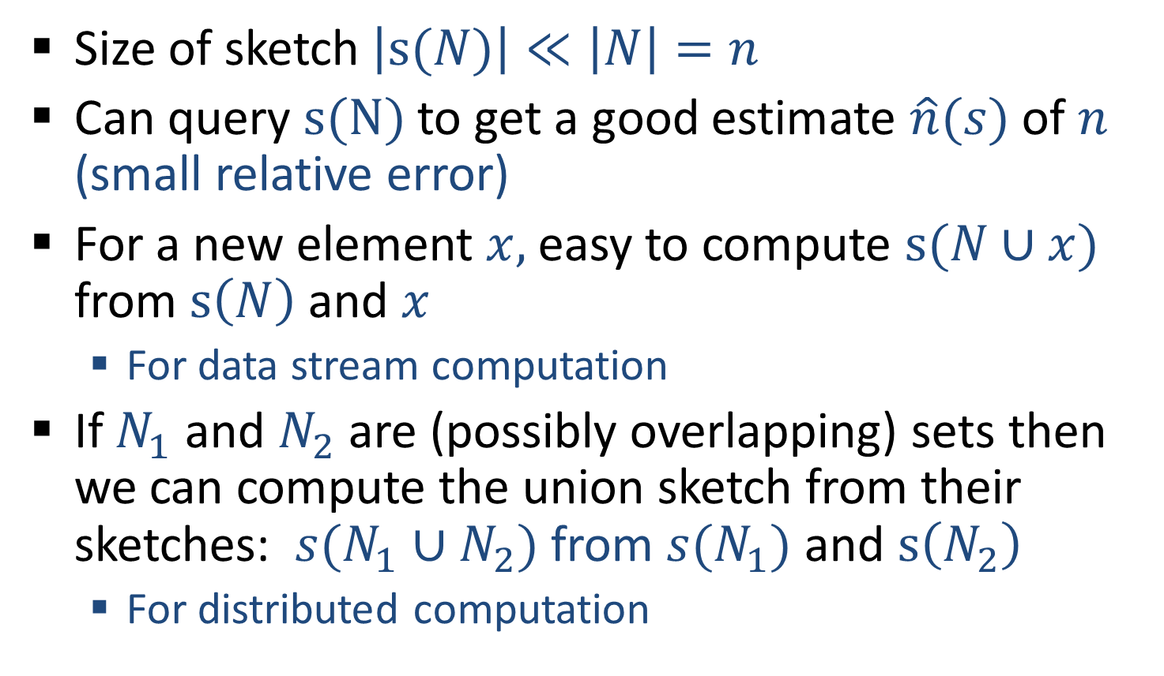
Distinct Elements: Approximate Counting
Size of sketch $\left|s(N)\right|≪\left|N\right|=n$
Can query $s(N)$ to get a good estimate $\hat{n}(s)$ of $n$ (small relative error)
For a new element $x,$easy to compute $s(N∪x)$ from $s\left(N\right)$ and $x$
  For data stream computation
If $N_{1}$ and $N_{2}$ are (possibly overlapping) sets then we can compute the union sketch from their sketches: $s(N_{1}∪N_{2})$ from ${s(N}_{1})$ and $s\left(N_{2}\right)$
  For distributed computation
Notes:
Important problem: counting source IPs at Web servers, IP flows at routers, Distinct search queries by search engines

Slide 5
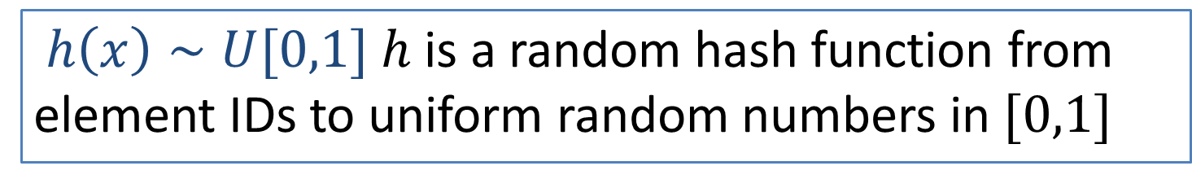
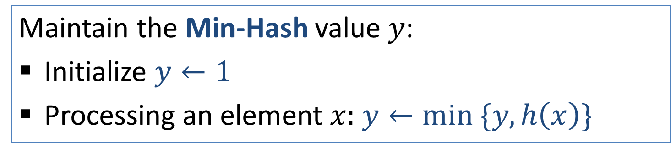
Distinct Elements: Approximate Counting
32,
12,
14,
32,
7,
12,
32,
7,
6,
12,
4,
Size-estimation/Minimum value technique:
[Flajolet-Martin 85, C 94]
$h\left(x\right)∼U[0,1]$ $h$ is a random hash function from element IDs to uniform random numbers in $[0,1]$
Maintain the Min-Hash value $y$:
Initialize $y←1$
Processing an element $x:$ $y←min \{y,h\left(x\right)\}$

Slide 6





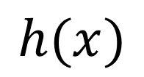












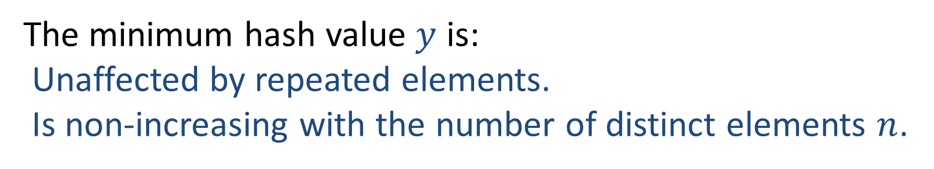





















Distinct Elements: Approximate Counting
$$x$$
32,
12,
14,
32,
7,
12,
32,
7,
6,
12,
4,
$$n$$
$$0$$
$$1$$
$$2$$
$$3$$
$$3$$
$$4$$
$$4$$
$$4$$
$$4$$
$$5$$
$$5$$
$$6$$
$$h(x)$$
$$0.45$$
$$0.35$$
$$0.74$$
$$0.45$$
$$0.21$$
$$0.35$$
$$0.45$$
$$0.21$$
$$0.14$$
$$0.35$$
$$0.92$$
$$y$$
$$1$$
$$0.45$$
$$0.14$$
$$0.14$$
$$0.35$$
$$0.35$$
$$0.35$$
$$0.21$$
$$0.21$$
$$0.21$$
$$0.21$$
$$0.14$$
The minimum hash value $y$ is:
Unaffected by repeated elements.
Is non-increasing with the number of distinct elements $n$.

Slide 7
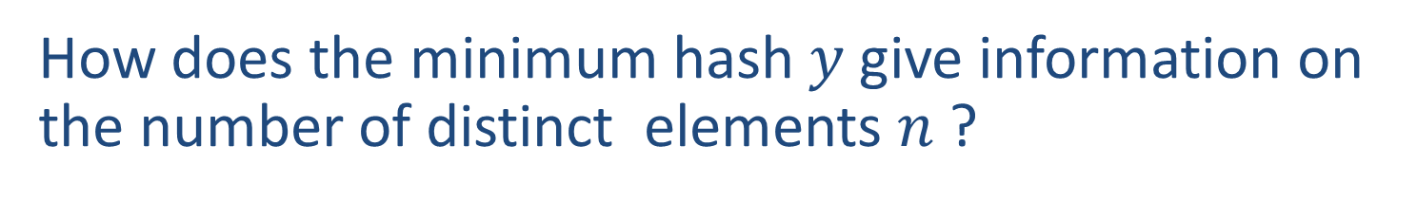




Distinct Elements: Approximate Counting
How does the minimum hash $y$ give information on the number of distinct elements $n$ ?
$$0$$
$$1$$
minimum
The expectation of the minimum is $E\left[min h\left(x\right)\right]=\frac{1}{n+1}$
A single value gives only limited information.
To boost information, we maintain $k≥1$ values
Notes:
Why expectation is 1/n+1 ? Close to a circle. Throw a random point for to cut into a line. Throw another n points. Expected gap between any two points is 1/(n+1).
Even before proposing and analyzing estimators, we can guess that this one minimum value carries limited information. So we can get very limited accuracy on the size estimate. We can boost this information by keeping k such registers.

Slide 8
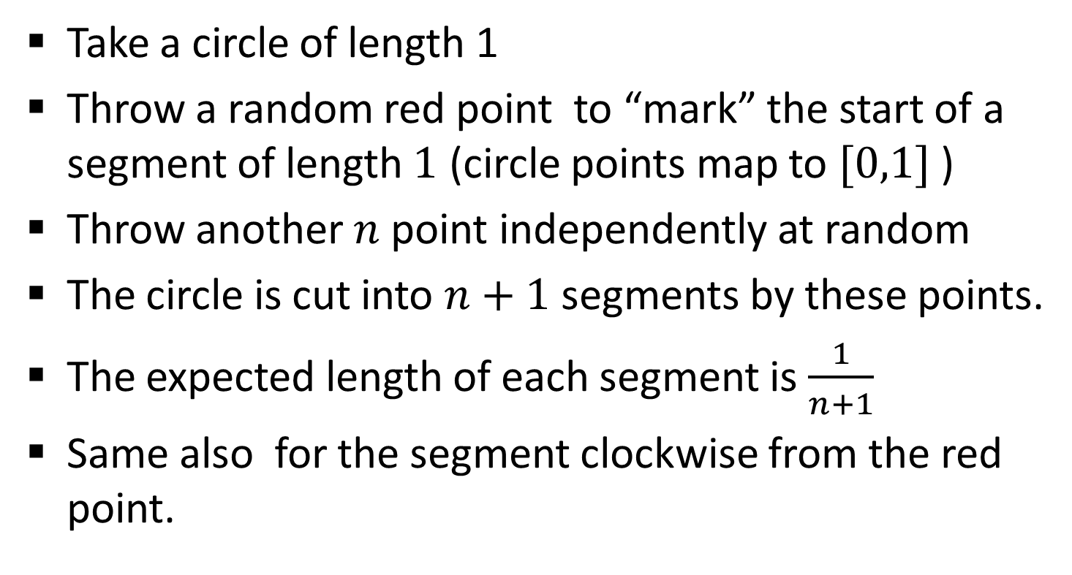

Why expectation is $\frac{1}{n+1}$?
Take a circle of length 1
Throw a random red point to “mark” the start of a segment of length $1$ (circle points map to $[0,1]$ )
Throw another $n$ point independently at random
The circle is cut into $n+1$ segments by these points.
The expected length of each segment is $\frac{1}{n+1}$
Same also for the segment clockwise from the red point.

Slide 9


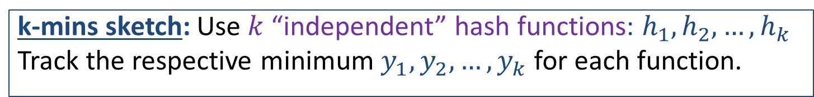

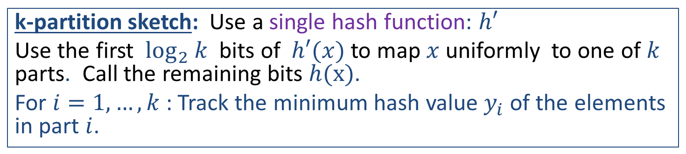
Min-Hash Sketches
These sketches maintain $k$ values $y_{1},y_{2},…,y_{k}$ from the range of the hash function (distribution).
k-mins sketch: Use $k$ “independent” hash functions: $h_{1},h_{2},…,h_{k}$
Track the respective minimum $y_{1},y_{2},…,y_{k}$ for each function.
Bottom-k sketch: Use a single hash function: $h$
Track the $k$ smallest values $y_{1},y_{2},…,y_{k}$
k-partition sketch: Use a single hash function: $h′$
Use the first $\log_{2} k$ bits of $h′(x)$ to map $x$uniformly to one of $k$ parts. Call the remaining bits $h(x)$.
For $i=1,…,k$: Track the minimum hash value $y_{i}$ of the elements in part $i$.
All sketches are the same for $k=1$

Slide 10
Min-Hash Sketches
k-mins, bottom-k, k-partition
Why study all 3 variants ? Different tradeoffs between update cost, accuracy, usage…
Beyond distinct counting:
Min-Hash sketches correspond to sampling schemes of large data sets
  Similarity queries between datasets
  Selectivity/subset queries
These patterns generally apply as methods to gather increased confidence from a random “projection”/sample.
Notes:
Further applications: in data summarization, we have control over the scheme we apply. Good to keep these options in mind.
Say that for some applications we need to maintain meta information on the k elements contributing to the Min-hash sketch.
These k elements can be viewed as a sample of the set. K-mins are independent samples with replacement. Bottom-k is order sampling (without replacement sampling). k-partition is to partition and sample.

Slide 11

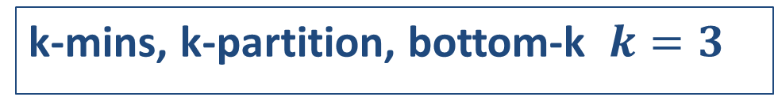
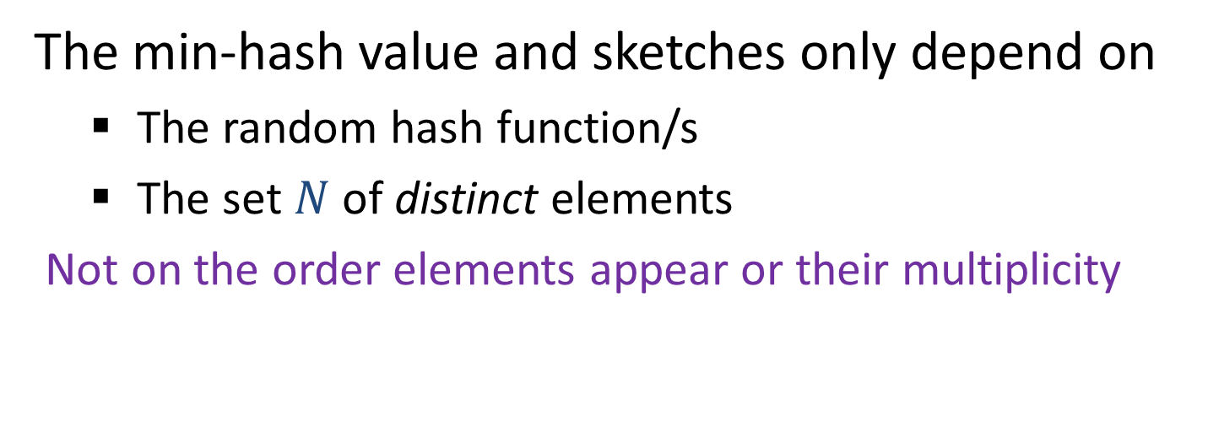



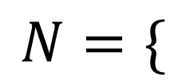


Min-Hash Sketches: Examples
k-mins, k-partition, bottom-k $k=3$
$$N=\{$$
32
$$,$$
12
$$,$$
14
$$,$$
7
$$,$$
6
$$,$$
4
$$\}$$
The min-hash value and sketches only depend on
  The random hash function/s
  The set $N$ of distinct elements
Not on the order elements appear or their multiplicity
Notes:
Further applications: in data summarization, we have control over the scheme we apply. Good to keep these options in mind.
Say that for some applications we need to maintain meta information on the k elements contributing to the Min-hash sketch.
These k elements can be viewed as a sample of the set. K-mins are independent samples with replacement. Bottom-k is order sampling (without replacement sampling). k-partition is to partition and sample.

Slide 12


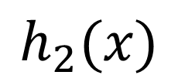
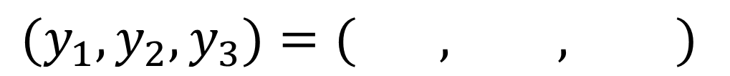
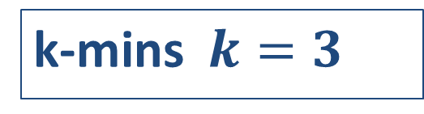




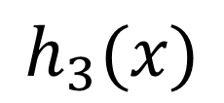




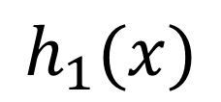












Min-Hash Sketches: Example
k-mins $k=3$
$$x$$
32
12
14
7
6
4
$$h_{1}(x)$$
$$0.45$$
$$0.35$$
$$0.74$$
$$0.21$$
$$0.14$$
$$0.92$$
$$h_{2}(x)$$
$$0.19$$
$$0.51$$
$$0.07$$
$$0.70$$
$$0.55$$
$$0.20$$
$$h_{3}(x)$$
$$0.10$$
$$0.71$$
$$0.93$$
$$0.50$$
$$0.89$$
$$0.18$$
$${(y}_{1},y_{2},y_{3})=( , , )$$
$$0.14$$
$$0.07$$
$$0.10$$
Notes:
Further applications: in data summarization, we have control over the scheme we apply. Good to keep these options in mind.
Say that for some applications we need to maintain meta information on the k elements contributing to the Min-hash sketch.
These k elements can be viewed as a sample of the set. K-mins are independent samples with replacement. Bottom-k is order sampling (without replacement sampling). k-partition is to partition and sample.

Slide 13
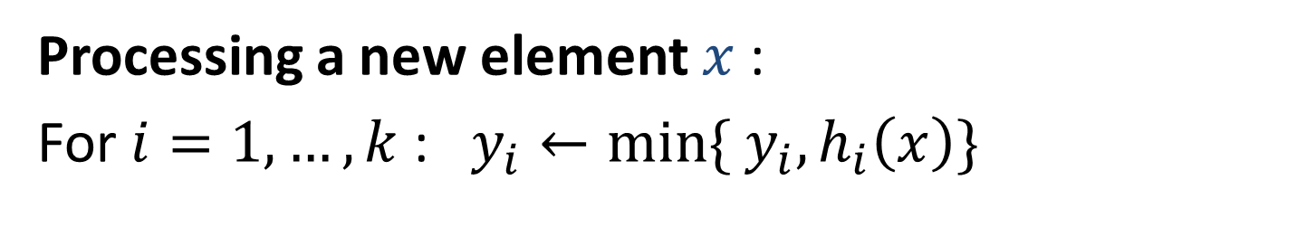

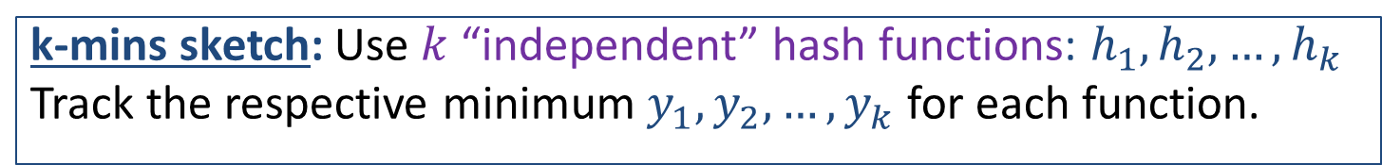



Min-Hash Sketches: k-mins
k-mins sketch: Use $k$ “independent” hash functions: $h_{1},h_{2},…,h_{k}$
Track the respective minimum $y_{1},y_{2},…,y_{k}$ for each function.
Processing a new element $x$:
For $i=1,…,k$ : $y_{i}←min\{ y_{i},h_{i}\left(x\right)\}$
$$h_{1}\left(x\right)=0.35$$
$$h_{2}\left(x\right)=0.51$$
$$h_{3}\left(x\right)=0.71$$
Computation: $O(k)$
Whether sketch is actually updated or not.

Slide 14

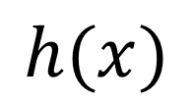
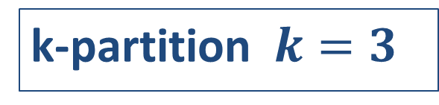




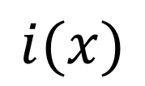




Min-Hash Sketches: Example
k-partition $k=3$
$$x$$
32
12
14
7
6
4
$$i(x)$$
$$2$$
$$3$$
$$1$$
$$1$$
$$2$$
$$3$$
part-hash
$$h(x)$$
$$0.19$$
$$0.51$$
$$0.07$$
$$0.70$$
$$0.55$$
$$0.20$$
value-hash
$${(y}_{1},y_{2},y_{3})=( , , )$$
$$0.07$$
$$0.19$$
$$0.20$$
Notes:
Further applications: in data summarization, we have control over the scheme we apply. Good to keep these options in mind.
Say that for some applications we need to maintain meta information on the k elements contributing to the Min-hash sketch.
These k elements can be viewed as a sample of the set. K-mins are independent samples with replacement. Bottom-k is order sampling (without replacement sampling). k-partition is to partition and sample.

Slide 15
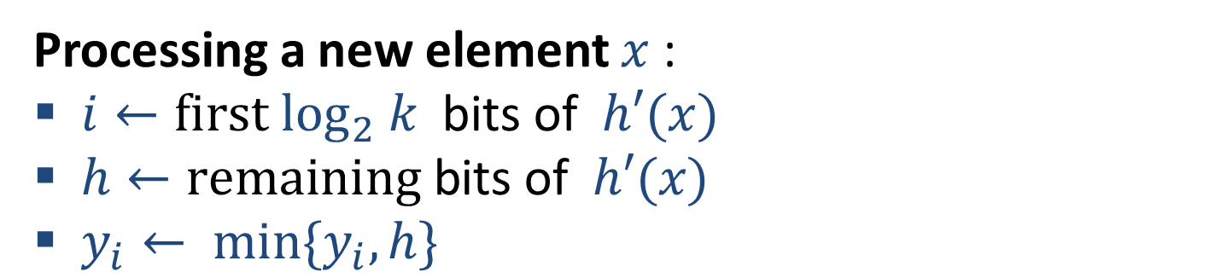


Min-Hash Sketches: k-partition
k-partition sketch: Use a single hash function: $h′$
Use the first $\log_{2} k$ bits of $h′(x)$ to map $x$uniformly to one of $k$ parts. Call the remaining bits $h(x)$.
For $i=1,…,k$: Track the minimum hash value $y_{i}$ of the elements in part $i$.
Processing a new element $x$:
$i←first\log_{2} k \text{bits} \text{of} h′(x)$
$h←remaining \text{bits} \text{of} h′(x)$
$y_{i}← min\{y_{i},h\}$
$$i\left(x\right)=2$$
$$h\left(x\right)=0.19$$
$$y_{2}← min\{y_{2},0.19\}$$
Computation: $O(1)$ to test or update

Slide 16




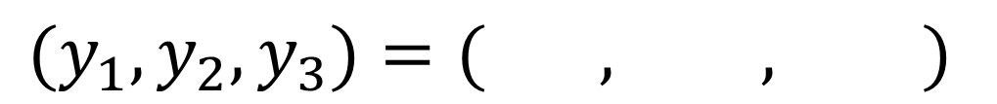

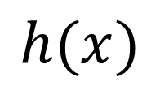





Min-Hash Sketches: Example
Bottom-k $k=3$
$$x$$
32
12
14
7
6
4
$$h(x)$$
$$0.19$$
$$0.51$$
$$0.07$$
$$0.70$$
$$0.55$$
$$0.20$$
$${(y}_{1},y_{2},y_{3})=( , , )$$
$$0.07$$
$$0.19$$
$$0.20$$
Notes:
Further applications: in data summarization, we have control over the scheme we apply. Good to keep these options in mind.
Say that for some applications we need to maintain meta information on the k elements contributing to the Min-hash sketch.
These k elements can be viewed as a sample of the set. K-mins are independent samples with replacement. Bottom-k is order sampling (without replacement sampling). k-partition is to partition and sample.

Slide 17
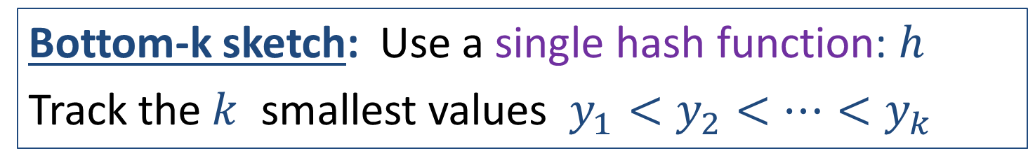
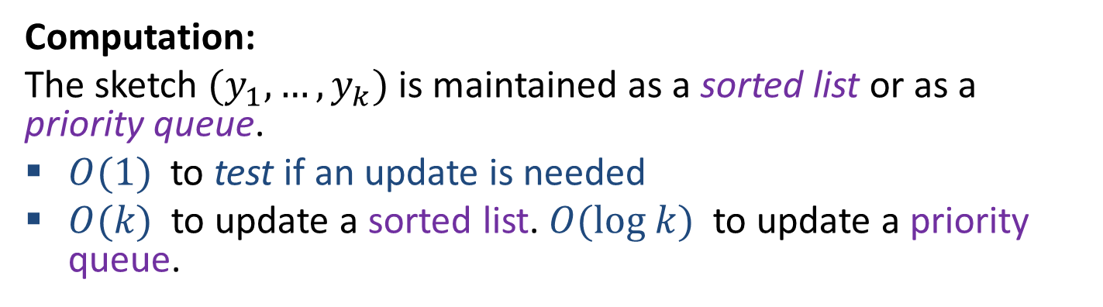
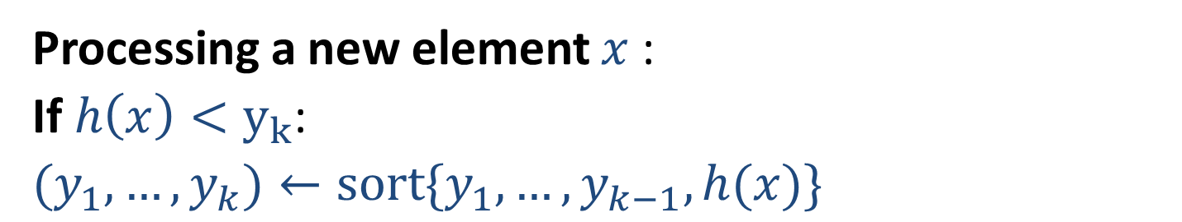
Min-Hash Sketches: bottom-k
Bottom-k sketch: Use a single hash function: $h$
Track the $k$ smallest values $y_{1}<y_{2}<⋯<y_{k}$
Processing a new element $x$:
If $h\left(x\right)<y_{k}$:
$(y_{1},…,y_{k})←sort{\{y}_{1},…, y_{k−1},h(x)\}$
Computation:
The sketch ${(y}_{1},…, y_{k})$ is maintained as a sorted list or as a priority queue.
$O(1)$ to test if an update is needed
$O(k)$ to update a sorted list. $O(log k)$ to update a priority queue.
We will see that #changes $≪$ #distinct elements

Slide 18


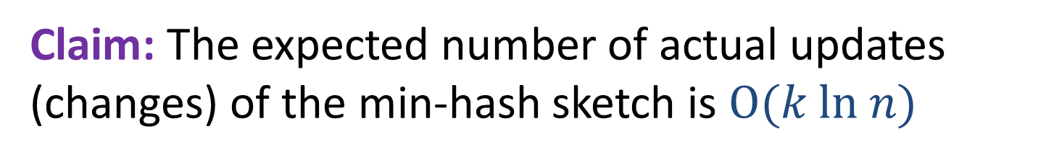







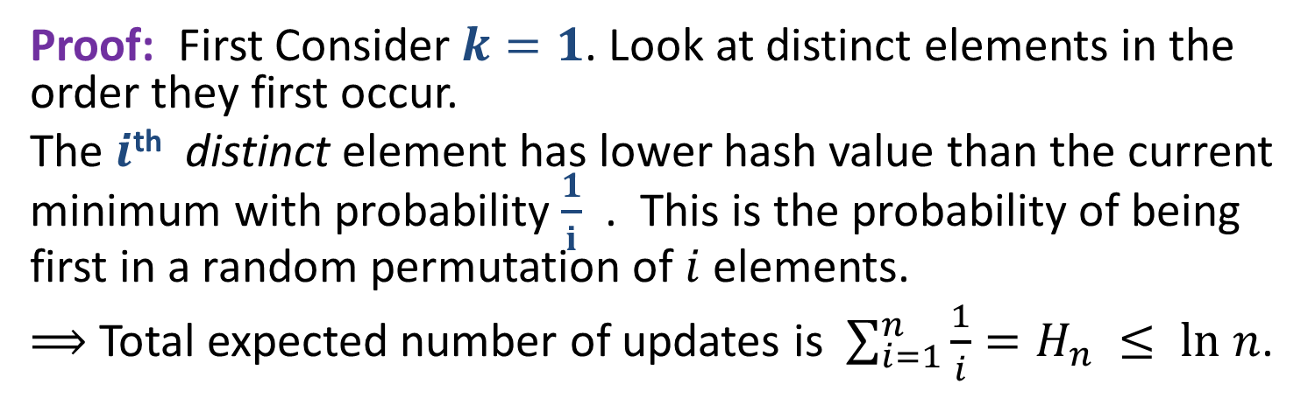


Min-Hash Sketches: Number of updates
Claim: The expected number of actual updates (changes) of the min-hash sketch is $O(k ln n)$
Proof: First Consider $k=1$. Look at distinct elements in the order they first occur.
The $i$^{th} distinct element has lower hash value than the current minimum with probability $\frac{1}{i}$ . This is the probability of being first in a random permutation of $i$elements.
$⟹$Total expected number of updates is $\sum_{i=1}^{n}{\frac{1}{i}=H_{n} }≤ ln n$.
32,
12,
14,
32,
7,
12,
32,
7,
6,
12,
4,
Update
Prob.
$$\frac{1}{2}$$
$$\frac{1}{3}$$
$$\frac{1}{4}$$
$$\frac{1}{5}$$
$$\frac{1}{6}$$
$$1$$
$$0$$
$$0$$
$$0$$
$$0$$
$$0$$
Notes:
The number of times sketch actually changes is very small comparing to stream size and even the number of distinct elements.
Why we care about bounding updates? 1. Sometimes changes cost more than testing if they are needed (say, with bottom-k, or with parallel updates). Later on we will see applications where it makes sense to record the “full history” of changes (that is, be able to obtain the sketch for any prefix of the stream).

Slide 19

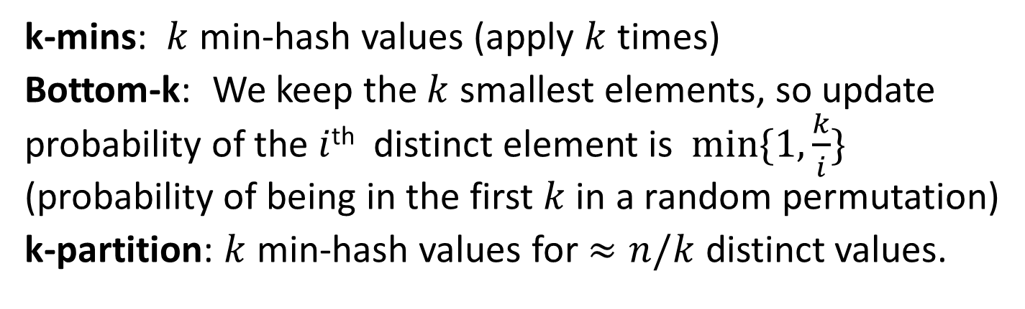
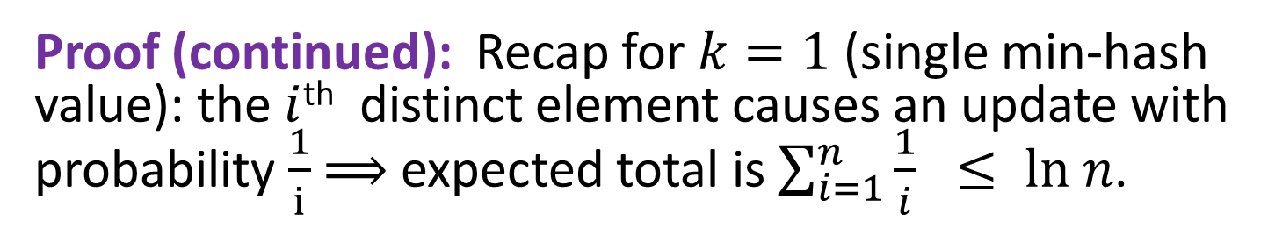
Min-Hash Sketches: Number of updates
Claim: The expected number of actual updates (changes) of the min-hash sketch is $O(k ln n)$
Proof (continued): Recap for $k=1$ (single min-hash value): the $i$^{th} distinct element causes an update with probability $\frac{1}{i}$ $⟹$expected total is $\sum_{i=1}^{n}{\frac{1}{i} }≤ ln n$.
k-mins: $k$ min-hash values (apply $k$ times)
Bottom-k: We keep the $k$ smallest elements, so update probability of the $i$^{th} distinct element is $min\{1,\frac{k}{i}\}$ (probability of being in the first $k$ in a random permutation)
k-partition: $k$ min-hash values for $≈n/k$ distinct values.

Slide 20
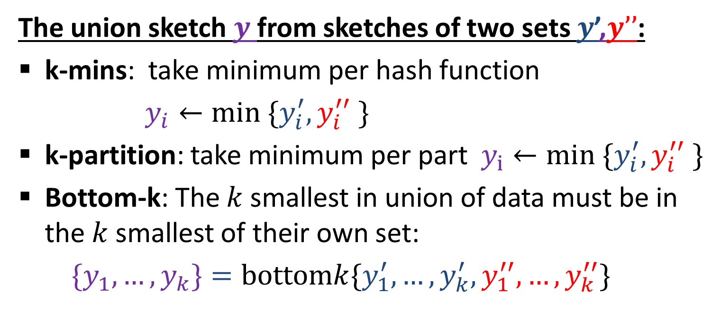
Merging Min-Hash Sketches
!! We apply the same set of hash function to all elements/data sets/streams.
The union sketch $y$ from sketches of two sets $y$’,$y’’$:
k-mins: take minimum per hash function
$y_{i}←min \{y_{i}^{′},y_{i}^{′′} \}$
k-partition: take minimum per part $y_{i}←min \{y_{i}^{′},y_{i}^{′′} \}$
Bottom-k: The $k$ smallest in union of data must be in the $k$ smallest of their own set:
${\{y}_{1}, …,y_{k}\}=bottomk\{y_{1}^{′},…,y_{k}^{′}, y_{1}^{′′},…,y_{k}^{′′}\}$

Slide 21
Using Min-Hash Sketches
Recap:
  We defined Min-Hash Sketches (3 types)
  Adding elements, merging Min-Hash sketches
  Some properties of these sketches
Next: We put Min-Hash sketches to work
  Estimating Distinct Count from a Min-Hash Sketch
    Tools from estimation theory
Notes:
When estimating anything from a sketch we try to use the information we have in the best possible way: maximize its value. The sketch is all what could afford to keep or transmit from the original data that we want to query.

Slide 22

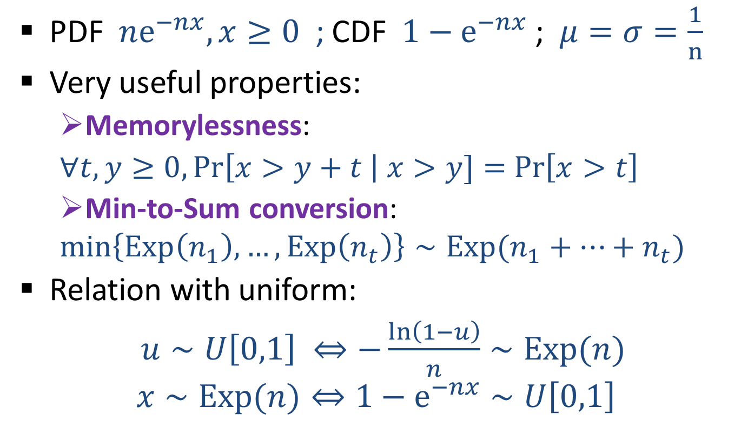
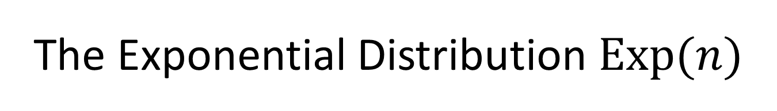
The Exponential Distribution $Exp(n)$
PDF $ne^{−nx}, x≥0$ ; CDF $1−e^{−nx}$ ; $μ=σ=\frac{1}{n}$
Very useful properties:
  Memorylessness:
  $∀t,y≥0, Pr\left[x>y+t \right| x>y]=$ $Pr\left[x>t\right]$
  Min-to-Sum conversion:
  $$min\left\{Exp\left(n_{1}\right),…,Exp\left(n_{t}\right)\right\}∼Exp(n_{1}+⋯+n_{t})$$
Relation with uniform:
$u∼U\left[0,1\right] ⇔−\frac{ln\left(1−u\right)}{n}∼Exp(n)$
$$x∼Exp(n)⇔1−e^{−nx}∼U\left[0,1\right]$$
Notes:
Mention radioactive decay. For a particular particle, time distribution to decay (memoryless. Conditioned on it not decaying, distribution is same). For n particles, first decay is the minimum.
Note that the relations to uniform are monotone probability u<t = probability –ln(1-u) < -ln(1-t)

Slide 23
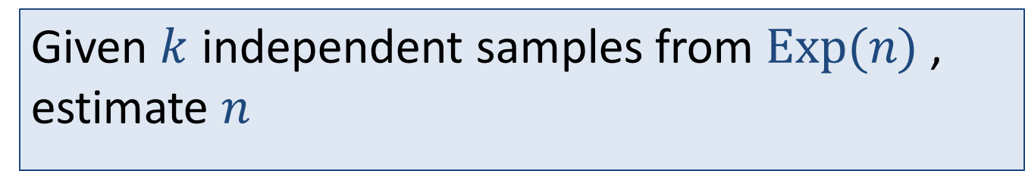
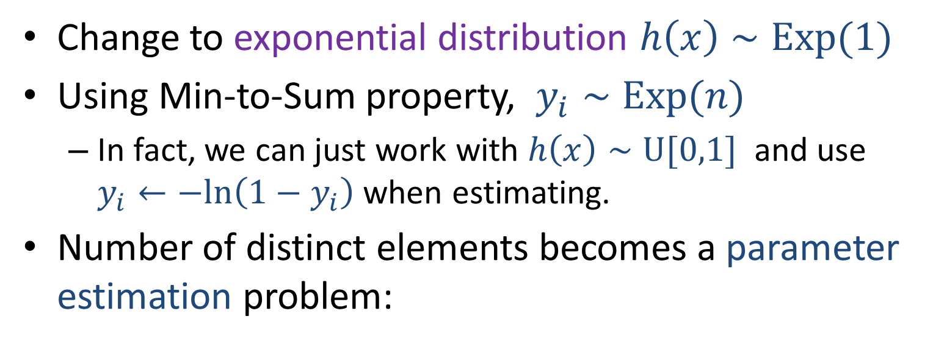
Estimating Distinct Count from a Min-Hash Sketch: k-mins
Change to exponential distribution $h\left(x\right)∼Exp(1)$
Using Min-to-Sum property, $y_{i}∼Exp(n)$
  In fact, we can just work with $h\left(x\right)∼U[0,1]$ and use $y_{i}←−ln\left(1−y_{i}\right)$ when estimating.
Number of distinct elements becomes a parameter estimation problem:
Given $k$ independent samples from $Exp(n)$ , estimate $n$
Notes:
Note that the relations to uniform are monotone probability u<t = probability –ln(1-u) < -ln(1-t)

Slide 24
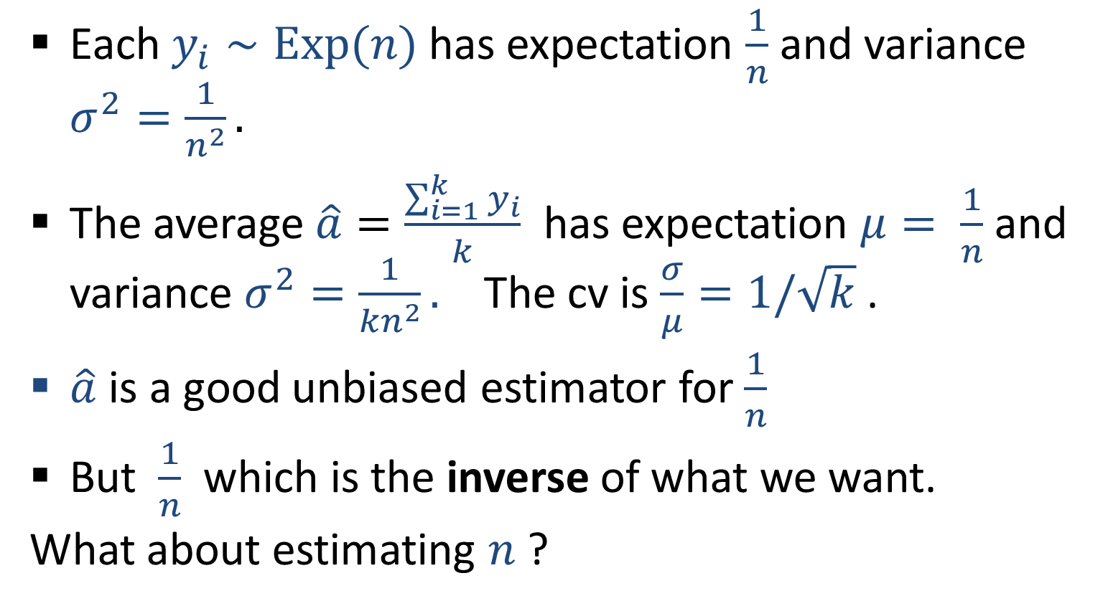
Estimating Distinct Count from a Min-Hash Sketch: k-mins
Each $y_{i}∼Exp(n)$ has expectation $\frac{1}{n}$ and variance $σ^{2}=\frac{1}{n^{2}}.$
The average $\hat{a}=\frac{\sum_{i=1}^{k}{y_{i}}}{k}$ has expectation $μ= \frac{1}{n}$ and variance $σ^{2}=\frac{1}{{kn}^{2}}.$ The cv is $\frac{σ}{μ}=1/\sqrt{k}$ .
$\hat{a}$ is a good unbiased estimator for $\frac{1}{n}$
But $\frac{1}{n}$ which is the inverse of what we want.
What about estimating $n$ ?

Slide 25
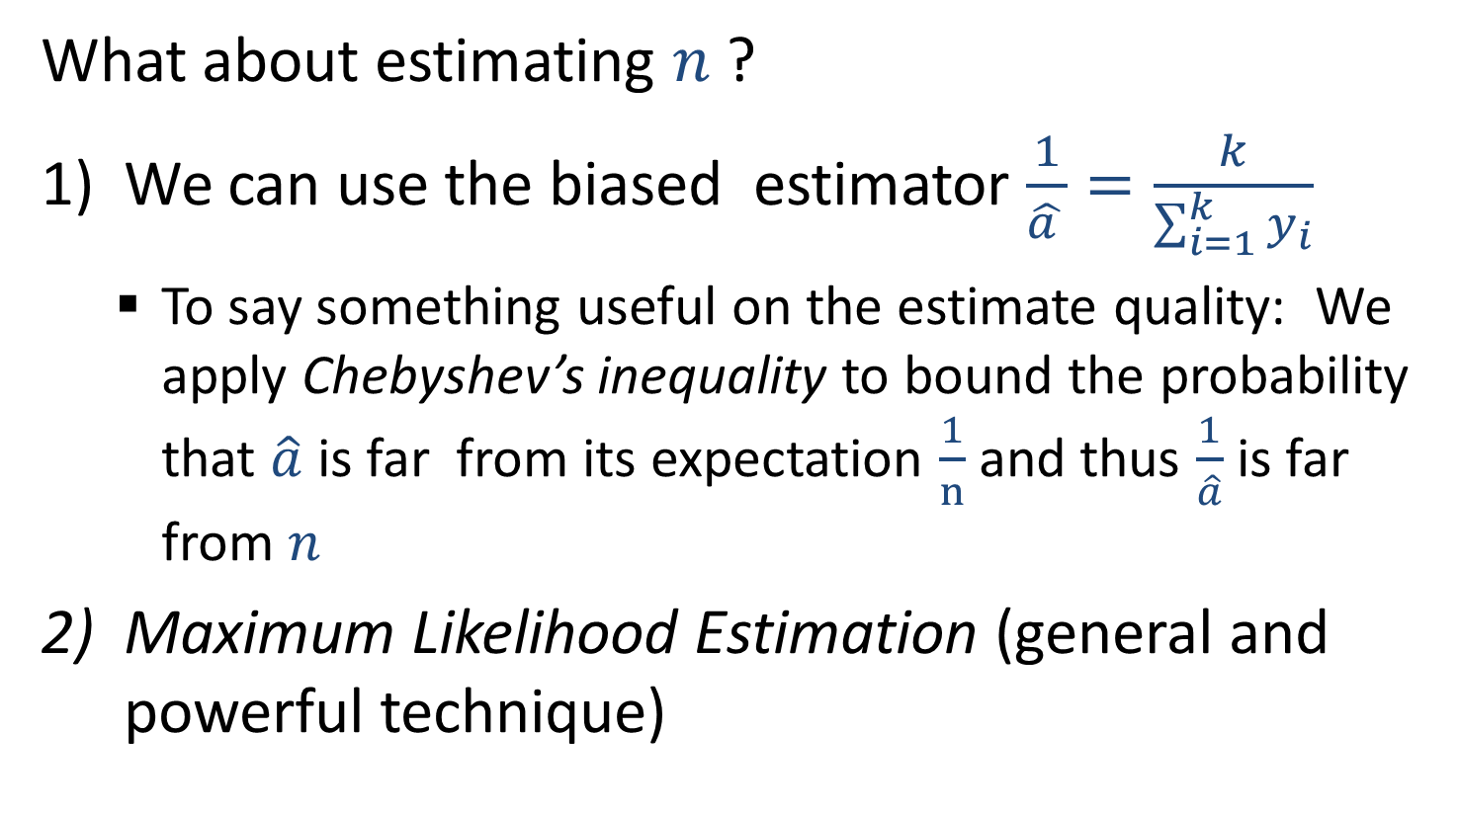
Estimating Distinct Count from a Min-Hash Sketch: k-mins
What about estimating $n$ ?
We can use the biased estimator $\frac{1}{\hat{a }}=\frac{k}{\sum_{i=1}^{k}{y_{i}}}$
  To say something useful on the estimate quality: We apply Chebyshev’s inequality to bound the probability that $\hat{a}$ is far from its expectation $\frac{1}{n}$ and thus $\frac{1}{\hat{a}}$ is far from $n$
Maximum Likelihood Estimation (general and powerful technique)

Slide 26
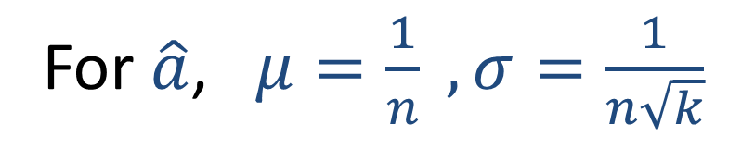
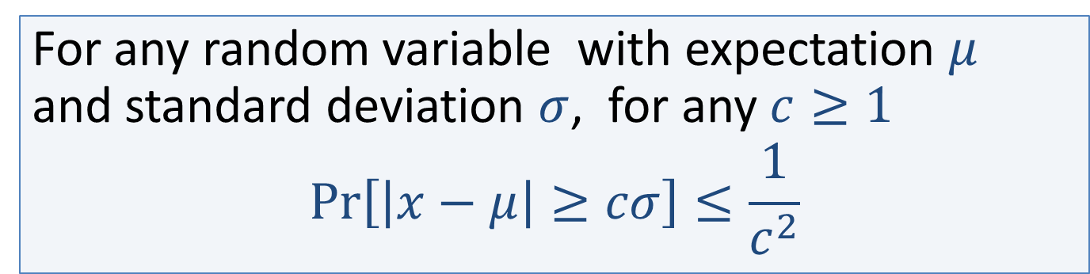
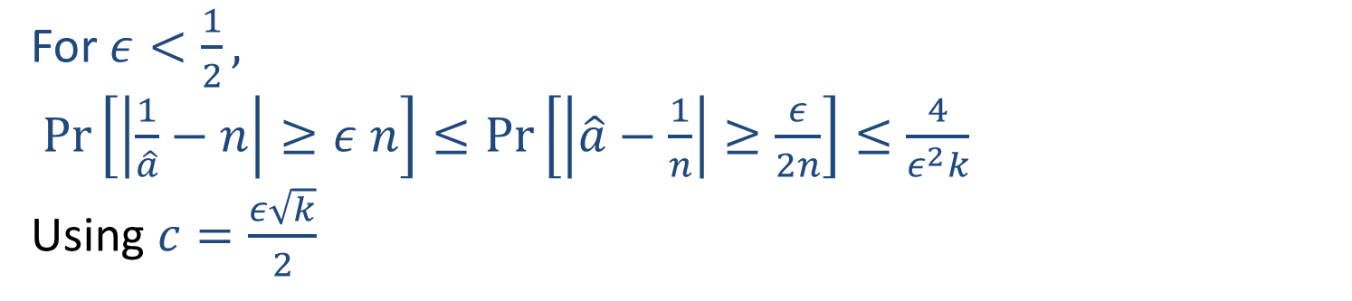
Chebyshev’s Inequality
For any random variable with expectation $μ$ and standard deviation $σ$, for any $c≥1$
$$Pr\left[\left|x−μ\right|≥cσ\right]≤\frac{1}{c^{2}}$$
For $\hat{a}$, $μ=\frac{1}{n} , σ=\frac{1}{n\sqrt{k}}$
For $ε<\frac{1}{2},$
$Pr\left[\left|\frac{1}{\hat{a}}−n\right|≥ε n\right]≤Pr\left[\left|\hat{a}−\frac{1}{n}\right|≥\frac{ε}{2n}\right]≤\frac{4}{ε^{2}k}$
Using $c=\frac{ε\sqrt{k}}{2}$

Slide 27
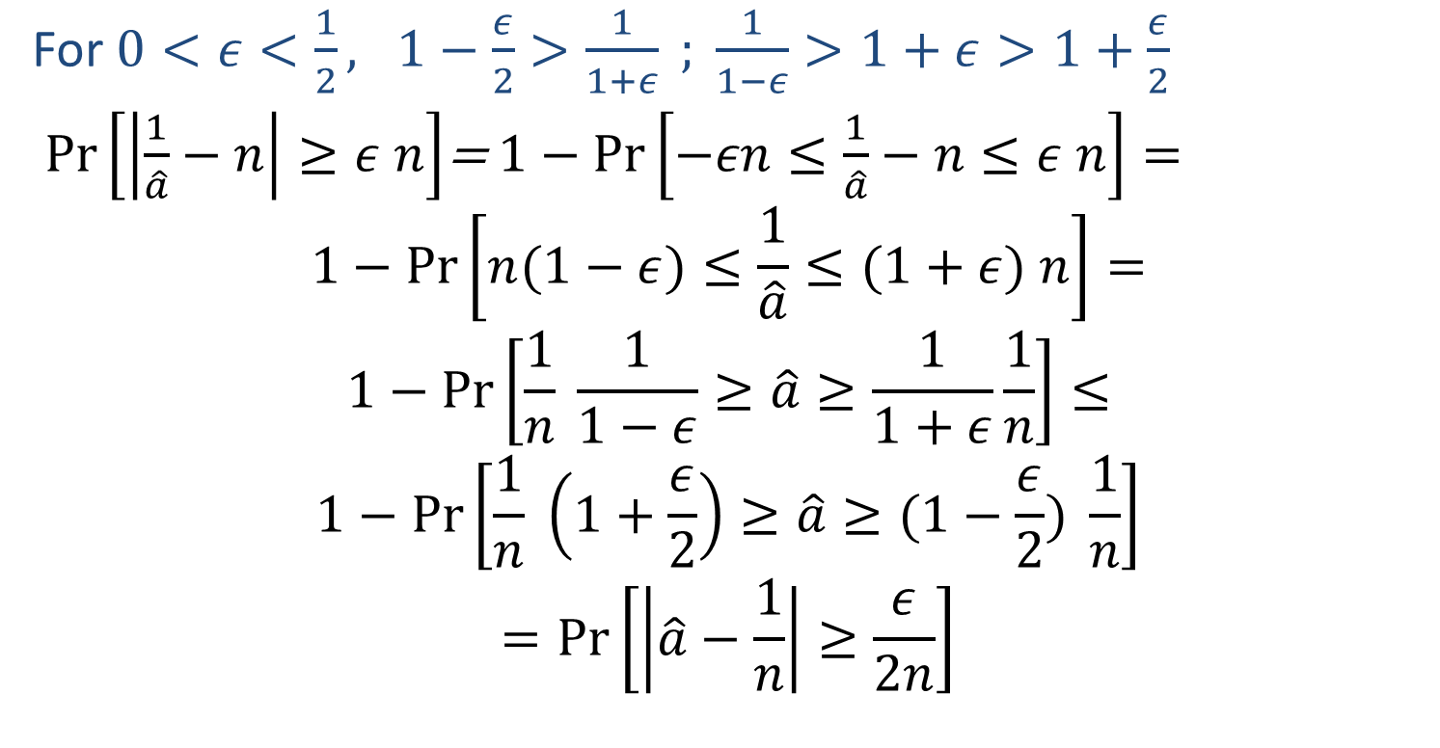
Using Chebyshev’s Inequality
For $0<ε<\frac{1}{2}, 1−\frac{ε}{2}>\frac{1}{1+ε} ; \frac{1}{1−ε}>1+ε>1+\frac{ε}{2}$
$Pr\left[\left|\frac{1}{\hat{a}}−n\right|≥ε n\right]$= $1−Pr\left[−εn≤\frac{1}{\hat{a}}−n≤ε n\right]=$
$$1−Pr\left[n(1−ε)≤\frac{1}{\hat{a}}≤(1+ε) n\right]=$$
$$1−Pr\left[\frac{1}{n} \frac{1}{1−ε}≥\hat{a}≥\frac{1}{1+ε}\frac{1}{n}\right]≤$$
$$1−Pr\left[\frac{1}{n} \left(1+\frac{ε}{2}\right)≥\hat{a}≥(1−\frac{ε}{2}) \frac{1}{n}\right]$$
$$=Pr\left[\left|\hat{a}−\frac{1}{n}\right|≥\frac{ε}{2n}\right]$$

Slide 28
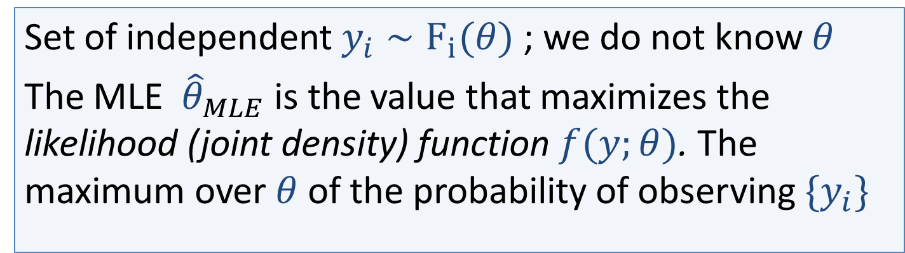
Maximum Likelihood Estimation
Set of independent $y_{i}∼F_{i}(θ)$ ; we do not know $θ$
The MLE ${\hat{θ}}_{MLE}$ is the value that maximizes the likelihood (joint density) function $f(y;θ)$. The maximum over $θ$ of the probability of observing ${\{y}_{i}\}$
Properties:
Principled way of deriving estimators
Converges in probability to true value (with enough i.i.d samples)… but generally biased
(Asymptotically!) optimal – minimizes MSE (mean square error) – meets Cramér-Rao lower bound
Notes:
“Niruut Maximalit”
Likelihood and density are the same function but we think of them differently. Fixed parameter and distribution over y versus fixed y and distribution over the parameter theta.

Slide 29

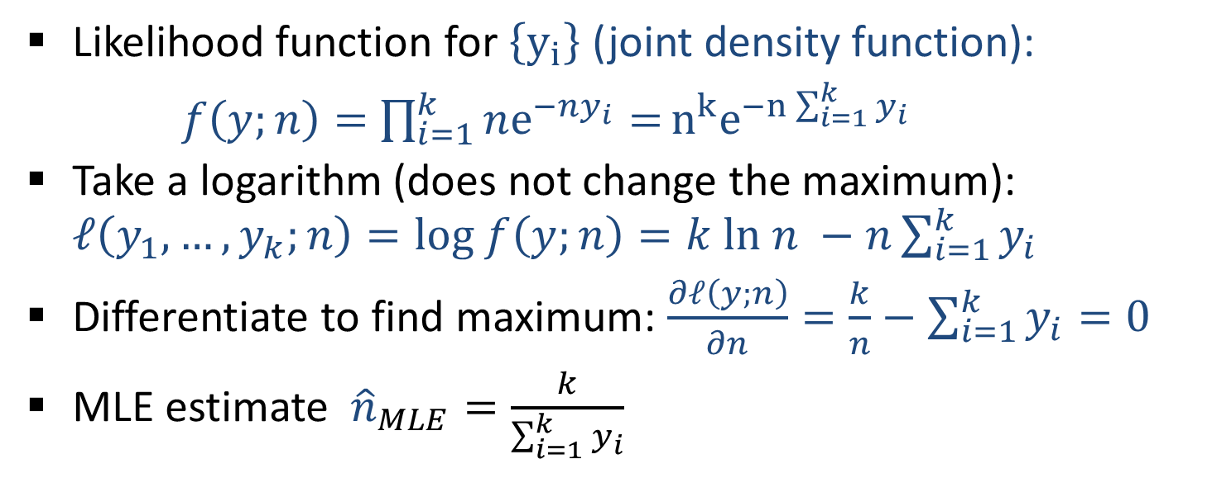
Estimating Distinct Count from a Min-Hash Sketch: k-mins MLE
Given $k$ independent samples from $Exp(n)$ , estimate $n$
Likelihood function for $\left\{y_{i}\right\}$ (joint density function):
$f\left(y;n\right)=$ $\prod_{i=1}^{k}{ne_{}^{−ny_{i}}=}n^{k}e^{−n\sum_{i=1}^{k}{y_{i}}}$
Take a logarithm (does not change the maximum): $ℓ\left(y_{1},…, y_{k};n\right)=log f\left(y;n\right)=k ln n −n\sum_{i=1}^{k}{y_{i}}$
Differentiate to find maximum: $\frac{∂ℓ\left(y;n\right)}{∂n}=\frac{k}{n}−\sum_{i=1}^{k}{y_{i}=0}$
MLE estimate ${\hat{n}}_{MLE}=\frac{k}{\sum_{i=1}^{k}{y_{i}}}$
We get the same estimator, depends only on the sum!

Slide 30
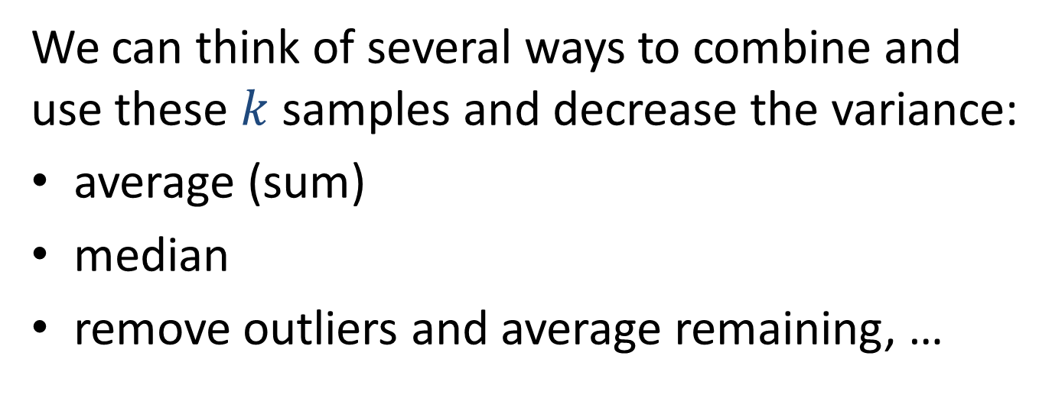

Given $k$ independent samples from $Exp(n)$ , estimate $n$
We can think of several ways to combine and use these $k$ samples and decrease the variance:
average (sum)
median
remove outliers and average remaining, …
We want to get the most value (best estimate) from the information we have (the sketch).
What combinations should we consider ?

Slide 31


Sufficient Statistic
A function $T\left(y\right)=T\left(y_{1},…,y_{k}\right)$ is a sufficient statistic for estimating some function of the parameter $θ$ if the likelihood function has the factored form $c\left(y\right)g(T\left(y\right);θ)$
Likelihood function (joint density) for $k$ exponential i.i.d random variables from $Exp(n)$ :
$$f\left(y;n\right)=\prod_{i=1}^{k}{ne_{}^{−ny_{i}}=}n^{k}e^{−n\sum_{i=1}^{k}{y_{i}}}$$
$⇒$The sum $\sum_{i=1}^{k}{y_{i}}$ is a sufficient statistic for $n$
Notes:
What does estimation theory tells us about sufficient statistic ?

Slide 32


Sufficient Statistic
A function $T\left(y\right)=T\left(y_{1},…,y_{k}\right)$ is a sufficient statistic for estimating some function of the parameter $θ$ if the likelihood function has the factored form $f\left(y;θ\right)=c\left(y\right)g(T\left(y\right);θ)$
In particular: The MLE depends on $y$only through $T(y)$
The maximum with respect to $θ$ does not depend on $c\left(y\right)$.
The maximum of $g(T\left(y\right);θ)$ , computed by deriving with respect to $θ$, is a function of T$\left(y\right)$.

Slide 33



Sufficient Statistic
$T\left(y\right)=T\left(y_{1},…,y_{k}\right)$ is a sufficient statistic for $θ$ if the likelihood function has the form $f\left(y;θ\right)=c\left(y\right)g(T\left(y\right);θ)$
Lemma: $T\left(y\right) sufficient ⟺$ Conditional distribution of $y$ given $T(y)$ does not depend on $θ$
If we fix $T\left(y\right)$, the density function is $f\left(y;θ\right)∝c\left(y\right)$
If we know the density up to fixed factor, it is determined completely by normalizing to 1
Notes:
The relation between densities (probabilities) for diffferent vectors y z is the ratio of c(y)/c(z)

Slide 34



Rao-Blackwell Theorem
Recap: $T\left(y\right)$ is a sufficient statistic for $θ⟺$ Conditional distribution of $y$ given $T(y)$ does not depend on $θ$
Rao-Blackwell Theorem: Given an estimator $b(y)$ of $θ$that is not a function of the sufficient statistic, we can get an estimator with at most the same MSE that depends only on $T(y)$: $E[b(y)|T(y)]$
$E[b(y)|T(y)]$ does not depend on $θ$ (critical)
Process is called: Rao-Blackwellization of $b(y)$
Notes:
The estimator $E[b(y)|T(y)]$ is well define (does not depend on parameter) because of conditional property.
Rao-Blackwellization: a way to get a better estimator

Slide 35


Rao-Blackwell Theorem
Density function of $y_{1},y_{2}$ given parameter $θ$
$$f(y_{1},y_{2};θ)$$
(1,3)
(2,2)
(2,1)
(3,2)
(3,0)
(4,0)
(1,2)
(3,1)
(1,4)
Notes:
Rao-Blackwellization: a way to get a better estimator

Slide 36


Rao-Blackwell Theorem
Sufficient statistic:
$$f(y_{1},y_{2};θ)$$
T$\left(y_{1},y_{2}\right)=y_{1}+y_{2}$
(1,3)
(2,2)
(2,1)
(3,2)
(3,0)
(4,0)
(1,2)
(3,1)
(1,4)
Notes:
Rao-Blackwellization: a way to get a better estimator

Slide 37

Rao-Blackwell Theorem
$$f(y_{1},y_{2};θ)$$
Sufficient statistic:
T$\left(y_{1},y_{2}\right)=y_{1}+y_{2}$
(1,3)
(2,2)
(2,1)
(3,2)
(3,0)
(4,0)
(1,2)
(3,1)
(1,4)
Notes:
Rao-Blackwellization: a way to get a better estimator

Slide 38

Rao-Blackwell Theorem
$$f(y_{1},y_{2};θ)$$
Sufficient statistic:
$$f\left(y_{1},y_{2};θ\right)|y_{1}+y_{2}$$
T$\left(y_{1},y_{2}\right)=y_{1}+y_{2}$
(1,3)
(2,2)
(2,1)
(3,2)
(3,0)
(4,0)
(1,2)
(3,1)
(1,4)
Notes:
Rao-Blackwellization: a way to get a better estimator

Slide 39


Rao-Blackwell Theorem
Estimator $\hat{θ}(y_{1},y_{2})$
T$\left(y_{1},y_{2}\right)=y_{1}+y_{2}$
3
(1,3)
2
(2,2)
1
(2,1)
2
(3,2)
0
(3,0)
0
(4,0)
2
(1,2)
1
(3,1)
4
(1,4)
Notes:
Rao-Blackwellization: a way to get a better estimator

Slide 40



Rao-Blackwell Theorem
$$\hat{θ}(y_{1},y_{2})$$
T$\left(y_{1},y_{2}\right)=y_{1}+y_{2}$
Rao-Blackwell: ${\hat{θ}}^{′}=E[\hat{θ}\left(y_{1},y_{2}\right)|y_{1}+y_{2}]$
3
(1,3)
2
(2,2)
1
(2,1)
1
1.5
(3,2)
2
0
(3,0)
0
(4,0)
2
(1,2)
3
1
(3,1)
4
(1,4)
Notes:
Rao-Blackwellization: a way to get a better estimator

Slide 41

Rao-Blackwell Theorem
$$\hat{θ}(y_{1},y_{2})$$
T$\left(y_{1},y_{2}\right)=y_{1}+y_{2}$
Rao-Blackwell: ${\hat{θ}}^{′}=E[\hat{θ}\left(y_{1},y_{2}\right)|y_{1}+y_{2}]$
Law of total expectation:
$$E[\hat{θ}′]=E[\hat{θ}]$$
Expectation (bias) remains the same
MSE (Mean Square Error) can only decrease
$$MSE\left[{\hat{θ}}^{′}\right]≤MSE[\hat{θ}]$$
Notes:
Rao-Blackwellization: a way to get a better estimator

Slide 42

Why does the MSE decrease?
Suppose we have two points with equal probabilities. We have an estimator of $μ$that gives estimates $a$ and $b$ on these points.
We replace it by an estimator that instead returns the average: $\frac{a+b}{2}$
The (scaled) contribution of these two points to the square error changes from
${\left(a−μ\right)}^{2}+{\left(b−μ\right)}^{2}$ to ${2\left(\frac{a+b}{2}−μ\right)}^{2}$

Slide 43

Why does the MSE decrease?
Show that
$${\left(a−μ\right)}^{2}+{\left(b−μ\right)}^{2}≥{2\left(\frac{a+b}{2}−μ\right)}^{2}$$

Slide 44



Sufficient Statistic for estimating $n$ from k-mins sketches
Given $k$ independent samples from $Exp(n)$ , estimate $n$
$f\left(y;n\right)=$ $\prod_{i=1}^{k}{ne_{}^{−ny_{i}}=}n^{k}e^{−n\sum_{i=1}^{k}{y_{i}}}$
The sum $\sum_{i=1}^{k}{y_{i}}$ is a sufficient statistic for estimating any function of $n$ (including $n$, $\frac{1}{n},n^{2}$)
Rao-Blackwell $⇒$ We can not gain by using estimators with a different dependence on ${\{y}_{i}\}$ (e.g. functions of median or of a smaller sum)

Slide 45


Estimating Distinct Count from a Min-Hash Sketch: k-mins MLE
MLE estimate ${\hat{n}}_{MLE}=\frac{k}{\sum_{i=1}^{k}{y_{i}}}$
$x=\sum_{i=1}^{k}{y_{i}}$ , the sum of i.i.d $∼Exp(n)$random variables), has PDF
$$f_{k,n}(x)=ne^{−nx}\frac{{\left(nx\right)}^{k−1}}{\left(k−1\right)!}$$
The expectation of the MLE estimate is
$$\int_{0}^{∞}{\frac{k}{x}f_{k,n}}\left(x\right)dx=\frac{k}{k−1}n$$
Notes:
We now look at the bias of this estimator. To do that, it convenient to work with the distribution of the sum (one vaiable)

Slide 46


Estimating Distinct Count from a Min-Hash Sketch: k-mins
Unbiased Estimator $\hat{n}=\frac{k−1}{\sum_{i=1}^{k}{y_{i}}}$ (for $k>1$)
The variance of the unbiased estimate is
$$σ^{2}=\int_{0}^{∞}{\frac{{\left(k−1\right)}^{2}}{x^{2}}f_{k,n}}\left(x\right)dx−n^{2}=\frac{1}{k−2}n^{2}$$
The CV is $\frac{σ}{μ}=\frac{1}{\sqrt{k−2}}$
Is this the best we can do ?

Slide 47
Cramér-Rao lower bound (CRLB)
Are we using the information in the sketch in the best possible way ?

Slide 48

Cramér-Rao lower bound (CRLB)
Information theoretic lower bound on the variance of any unbiased estimator $\hat{θ}$ of $θ$.
Likelihood function: $f\left(y;θ\right)$
Log likelihood:
$$ℓ\left(y;θ\right)=ln f\left(y;θ\right)$$
Fisher Information
$$I\left(θ\right)=−E\left[\frac{∂^{2}ℓ\left(y;θ\right)}{∂θ^{2}}\right]$$
CRLB: Any unbiased estimator has $V\left(\hat{θ}\right)≥\frac{1}{I\left(θ\right)}$

Slide 49


CRLB for estimating $n$
Likelihood function for $n,y=\left\{y_{i}\right\}$
$f\left(y;n\right)=\prod_{i=1}^{k}{ne_{}^{−ny_{i}}=}n^{k}e^{−n\sum_{i=1}^{k}{y_{i}}}$
Log likelihood $ℓ\left(y;n\right)=kln n−n\sum_{i=1}^{k}{y_{i}}$
Negated second derivative:$\frac{∂^{2}ℓ\left(y;n\right)}{∂^{2}n}=−\frac{k}{n^{2}}$
Fisher information: $I\left(n\right)=−E[\frac{∂^{2}ℓ\left(y;n\right)}{∂^{2}n}]=\frac{k}{n^{2}}$
CRLB : $var\left[\hat{n}\right]≥\frac{1}{I\left(n\right)}=\frac{n^{2}}{k}$

Slide 50



Estimating Distinct Count from a Min-Hash Sketch: k-mins
Unbiased Estimator $\hat{n}=\frac{k−1}{\sum_{i=1}^{k}{y_{i}}}$ (for $k>1$)
Our estimator has CV $\frac{1}{\sqrt{k−2}}$
The Cramér-Rao lower bound on CV is $\frac{1}{\sqrt{k}}$
$⇒$
we are using the information in the sketch nearly optimally !

Slide 51


Estimating Distinct Count from a Min-Hash Sketch: Bottom-k
Bottom-k sketch $y_{1}<y_{2}<⋯<y_{k}$
Can we specify the distribution? Use Exponential D.
$k=1$ same as k-mins $y_{1}∼Exp(n)$
The minimum $y_{2}$ of the remaining $n−1$ elements is $Exp\left(n−1\right)| y_{2}>y_{1}.$ Since memoryless, ${y_{2}−y}_{1}∼Exp(n−1)$.
More generally ${y_{i+1}−y}_{i}∼Exp(n−i)$.
What is the relation with k-mins sketches?
Notes:
Show on board: to condition on > y_i, divide density by probabilty of being > y_i

Slide 52



Bottom-k versus k-mins sketches
Bottom-k sketch: samples from
$$Exp\left(n\right),Exp\left(n−1\right),…,Exp(n−k+1)$$
K-mins sketch: $k$samples from $Exp\left(n\right)$
To obtain $x∼Exp\left(n\right)$ from $z∼Exp\left(n−i\right)$ (without knowing $n$) we can take $min\{z,t\}$ where $t∼Exp\left(i\right)$
We can use k-mins estimators with bottom-k. Can do even better by taking expectation over choices of $t$.
Bottom-k sketches carry strictly more information than k-mins sketches!
Notes:
Show on board: to condition on > y_i, divide density by probabilty of being > y_i

Slide 53

Estimating Distinct Count from a Min-Hash Sketch: Bottom-k
Likelihood function of $y_{1},…,y_{k},n$:
$$f\left(y;n\right)=\prod_{i=1}^{k}{(n+1−i)e_{}^{−(n+1−i)(y_{i}−y_{i−1})}=}$$
$$\frac{n!}{\left(n−k\right)!} e^{−(n+1)\sum_{i=1}^{k}{{(y}_{i}−y_{i−1})}}e^{\sum_{i}^{k}{i\left(y_{i}−y_{i−1}\right) }}=$$
$${=e}^{ky_{k}−\sum_{i=1}^{k−1}{y_{i} }}\frac{n!}{\left(n−k\right)!}e^{−\left(n+1\right)y_{k}}$$
Does not depend on n
Depends on n
What does estimation theory tell us?

Slide 54


Estimating Distinct Count from a Min-Hash Sketch: Bottom-k
What does estimation theory tell us?
Likelihood function
$$f\left(y;n\right){=e}^{ky_{k}−\sum_{i=1}^{k−1}{y_{i} }}\frac{n!}{\left(n−k\right)!}e^{−\left(n+1\right)y_{k}}$$
$y_{k}$ (maximum value in the sketch) is a sufficient statistic for estimating $n$ (or any function of $n$ ).
Captures everything we can glean from the bottom-k sketch on $n$

Slide 55



Bottom-k: MLE for Distinct Count
Likelihood function (probability density) is
$$f\left(y;n\right){=e}^{ky_{k}−\sum_{i=1}^{k−1}{y_{i} }}\frac{n!}{\left(n−k\right)!}e^{−\left(n+1\right)y_{k}}$$
Find the value of $n$ which maximizes $f\left(y;n\right)$ :
Look only at part that depends on $n$
Take the logarithm (same maximum)
$$ℓ\left(y;n\right)=\sum_{i=0}^{k−1}{ln(n−i)}−\left(n+1\right)y_{k}$$

Slide 56




Bottom-k: MLE for Distinct Count
We look for $n$ which maximizes
$$ℓ\left(y;n\right)=\sum_{i=0}^{k−1}{ln(n−i)}−\left(n+1\right)y_{k}$$
$$\frac{∂ℓ\left(y;n\right)}{∂n}=\sum_{i=0}^{k−1}{\frac{1}{n−i}}−y_{k}$$
$$\sum_{i=0}^{k−1}{\frac{1}{n−i}}=y_{k}$$
MLE is the solution of:
Need to solve numerically
Notes:
Recall that y_k here is the exponential incarnation: transform the uniform minimum u by –ln(1-u)

Slide 57

Summary: k-mins count estimators
k-mins sketch with $U\left[0,1\right]$ dist: $\left(y_{1}′,…, y_{k}′\right)$
With $Exp$ dist: $\left(y_{1},…, y_{k}\right)$ $y_{i}=−ln(1−y_{i}^{′})$
Sufficient statistic for (any function of) $n$ : $\sum_{i=1}^{k}{y_{i}}$
MLE/Unbiased est for $\frac{1}{n}$: $\frac{\sum_{i=1}^{k}{y_{i}}}{k}$ cv: $\frac{1}{\sqrt{k}}$ CRLB: $\frac{1}{\sqrt{k}}$
MLE for $n$: $\frac{k}{\sum_{i=1}^{k}{y_{i}}}$
Unbiased est for $n$: $\frac{k−1}{\sum_{i=1}^{k}{y_{i}}}$ cv: $\frac{1}{\sqrt{k−2}}$ CRLB: $\frac{1}{\sqrt{k}}$

Slide 58


Summary: bottom-k count estimators
Bottom-k sketch with $U\left[0,1\right]$: $y_{1}^{′}<⋯<y_{k}^{′}$
With $Exp$ dist: $y_{1}^{}<⋯<y_{k}^{}$ $y_{i}=−ln(1−y_{i}^{′})$
Sufficient statistic for (any function of) $n$ : $y_{k}$
Contains strictly more information than k-mins
When $n≫k$, approximately the same as k-mins
MLE for $n$ is the solution of:
$$\sum_{i=0}^{k−1}{\frac{1}{n−i}}=y_{k}$$

Slide 59
Bibliography
See lecture 3
We will continue with Min Hash sketches
Use as random samples
Applications to similarity
Inverse-Probability based distinct count estimators

