Slide 1
I/O Efficient Algorithms

Slide 2
Merge-sort
M/B
M/B
M/B

Slide 3
M/B-way merge
<M/B sorted lists of total size n can be merged in O(n/B) I/Os

Slide 4
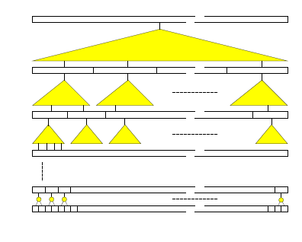
Funnel sort
N^{1/3}
N^{2/9}
N^{4/27}

Slide 9
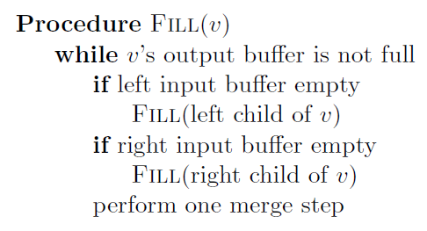

Slide 10
Lemma 1: The size of a k-merger (excluding its input and output buffers) is O(k^2)

Slide 11
Lemma 2: The number of I/Os performed by a k-merger is

Slide 12
Bibliography
Paper that started the research:
http://dl.acm.org/citation.cfm?id=48535
The cache oblivious model:
http://dl.acm.org/citation.cfm?id=2071383
Larse Arge home page: http://www.madalgo.au.dk/~large/

