Slide 1
Leveraging Big Data: Lecture 13
http://www.cohenwang.com/edith/bigdataclass2013
Instructors:
Edith Cohen
Amos Fiat
Haim Kaplan
Tova Milo

Slide 2





What are Linear Sketches?
Linear Transformations of the input vector to a lower dimension.
$$5$$
$$⋮$$
$$b=$$
$$0$$
$$2$$
Examples: JL Lemma on Gaussian random projections, AMS sketch
When to use linear sketches?

Slide 3
Min-Hash sketches
Suitable for nonnegative vectors
  (we will talk about weighted vectors later today)
Mergeable (under MAX)
In particular, can replace value with a larger one
One sketch with many uses: distinct count, similarity, (weighted) sample
But.. no support for negative updates

Slide 4



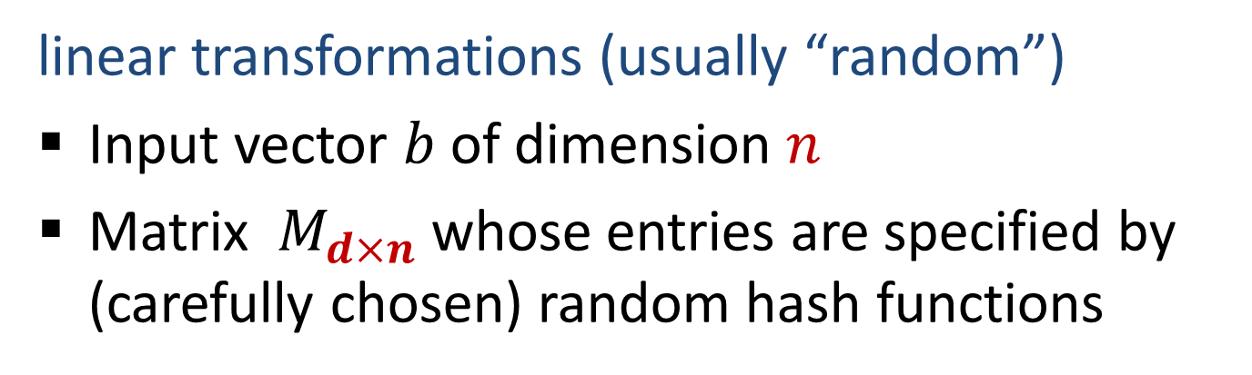





Linear Sketches
linear transformations (usually “random”)
Input vector $b$ of dimension $n$
Matrix $M_{d×n}$ whose entries are specified by (carefully chosen) random hash functions
$$d$$
$$M$$
$$=$$
$$s$$
$$d$$
$$b$$
$$n$$
$$d≪n$$

Slide 5
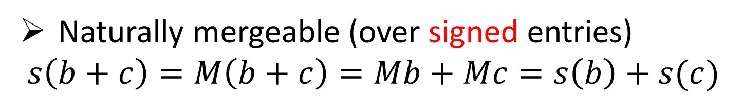
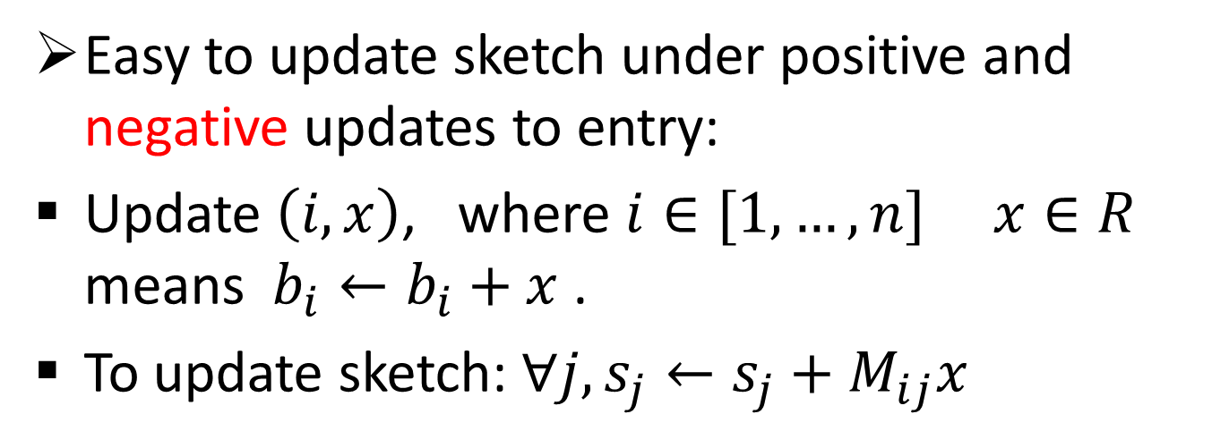
Advantages of Linear Sketches
Easy to update sketch under positive and negative updates to entry:
Update $\left(i,x\right)$, where $i∈[1,…,n]$ $x∈R$ means $b_{i}←b_{i}+x$ .
To update sketch: $∀j, s_{j}←s_{j}+M_{ij}x$
Naturally mergeable (over signed entries)
$s\left(b+c\right)=M\left(b+c\right)=Mb+Mc=s\left(b\right)+s(c)$

Slide 6
Linear sketches: Today
Design linear sketches for:
“Exactly1?” : Determine if there is exactly one nonzero entry (special case of distinct count)
“Sample1”: Obtain the index and value of a (random) nonzero entry
Application: Sketch the “adjacency vectors” of each node so that we can compute connected components and more by just looking at the sketches.

Slide 7
Linear sketches: Today
Design linear sketches for:
“Exactly1?” : Determine if there is exactly one nonzero entry (special case of distinct count)
“Sample1”: Obtain the index and value of a (random) nonzero entry
Application: Sketch the “adjacency vectors” of each node so that we can compute connected components and more by just looking at the sketches.

Slide 8
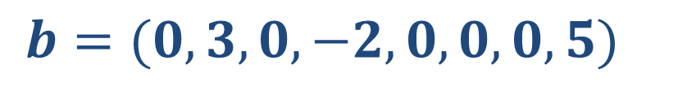
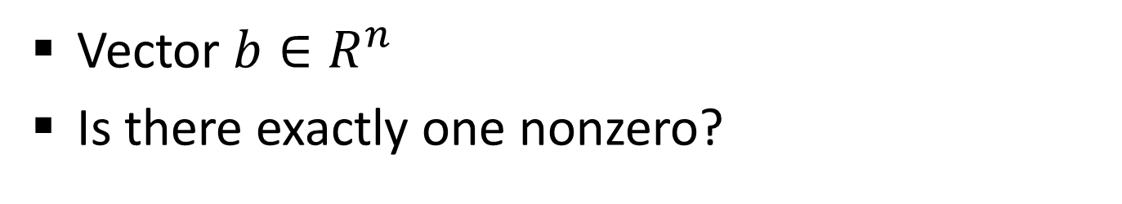
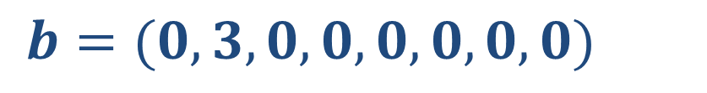
Exactly1?
Vector $b∈R^{n}$
Is there exactly one nonzero?
$b=(0,3,0,−2,0,0,0,5)$
No (3 nonzeros)
$b=(0,3,0,0,0,0,0,0)$
Yes

Slide 9
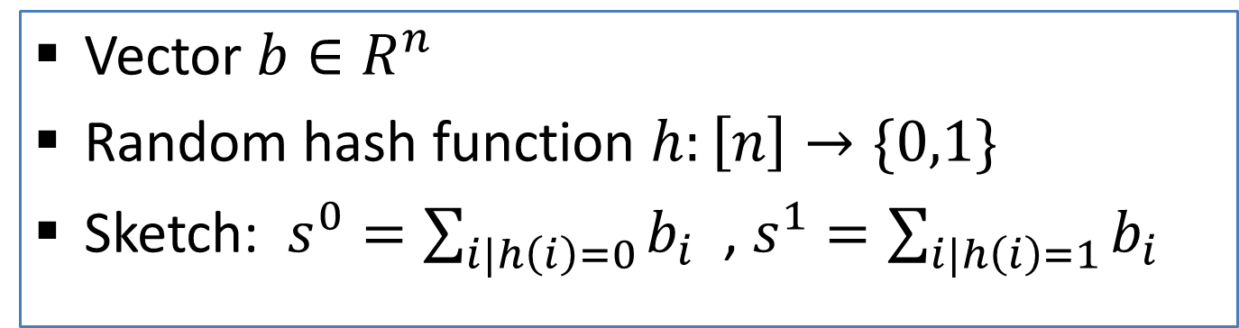
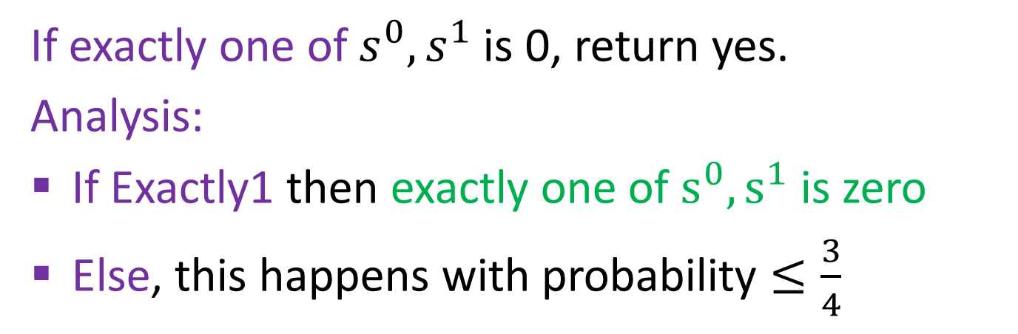
Exactly1? sketch
Vector $b∈R^{n}$
Random hash function $h:\left[n\right]→\{0,1\}$
Sketch: $s^{0}=\sum_{i|h\left(i\right)=0}{b_{i}}$ , $s^{1}=\sum_{i|h\left(i\right)=1}{b_{i}}$
If exactly one of $s^{0},s^{1}$ is 0, return yes.
Analysis:
If Exactly1 then exactly one of $s^{0},s^{1}$ is zero
Else, this happens with probability $≤\frac{3}{4}$
How to boost this ?
Notes:
If entries were not signed, this would be ½. But in general, sum of non-zeros can cancel out.
Vector (-1,1,1) gives 3/4 . In general, look at all non zeros and put aside 2 of them. Now fix the hash on the rest.
The probability that all 4 possibilities for placing the remaining two results in exactly one nonzero is 0 (possible for ¾)

Slide 10

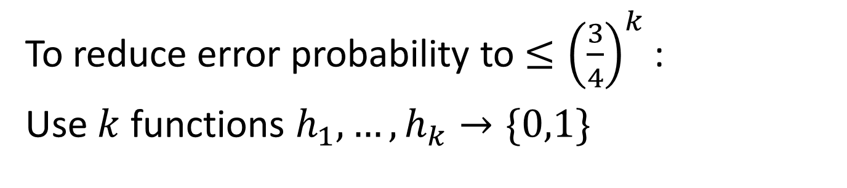

….Exactly1? sketch
To reduce error probability to $≤{\left(\frac{3}{4}\right)}^{k}$:
Use $k$ functions $h_{1},…,h_{k}→\{0,1\}$
Sketch: $s_{j}^{0}=\sum_{i|h_{j}\left(i\right)=0}{b_{i}}$ , $s_{j}^{1}=\sum_{i|h_{j}\left(i\right)=1}{b_{i}}$
With $k=O(\log{n)}$, error probability $≤\frac{1}{n^{c}}$
Notes:
If entries were not signed, this would be ½. But in general, sum of non-zeros can cancel out.
Vector (-1,1,1) gives 2/3

Slide 11





















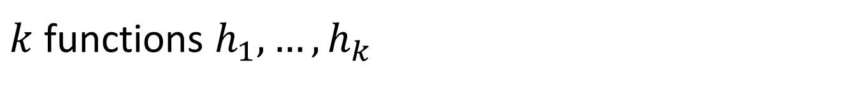




Exactly1? Sketch in matrix form
$k$ functions $h_{1},…,h_{k}$
Sketch: $s_{j}^{0}=\sum_{i|h_{j}\left(i\right)=0}{b_{i}}$ , $s_{j}^{1}=\sum_{i|h_{j}\left(i\right)=1}{b_{i}}$
$$\begin{matrix}h_{1}(1) & h_{1}\left(2\right)\end{matrix}$$
$$s_{1}^{0}$$
$$\begin{matrix}⋯ & h_{1}\left(n\right)\end{matrix}$$
$$5$$
$$\begin{matrix}{1−h}_{1}(1) & 1−h_{1}\left(2\right)\end{matrix}$$
$$\begin{matrix}⋯ & {1−h}_{1}\left(n\right)\end{matrix}$$
$$s_{1}^{1}$$
$$⋮$$
$$s_{2}^{0}$$
$$\begin{matrix}h_{2}(1) & { h}_{2}\left(2\right)\end{matrix}$$
$$\begin{matrix}⋯ & h_{2}\left(n\right)\end{matrix}$$
$$=$$
$$0$$
$$s_{2}^{1}$$
$$\begin{matrix}{1−h}_{2}(1) & {1−h}_{2}\left(2\right)\end{matrix}$$
$$\begin{matrix}⋯ & {1−h}_{2}\left(n\right)\end{matrix}$$
$$⋮$$
$$⋮$$
$$⋮$$
$$⋮$$
$$\begin{matrix}{1−h}_{k}(1) & {1−h}_{k}\left(2\right)\end{matrix}$$
$$\begin{matrix}⋯ & 1−h_{k}\left(n\right)\end{matrix}$$
$$2$$
$$s_{k}^{1}$$
Notes:
If all s pairs have exactly one nz, we return yes.

Slide 12
Linear sketches: Next
Design linear sketches for:
“Exactly1?” : Determine if there is exactly one nonzero entry (special case of distinct count)
“Sample1”: Obtain the index and value of a (random) nonzero entry
Application: Sketch the “adjacency vectors” of each node so that we can compute connected components and more by just looking at the sketches.

Slide 13



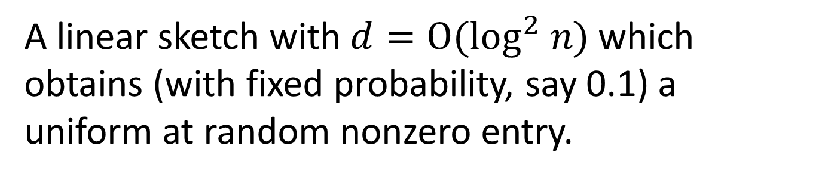


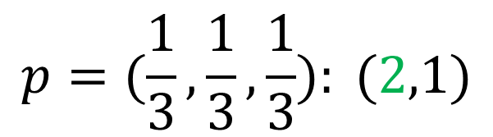
Sample1 sketch
Cormode Muthukrishnan Rozenbaum 2005
A linear sketch with $d=O(\log^{2} n)$ which obtains (with fixed probability, say 0.1) a uniform at random nonzero entry.
Vector $b=(0,1,0,−5,0,0,0,3)$
With probability $>0.1$ return
$$p=(\frac{1}{3},\frac{1}{3},\frac{1}{3}): (2,1)$$
$$(4,−5)$$
$$(8,3)$$
Else return failure
Also, very small $<\frac{1}{n^{c}}$ probability of wrong answer

Slide 14
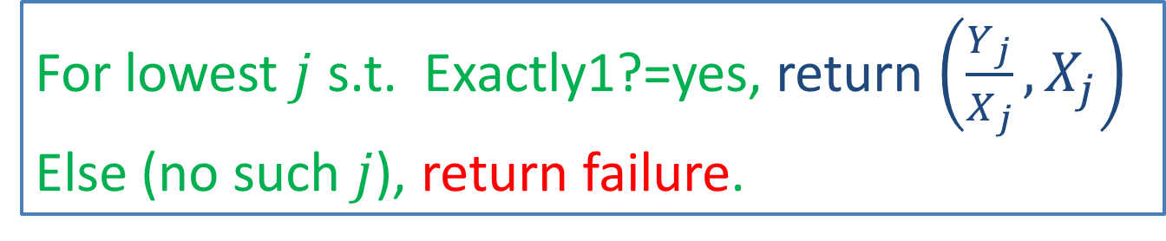
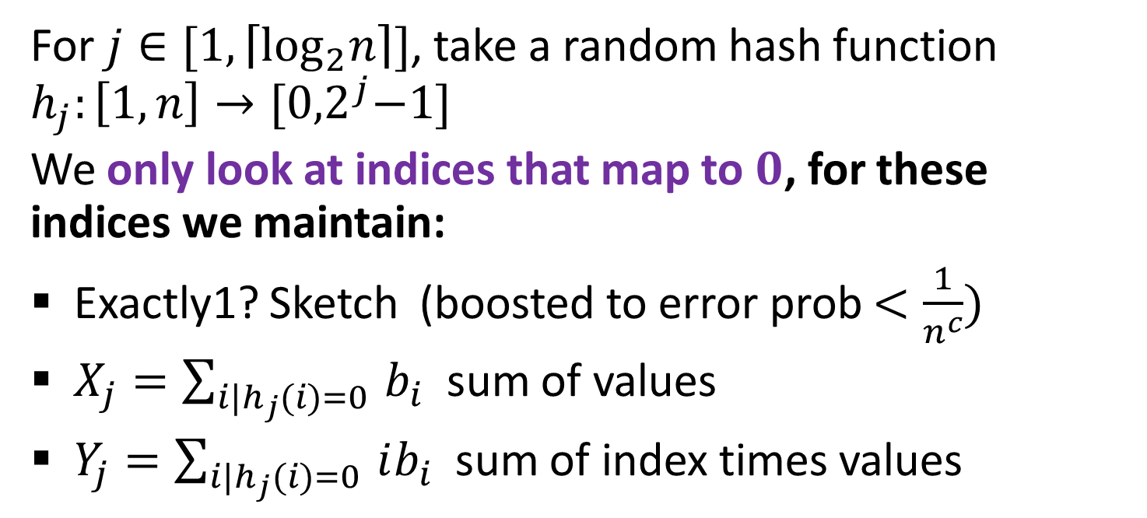
Sample1 sketch
For $j∈[1,\left\lceil \log_{2}n\right\rceil ]$, take a random hash function $h_{j}:\left[1,n\right]→{[0,2}^{j}−1]$
We only look at indices that map to $0$, for these indices we maintain:
Exactly1? Sketch (boosted to error prob $<\frac{1}{n^{c}})$
$X_{j}=\sum_{i|h_{j}(i)=0 }{b_{i}}$ sum of values
$Y_{j}=\sum_{i|h_{j}(i)=0 }{ib_{i}}$ sum of index times values
For lowest $j$ s.t. Exactly1?=yes, return $\left(\frac{Y_{j}}{X_{j}},X_{j}\right)$
Else (no such $j$), return failure.

Slide 15
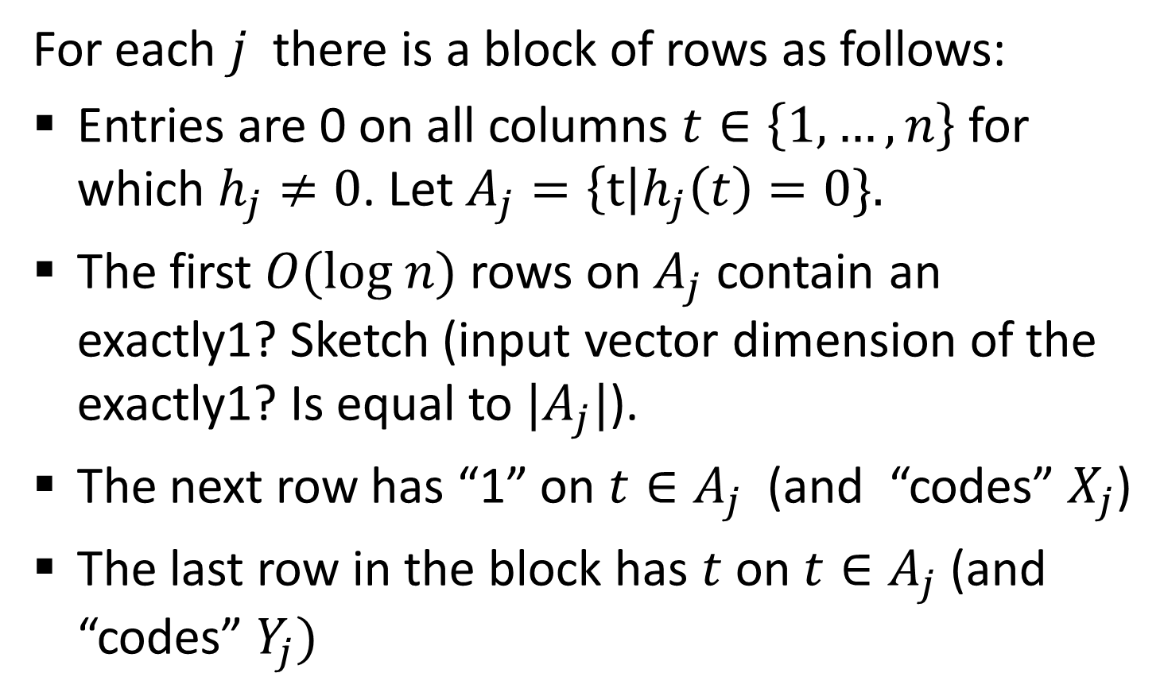
Matrix form of Sample1
For each $j$ there is a block of rows as follows:
Entries are 0 on all columns $t∈\left\{1,…, n\right\}$ for which $h_{j}≠0$. Let $A_{j}=\left\{t\right|h_{j}\left(t\right)=0\}.$
The first $O(log n)$ rows on $A_{j}$ contain an exactly1? Sketch (input vector dimension of the exactly1? Is equal to $|A_{j}|$).
The next row has “1” on ${t∈A}_{j}$ (and “codes” $X_{j}$)
The last row in the block has $t$ on $t∈A_{j}$ (and “codes” $Y_{j})$

Slide 16
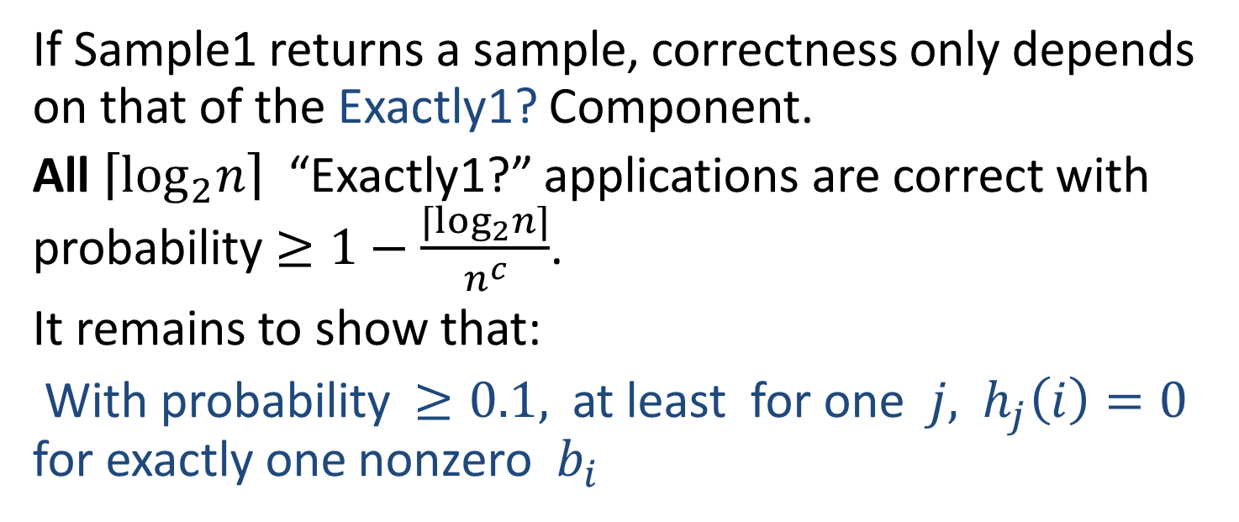
Sample1 sketch: Correctness
For lowest $j$ such that Exactly1?=yes, return $(Y_{j},X_{j})$
If Sample1 returns a sample, correctness only depends on that of the Exactly1? Component.
All $\left\lceil \log_{2}n\right\rceil$ “Exactly1?” applications are correct with probability $≥1−\frac{⌈\log_{2}n⌉}{n^{c}}$.
It remains to show that:
With probability $≥0.1,$ at least for one $j,$ $h_{j}\left(i\right)=0$ for exactly one nonzero $b_{i}$

Slide 17
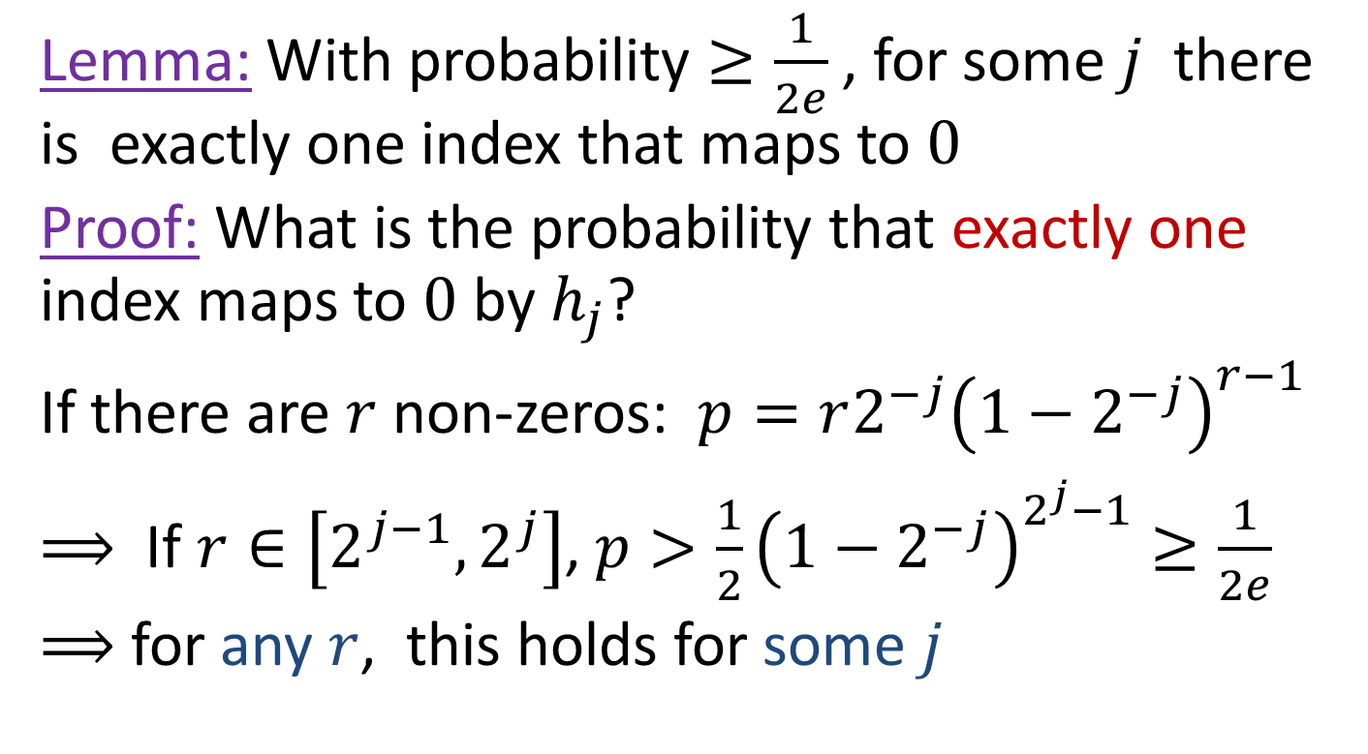
Sample1 Analysis
Lemma: With probability $≥\frac{1}{2e}$, for some $j$ there is exactly one index that maps to $0$
Proof: What is the probability that exactly one index maps to $0$ by $h_{j}$?
If there are $r$ non-zeros: $p=r2^{−j}{\left(1−2^{−j}\right)}^{r−1}$
$⟹$ If $r∈\left[2^{j−1},2^{j}\right]$, $p>\frac{1}{2}{\left(1−2^{−j}\right)}^{2^{j}−1}≥\frac{1}{2e}$
$⟹$ for any $r$, this holds for some $j$

Slide 18

Sample1: boosting success probability
Same trick as before:
We can use $O(\log{n)}$ independent applications to obtain a sample1 sketch with success probability that is $≥1−1/n^{c}$ for a constant $c$ of our choice.
We will need this small error probability for the next part: Connected components computation over sketched adjacency vectors of nodes.

Slide 19
Linear sketches: Next
Design linear sketches for:
“Exactly1?” : Determine if there is exactly one nonzero entry (special case of distinct count)
“Sample1”: Obtain the index and value of a (random) nonzero entry
Application: Sketch the “adjacency vectors” of each node so that we can compute connected components and more by just looking at the sketches.

Slide 20
Connected Components: Review
Repeat:
Each node selects an incident edge
Contract all selected edges (contract = merge the two endpoints to a single node)

Slide 21
Connected Components: Review
Iteration1:
Each node selects an incident edge

Slide 22
Connected Components: Review
Iteration1:
Each node selects an incident edge
Contract selected edges

Slide 23
Connected Components: Review
Iteration 2:
Each (contracted) node selects an incident edge

Slide 24
Connected Components: Review
Iteration2:
Each (contracted) node selects an incident edge
Contract selected edges
Done!

Slide 25
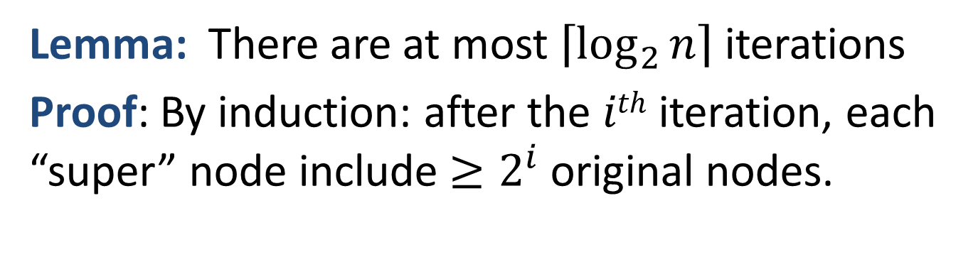
Connected Components: Analysis
Repeat:
Each “super” node selects an incident edge
Contract all selected edges (contract = merge the two endpoint super node to a single super node)
Lemma: There are at most $\left\lceil \log_{2}{n}\right\rceil$ iterations
Proof: By induction: after the $ith$ iteration, each “super” node include ${≥2}^{i}$ original nodes.

Slide 26
Adjacency sketches
Ahn, Guha and McGregor 2012

Slide 27
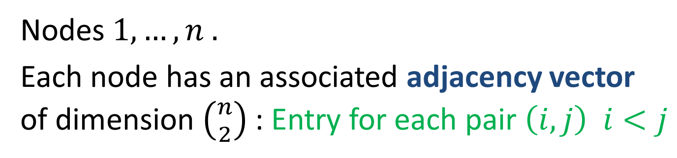
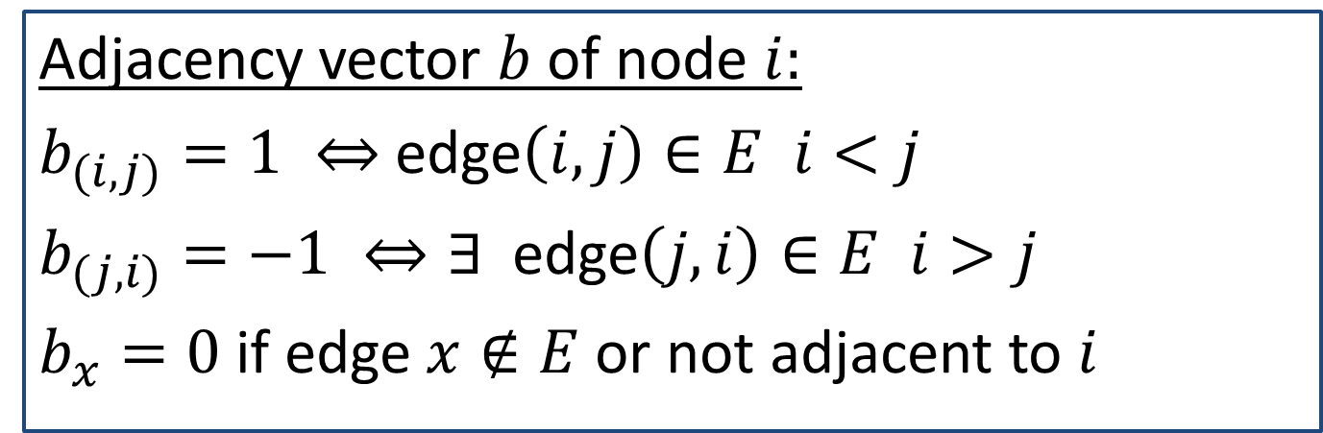
Adjacency Vectors of nodes
Nodes $1,…, n .$
Each node has an associated adjacency vector of dimension $\left({n \atop 2}\right)$ : Entry for each pair $\left(i,j\right) i<j$
Adjacency vector $b$of node $i:$
$b_{(i,j)}=1 ⇔$edge$\left(i,j\right)∈E i<j$
$b_{(j,i)}=−1 ⇔∃$ edge$\left(j,i\right)∈E i>j$
$b_{x}=0$ if edge $x∉E$ or not adjacent to $i$
Notes:
We do not explicitly represent these vectors, we will work with their sample1 sketches, that have polylogarithmic dimension. Note that the adjacency vectors are a different representation of the adjacency list of the node.

Slide 28





Adjacency vector of a node
Node 3:
(1,2) | (1,3) | (1,4) | (1,5) | (2,3) | (2,4) | (2,5) | (3,4) | (3,5) | (4,5)
0 | -1 | 0 | 0 | -1 | 0 | 0 | +1 | 0 | 0
$$3$$
$$1$$
$$4$$
$$5$$
$$2$$

Slide 29
Adjacency vector of a node
Node 5:
(1,2) | (1,3) | (1,4) | (1,5) | (2,3) | (2,4) | (2,5) | (3,4) | (3,5) | (4,5)
0 | 0 | 0 | 0 | 0 | 0 | 0 | 0 | 0 | -1
$$3$$
$$1$$
$$4$$
$$5$$
$$2$$

Slide 30
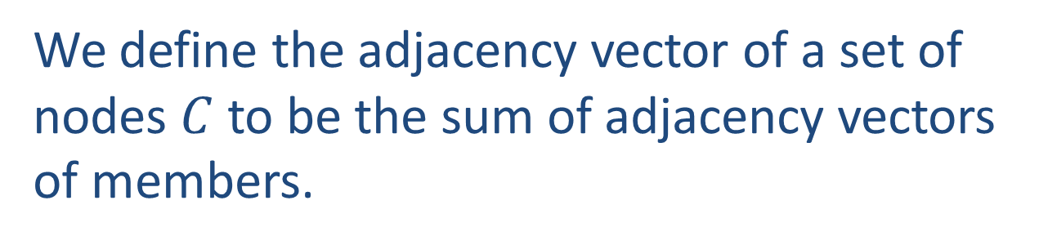
Adjacency vector of a set of nodes
We define the adjacency vector of a set of nodes $C$ to be the sum of adjacency vectors of members.
What is the graph interpretation ?

Slide 31
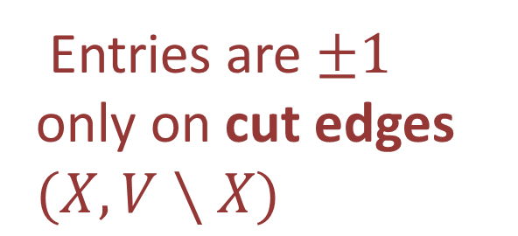






Adjacency vector of a set of nodes
$$X=\{2,3,4\}:$$
(1,2) | (1,3) | (1,4) | (1,5) | (2,3) | (2,4) | (2,5) | (3,4) | (3,5) | (4,5)
0 | 0 | 0 | 0 | +1 | +1 | 0 | 0 | 0 | 0
0 | -1 | 0 | 0 | -1 | 0 | 0 | +1 | 0 | 0
0 | 0 | 0 | 0 | 0 | -1 | 0 | -1 | 0 | +1
0 | -1 | 0 | 0 | 0 | 0 | 0 | 0 | 0 | +1
$$3$$
Entries are $±1$ only on cut edges $(X,V∖X)$
$$1$$
$$4$$
$$5$$
$$2$$

Slide 32
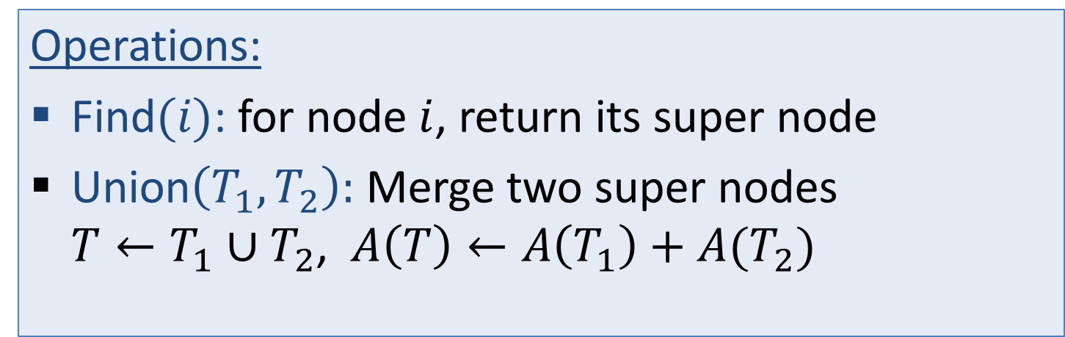
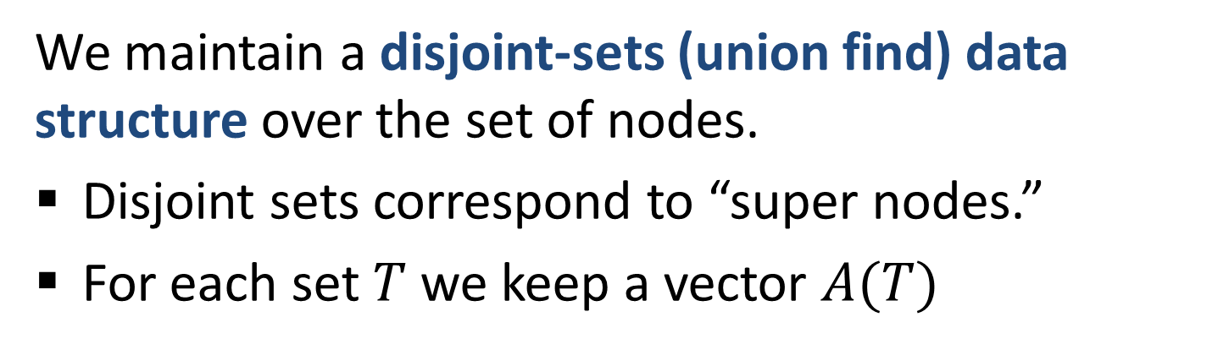
Stating Connected Components Algorithm in terms of adjacency vectors
We maintain a disjoint-sets (union find) data structure over the set of nodes.
Disjoint sets correspond to “super nodes.”
For each set $T$ we keep a vector $A(T)$
Operations:
Find$(i)$: for node $i$, return its super node
Union$\left(T_{1},T_{2}\right):$ Merge two super nodes $T←T_{1}∪T_{2}$, $A\left(T\right)←A\left(T_{1}\right)+A(T_{2})$

Slide 33

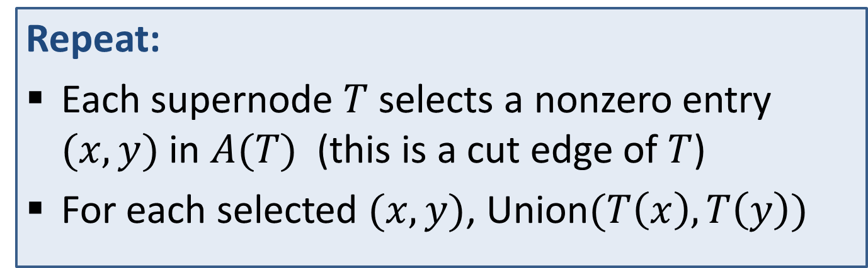
Connected Components Computation in terms of adjacency vectors
Initially, each node $i$ creates a supernode with $A$ being the adjacency vector of $i$
Repeat:
Each supernode $T$ selects a nonzero entry $(x,y)$ in $A(T)$ (this is a cut edge of $T$)
For each selected $(x,y)$, Union$(T\left(x\right),T\left(y\right))$

Slide 34
Connected Components in sketch space
Sketching: We maintain a sample1 sketch of the adjacency vector of each node.: When edges are added or deleted we update the sketch.
Connected Component Query: We apply the connected component algorithm for adjacency vectors over the sketched vectors.

Slide 35
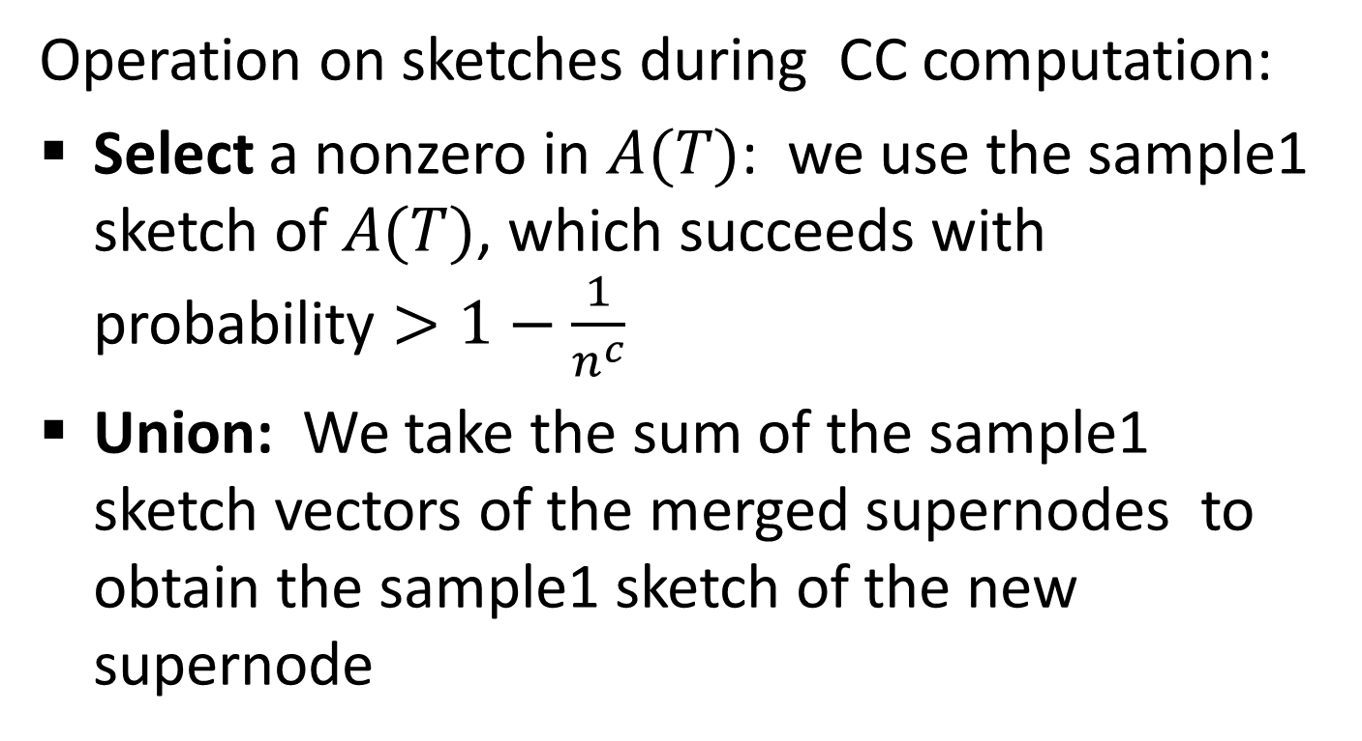
Connected Components in sketch space
Operation on sketches during CC computation:
Select a nonzero in $A(T)$: we use the sample1 sketch of $A(T)$, which succeeds with probability $>1−\frac{1}{n^{c}}$
Union: We take the sum of the sample1 sketch vectors of the merged supernodes to obtain the sample1 sketch of the new supernode

Slide 36





Connected Components in sketch space
Iteration1:
Each supernode (node) uses its sample1 sketch to select an incident edge
Sample1 sketches of dimension $d$
$$[4,−2,..,7,…]$$
$$[4,−2,..,7,…]$$
$$[4,−2,..,7,…]$$
$$[4,−2,..,7,…]$$
$$[4,−2,..,7,…]$$
$$[4,−2,..,7,…]$$
$$[4,−2,..,7,…]$$
$$[4,−2,..,7,…]$$
$$[4,−2,..,7,…]$$

Slide 37
Connected Components in sketch space
Iteration1 (continue):
Union the nodes in each path/cycle. Sum up the sample1 sketches.
$$[4,−2,..,7,…]$$
$$[4,−2,..,7,…]$$
$$[4,−2,..,7,…]$$
$$[4,−2,..,7,…]$$
$$[4,−2,..,7,…]$$
$$[4,−2,..,7,…]$$
$$[4,−2,..,7,…]$$
$$[4,−2,..,7,…]$$
$$[4,−2,..,7,…]$$

Slide 38
Connected Components in sketch space
Iteration1 (end):
New super nodes with their vectors
$$[4,−2,..,7,…]$$
$$[4,−2,..,7,…]$$
$$[4,−2,..,7,…]$$
$$[4,−2,..,7,…]$$
$$[4,−2,..,7,…]$$
$$[4,−2,..,7,…]$$
$$[4,−2,..,7,…]$$
$$[4,−2,..,7,…]$$
$$[4,−2,..,7,…]$$
$$[4,−2,..,7,…]$$
$$[4,−2,..,7,…]$$
$$[4,−2,..,7,…]$$
$$[4,−2,..,7,…]$$

Slide 39
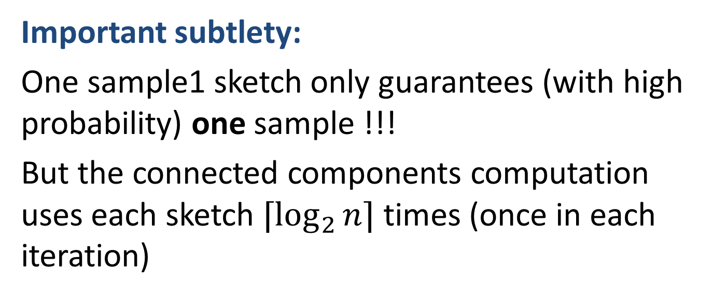

Connected Components in sketch space
Important subtlety:
One sample1 sketch only guarantees (with high probability) one sample !!!
But the connected components computation uses each sketch $⌈\log_{2}{n⌉}$ times (once in each iteration)
Solution: We maintain $⌈\log_{2}{n⌉}$ sets of sample1 sketches of the adjacency vectors.

Slide 40
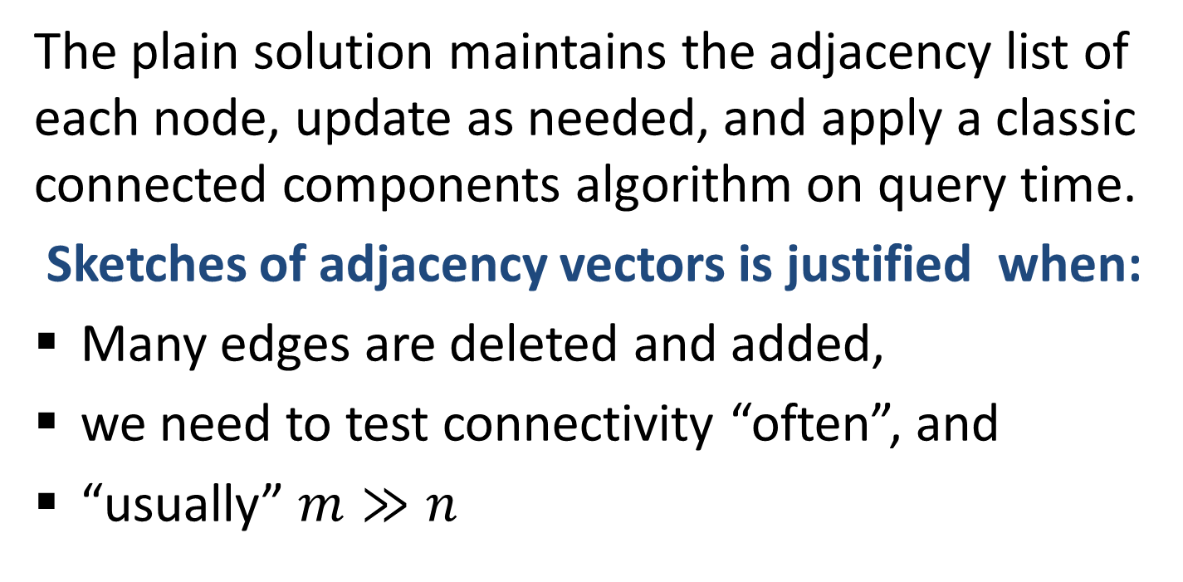
Connected Components in sketch space
When does sketching pay off ??
The plain solution maintains the adjacency list of each node, update as needed, and apply a classic connected components algorithm on query time.
Sketches of adjacency vectors is justified when:
Many edges are deleted and added,
we need to test connectivity “often”, and
“usually” $m≫n$

Slide 41
Bibliography
Ahn, Guha, McGregor: “Analysing graph structure via linear measurements.” 2013
Cormode, Muthukrishnan, Rozenbaum, “Summarizing and Mining Inverse Distributions on Data Streams via Dynamic Inverse Sampling” VLDB 2005
Jowhari, Saglam, Tardos, “Tight bounds for Lp samplers, finding duplicates in streams, and related problems.” PODS 2011

Slide 42
Back to Random Sampling
Powerful tool for data analysis: Efficiently estimate properties of a large population (data set) by examining the smaller sample.
We saw sampling several times in this class:
Min-Hash: Uniform over distinct items
ADS: probability decreases with distance
Sampling using linear sketches
Sample coordination: Using same set of hash functions. We get mergeability and better similarity estimators between sampled vectors.

Slide 43
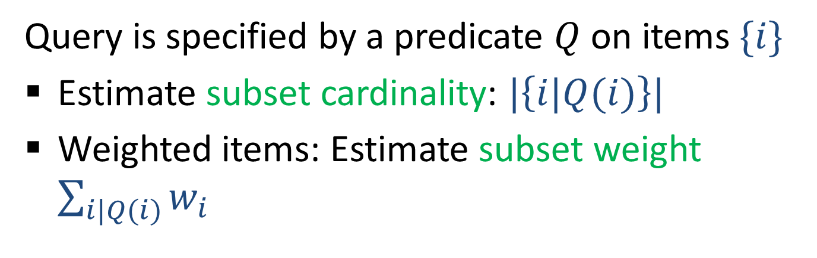
Subset (Domain/Subpopulation) queries:
Important application of samples
Query is specified by a predicate $Q$ on items $\{i\}$
Estimate subset cardinality: $|\left\{i|Q(i)\right\}|$
Weighted items: Estimate subset weight $\sum_{i|Q(i)}{w_{i}}$

Slide 44
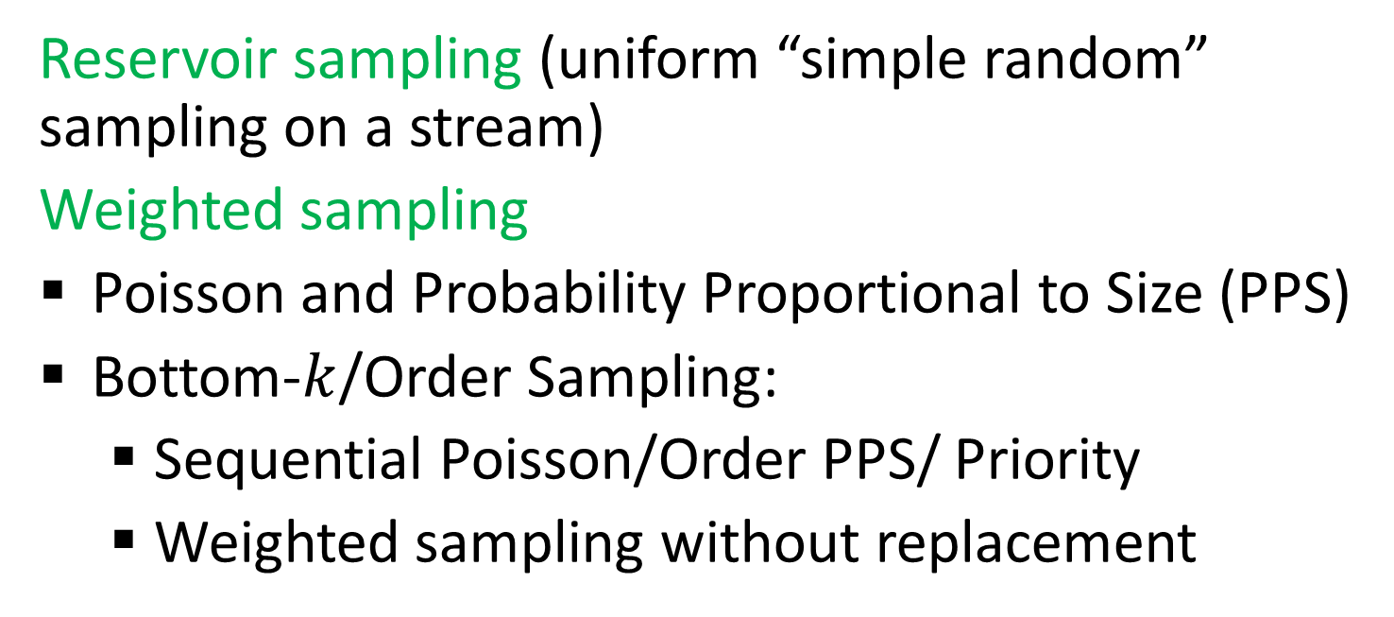
More on “basic” sampling
Reservoir sampling (uniform “simple random” sampling on a stream)
Weighted sampling
Poisson and Probability Proportional to Size (PPS)
Bottom-$k$/Order Sampling:
  Sequential Poisson/Order PPS/ Priority
  Weighted sampling without replacement
Many names because these highly useful and natural sampling schemes were re-invented multiple times, by Computer Scientists and Statisticians

Slide 45
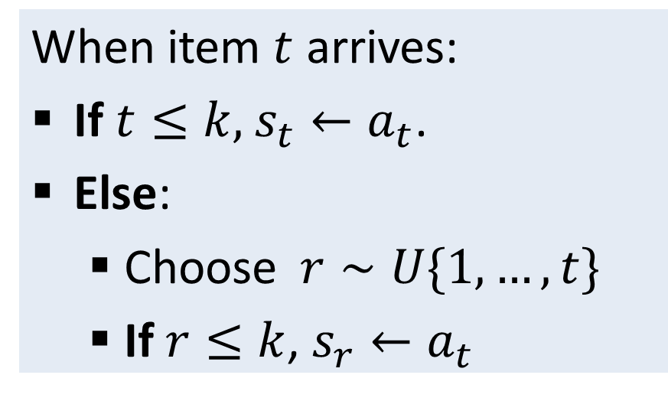
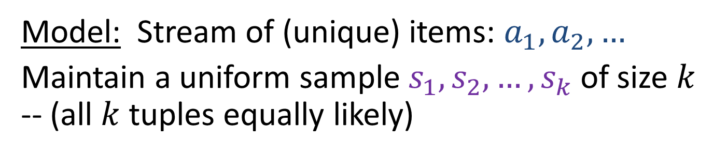
Reservoir Sampling:
[Knuth 1969,1981; Vitter 1985, …]
Model: Stream of (unique) items: $a_{1},a_{2},…$
Maintain a uniform sample $s_{1},s_{2},…, s_{k}$of size $k$ -- (all $k$ tuples equally likely)
When item $t$ arrives:
If $t≤k,$ $s_{t}←a_{t}$.
Else:
  Choose $r∼U\{1,…, t\}$
  If $r≤k$, $s_{r}←a_{t}$

Slide 46
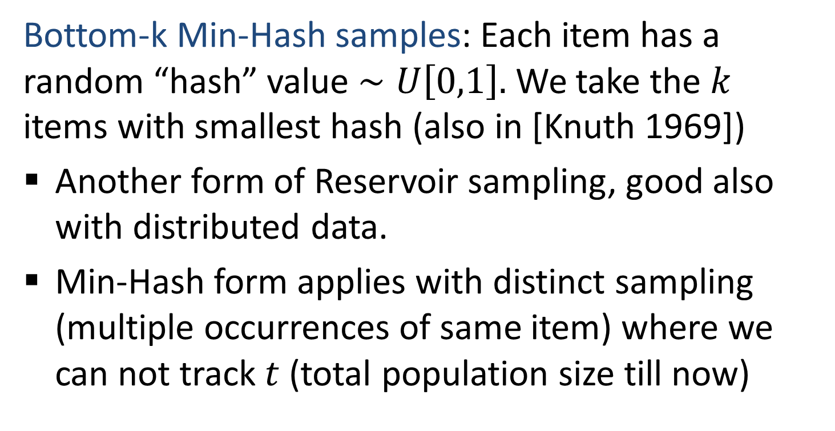

Reservoir using bottom-$k$ Min-Hash
Bottom-k Min-Hash samples: Each item has a random “hash” value $∼U\left[0,1\right].$ We take the $k$ items with smallest hash (also in [Knuth 1969])
Another form of Reservoir sampling, good also with distributed data.
Min-Hash form applies with distinct sampling (multiple occurrences of same item) where we can not track $t$ (total population size till now)

Slide 47
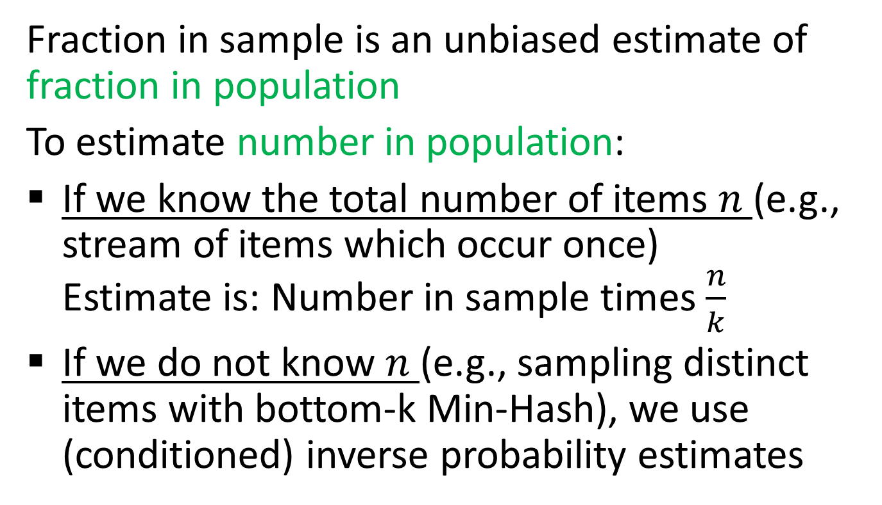
Subset queries with uniform sample
Fraction in sample is an unbiased estimate of fraction in population
To estimate number in population:
If we know the total number of items $n$ (e.g., stream of items which occur once) Estimate is: Number in sample times $\frac{n}{k}$
If we do not know $n$ (e.g., sampling distinct items with bottom-k Min-Hash), we use (conditioned) inverse probability estimates
First option is better (when available): Lower variance for large subsets

Slide 48
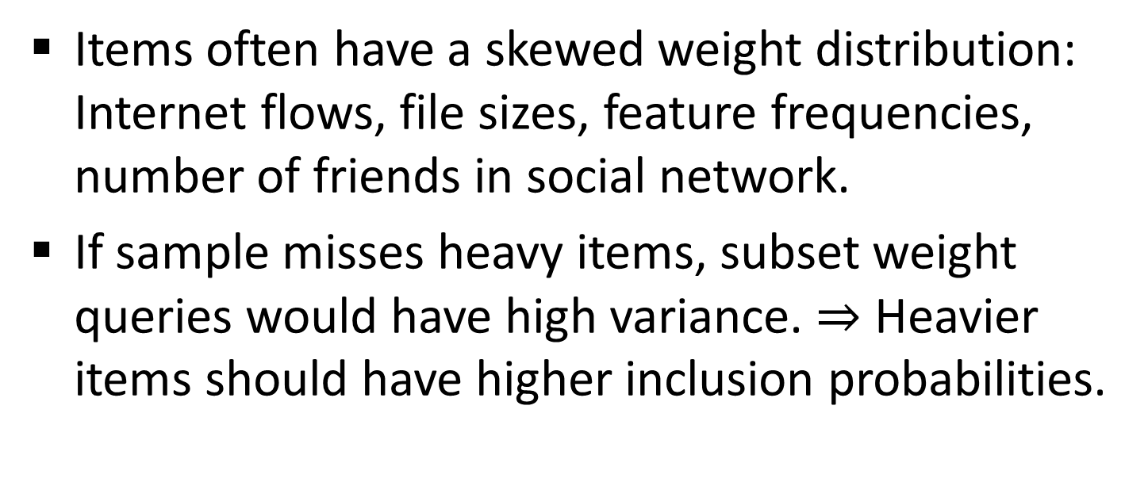
Weighted Sampling
Items often have a skewed weight distribution: Internet flows, file sizes, feature frequencies, number of friends in social network.
If sample misses heavy items, subset weight queries would have high variance. $⇒$ Heavier items should have higher inclusion probabilities.

Slide 49



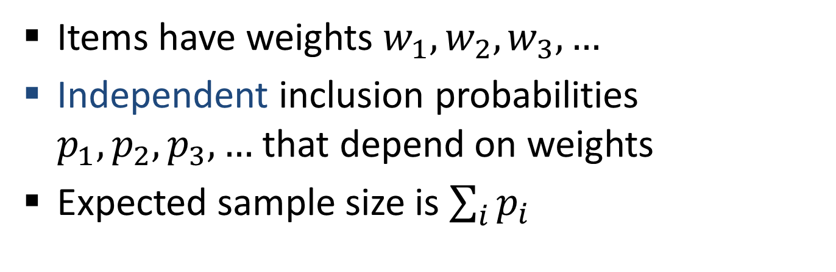




Poisson Sampling (generalizes Bernoulli)
Items have weights $w_{1},w_{2},w_{3},…$
Independent inclusion probabilities $p_{1},p_{2},p_{3},…$ that depend on weights
Expected sample size is $\sum_{i}{p_{i}}$
$$p_{1}$$
$$p_{2}$$
$$p_{3}$$
$$p_{4}$$
$$p_{5}$$
$$p_{6}$$
$$…$$

Slide 50
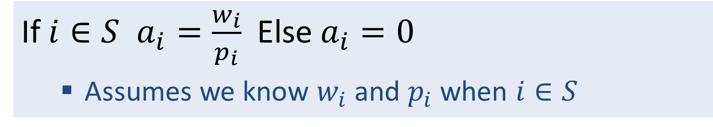
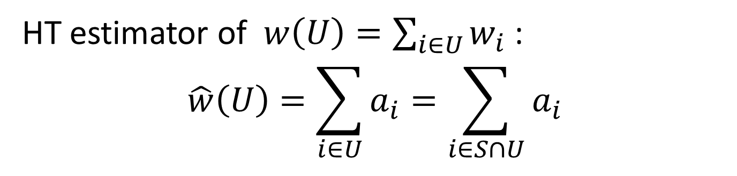
Poisson: Subset Weight Estimation
Inverse Probability estimates [HT52]
If $i∈S$ $a_{i}=\frac{w_{i}}{p_{i}}$ Else $a_{i}=0$
  Assumes we know $w_{i}$ and $p_{i}$ when $i∈S$
HT estimator of $w\left(U\right)=\sum_{i∈U}{w_{i}}$ :
$$\hat{w}\left(U\right)=\sum_{i∈U}{a_{i}}=\sum_{i∈S∩U}{a_{i}}$$
$$p_{1}$$
$$p_{2}$$
$$p_{3}$$
$$p_{4}$$
$$p_{5}$$
$$p_{6}$$
$$…$$

Slide 51
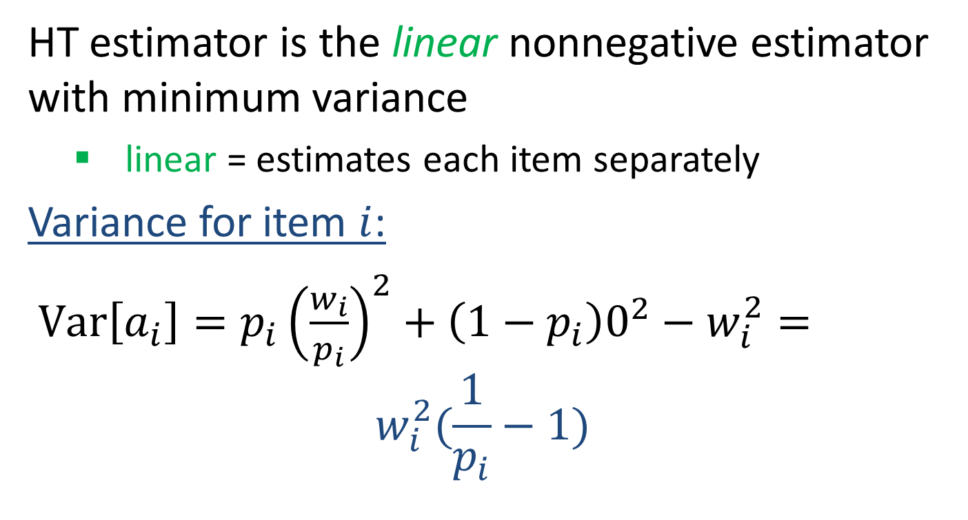
Poisson with HT estimates: Variance
HT estimator is the linear nonnegative estimator with minimum variance
  linear = estimates each item separately
Variance for item $i$:
$Var\left[a_{i}\right]=p_{i}{\left(\frac{w_{i}}{p_{i}}\right)}^{2}+\left(1−p_{i}\right)0^{2}−w_{i}^{2}=$
$$w_{i}^{2}(\frac{1}{p_{i}}−1)$$

Slide 52
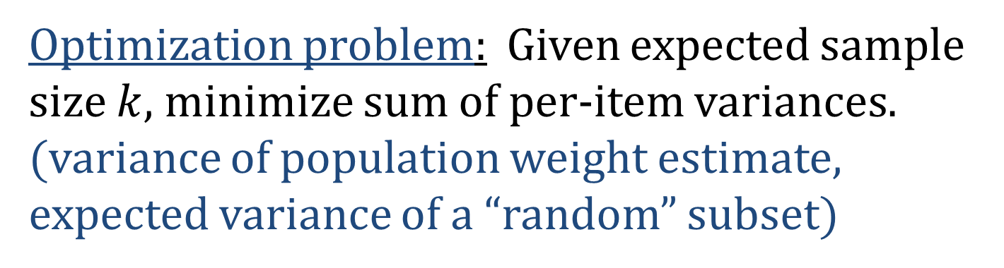

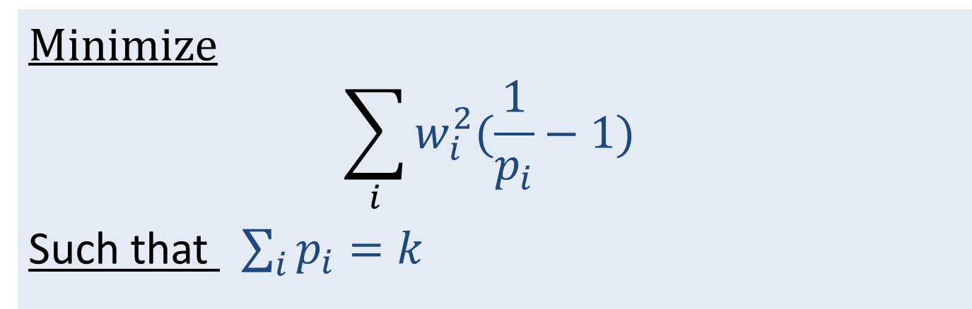
Poisson: How to choose $p_{i}$ ?
Optimization problem: Given expected sample size $k$, minimize sum of per-item variances. (variance of population weight estimate, expected variance of a “random” subset)
Minimize
$$\sum_{i}{w_{i}^{2}(\frac{1}{p_{i}}−1) }$$
Such that $\sum_{i}{p_{i}}=k$

Slide 53


Probability Proportional to Size (PPS)
Minimize
$$\sum_{i}{w_{i}^{2}(\frac{1}{p_{i}}−1) }$$
Such that $\sum_{i}{p_{i}}=k$
Solution: Each item is sampled with probability $p_{i}∝w_{i}$ (truncate with 1).
We show proof for 2 items…

Slide 54
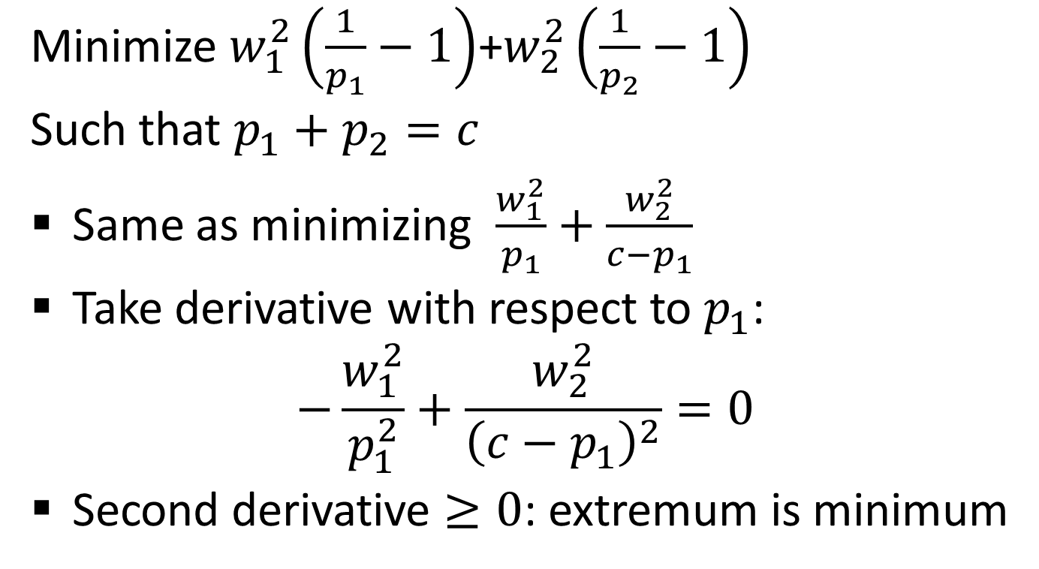
PPS minimizes variance: 2 items
Minimize $w_{1}^{2}\left(\frac{1}{p_{1}}−1\right)$+$w_{2}^{2}\left(\frac{1}{p_{2}}−1\right)$
Such that $p_{1}+p_{2}=c$
Same as minimizing $\frac{w_{1}^{2}}{p_{1}}+\frac{w_{2}^{2}}{c−p_{1}}$
Take derivative with respect to $p_{1}$:
$$−\frac{w_{1}^{2}}{p_{1}^{2}}+\frac{w_{2}^{2}}{{\left(c−p_{1}\right)}^{2}}=0$$
Second derivative $≥0$: extremum is minimum

Slide 55

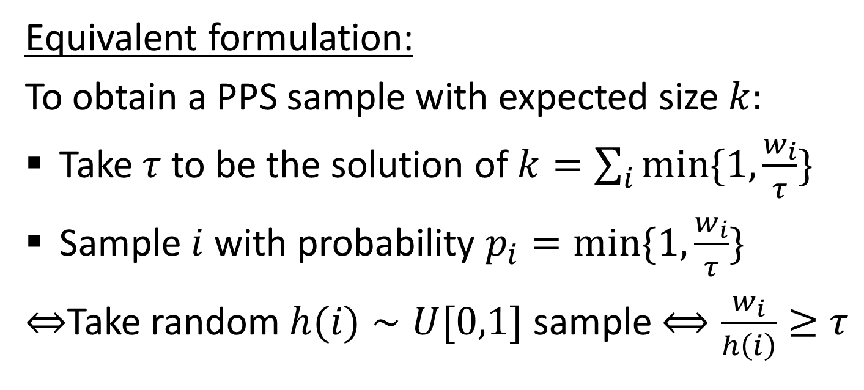
Probability Proportional to Size (PPS)
Equivalent formulation:
To obtain a PPS sample with expected size $k:$
Take $τ$ to be the solution of $k=\sum_{i}{min\{1,\frac{w_{i}}{τ}\}}$
Sample $i$ with probability $p_{i}=min\{1,\frac{w_{i}}{τ}\}$
$⇔$Take random $h(i)∼U[0,1]$ sample $⟺\frac{w_{i}}{h\left(i\right)}≥τ$
For given weights ${\{w}_{i}\}$, $k$ uniquely determines $τ$

Slide 56
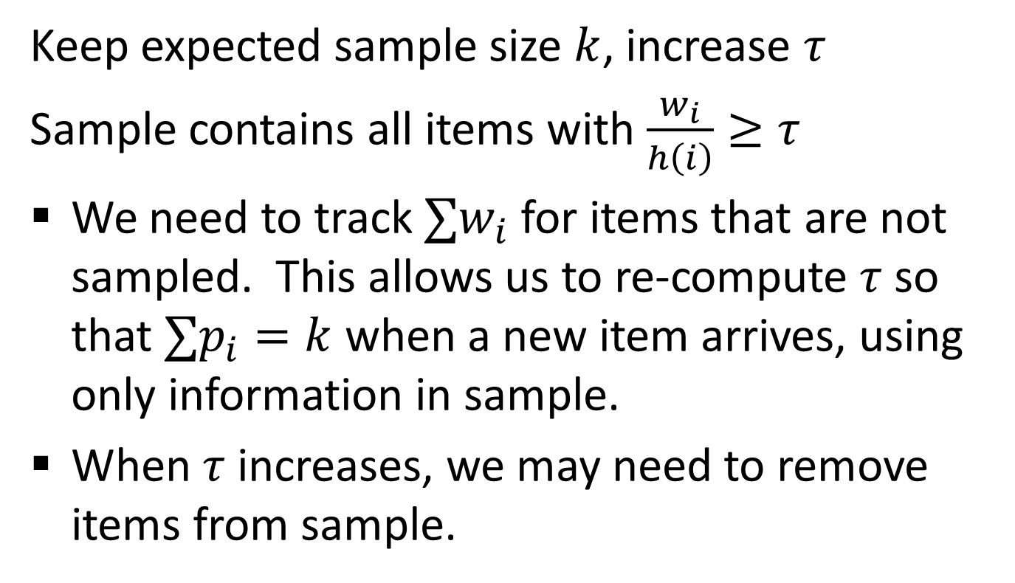

Poisson PPS on a stream
Keep expected sample size $k$, increase $τ$
Sample contains all items with $\frac{w_{i}}{h\left(i\right)}≥τ$
We need to track $∑w_{i}$ for items that are not sampled. This allows us to re-compute $τ$ so that $∑p_{i}=k$ when a new item arrives, using only information in sample.
When $τ$ increases, we may need to remove items from sample.
Poisson sampling has a variable sample size !!
We prefer to specify a fixed sample size $k$
Notes:
Details left as an exercise

Slide 57
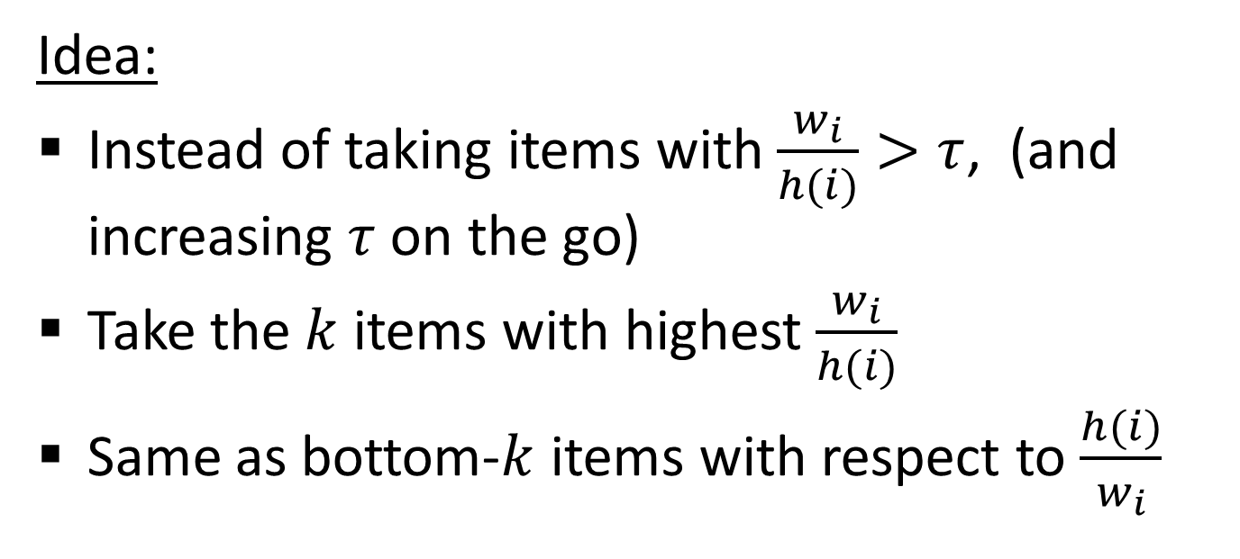
Obtaining a fixed sample size
Proposed schemes include Rejective sampling, Varopt sampling [Chao 1982] [CDKLT2009], ….
We focus here on bottom-k/order sampling.
Idea:
Instead of taking items with $\frac{w_{i}}{h(i)}>τ$, (and increasing $τ$ on the go)
Take the $k$ items with highest $\frac{w_{i}}{h(i)}$
Same as bottom-$k$ items with respect to $\frac{h(i)}{w_{i}}$

Slide 58

Keeping sample size fixed
Bottom-$k$/Order sampling
[Bengt Rosen (1972,1997), Esbjorn Ohlsson (1990-)]
Scheme(s) (re-)invented very many times… E.g.
Duffield Lund Thorup (JACM 2007).… (“priority” sampling), Efraimidis Spirakis 2006, C 1997, CK 2007

Slide 59
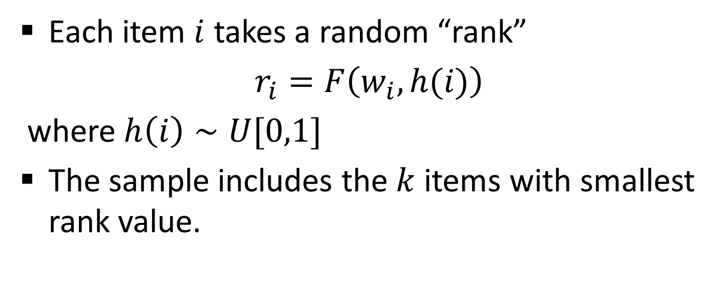
Bottom-k sampling (weighted): General form
Each item $i$ takes a random “rank”
$r_{i}=F\left(w_{i},h(i)\right)$
where $h\left(i\right)∼U[0,1]$
The sample includes the $k$ items with smallest rank value.

Slide 60
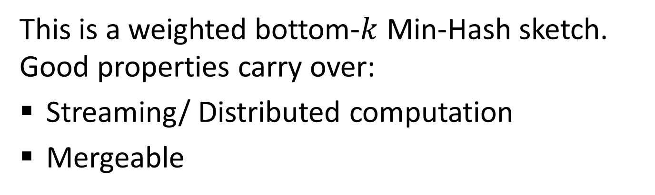
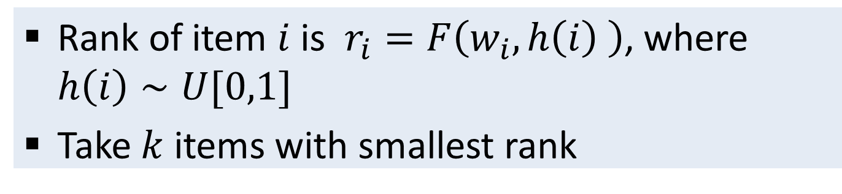
Weighted Bottom-k sample: Computation
Rank of item $i$ is $r_{i}=F\left(w_{i},h\left(i\right) \right)$, where $h\left(i\right)∼U[0,1]$
Take $k$ items with smallest rank
This is a weighted bottom-$k$ Min-Hash sketch. Good properties carry over:
Streaming/ Distributed computation
Mergeable

Slide 61
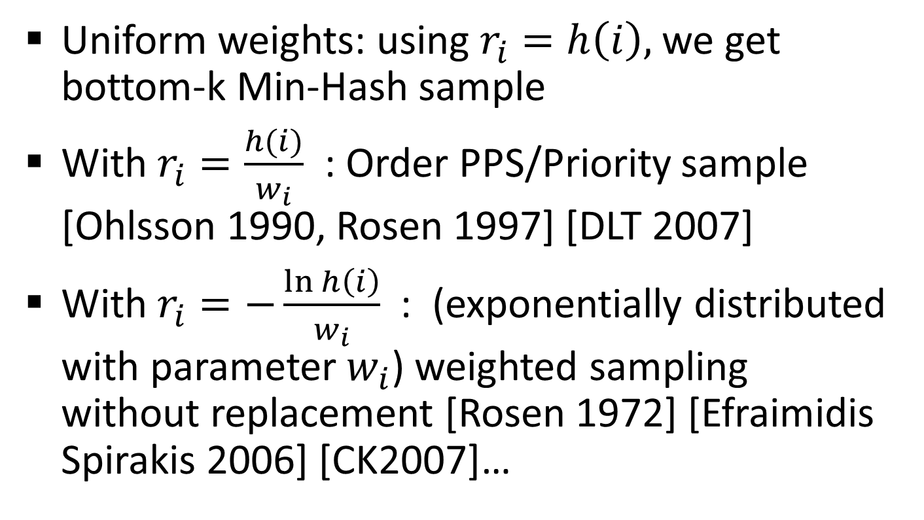

Choosing $F(w,h)$
Uniform weights: using $r_{i}=h\left(i\right),$ we get bottom-k Min-Hash sample
With $r_{i}=\frac{h(i)}{w_{i}}$ : Order PPS/Priority sample [Ohlsson 1990, Rosen 1997] [DLT 2007]
With $r_{i}=−\frac{\ln{h\left(i\right)}}{w_{i}}$: (exponentially distributed with parameter $w_{i}$) weighted sampling without replacement [Rosen 1972] [Efraimidis Spirakis 2006] [CK2007]…

Slide 62
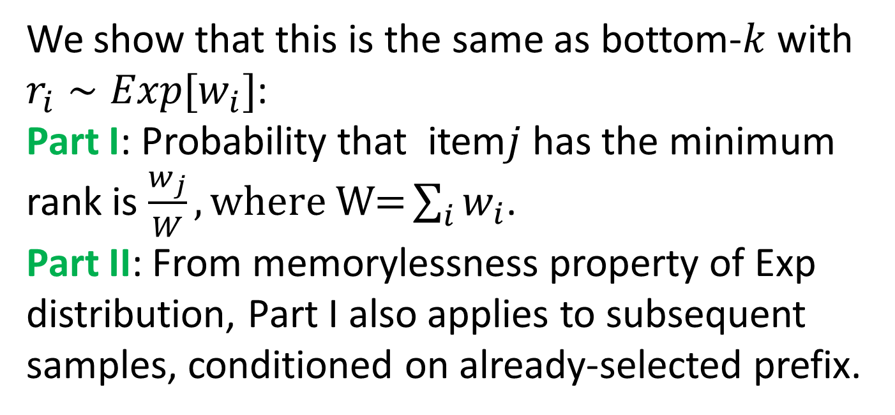

Weighted Sampling without Replacement
Iteratively $k$ times:
Choose $i$ with probability $p=w_{i}/\sum_{i∉S}{w_{i}}$
We show that this is the same as bottom-$k$ with $r_{i}∼Exp[w_{i}]$:
Part I: Probability that item$j$ has the minimum rank is $\frac{w_{j}}{W},\text{where} \text{W}\text{=}\sum_{i}{w_{i}}$.
Part II: From memorylessness property of Exp distribution, Part I also applies to subsequent samples, conditioned on already-selected prefix.

Slide 63

Weighted Sampling without Replacement
Lemma: Probability that item$j$ has the minimum rank is $\frac{w_{j}}{W},\text{where} \text{W}\text{=}\sum_{i}{w_{i}}$.
Proof: Let $W′\text{=}\sum_{i≠j}{w_{i}}$. Minimum of Exp r.v. has an Exp distribution with sum of parameters. Thus
${min\{r}_{i}, i≠j\} ∼Exp[W′]$ $r_{1}∼Exp[w_{1}]$
$$\operatorname{Pr}\left[r_{j}<{min\{r}_{i}, i≠j\}\right]=\int_{0}^{∞}{w_{j}e^{−x w_{1}}\int_{x}^{∞}{W′e^{−y W′}dydx}}=\int_{0}^{∞}{w_{j}e^{−x w_{j}}e^{−x W′}dx=}\frac{w_{j}}{W}\int_{0}^{∞}{{We}^{−xW}}dx$$

Slide 64


Weighted bottom-$k$: Inverse probability estimates for subset queries
Same as with Min-Hash sketches (uniform weights):
For each $i∈S$ , compute $p_{i}$: probability that $i∈S$ given $\left\{r_{j}\right\}|j≠i$
This is exactly the probability that $r_{i}$ is smaller than ${y=k}^{th}\left\{r_{j} | j≠i\right\}$. Note that in our sample $y={\left(k+1\right)}^{th}\{r_{j}\}$
$$p_{i}=\underset{x∼U[0,1]}{Pr}\left[F\left(w_{i},x\right)\right]≤y$$
We take $a_{i}=1/p_{i}$

Slide 65


Weighted bottom-$k$:
Remark on subset estimators
Inverse Probability (HT) estimators apply also when we do not know the total weight of the population.
We can estimate the total weight by $\sum_{i∈S}{a_{i}}$ (same as with unweighted sketches we used for distinct counting).
When we know the total weight, we can get better estimators for larger subsets:
With uniform weights, we could use fraction-in-sample times total. Weighted case is harder.

Slide 66
Weighted Bottom-k sample:
Remark on similarity queries
Rank of item $i$ is $r_{i}=F\left(w_{i},h\left(i\right) \right)$, where $h\left(i\right)∼U[0,1]$
Take $k$ items with smallest rank
Remark:
Similarly to “uniform” weight Min-Hash sketches,
“Coordinated” weighted bottom-k samples of different vectors support similarity queries (weighted Jaccard, Cosine, Lp distance) and other queries which involve multiple vectors [CK2009-2013]

