Slide 1
Leveraging Big Data: Lecture 11
http://www.cohenwang.com/edith/bigdataclass2013
Instructors:
Edith Cohen
Amos Fiat
Haim Kaplan
Tova Milo

Slide 2
Today’s topics
Graph datasets
Mining graphs: which properties we look at and why
Challenges with massive graphs
Some techniques/algorithms for very large graphs:
Min-Hash sketches of reachability sets
All-Distances sketches

Slide 3
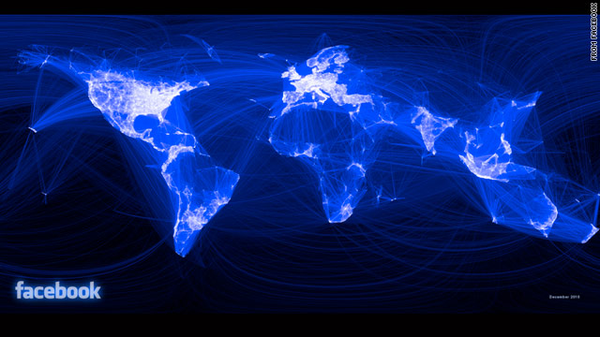
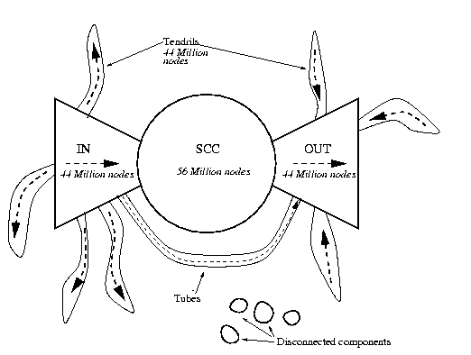
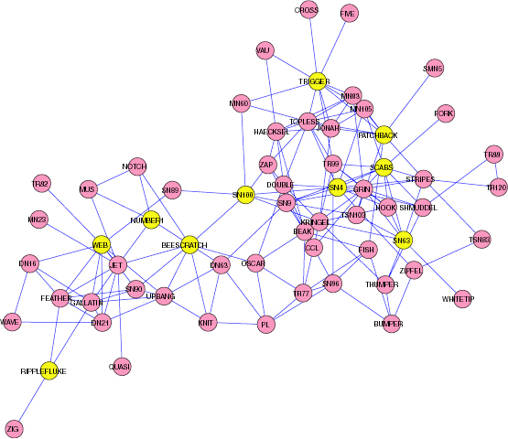
Graph Datasets: Represent relations between “things”
Bowtie structure of the Web Broder et. al. 2001
Dolphin interactions

Slide 4
Graph Datasets
Hyperlinks (the Web)
Social graphs (Facebook, Twitter, LinkedIn,…)
Email logs, phone call logs , messages
Commerce transactions (Amazon purchases)
Road networks
Communication networks
Protein interactions
…

Slide 5
Properties
Directed/Undirected
Snapshot or with time dimension (dynamic)
One or more types of entities (people, pages, products)
Meta data associated with nodes
Some graphs are really large: billions of edges for Facebook and Twitter graphs

Slide 6
Mining the link structure: Node/Network-level properties
Connected/Strongly connected components
Diameter (longest shortest s-t path)
Effective diameter (90% percentile of pairwise distance)
Distance distribution (number of pairs within each distance)
Degree distribution
Clustering coefficient: Ratio of the number of closed triangles to open triangles.

Slide 7
Diameter
Diameter is 3

Slide 8
Distance distribution of
Distance 1: 5
Distance 2: 5
Distance 3: 1

Slide 9
Triangles
Open triangle

Slide 10
Triangles
closed triangle

Slide 11
Triangles
Social graphs have many more closed triangle than random graphs
“Communities” have more closed triangles

Slide 12
…Mining the link structure
Centrality (who are the most important nodes?)
Similarity of nodes (link prediction, targeted ads, friend/product recommendations, Meta-Data completion)
Communities: set of nodes that are more tightly related to each other than to others
“cover:” set of nodes with good coverage (facility location, influence maximization)

Slide 13
Communities Example (overlapping)
Star Wars

Slide 14
Communities Example (overlapping)
Ninjago

Slide 15
Communities Example (overlapping)
Bad Guys

Slide 16
Communities Example (overlapping)
Good Guys

Slide 17
Also a good “cover”

Slide 18
Centrality
Central Guys

Slide 19
Centrality
Which are the most important nodes ?
… answer depends on what we want to capture:
Degree (in/out): largest number of followers, friends. Easy to compute locally. Spammable.
Eigenvalue (PageRank): Your importance/ reputation recursively depend on that of your friends
Betweenness: Your value as a “hub” -- being on a shortest path between many pairs.
Closeness: Centrally located, able to quickly reach/infect many nodes.
Notes:
Monitin=Reputation

Slide 20
Centrality
Central with respect to all measures

Slide 21
Computing on Very Large Graphs
Many applications, platforms, algorithms
Clusters (Map Reduce, Hadoop) when applicable
iGraph/Pregel better with edge traversals
(Semi-)streaming : pass(es), keep small info (per-node)
General algorithm design principles :
settle for approximations
keep total computation/ communication/ storage “linear” in the size of the data
Parallelize (minimize chains of dependencies)
Localize dependencies

Slide 22
Next: Node sketches (this lecture and the next one)
Min-Hash sketches of reachability sets
All-distances sketches (ADS)
Connectivity sketches (Guha/McGregor)
Sketching:
Compute a sketch for each node, efficiently
From sketch(es) can estimate properties that are “harder” to compute exactly

Slide 23
Review (lecture 2): Min Hash Sketches
“Items” $V$
Random hash function $h:V→[0,1]$
For a subset $N⊂V$ we get a sketch $s(N)$
From $s(N)$ we can:
Estimate cardinality $|N|$,
Obtain a random sample of $N$,
Estimate similarity, union, sketch merged sets
Basic sketch ($k=1$) : maintain the minimum $h(N)$

Slide 24
Review: Min-Hash Sketches
$k$ values $y_{1},y_{2},…,y_{k}$ from the range of the hash function (distribution).
k-mins sketch: Use $k$ “independent” hash functions: $h_{1},h_{2},…,h_{k}$
Track the respective minimum $y_{1},y_{2},…,y_{k}$ for each function.
Bottom-k sketch: Use a single hash function: $h$
Track the $k$ smallest values $y_{1},y_{2},…,y_{k}$
k-partition sketch: Use a single hash function: $h′$
Use the first $\log_{2} k$ bits of $h′(x)$ to map $x$uniformly to one of $k$ parts. Call the remaining bits $h(x)$.
For $i=1,…,k$: Track the minimum hash value $y_{i}$ of the elements in part $i$.
All sketches are the same for $k=1$

Slide 25
Sketching Reachability Sets

Slide 26
Reachability Set of
Size 4

Slide 27
Reachability Set of
Size 13

Slide 28
Why sketch reachability sets ?
From reachability sketch(es) we can:
Estimate cardinality of reachability set
Get a sample of the reachable nodes
Estimate relations between reachability sets (e.g., Jaccard similarity)
Exact computation is costly: $O(mn)$ with $n$ nodes and $m$ edges, representation size is massive: does not scale to large networks!

Slide 29
Min-Hash sketches of all Reachability sets
0.37
0.12
0.28
0.45
0.34
0.23
0.85
0.93
0.77
0.06
0.69
0.32
hash values $h(v)∼U[0,1]$
0.95

Slide 30
Min-Hash sketches of all Reachability Sets: $k=1$
For each $v$: $s\left(v\right)←\min_{v ↝ u}$ $h(u)$
Depending on application, may also want to include node ID in sketch:
$\underset{v ↝ u}{argmin}$ $h(u)$

Slide 31
Min-Hash sketches of all Reachability Sets: $k=1$
0.37
{0.23}
0.12
0.28
0.45
{0.12}
{0.23}
{0.12}
{0.23}
0.34
{0.12}
{0.23}
0.23
{0.12}
0.85
0.93
{0.06}
{0.12}
{0.06}
0.77
0.06
0.69
{0.06}
{0.06}
$s\left(v\right)←\min_{v ↝ u}$ $h(u)$
0.95
0.32

Slide 32
Min-Hash sketches of all Reachability Sets: bottom-2 $(k=2)$
For each $v$: $s\left(v\right)←\underset{v ↝ u}{bottom\text{−}2}$ $h(u)$

Slide 33
Min-Hash sketches of all Reachability Sets: bottom-2
0.37
0.12
0.28
0.45
{0.23,0.37}
0.34
{0.12,0.23}
0.23
0.85
0.93
{0.06,0.12}
0.77
0.06
0.69
0.95
0.32

Slide 34
Next: Computing Min-Hash sketches of all reachability sets efficiently
Sketch size for a node: $O(k)$
Total computation $≈O(km)$
Algorithms/methods:
Graphs searches (say BFS)
Dynamic programming/ Distributed

Slide 35
Computing Min-Hash Sketches of all Reachability Sets: $k=1$ BFS method
$s\left(v\right)←\min_{v ↝ u}$ $h(u)$
Iterate over nodes $u$ by increasing $h(u)$:
Visit nodes $v$ through a reverse search from $u$:
IF $s\left(v\right)=∅,$
$s\left(v\right)←h(u)$
Continue search on $inNeighbors(v)$
ELSE, truncate search at $v$

Slide 36
Compute Min-Hash sketches of all Reachability Sets: $k=1$, BFS
0.37
{0.23}
0.12
0.28
0.45
{0.12}
{0.23}
{0.12}
{0.23}
0.34
{0.12}
{0.23}
0.23
{0.12}
0.85
0.93
{0.06}
{0.12}
{0.06}
0.77
0.06
0.69
{0.06}
{0.06}
$s\left(v\right)←\min_{v ↝ u}$ $h(u)$
0.95
0.32

Slide 37
Computing Min-Hash sketches of all reachability sets: $k=1$ BFS method
Analysis:
Each arc is used exactly once $O(m)$

Slide 38
Parallelizing BFS-based Min-Hash computation
Each graph search depends on all previous ones: seems like we need to perform $n$ searches sequentially.
How can we reduce dependencies ?

Slide 39
Parallelizing BFS-based Min-Hash computation
Idea ($k=1):$
Create a super-node of the $n/2$ lowest hash nodes.
Perform a (reverse) search from super-node and mark all nodes that are accessed.
Concurrently perform searches:
From the lowest-hash $n/2$ nodes (sequentially)
From the highest-hash $n/2$ (sequentially). Prune searches also at marked nodes

Slide 40
Parallelizing BFS-based Min-Hash computation
Correctness:
For the lower $n/2$ hash values: computation is the same.
For the higher $n/2$:
We do not know the minimum reachable hash from higher-hash nodes, but we do know it is one of the lower $n/2$ hash values. This is all we need to know for correct pruning.

Slide 41
Parallelizing BFS-based Min-Hash computation
This only gives us $n/2$ instead of $n$ sequential searches.
How can we obtain more parallelism ?
We recursively apply this to each of the lower/higher sets:

Slide 42
Parallelizing BFS-based Min-Hash computation
Nodes ordered by $h(u)$
Super-nodes created in recursion
The depth of dependencies is at most $\log_{2}n$
The total number of edge traversals can increase by a factor of $\log_{2}n$

Slide 43
Computing Min-Hash Sketches of all Reachability Sets: bottom-$k$, BFS method
Next: Computing sketches using the BFS method for k>1
$s\left(v\right)←\underset{v ↝ u}{bottom\text{−}k}$ $h(u)$

Slide 44
Computing Min-Hash Sketches of all Reachability Sets: bottom-$k$, BFS method
$s\left(v\right)←\underset{v ↝ u}{bottom\text{−}k}$ $h(u)$
Iterate over nodes $u$ by increasing $h(u)$:
Visit nodes $v$ through a reverse search from $u$:
IF $\left|s\left(v\right)\right|<k,$
$s\left(v\right)←s\left(v\right)∪\{h\left(u\right)\}$
Continue search on $inNeighbors(v)$
ELSE, truncate search at $v$

Slide 45
Min-Hash sketches of all Reachability Sets: bottom-2
0.37
0.12
0.28
0.45
{0.23, }
0.37
0.34
{0.12, }
0.23
0.23
0.85
0.93
{0.06, }
0.12
0.77
0.06
0.69
0.95
0.32

Slide 46
Computing Min-Hash Sketches of all Reachability Sets: $k=1$ Distributed (DP)
Next: back to $k=1.$
We present another method to compute the sketches. The algorithm has fewer dependencies. It is specified for each node. It is suitable for computation that is:
Distributed, Asynchronous
Dynamic Programming (DP)
Multiple passes on the set of arcs

Slide 47
Computing Min-Hash Sketches of all Reachability Sets: $k=1$ Distributed (DP)
$s\left(v\right)←\min_{v ↝ u}$ $h(u)$
Initialize $s\left(v\right)←h(v)$
IF $s\left(v\right)$ is initialized/updated, send $s(v)$ to $inNeighbors(v)$
IF value $x$ is received from neighbor:
$s\left(v\right)←\min{\{s\left(v\right),x\}}$

Slide 48
DP computation of Min-Hash sketches $k=1$
0.37
{0.37}
0.12
0.28
0.45
{0.12}
{0.45}
{0.28}
{0.23}
0.34
{0.34}
{0.85}
0.23
{0.93}
0.85
0.93
{0.06}
{0.77}
{0.69}
0.77
0.06
0.69
{0.95}
{0.32}
Initialize: $s\left(v\right)←h(v)$
0.95
0.32

Slide 49
DP computation of Min-Hash sketches $k=1$
0.37
{0.37}
0.12
0.28
0.45
{0.12}
{0.45}
{0.28}
{0.23}
0.34
{0.34}
{0.85}
0.23
{0.93}
0.85
0.93
{0.06}
{0.77}
{0.69}
0.77
0.06
0.69
{0.95}
{0.32}
Send to inNeighbors
0.95
0.32

Slide 50
DP computation of Min-Hash sketches $k=1$
0.37
{0.37}
0.12
0.28
0.45
{0.12}
{0.45}
{0.12}
{0.23}
0.34
{0.12}
{0.23}
0.23
{0.28}
0.85
0.93
{0.06}
{0.12}
{0.06}
0.77
0.06
0.69
{0.32}
{0.32}
Update
0.95
0.32

Slide 51
DP computation of Min-Hash sketches $k=1$
0.37
{0.37}
0.12
0.28
0.45
{0.12}
{0.45}
{0.12}
{0.23}
0.34
{0.12}
{0.23}
0.23
{0.28}
0.85
0.93
{0.06}
{0.12}
{0.06}
0.77
0.06
0.69
{0.32}
{0.32}
If updated, send to inNeighbors
0.95
0.32

Slide 52
DP computation of Min-Hash sketches $k=1$
0.37
{0.37}
0.12
0.28
0.45
{0.12}
{0.45}
{0.12}
{0.23}
0.34
{0.12}
{0.23}
0.23
{0.28}
0.85
0.93
{0.06}
{0.12}
{0.06}
0.77
0.06
0.69
{0.32}
{0.32}
Update
0.95
0.32

Slide 53
DP computation of Min-Hash sketches $k=1$
0.37
{0.23}
0.12
0.28
0.45
{0.12}
{0.23}
{0.12}
{0.23}
0.34
{0.12}
{0.23}
0.23
{0.12}
0.85
0.93
{0.06}
{0.12}
{0.06}
0.77
0.06
0.69
{0.06}
{0.06}
If updated, send to inNeighbors. Done.
0.95
0.32

Slide 54
Analysis of DP: Edge traversals
Lemma: Each arc is used in expectation $< ln n$ times.
Proof: We bound the expected number of updates of $s(v)$. (similar to lecture2)
Consider nodes $v=u_{1},u_{2},…$ in order that ${h(u}_{i})$ is propagated to (can reach) $v$.
The probability that $h(u_{i})$ updates $s(v)$: $Pr⁡[h\left(u_{i}\right)<\underset{j<i}{\min{h\left(u_{j}\right)}}]=\frac{1}{i}$
Summing over nodes (linearity of expectation): $\sum_{i=1}^{n}{\frac{1}{i}=H_{n}<ln n}$

Slide 55
Analysis of DP: dependencies
The longest chain of dependencies is at most the longest shortest path (the diameter of the graph)

Slide 56
Next: All-Distances Sketches (ADS)
Often we care about distance, not only reachability:
Nodes that are closer to you, in distance or in Dijkstra (Nearest-Neighbor) rank, are more meaningful.
We want a sketch that supports distance-based queries.

Slide 57
Applications of ADSs
Estimate node/subset/network level properties that are expensive to compute exactly:

Slide 58
Applications of ADSs
Distance distribution, effective diameter
Closeness centrality
Similarity (e.g., Jaccard similarity of $d$-hop neighborhoods or $x$ nearest neighbors, closeness)
Distance oracles
Tightness of $F⊂V$ as a community
Coverage of $F⊂V$

Slide 59
Bibliography
Recommended further reading on social networks analysis:
Book: “Networks, Crowds, and Markets: Reasoning About a Highly Connected World” By David Easley and Jon Kleinberg.
http://www.cs.cornell.edu/home/kleinber/networks-book/
Course/Lectures by Lada Adamic: https://www.coursera.org/course/sna
http://open.umich.edu/education/si/si508/fall2008

Slide 60
Bibliography
Reachability Min-Hash sketches, All-Distances sketches (lectures 11,12):
E. Cohen “Size-Estimation Framework with Applications to Transitive Closure and Reachability” JCSS 1997
E. Cohen H. Kaplan “Spatially-decaying aggregation over a network” JCSS 2007
E. Cohen H. Kaplan “Summarizing data using bottom-k sketches” PODC 2007
E. Cohen: “All-Distances Sketches, Revisited: HIP Estimators for Massive Graphs Analysis” arXiv 2013

