Slide 1
Leveraging Big Data
http://www.cohenwang.com/edith/bigdataclass2013
Edith Cohen
Amos Fiat
Haim Kaplan
Tova Milo
Instructors:
Disclaimer: This is the first time we are offering this class (new material also to the instructors!)
EXPECT many glitches
Ask questions

Slide 2
What is Big Data ?
Huge amount of information, collected continuously: network activity, search requests, logs, location data, tweets, commerce, data footprint for each person ….
What’s new ?
Scale: terabytes -> petabytes -> exabytes -> …
Diversity: relational, logs, text, media, measurements
Movement: streaming data, volumes moved around
Eric Schmidt (Google) 2010: “Every 2 Days We Create As Much Information As We Did Up to 2003”

Slide 3
The Big Data Challenge
To be able to handle and leverage this information, to offer better services, we need
Architectures and tools for data storage, movement, processing, mining, ….
Good models

Slide 4
Big Data Implications
Many classic tools are not all that relevant
  Can’t just throw everything into a DBMS
Computational models:
  map-reduce (distributing/parallelizing computation)
  data streams (one or few sequential passes)
Algorithms:
  Can’t go much beyond “linear” processing
  Often need to trade-off accuracy and computation cost
More issues:
  Understand the data: Behavior models with links to Sociology, Economics, Game Theory, …
  Privacy, Ethics
Notes:
Say that we do build on everything we already know, but often not out of the box – we need to adapt things. Sometimes return to old things that are becoming relevant.
With DBMS, we want to extend query languages like SQL to bigger domains. With both DBMS and algorithms we can also try to reduce data size.
To analyse social networks we look at socioogy research from mid-20th century.
To understand ecommerce and resource allocation issues we look at game theory and economics
Privacy: when I started working at AT&T in the early 90’s had easy access to call detail data (all long distance calls). Now access to such data is highly guarded. Annual training, can not take out, companies much notify customers on every glitch.
Companes like google, apple, AT&T have a huge amount of information on any of us. Where we are, what we search for, what we worry about.

Slide 5
This Course
Selected topics that
We feel are important
We think we can teach
Aiming for breadth
  but also for depth and developing good working understanding of concepts
http://www.cohenwang.com/edith/bigdataclass2013

Slide 6
Today
Short intro to synopsis structures
The data streams model
The Misra Gries frequent elements summary
  Stream algorithm (adding an element)
  Merging Misra Gries summaries
Quick review of randomization
Morris counting algorithm
  Stream counting
  Merging Morris counters
Approximate distinct counting

Slide 7
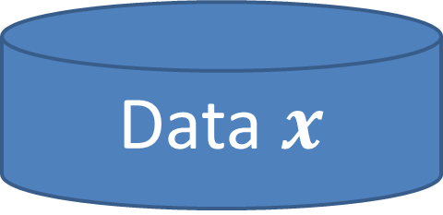

Synopsis (Summary) Structures
A small summary of a large data set that (approximately) captures some statistics/properties we are interested in.
Examples: random samples, sketches/projections, histograms, …
Data $x$
Synopsis $S$
Notes:
We usually do not get all useful properties. Easy to add is important for streams. Mergeability
for distributing the computation.

Slide 8
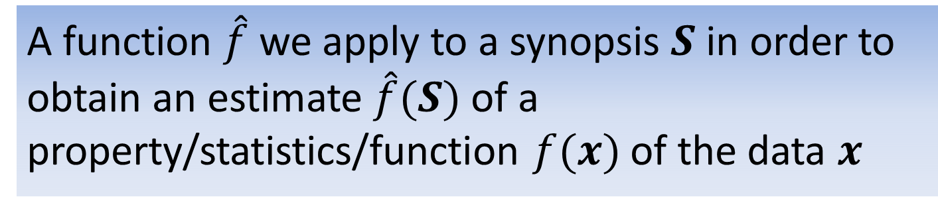
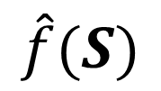



Query a synopsis: Estimators
A function $\hat{f}$ we apply to a synopsis $S$ in order to obtain an estimate $\hat{f}(S)$ of a property/statistics/function $f(x)$ of the data $x$
Data $x$
Synopsis $S$
? $f(x)$
$$\hat{f}(S)$$

Slide 9
Synopsis Structures
A small summary of a large data set that (approximately) captures some statistics/properties we are interested in.
Useful features:
  Easy to add an element
  Mergeable : can create summary of union from summaries of data sets
  Deletions/“undo” support
  Flexible: supports multiple types of queries
Notes:
We usually do not get all useful properties. Easy to add is important for streams. Mergeability
for distributing the computation.

Slide 10






Mergeability
Data $1$
Synopsis $1$
Data $2$
Synopsis $2$
Data $1+2$
Synopsis 1$2$
Enough to consider merging two sketches
Notes:
We want to get the same result if sketching the union of the data sets or from merging the two sketches.
If we can merge two sketches to a sketch of the union, we can do sketching, adding elements, merging, in any order and get the same result.

Slide 11









Why megeability is useful
Synopsis $1$
Synopsis $2$
Synopsis $3$
Synopsis $4$
S. $1∪2$
Synopsis $5$
S. $3∪4$
S. $1∪2∪5$
$1∪2∪3∪4∪5$

Slide 12
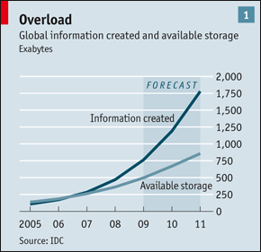
Synopsis Structures: Why?
Data can be too large to:
  Keep for long or even short term
  Transmit across the network
  Process queries over in reasonable time/computation
Data, data, everywhere. Economist 2010

Slide 13
The Data Stream Model
Data is read sequentially in one (or few) passes
We are limited in the size of working memory.
We want to create and maintain a synopsis which allows us to obtain good estimates of properties

Slide 14
Streaming Applications
Network management: traffic going through high speed routers (data can not be revisited)
I/O efficiency (sequential access is cheaper than random access)
Scientific data, satellite feeds

Slide 15
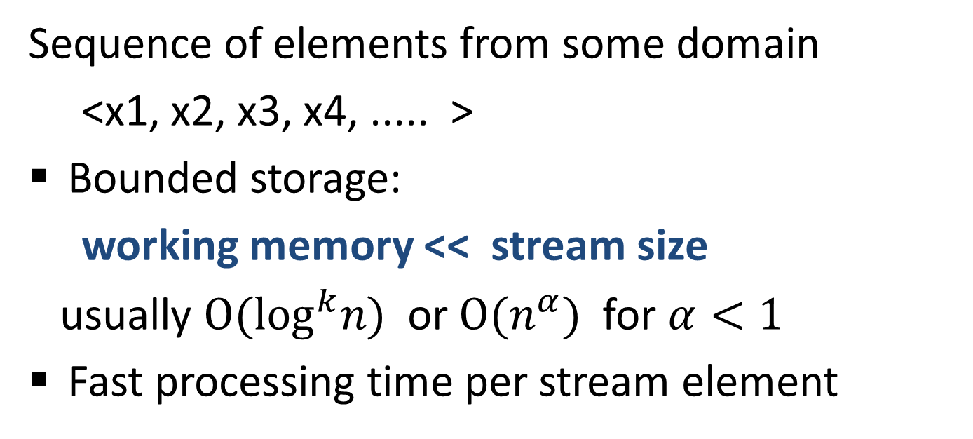
Streaming model
Sequence of elements from some domain
<x1, x2, x3, x4, ..... >
Bounded storage:
working memory << stream size
usually ${O(log}^{k}n)$ or ${O(n}^{α})$ for $α<1$
Fast processing time per stream element

Slide 16
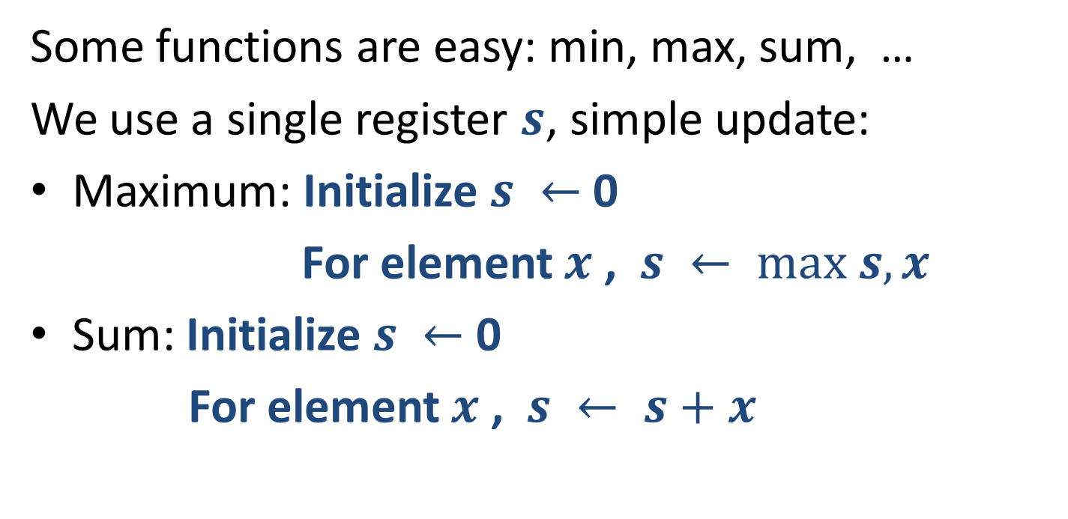
What can we compute over a stream ?
32,
112,
14,
9,
37,
83,
115,
2,
Some functions are easy: min, max, sum, …
We use a single register $s$, simple update:
Maximum: Initialize $s ←$ 0
For element $x$ , $s ← max s,x$
Sum: Initialize $s ←$ 0
For element $x$ , $s ← s+x$
The “synopsis” here is a single value.
It is also mergeable.
Notes:
Application when we need to count many things (network flows) at the same time. Want to use smaller registers.

Slide 17
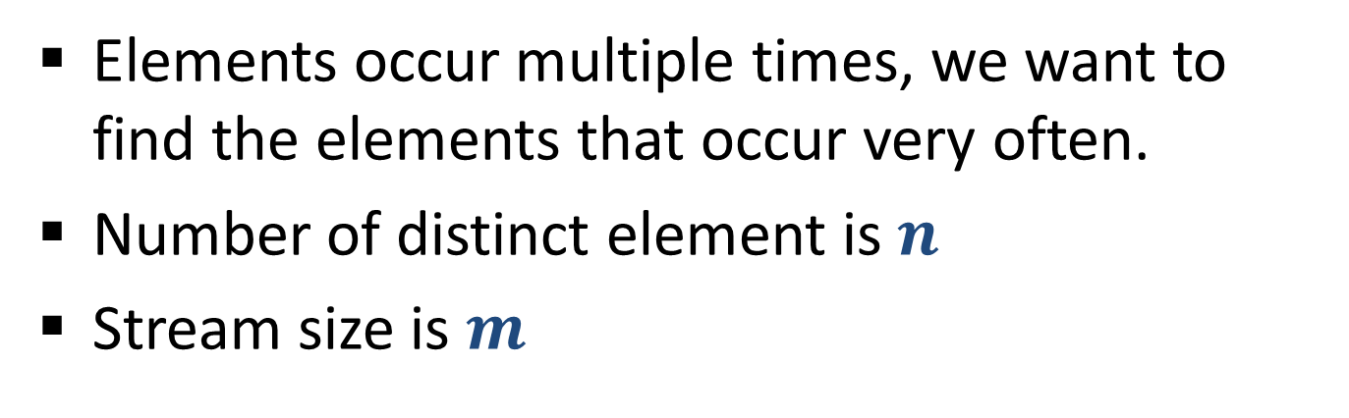
Frequent Elements
32,
12,
14,
32,
7,
12,
32,
7,
6,
12,
4,
Elements occur multiple times, we want to find the elements that occur very often.
Number of distinct element is $n$
Stream size is $m$

Slide 18
Frequent Elements
32,
12,
14,
32,
7,
12,
32,
7,
6,
12,
4,
Applications:
Networking: Find “elephant” flows
Search: Find the most frequent queries
Zipf law: Typical frequency distributions are highly skewed: with few very frequent elements.
Say top 10% of elements have 90% of total occurrences.
We are interested in finding the heaviest elements

Slide 19
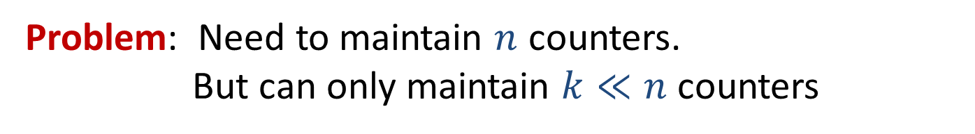
Frequent Elements: Exact Solution
32,
12,
14,
32,
7,
12,
32,
7,
6,
12,
4,
Exact solution:
Create a counter for each distinct element on its first occurrence
When processing an element, increment the counter
32
12
14
7
6
4
Problem: Need to maintain $n$ counters.
But can only maintain $k≪n$ counters

Slide 20
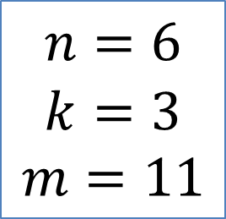
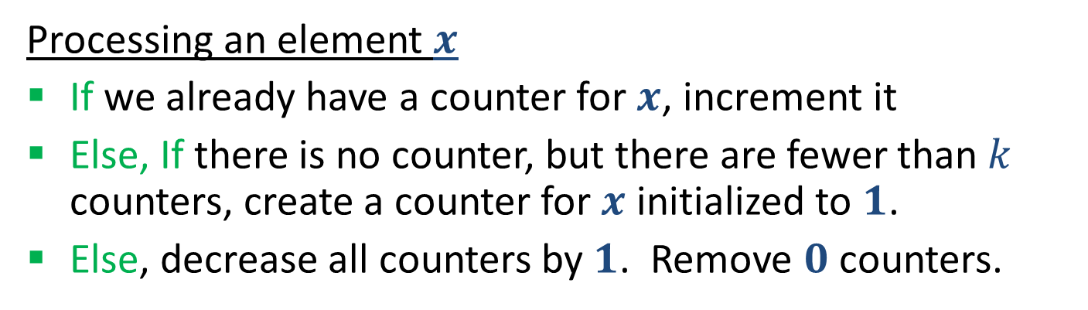
Frequent Elements: Misra Gries 1982
32,
12,
14,
32,
7,
12,
32,
7,
6,
12,
4,
Processing an element $x$
If we already have a counter for $x$, increment it
Else, If there is no counter, but there are fewer than $k$ counters, create a counter for $x$ initialized to $1$.
Else, decrease all counters by $1$. Remove $0$ counters.
32
12
14
12
7
12
4
$$n=6$$
$$k=3$$
$$m=11$$

Slide 21
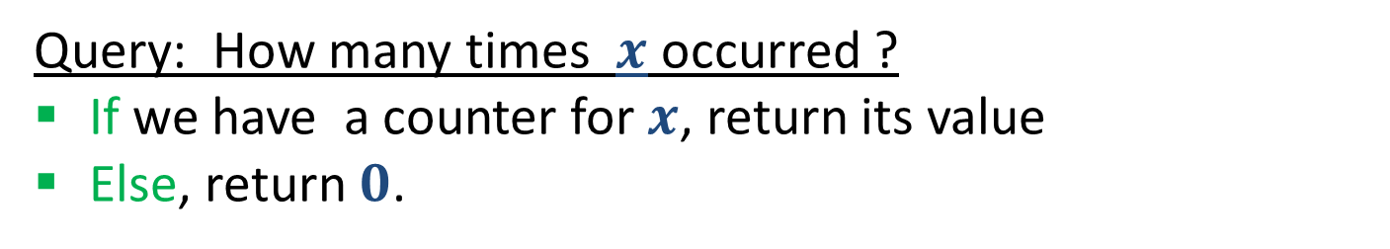
Frequent Elements: Misra Gries 1982
32,
12,
14,
32,
7,
12,
32,
7,
6,
12,
4,
Processing an element $x$
If we already have a counter for $x$, increment it
Else, If there is no counter, but there are fewer than $k$ counters, create a counter for $x$ initialized to $1$.
Else, decrease all counters by $1$. Remove $0$ counters.
Query: How many times $x$ occurred ?
If we have a counter for $x$, return its value
Else, return $0$.
This is clearly an under-estimate.
What can we say precisely?

Slide 22
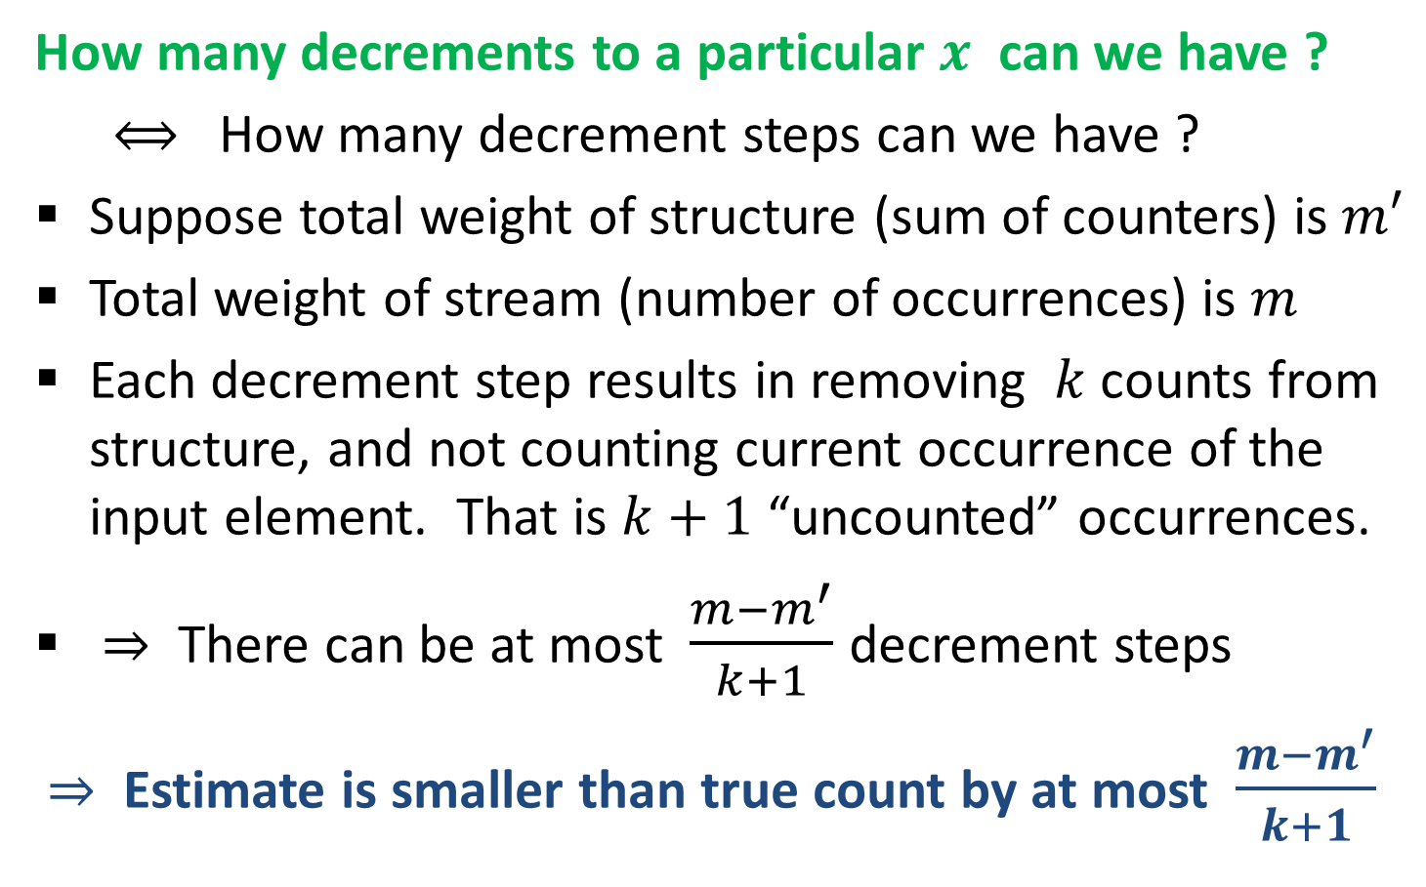
Misra Gries 1982 : Analysis
How many decrements to a particular $x$ can we have ?
$⟺$ How many decrement steps can we have ?
Suppose total weight of structure (sum of counters) is $m′$
Total weight of stream (number of occurrences) is $m$
Each decrement step results in removing $k$ counts from structure, and not counting current occurrence of the input element. That is $k+1$ “uncounted” occurrences.
$⇒$ There can be at most $\frac{{m−m}^{′}}{k+1}$ decrement steps
$⇒$ Estimate is smaller than true count by at most $\frac{{m−m}^{′}}{k+1}$

Slide 23
Misra Gries 1982 : Analysis
Estimate is smaller than true count by at most $\frac{{m−m}^{′}}{k+1}$
$⇒$ We get good estimates for $x$ when the number of occurrences $≫\frac{m−m′}{k+1}$
Error bound is inversely proportional to $k$
The error bound can be computed with summary: We can track $m$ (simple count), know $m’$ (can be computed from structure) and $k$.
MG works because typical frequency distributions have few very popular elements “Zipf law”

Slide 24
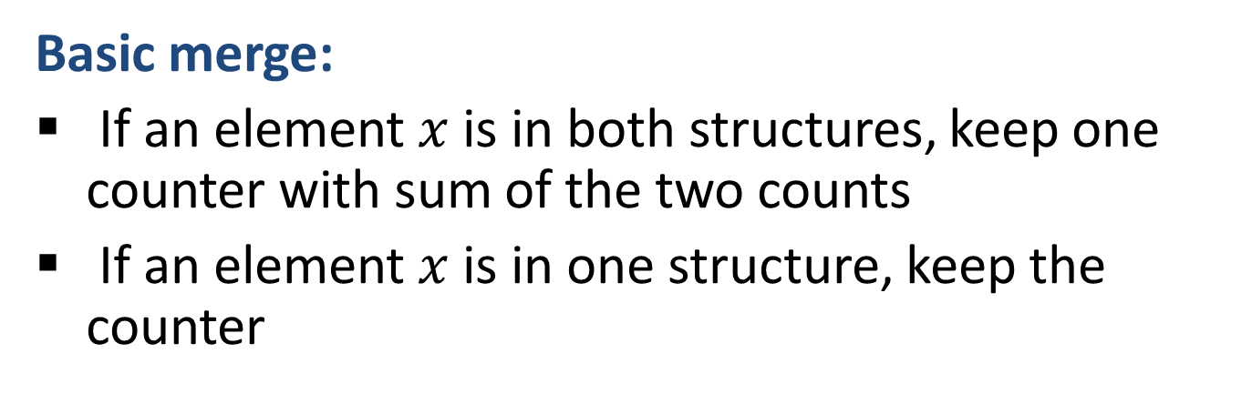
Merging two Misra Gries Summaries
[ACHPWY 2012]
Basic merge:
If an element $x$ is in both structures, keep one counter with sum of the two counts
If an element $x$ is in one structure, keep the counter
Reduce: If there are more than $k$ counters
Take the $\left(k+1\right)$^{th} largest counter
Subtract its value from all other counters
Delete non-positive counters

Slide 25
Merging two Misra Gries Summaries
32
12
14
7
6
14
Basic Merge:
32
12
14
7
6

Slide 26
Merging two Misra Gries Summaries
32
12
14
7
6
4th largest
Reduce since there are more than $k=3$ counters :
Take the $\left(k+1\right)$^{th} = 4th largest counter
Subtract its value (2) from all other counters
Delete non-positive counters

Slide 27
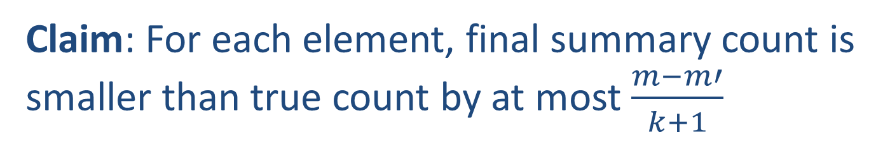
Merging MG Summaries: Correctness
Claim: Final summary has at most $k$ counters
Proof: We subtract the $(k+ 1)$^{th} largest from everything, so at most the $k$ largest can remain positive.
Claim: For each element, final summary count is smaller than true count by at most $\frac{m−m′}{k+1}$

Slide 28
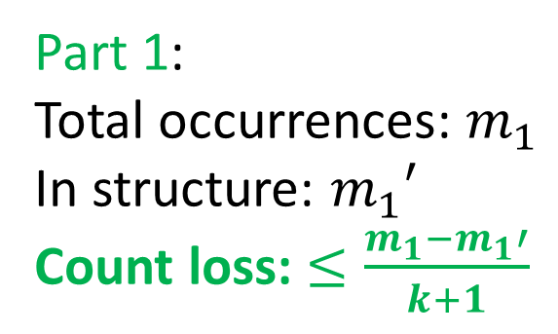
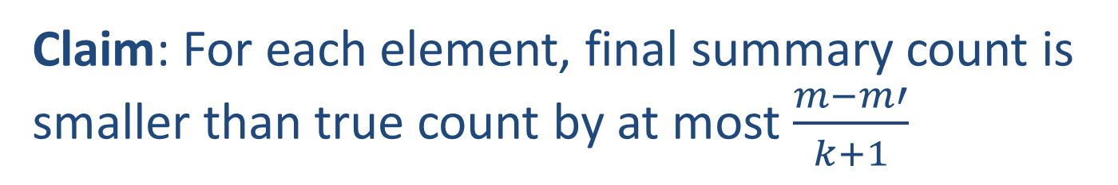
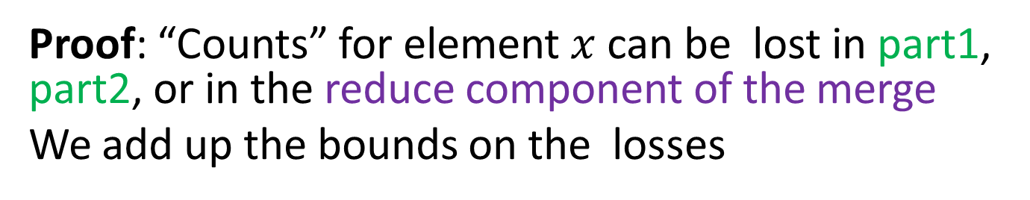
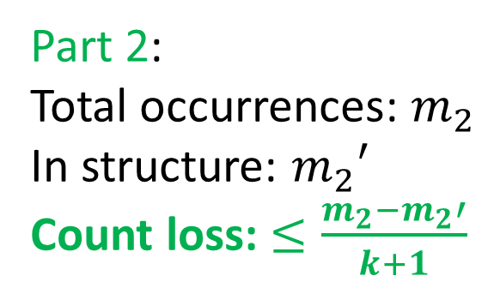
Merging MG Summaries: Correctness
Claim: For each element, final summary count is smaller than true count by at most $\frac{m−m′}{k+1}$
Proof: “Counts” for element $x$ can be lost in part1, part2, or in the reduce component of the merge
We add up the bounds on the losses
Part 1:
Total occurrences: $m_{1}$
In structure: $m_{1}′$
Count loss: $≤\frac{m_{1}−m_{1}′}{k+1}$
Part 2:
Total occurrences: $m_{2}$
In structure: $m_{2}′$
Count loss: $≤\frac{m_{2}−m_{2}′}{k+1}$
Reduce loss is at most $X=(k+1)$^{th} largest counter

Slide 29


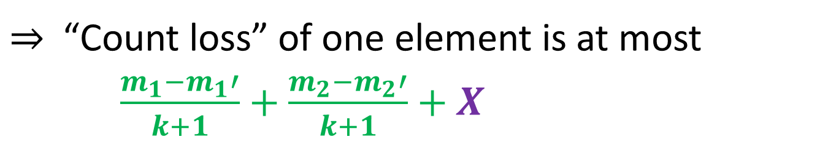
Merging MG Summaries: Correctness
$⇒$“Count loss” of one element is at most
$\frac{m_{1}−m_{1}′}{k+1}+$ $\frac{m_{2}−m_{2}′}{k+1}+X$
Part 1:
Total occurrences: $m_{1}$
In structure: $m_{1}′$
Count loss: $≤\frac{m_{1}−m_{1}′}{k+1}$
Part 2:
Total occurrences: $m_{2}$
In structure: $m_{2}′$
Count loss: $≤\frac{m_{2}−m_{2}′}{k+1}$
Reduce loss is at most $X=(k+1)$^{th} largest counter

Slide 30
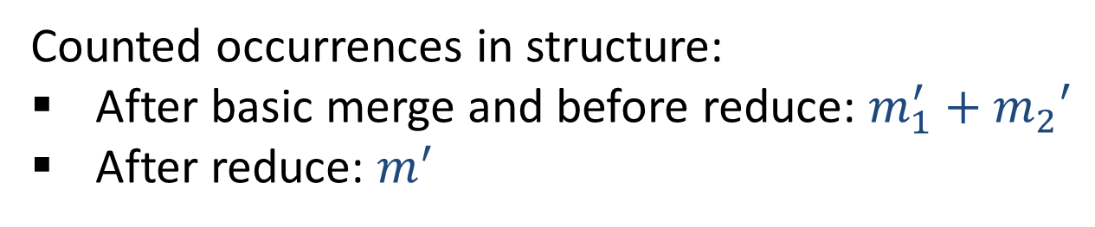
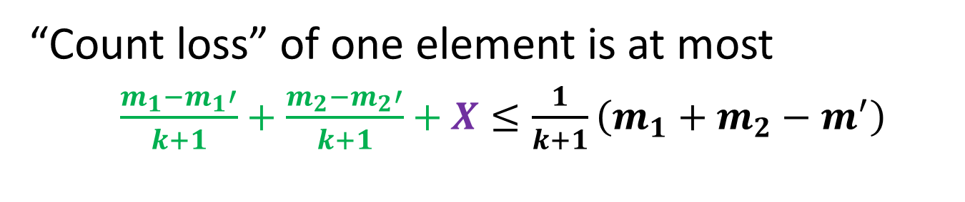
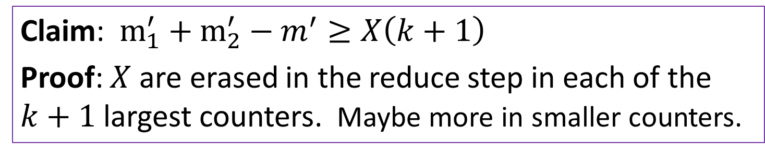
Merging MG Summaries: Correctness
Counted occurrences in structure:
After basic merge and before reduce: ${m_{1}^{′}+m}_{2}′$
After reduce: $m^{′}$
Claim: $m_{1}^{′}+m_{2}^{′}−m^{′}≥X\left(k+1\right)$
Proof: $X$ are erased in the reduce step in each of the $k+1$ largest counters. Maybe more in smaller counters.
“Count loss” of one element is at most
$\frac{m_{1}−m_{1}′}{k+1}+$ $\frac{m_{2}−m_{2}′}{k+1}+X≤\frac{1}{k+1}\left(m_{1}+m_{2}−m^{′}\right)$
$$⇒at most \frac{m−m′}{k+1} uncounted occurrences$$

Slide 31

Using Randomization
Misra Gries is a deterministic structure
The outcome is determined uniquely by the input
Usually we can do much better with randomization

Slide 32

Randomization in Data Analysis
Often a critical tool in getting good results
Random sampling / random projections as a means to reduce size/dimension
Sometimes data is treated as samples from some distribution, and we want to use the data to approximate that distribution (for prediction)
Sometimes introduced into the data to mask insignificant points (for robustness)

Slide 33

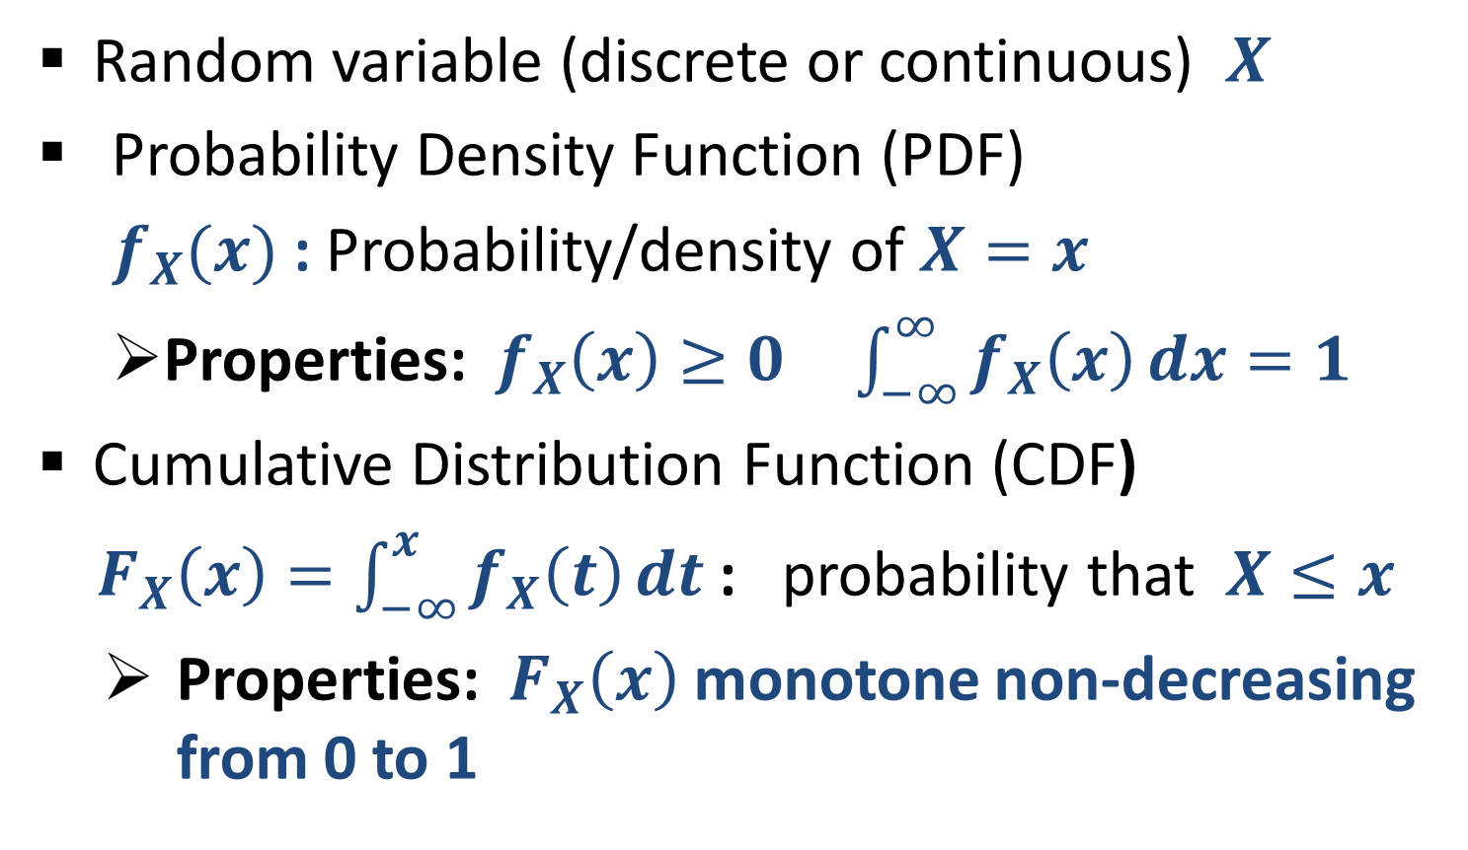
Randomization: Quick review
Random variable (discrete or continuous) $X$
  Probability Density Function (PDF)
  $f_{X}(x)$ : Probability/density of $X=x$
  Properties: $f_{X}\left(x\right)≥0 \int_{−∞}^{∞}{f_{X}\left(x\right)}dx=1$
Cumulative Distribution Function (CDF)
$F_{X}\left(x\right)=\int_{−∞}^{x}{f_{X}\left(t\right)}dt$: probability that $X≤x$
  Properties: $F_{X}\left(x\right)$ monotone non-decreasing from 0 to 1

Slide 34
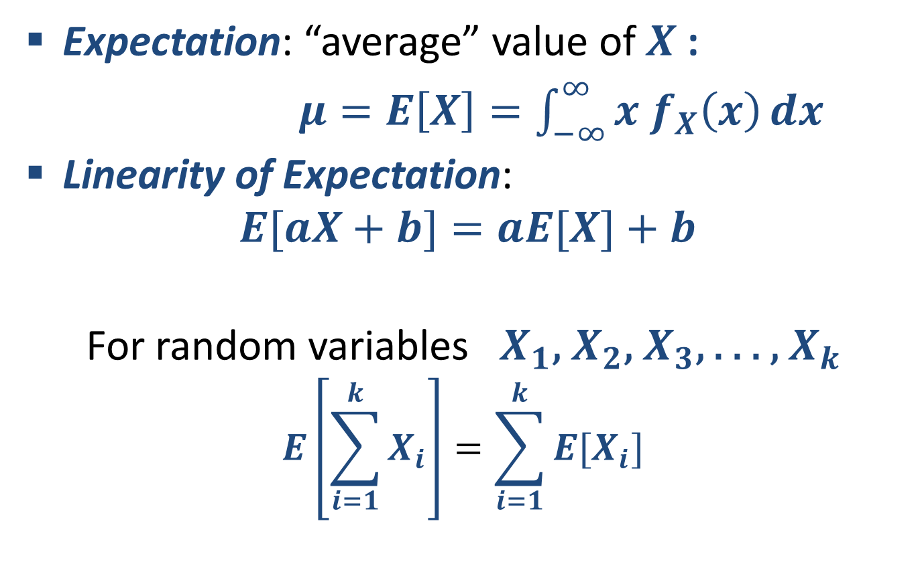
Quick review: Expectation
Expectation: “average” value of $X$:
$μ=E\left[X\right]=\int_{−∞}^{∞}{{x f}_{X}\left(x\right)}dx$
Linearity of Expectation:
$$E[aX+b]=aE[X]+b$$
For random variables $X_{1}\text{, }X_{2}\text{,}{ X}_{3}\text{, }\text{. . . ,} X_{k}$
$$E\left[\sum_{i=1}^{k}{X_{i}}\right]=\sum_{i=1}^{k}{{E[X}_{i}]}$$

Slide 35
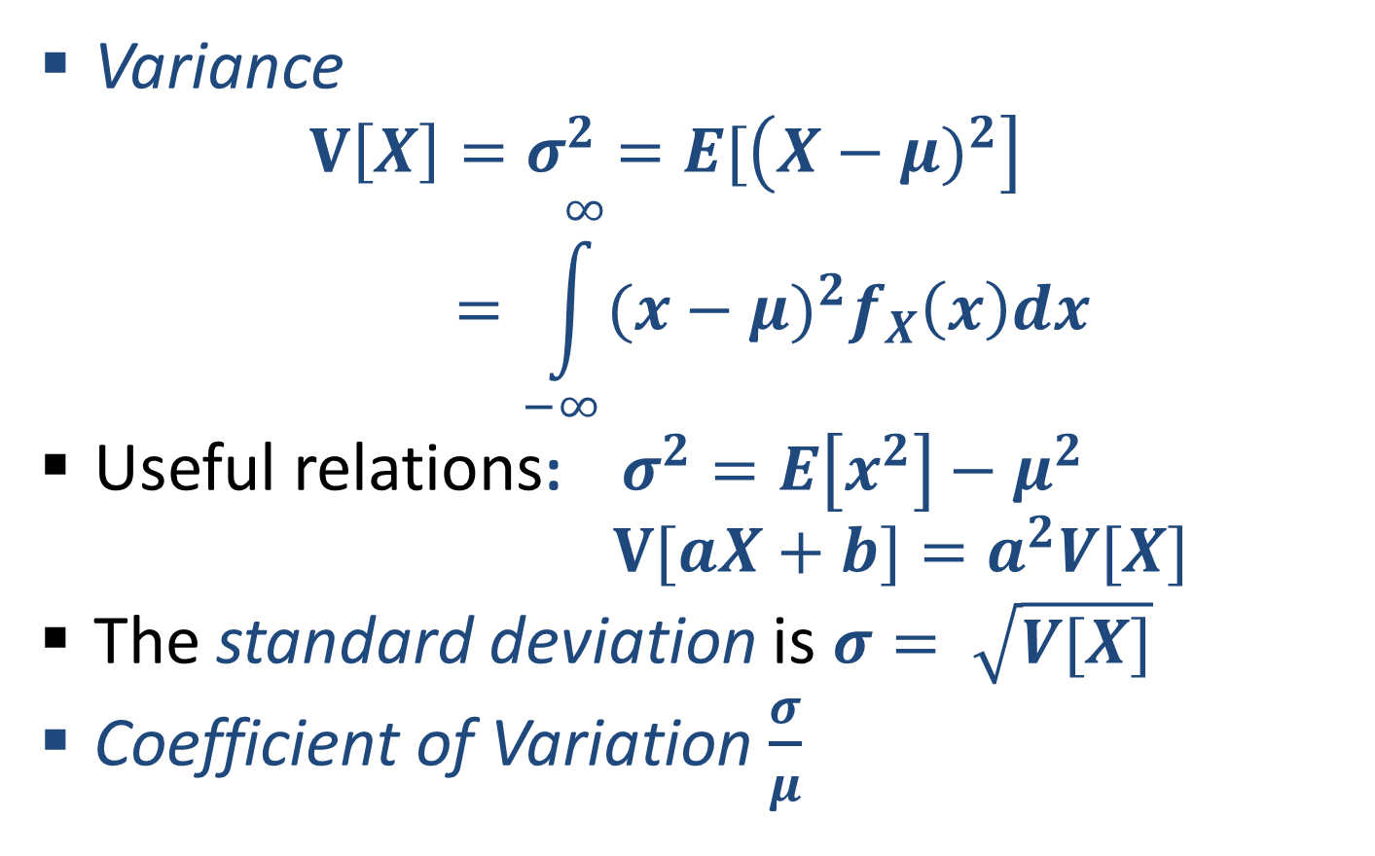
Quick review: Variance
Variance
$$V\left[X\right]=σ^{2}=E[\left(X−{μ)}^{2}\right]=\int_{−∞}^{∞}{{(x−{μ)}^{2}f}_{X}\left(x\right)dx}$$
Useful relations: $σ^{2}=E\left[x^{2}\right]−μ^{2}$
$V[aX+b]=a^{2}V[X]$
The standard deviation is $σ= \sqrt{V[X]}$
Coefficient of Variation $\frac{σ}{μ}$

Slide 36
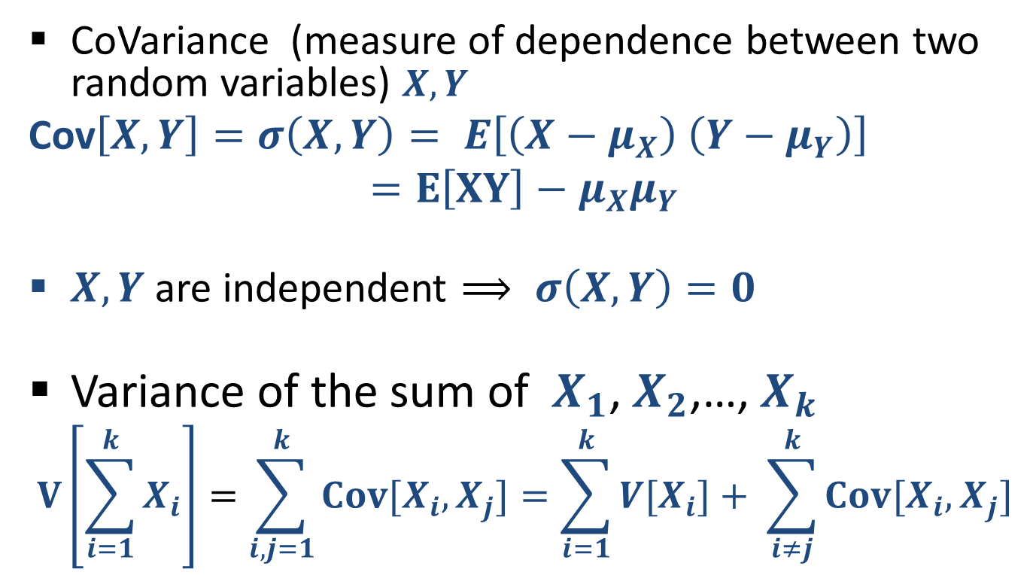
Quick review: CoVariance
CoVariance (measure of dependence between two random variables) $X,Y$
Cov$\left[X,Y\right]=σ\left(X,Y\right)= E\left[\left(X−μ_{X}\right) \left(Y−μ_{Y}\right)\right]$
$$=E\left[XY\right]−μ_{X}μ_{Y}$$
$X,Y$ are independent $⟹ σ\left(X,Y\right)=0$
Variance of the sum of $X_{1}$, $X_{2}$,…, $X_{k}$
$$V\left[\sum_{i=1}^{k}{X_{i}}\right]=\sum_{i,j=1}^{k}{{Cov[X}_{i},X_{j}]}=\sum_{i=1}^{k}{{V[X}_{i}]}+ \sum_{i≠j}^{k}{{Cov[X}_{i},X_{j}]}$$
When (pairwise) independent
Notes:
Shonut meshutefet mention pairwise independence for “ linearity of variance”

Slide 37
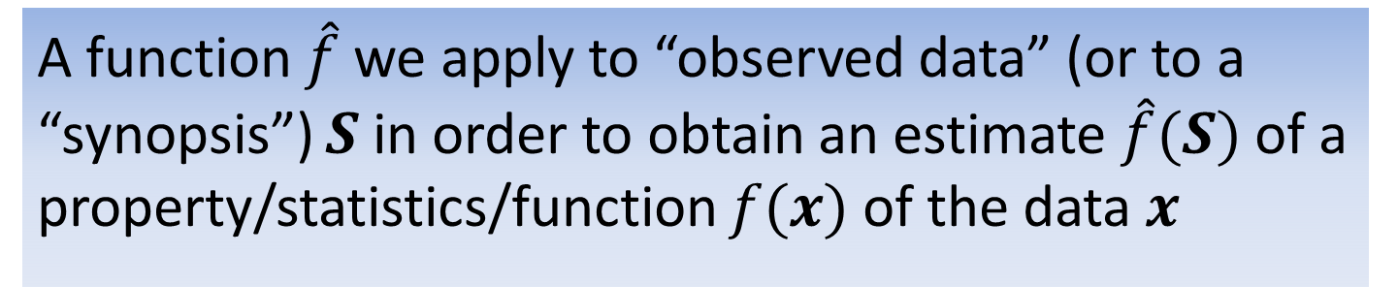


Back to Estimators
A function $\hat{f}$ we apply to “observed data” (or to a “synopsis”) $S$ in order to obtain an estimate $\hat{f}(S)$ of a property/statistics/function $f(x)$ of the data $x$
Data $x$
Synopsis $S$
? $f(x)$
$$\hat{f}(S)$$

Slide 38
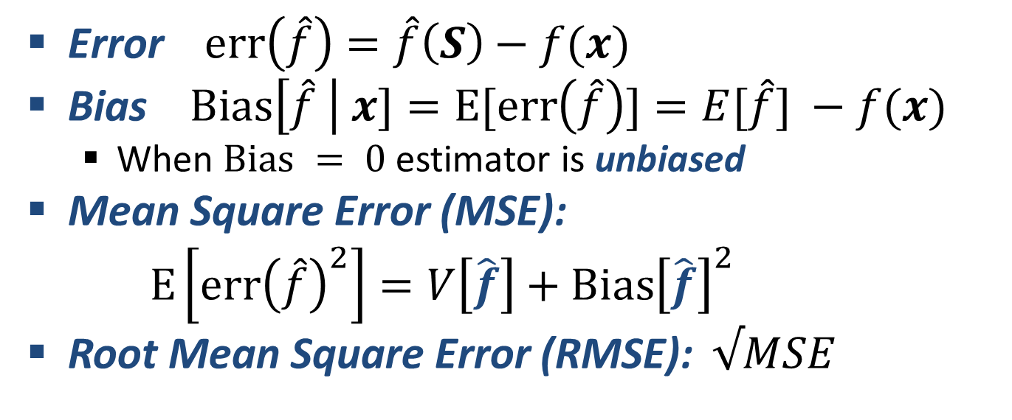
Quick Review: Estimators
A function $\hat{f}$ we apply to “observed data” (or to a “synopsis”) $S$ in order to obtain an estimate $\hat{f}(S)$ of a property/statistics/function $f(x)$ of the data $x$
Error $err\left(\hat{f}\right)=\hat{f}\left(S\right)−f(x)$
Bias $Bias\left[\hat{f} \right| x]=E[err\left(\hat{f}\right)]=E[\hat{f}] −f(x)$
  When $Bias = 0$estimator is unbiased
Mean Square Error (MSE):
$E\left[{err\left(\hat{f}\right)}^{2}\right]=V\left[\hat{f}\right]+Bias{\left[\hat{f}\right]}^{2}$
Root Mean Square Error (RMSE): $√MSE$

Slide 39
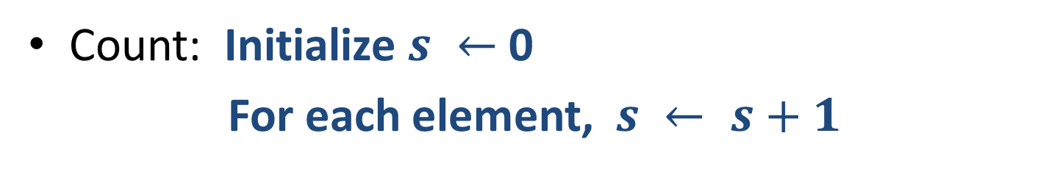

Back to stream counting
1,
1,
1,
1,
1,
1,
1,
1,
Count: Initialize $s ←$ 0
For each element, $s ← s+1$
Register (our synopsis) size (bits) is $⌈\log_{2} n⌉$ where $n$ is the current count
Can we use fewer bits ? Important when we have many streams to count, and fast memory is scarce (say, inside a backbone router)
What if we are happy with an approximate count ?
Notes:
Application when we need to count many things (network flows) at the same time. Want to use smaller registers.

Slide 40

Morris Algorithm 1978
The first streaming algorithm
1,
1,
1,
1,
1,
1,
1,
1,
Stream counting:
Stream of +1 increments
Maintain an approximate count
Idea: track $log n$ instead of $n$
Use $log log n$ bits instead of $log n$ bits

Slide 41


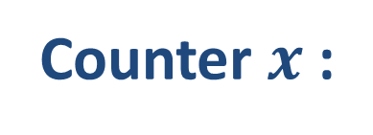


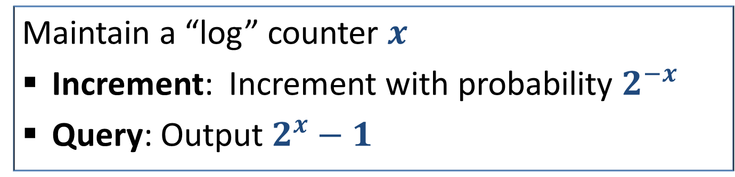


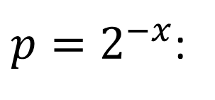
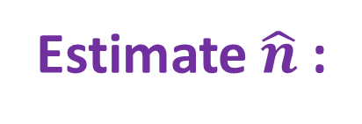



Morris Algorithm
Maintain a “log” counter $x$
Increment: Increment with probability $2^{−x}$
Query: Output $2^{x}−1$
Stream:
1,
1,
1,
1,
1,
1,
1,
1,
Count $n$:
1,
2,
3,
4,
5,
6,
7,
8,
1
$\frac{1}{2}$
$\frac{1}{2}$
$\frac{1}{4}$
$\frac{1}{4}$
$\frac{1}{4}$
$\frac{1}{4}$
$\frac{1}{8}$
$\frac{1}{8}$
$p=2^{−x}$:
Counter $x$:
0
1
1
2
2
2
2
3
3
Estimate $\hat{n}$:
0
1
1
3
3
3
3
7
7

Slide 42
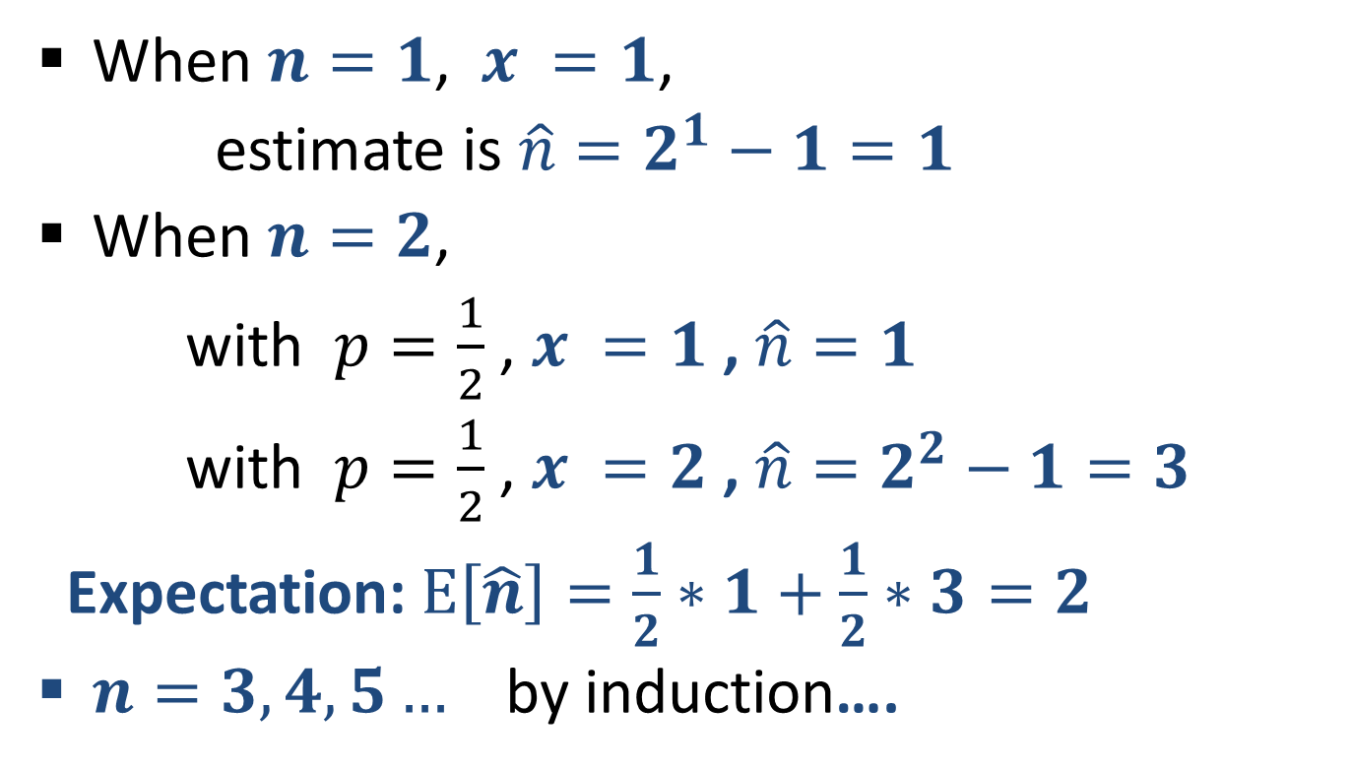
Morris Algorithm: Unbiasedness
When $n=1$, $x =1$,
estimate is ${\hat{n}=2}^{1}−1=1$
When $n=2$,
with $p=\frac{1}{2}$ , $x =1$ , $\hat{n}=1$
with $p=\frac{1}{2}$ , $x =2$ , $\hat{n}=2^{2}−1=3$
Expectation: $E\left[\hat{n}\right]=\frac{1}{2}∗1+\frac{1}{2}∗3=2$
$n=3,4,5…$ by induction….

Slide 43
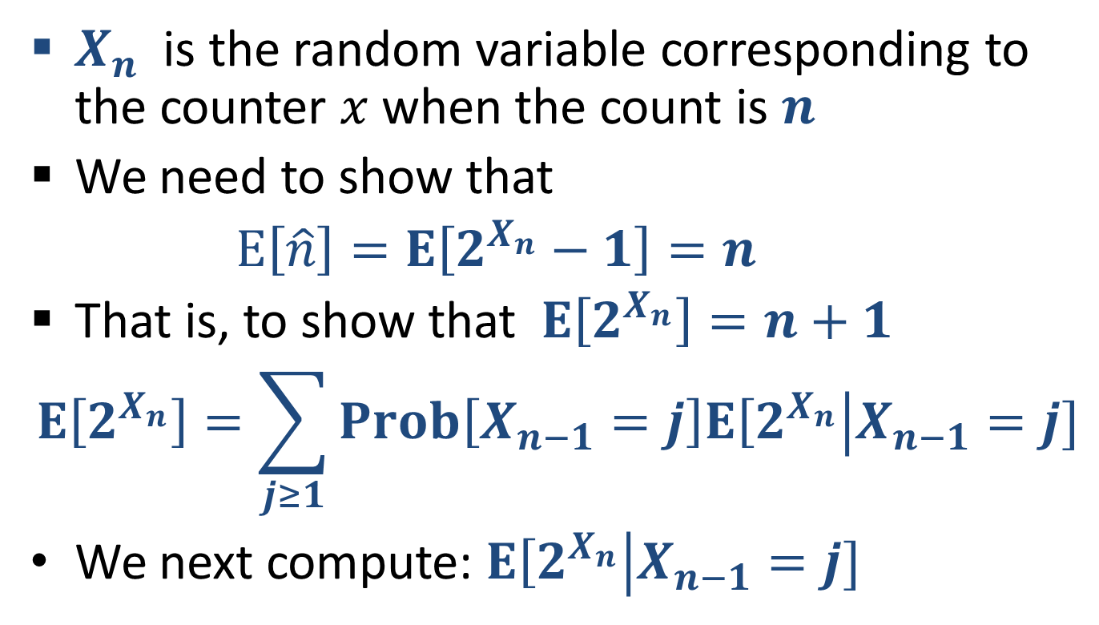
Morris Algorithm: …Unbiasedness
$X_{n}$ is the random variable corresponding to the counter $x$ when the count is $n$
We need to show that
$E\left[\hat{n}\right]=E\left[2^{X_{n}}−1\right]=n$
That is, to show that $E\left[2^{X_{n}}\right]=n+1$
$$E\left[2^{X_{n}}\right]=\sum_{j≥1}{Prob\left[X_{n−1}=j\right]E\left[2^{X_{n}}\right|X_{n−1}=j]}$$
We next compute: $E\left[2^{X_{n}}\right|X_{n−1}=j]$

Slide 44
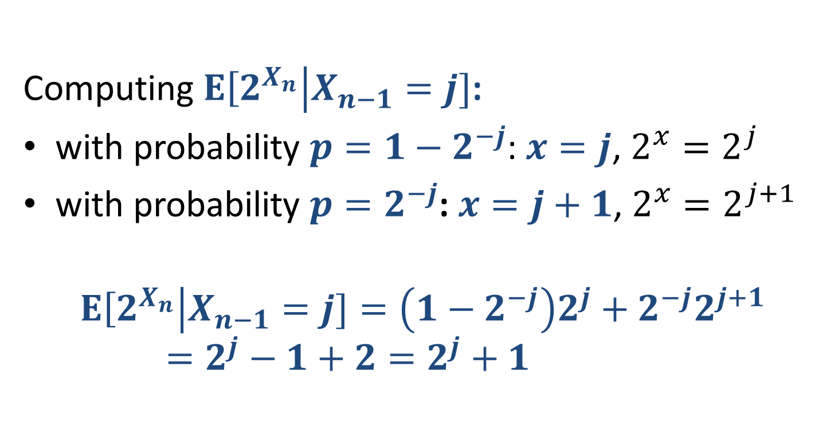
Morris Algorithm: …Unbiasedness
Computing $E\left[2^{X_{n}}\right|X_{n−1}=j]$:
with probability $p=1−2^{−j}$: $x=j$, $2^{x}=2^{j}$
with probability $p=2^{−j}$: $x=j+1$, $2^{x}=2^{j+1}$
$$E\left[2^{X_{n}}\right|X_{n−1}=j]=\left(1−2^{−j}\right)2^{j}+2^{−j}2^{j+1}=2^{j}−1+2=2^{j}+1$$

Slide 45


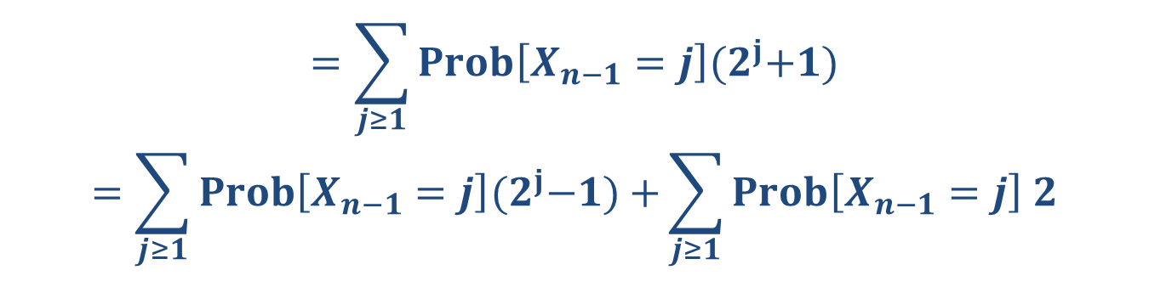

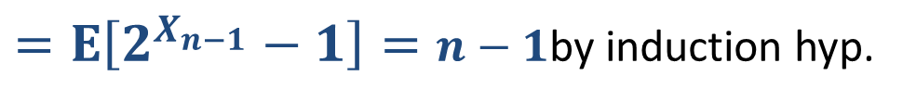
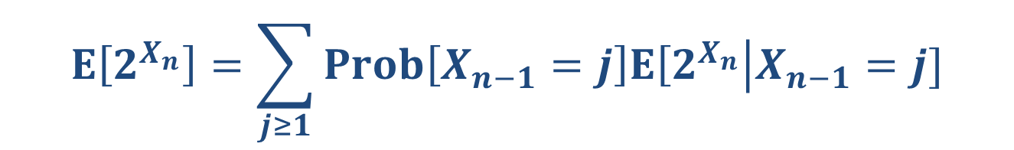
Morris Algorithm: …Unbiasedness
$$E\left[2^{X_{n}}\right|X_{n−1}=j] =2^{j}+1$$
$$E\left[2^{X_{n}}\right]=\sum_{j≥1}{Prob\left[X_{n−1}=j\right]E\left[2^{X_{n}}\right|X_{n−1}=j]}$$
$$=\sum_{j≥1}{Prob\left[X_{n−1}=j\right]{(2}^{j}+1)}$$
$$=\sum_{j≥1}{Prob\left[X_{n−1}=j\right]{(2}^{j}−1)+}\sum_{j≥1}{Prob\left[X_{n−1}=j\right] 2}$$
$=E\left[2^{X_{n−1}}−1\right]=n−1$by induction hyp.
$$1$$
$$=n+1$$

Slide 46
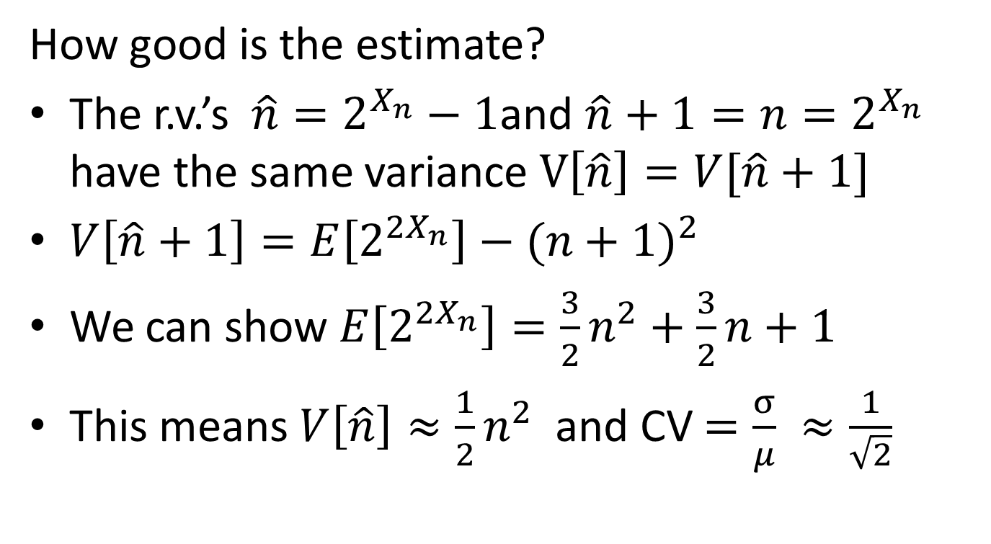
Morris Algorithm: Variance
How good is the estimate?
The r.v.’s $\hat{n}=2^{X_{n}}−1$and $\hat{n}+1=n=2^{X_{n}}$ have the same variance $V\left[\hat{n}\right]=V[\hat{n}+1]$
$V\left[\hat{n}+1\right]=E\left[2^{{2X}_{n}}\right]−{(n+1)}^{2}$
We can show $E\left[2^{{2X}_{n}}\right]=\frac{3}{2}n^{2}+\frac{3}{2}n+1$
This means $V\left[\hat{n}\right]≈\frac{1}{2}n^{2}$ and CV $=\frac{σ}{μ} ≈\frac{1}{\sqrt{2}}$
How to reduce the error ?

Slide 47
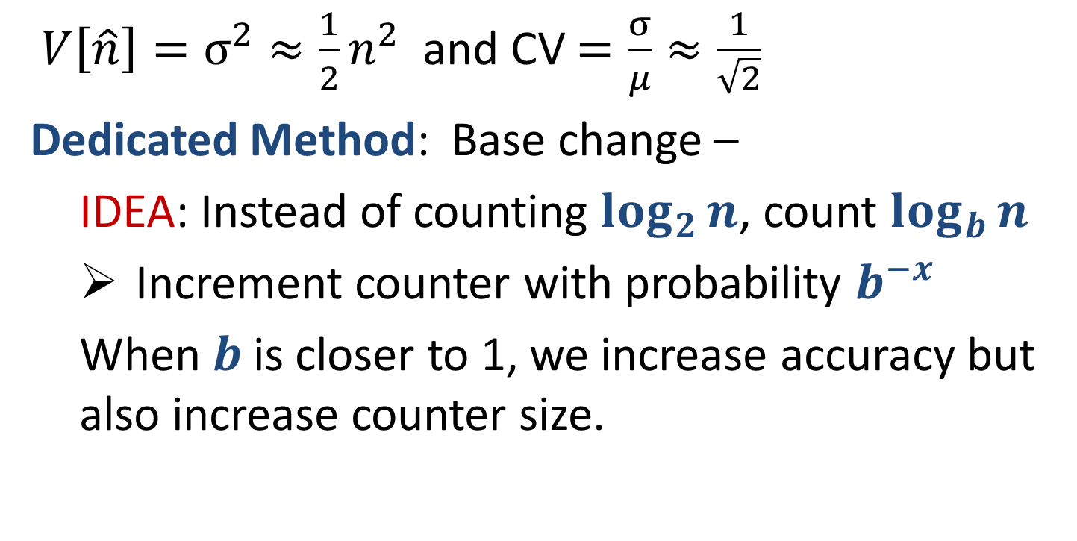
Morris Algorithm: Reducing variance 1
$V\left[\hat{n}\right]=σ^{2}≈\frac{1}{2}n^{2}$ and CV $=\frac{σ}{μ}≈\frac{1}{\sqrt{2}}$
Dedicated Method: Base change –
  IDEA: Instead of counting $\log_{2}{n}$, count $\log_{b}{n}$
  Increment counter with probability $b^{−x}$
  When $b$ is closer to 1, we increase accuracy but also increase counter size.

Slide 48
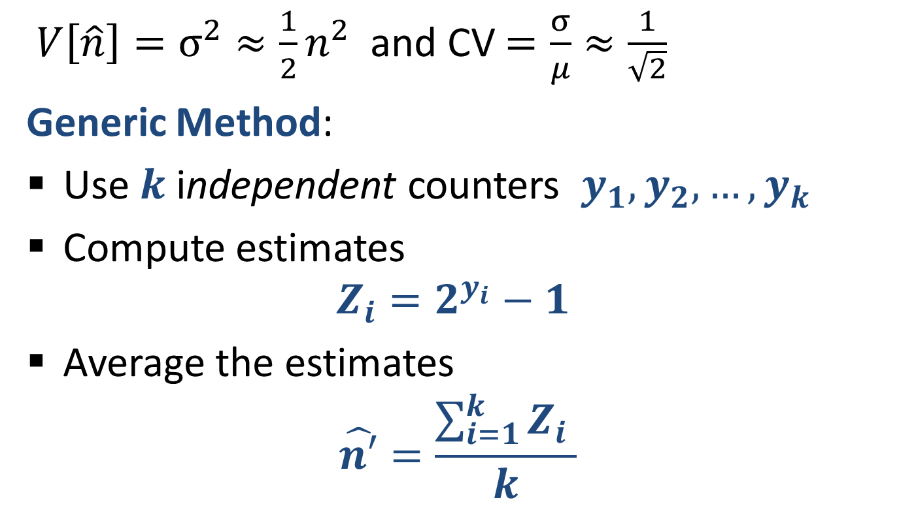
Morris Algorithm: Reducing variance 2
$V\left[\hat{n}\right]=σ^{2}≈\frac{1}{2}n^{2}$ and CV $=\frac{σ}{μ}≈\frac{1}{\sqrt{2}}$
Generic Method:
Use $k$ independent counters $y_{1},y_{2},…,y_{k}$
Compute estimates
$${Z_{i}=2}^{y_{i}}−1$$
Average the estimates
$$\hat{n′}=\frac{\sum_{i=1}^{k}{{Z_{i}}_{ }}}{k}$$

Slide 49
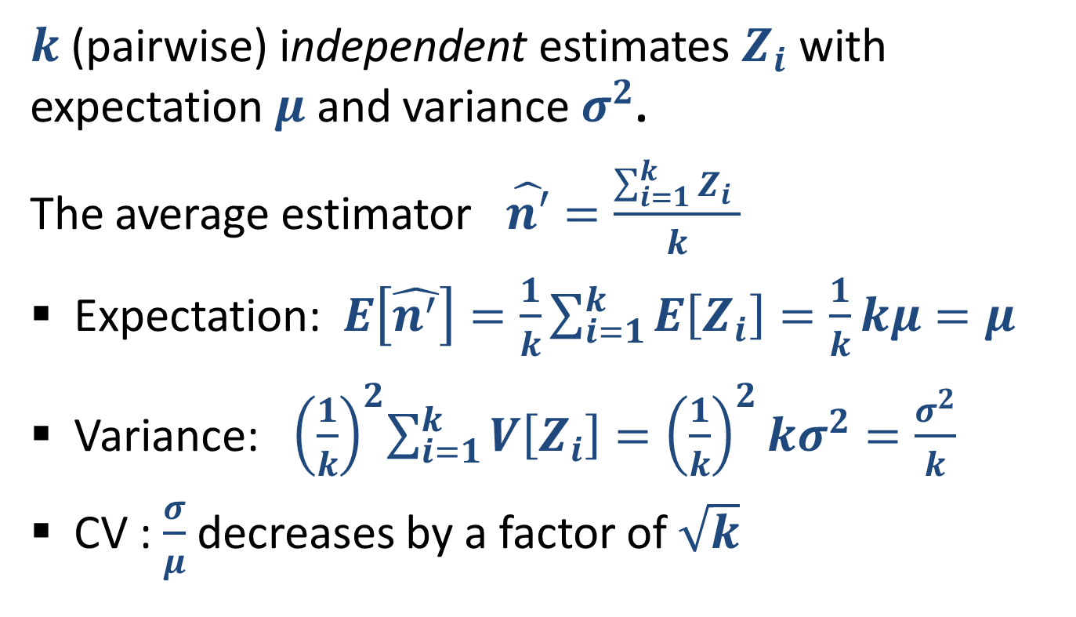
Reducing variance by averaging
$k$ (pairwise) independent estimates $Z_{i}$ with expectation $μ$ and variance $σ^{2}$.
The average estimator $\hat{n′}=\frac{\sum_{i=1}^{k}{{Z_{i}}_{ }}}{k}$
Expectation: $E\left[\hat{n^{′}}\right]=\frac{1}{k}\sum_{i=1}^{k}{E\left[Z_{i}\right]=\frac{1}{k}kμ=μ}$
Variance:${ \left(\frac{1}{k}\right)}^{2}\sum_{i=1}^{k}{V\left[Z_{i}\right]={\left(\frac{1}{k}\right)}^{2}kσ^{2}=\frac{σ^{2}}{k}}$
CV : $\frac{σ}{μ}$ decreases by a factor of $\sqrt{k}$

Slide 50
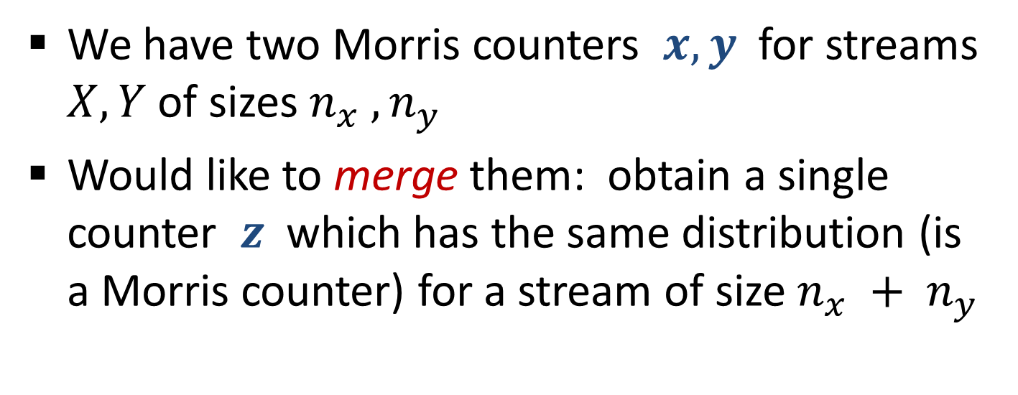
Merging Morris Counters
We have two Morris counters $x, y$ for streams $X, Y$of sizes $n_{x} , n_{y}$
Would like to merge them: obtain a single counter $z$ which has the same distribution (is a Morris counter) for a stream of size $n_{x} + n_{y}$

Slide 51




Merging Morris Counters
Morris-count stream $X$ to get $x$
Morris-count stream $Y$ to get $y$
Merge the Morris counts $x$, $y$ (into $x$):
For $i=1…y$
Increment $x$ with probability $2^{−x+i−1}$
Correctness for $x=0$: at all steps we have we $x=i−1$and probability$=1$ . In the end we have $x=y$
Correctness (Idea): We will show that the final value of $x$ “corresponds” to counting $Y$ after $X$

Slide 52


Merging Morris Counters: Correctness
We want to achieve the same effect as if the Morris counting was applied to a concatenation of the streams $X Y$
We consider two scenarios :
1. Morris counting applied to $Y$
2. Morris counting applied to $Y$ after $X$
We want to simulate the result of (2) given $y$ (result of (1)) and $x$

Slide 53


Merging Morris Counters: Correctness
Restated Morris (for sake of analysis only)
Associate an (independent) random $u(z)∼U[0,1]$ with each element $z$of the stream
Process element $z$: Increment $x$if $u(z)<2^{−x}$
We “map” executions of (1) and (2) by looking at the same randomization $u$.
We will see that each execution of (1), in terms of the set of elements that increment the counter, maps to many executions of (2)

Slide 54

Merging algorithm:
Correctness Plan
We fix the whole run (and randomization) on $X$.
We fix the set of elements that result in counter increments on $Y$in (1)
We work with the distribution of $u:Y$ conditioned on the above.
We show that the corresponding distribution over executions of (2) (set of elements that increment the counter) emulates our merging algorithm.

Slide 55


















What is the conditional distribution?
Elements that did not increment counter when counter value was $x$ have $u\left(z\right)≥2^{−x}$
Elements that did increment counter have $u\left(z\right)≤2^{−x}$
$u$:
[$\frac{1}{2}$,1]
[$0,\frac{1}{2}$]
[$\frac{1}{4}$,1]
[$\frac{1}{4}$,1]
[$\frac{1}{4}$,1]
[$0,\frac{1}{4}$]
[$\frac{1}{8},1$]
[0,1]
Stream:
1,
1,
1,
1,
1,
1,
1,
1,
$p=2^{−x}$:
1
$\frac{1}{2}$
$\frac{1}{2}$
$\frac{1}{4}$
$\frac{1}{4}$
$\frac{1}{4}$
$\frac{1}{4}$
$\frac{1}{8}$
$\frac{1}{8}$

Slide 56


Merge the Morris counts $x$, $y$ (into $x$):
For $i=1…y$
Increment $x$ with probability $2^{−x+i−1}$
To show correctness of merge, suffices to show:
Elements of $Y$that did not increment in (1) do not increment in (any corresponding run of) (2)
Element $z$ that had the $i^{th}$ increment in (1), conditioned on $x$in the simulation so far, increments in (2) with probability $2^{−x+i−1}$
We show this inductively.
Also show that at any point $x≥y^{′}$, where $y′$ is the count in (1).

Slide 57

Merge the Morris counts $x$, $y$ (into $x$):
For $i=1…y$
Increment $x$ with probability $2^{−x+i−1}$
The first element of $Y$ incremented the counter in (1). It has $u\left(z\right)∈[0,1]$.
The probability that it gets counted in (2) is
$$Pr\left[u\left(z\right)≤2^{−x} \right| u\left(z\right)∈\left[0,1\right]]= 2^{−x}$$
Initially, $x≥y^{′}=0$. After processing, $y^{′}=1$. If $x$ was initially 0, it is incremented with probability 1, so we maintain $x≥y^{′}$.

Slide 58


Merge the Morris counts $x$, $y$ (into $x$):
For $i=1…y$
Increment $x$ with probability $2^{−x+i−1}$
Elements of $Y$that did not increment in (1) do not increment in (any corresponding run of) (2)
Proof: An element $z$of $Y$ that did not increment the counter when its value in (1) was $y′$, has $u\left(z\right)∈[2^{−y′},1]$.
Since we have $x≥y′$, this element will also not increment in (2), since $u\left(z\right)≥2^{−y^{′}}≥2^{−x}$.
The counter in neither (1) nor (2) changes after processing $z$, so we maintain the relation $x≥y′$.

Slide 59


Merge the Morris counts $x$, $y$ (into $x$):
For $i=1…y$
Increment $x$ with probability $2^{−x+i−1}$
Element $z$ that had the $i^{th}$ increment in (1), conditioned on $x$ in the simulation so far, increments in (2) with probability $2^{−x+i−1}$
Proof: Element $z$ has $u\left(z\right)∈\left[0,2^{−(i−1)}\right]$ (we had $y′=i−1$ before the increment).
Element $z$ increments in (2) $⟺$ $u\left(z\right)∈\left[0,2^{−x}\right]$.
$Pr\left[u\left(z\right)∈\left[0,2^{−x}\right] |u\left(z\right)∈\left[0,2^{−\left(i−1\right)}\right]\right]=$ $2^{−x+i−1}$
If we had equality $x=y^{′}=i−1$, $x$ is incremented with probability 1, so we maintain the relation $x≥y′$

Slide 60

Random Hash Functions
Simplified and Idealized
For a domain $D$ and a probability distribution $F$ over $R$
A distribution over a family $H$of hash functions $h:D→R$ with the following properties:
Each function $h∈H$ has a concise representation and it is easy to choose $h∼H$
For each $x∈D$, when choosing $h∼H$
  $h\left(x\right)∼F$ ($h\left(x\right)$is a random variable with distribution $F$)
  The random variables $h\left(x\right)$ are independent for different $x∈D$.
We use random hash functions as a way to attach a “permanent” random value to each identifier in an execution

Slide 61

Counting Distinct Elements
32,
12,
14,
32,
7,
12,
32,
7,
6,
12,
4,
Elements occur multiple times, we want to count the number of distinct elements.
Number of distinct element is $n$ ($=6$ in example)
Number of elements in this example is 11

Slide 62
Counting Distinct Elements:
Example Applications
32,
12,
14,
32,
7,
12,
32,
7,
6,
12,
4,
Networking:
  Packet or request streams: Count the number of distinct source IP addresses
  Packet streams: Count the number of distinct IP flows (source+destination IP, port, protocol)
Search: Find how many distinct search queries were issued to a search engine each day

Slide 63
Distinct Elements: Exact Solution
32,
12,
14,
32,
7,
12,
32,
7,
6,
12,
4,
Exact solution:
Maintain an array/associative array/ hash table
Hash/place each element to the table
Query: count number of entries in the table
Problem: For $n$ distinct elements, size of table is $Ω(n)$
But this is the best we can do (Information theoretically) if we want an exact distinct count.

Slide 64

Distinct Elements: Approximate Counting
32,
12,
14,
32,
7,
12,
32,
7,
6,
12,
4,
IDEA: Size-estimation/Min-Hash technique :
[Flajolet-Martin 85, C 94]
Use a random hash function $h\left(x\right)∼U[0,1]$mapping element IDs to uniform random numbers in [0,1]
Track the minimum $h\left(x\right)$
Intuition: The minimum and $n$ are very related :
With $n$distinct elements, expectation of the minimum $E\left[min h\left(x\right)\right]=\frac{1}{n+1}$
Can use the average estimator with $k$ repetitions

Slide 65
Bibliography
Misra Gries Summaries
J. Misra and David Gries, Finding Repeated Elements. Science of Computer Programming 2, 1982
  http://www.cs.utexas.edu/users/misra/scannedPdf.dir/FindRepeatedElements.pdf
Merging: Agarwal, Cormode, Huang, Phillips, Wei, and Yi, Mergeable Summaries, PODS 2012
  Approximate counting (Morris Algorithm)
Robert Morris. Counting Large Numbers of Events in Small Registers. Commun. ACM, 21(10): 840-842, 1978
  http://www.inf.ed.ac.uk/teaching/courses/exc/reading/morris.pdf
Philippe Flajolet Approximate counting: A detailed analysis. BIT 25 1985
  http://algo.inria.fr/flajolet/Publications/Flajolet85c.pdf
Merging Morris counters: these slides
Approximate distinct counting
P. Flajolet and G. N. Martin. Probabilistic counting. In Proceedings of Annual IEEE Symposium on Foundations of Computer Science (FOCS), pages 76–82, 1983
E. Cohen Size-estimation framework with applications to transitive closure and reachability, JCSS 1997

