Slide 1

Estimation for Monotone Sampling:
Competitiveness and Customization
Edith Cohen
Microsoft Research

Slide 2




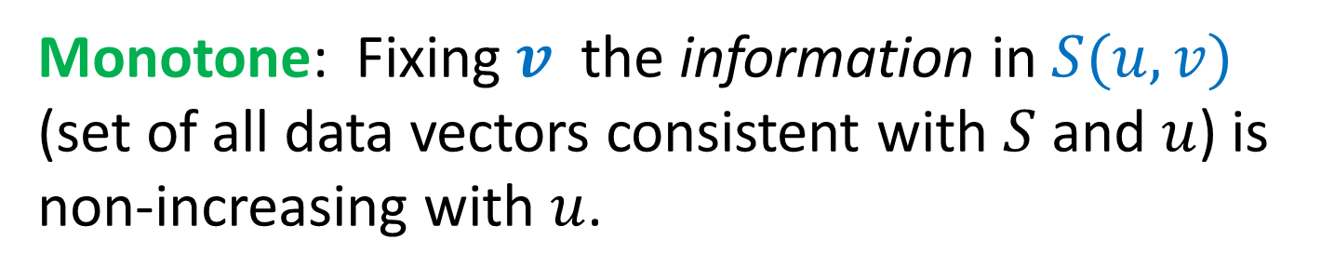
A Monotone Sampling Scheme
  Data domain
  $$V(⊂ R^{r})$$
random seed
$$u \sim U\left[0,1\right]$$
$$v$$
  Outcome $S(v,u)$ : function of the data and seed
Monotone: Fixing $v$ the information in $S(u,v)$ (set of all data vectors consistent with $S$ and $u$) is non-increasing with $u$.
Notes:
What is monotone sampling/ monotone estimation. Sampling: The randomization is captured by the seed u

Slide 3
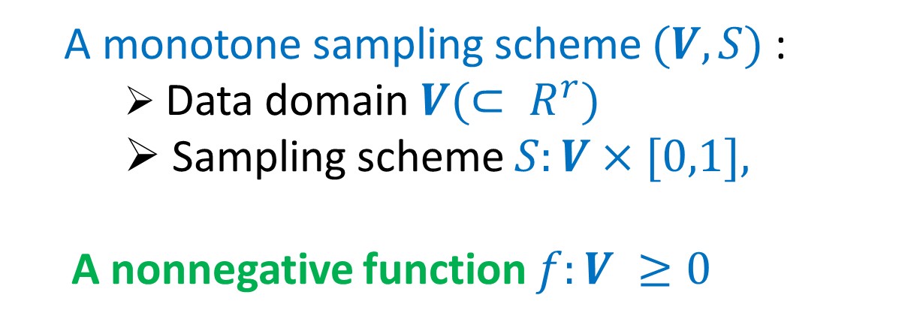


Monotone Estimation Problem (MEP)
A monotone sampling scheme $(V,S)$:
    Data domain $V(⊂ R^{r})$
    Sampling scheme $S:V×[0,1],$
  A nonnegative function $f:V ≥0$
Goal: estimate $f\left(v\right)$
Specify an estimator $\hat{f}(S)$ that is:
Unbiased, nonnegative, (Pareto) “optimal”

Slide 4


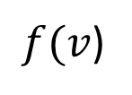

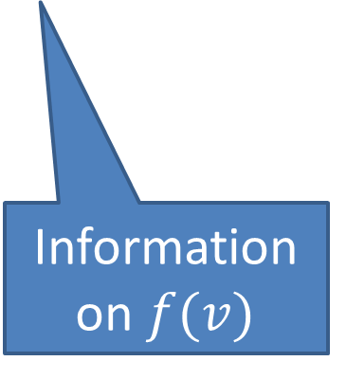
What we know on $f(v)$ from $S$
Fix the data $v.$ The lower the seed $u$ is, the more we know on $v$ and hence on $f(v)$.
$f(v$)
Information on $f(v)$
$$u$$
1
Notes:
If we do not have convergence to f(v) as u goes to 0 (for all v), we can not hope for an unbiased estimator.

Slide 5
Data is sampled/sketched/summarized. We process queries posed over the data by applying an estimator to the sample.
MEP applications in data analysis:
Scalable but perhaps approximate query processing:
We give an example
Notes:
We give some motivation, explain the relation to coordinated sampling.

Slide 6
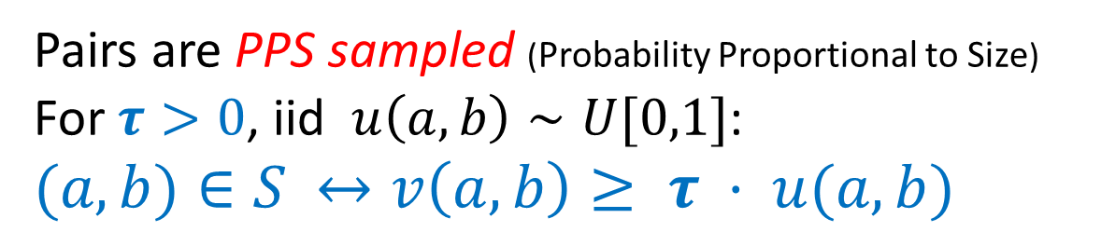
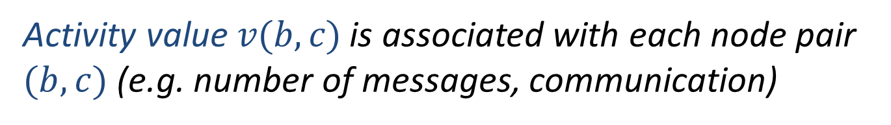
Example: Social/Communication data
Activity value $v(b,c)$is associated with each node pair $(b,c)$(e.g. number of messages, communication)
Pairs are PPS sampled (Probability Proportional to Size)
For $τ>0$, iid $u\left(a,b\right)∼U[0,1]$:
$(a,b)∈S$ $↔v\left(a,b\right)≥ τ · u(a,b)$
Monday activity
(a,b) 40
(f,g) 5
(h,c) 20
(a,z) 10
……
(h,f) 10
(f,s) 10
Monday Sample:
(a,b) 40
(a,z) 10
……..
(f,s) 10

Slide 7
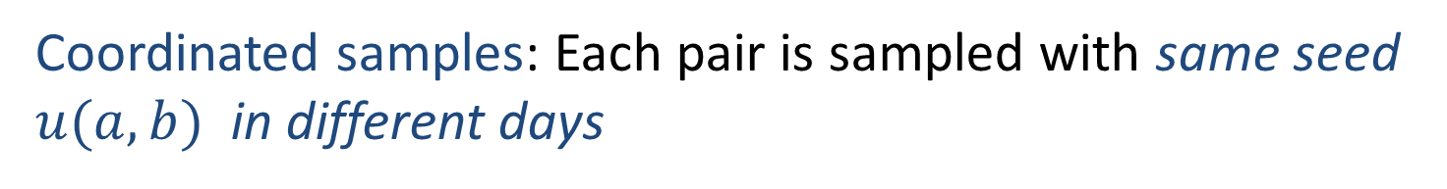
Samples of multiple days
Coordinated samples: Each pair is sampled with same seed $u(a,b)$ in different days
Monday activity
(a,b) 40
(f,g) 5
(h,c) 20
(a,z) 10
……
(h,f) 10
(f,s) 10
Tuesday activity
(a,b) 3
(f,g) 5
(g,c) 10
(a,z) 50
……
(s,f) 20
(g,h) 10
Wednesday activity
(a,b) 30
(g,c) 5
(h,c) 10
(a,z) 10
……
(b,f) 20
(d,h) 10
Monday Sample:
(a,b) 40
(a,z) 10
……..
(f,s) 10
Tuesday Sample:
(g,c)
(a,z) 50
……..
(g,h)
Wednesday Sample:
(a,b) 30
(b,f) 20
……..
(d,h) 10

Slide 8

Matrix view keys $×$ instances
In our example: keys (a,b) are user-user pairs. Instances are days.
 | Su | Mo | Tu | We | Th | Fr | Sa
(a,b) | 40 | 30 | 10 | 43 | 55 | 30 | 20
(g,c) | 0 | 5 | 0 | 0 | 4 | 0 | 10
(h,c) | 5 | 0 | 0 | 60 | 3 | 0 | 2
(a,z) | 20 | 10 | 5 | 24 | 15 | 7 | 4
(h,f) | 0 | 7 | 6 | 3 | 8 | 5 | 20
(f,s) | 0 | 0 | 0 | 20 | 100 | 70 | 50
(d,h) | 13 | 10 | 8 | 0 | 0 | 5 | 6

Slide 9
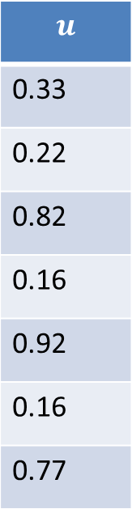
Matrix view keys $×$ instances
Coordinated PPS sample $τ=100$
$$u$$
0.33
0.22
0.82
0.16
0.92
0.16
0.77
 | Su | Mo | Tu | We | Th | Fr | Sa
(a,b) | 40 | 30 | 10 | 43 | 55 | 30 | 20
(g,c) | 0 | 5 | 0 | 0 | 4 | 0 | 10
(h,c) | 5 | 0 | 0 | 60 | 3 | 0 | 2
(a,z) | 20 | 10 | 5 | 24 | 15 | 7 | 4
(h,f) | 0 | 7 | 6 | 3 | 8 | 5 | 20
(f,s) | 0 | 0 | 0 | 20 | 100 | 70 | 50
(d,h) | 13 | 10 | 8 | 0 | 0 | 5 | 6
Notes:
Tau can be different per entry in general.
Here each column (day) is PPS sampled
Coordination (using same u for the same key in all instances):
A key that is sampled in one instance (has a small u) is more likely to be sampled in others

Slide 10
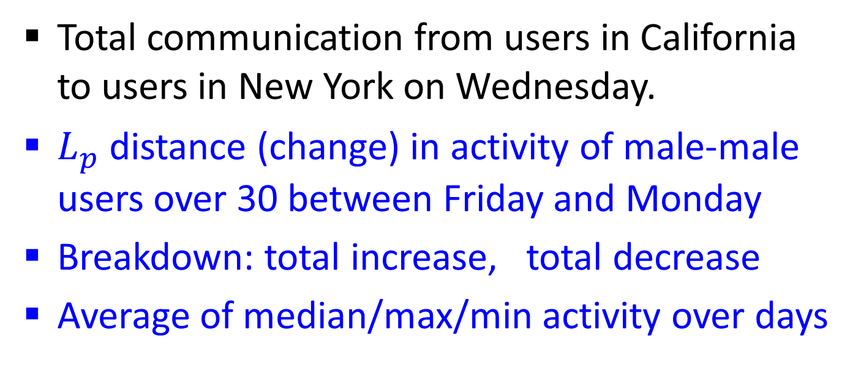
Example Queries
Total communication from users in California to users in New York on Wednesday.
$L_{p}$ distance (change) in activity of male-male users over 30 between Friday and Monday
Breakdown: total increase, total decrease
Average of median/max/min activity over days
We would like to estimate the query result from the sample

Slide 11
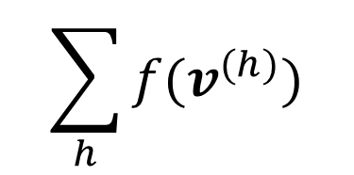
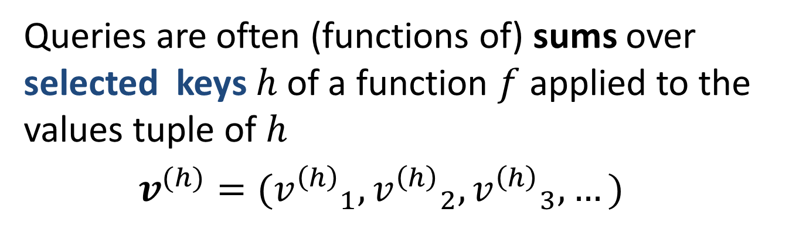
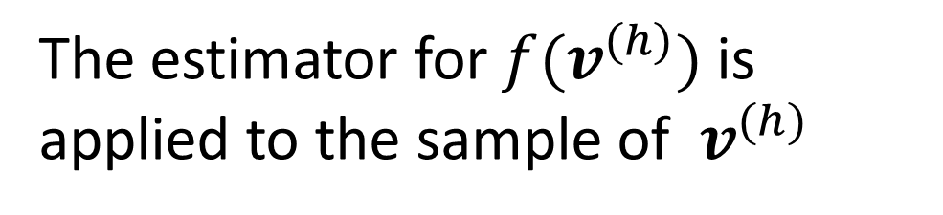
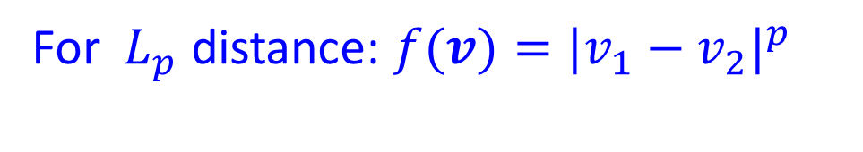
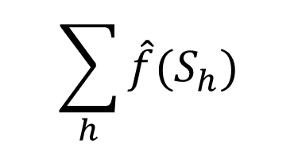
Estimate one key at a time
Queries are often (functions of) sums over selected keys $h$ of a function $f$ applied to the values tuple of $h$
$v^{(h)}=({v^{\left(h\right)}}_{1}^{},{v^{\left(h\right)}}_{2}^{},{v^{\left(h\right)}}_{3}^{},…)$
$$\sum_{h}{f(v^{(h)})}$$
For ${ L}_{p}$ distance: $f(v)={{|v}_{1}−v_{2}|}^{p}$
Estimate one key at a time:
$$\sum_{h}{\hat{f}(S_{h})}$$
The estimator for $f(v^{(h)})$ is applied to the sample of $v^{(h)}$

Slide 12
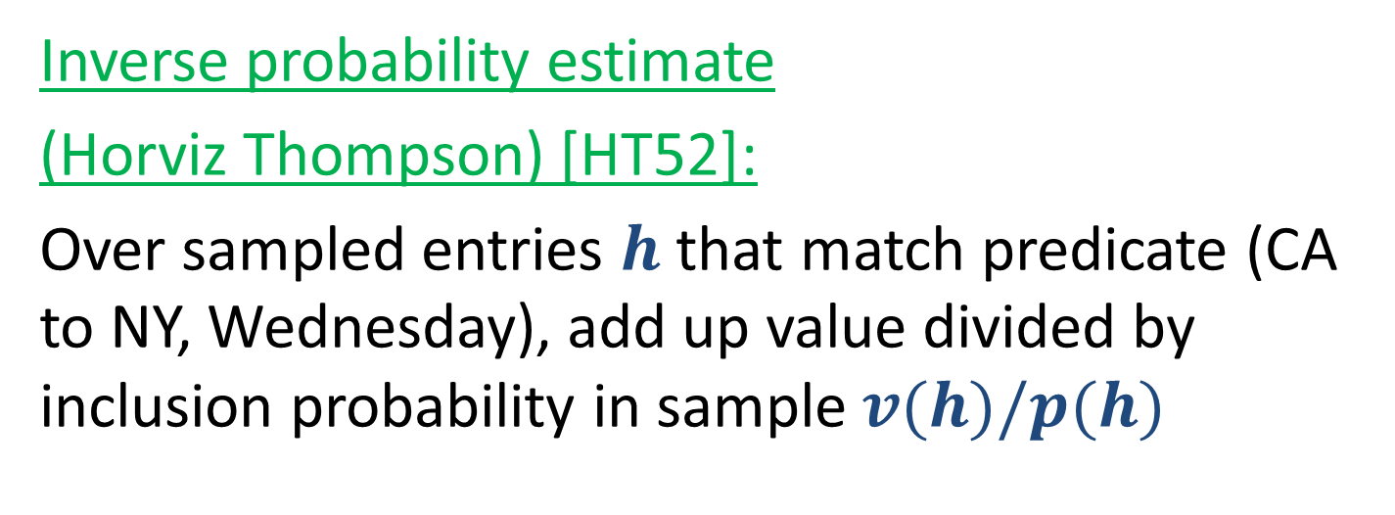
“Warmup” queries:
Estimate a single entry at a time
Total communication from users in California to users in New York on Wednesday.
Inverse probability estimate
(Horviz Thompson) [HT52]:
Over sampled entries $h$ that match predicate (CA to NY, Wednesday), add up value divided by inclusion probability in sample $v(h)/p(h)$
Notes:
To apply this we need to know inclusion probability. When we know v and u, we can compute it.
This estimator is unbiased. Let’s see an example.

Slide 13

HT estimator (single-instance)
Coordinated PPS sample $τ=100$
$$u$$
0.33
0.22
0.82
0.14
0.92
0.16
0.77
 | Su | Mo | Tu | We | Th | Fr | Sa
(a,b) | 40 | 30 | 10 | 43 | 55 | 30 | 20
(g,c) | 0 | 5 | 0 | 0 | 4 | 0 | 10
(h,c) | 5 | 0 | 0 | 60 | 3 | 0 | 2
(a,z) | 20 | 10 | 5 | 24 | 13 | 7 | 4
(h,f) | 0 | 7 | 6 | 3 | 8 | 5 | 20
(f,s) | 0 | 0 | 0 | 20 | 100 | 70 | 50
(d,h) | 13 | 10 | 8 | 0 | 0 | 5 | 6
Notes:
This is the sampled data (sampled entries marked) randomization on the left.

Slide 14
HT estimator (single-instance)
$τ=100$. Select Wednesday, CA-NY
$$u$$
0.33
0.22
0.82
0.16
0.92
0.16
0.77
 | Su | Mo | Tu | We | Th | Fr | Sa
(a,b) | 40 | 30 | 10 | 43 | 55 | 30 | 20
(g,c) | 0 | 5 | 0 | 0 | 4 | 0 | 10
(h,c) | 5 | 0 | 0 | 60 | 3 | 0 | 2
(a,z) | 20 | 10 | 5 | 24 | 15 | 7 | 4
(h,f) | 0 | 7 | 6 | 3 | 8 | 5 | 20
(f,s) | 0 | 0 | 0 | 20 | 100 | 70 | 50
(d,h) | 13 | 10 | 8 | 0 | 0 | 5 | 6
Notes:
Green entries are our selection according to query. We only see the sample however. In the sample we have two sampled entries in our selection.

Slide 15
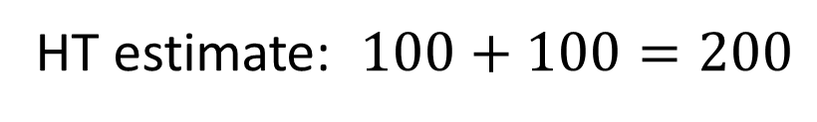
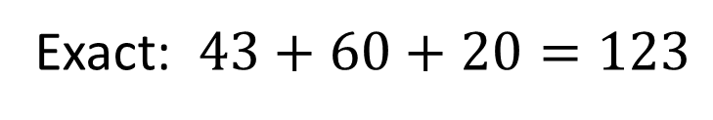



HT estimator for single-instance
$τ=100$. Select Wednesday, CA-NY
 | We
(a,b) | 43
(g,c) | 0
(h,c) | 60
(a,z) | 24
(h,f) | 3
(f,s) | 20
(d,h) | 0
Exact: $43+60+20=123$
$$u$$
0.33
0.22
0.82
0.16
0.92
0.16
0.77
$$p=0.43$$
HT estimate is 0 for keys that are not sampled, $v/p$ when key is sampled
HT estimate: $100+100=200$
$$p=0.20$$
Notes:
We have two sampled entries in our selection.

Slide 16

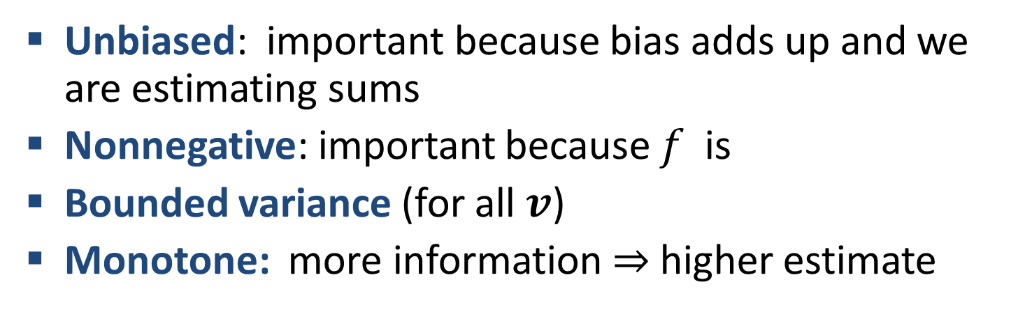
Inverse-Probability (HT) estimator
Unbiased: important because bias adds up and we are estimating sums
Nonnegative: important because $f$ is
Bounded variance (for all $v$)
Monotone: more information $⇒$ higher estimate
Optimality: UMVU The unique minimum variance (unbiased, nonnegative, sum) estimator
Works when $f$ depends on a single entry.
What about general $f$?

Slide 17

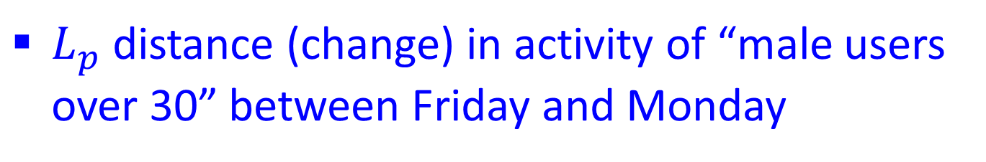

Queries involving multiple columns
$L_{p}$ distance (change) in activity of “male users over 30” between Friday and Monday
$$f(v)={{|v}_{1}−v_{2}|}^{p}$$
Breakdown: total increase, total decrease
$$f(v)={{max\{0,v}_{1}−v_{2}\}}^{p}$$
HT may not work at all now and may not be optimal when it does.
We want estimators with the same nice properties

Slide 18
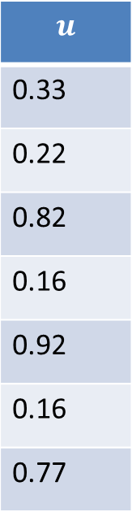
Sampled data
Coordinated PPS sample $τ=100$
$$u$$
0.33
0.22
0.82
0.16
0.92
0.16
0.77
 | Su | Mo | Tu | We | Th | Fr | Sa
(a,b) | 40 | 30 | 10 | 43 | 55 | 30 | 20
(g,c) | 0 | 5 | 0 | 0 | 4 | 0 | 10
(h,c) | 5 | 0 | 0 | 60 | 3 | 0 | 2
(a,z) | 20 | 10 | 5 | 24 | 15 | 7 | 4
(h,f) | 0 | 7 | 6 | 3 | 8 | 5 | 20
(f,s) | 0 | 0 | 0 | 20 | 100 | 70 | 50
(d,h) | 13 | 10 | 8 | 0 | 0 | 5 | 6
Want to estimate ${\left(55−43\right)}^{2}+{\left(8−3\right)}^{2}+{\left(24−15\right)}^{2}$
Lets look at key (a,z), and estimating ${\left(24−15\right)}^{2}$
Notes:
Distance between Wednesday and Thursday on pairs with source “a”

Slide 19
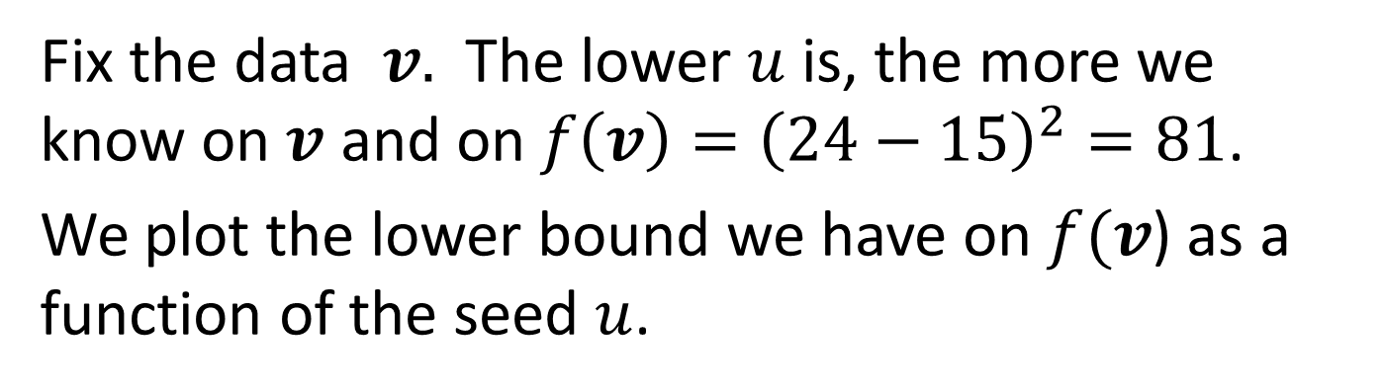


Information on $f$
Fix the data $v.$ The lower $u$ is, the more we know on $v$ and on $f\left(v\right)={\left(24−15\right)}^{2}=81$.
We plot the lower bound we have on $f(v$) as a function of the seed $u$.
81
$$u$$
0.15
0.24
1

Slide 20
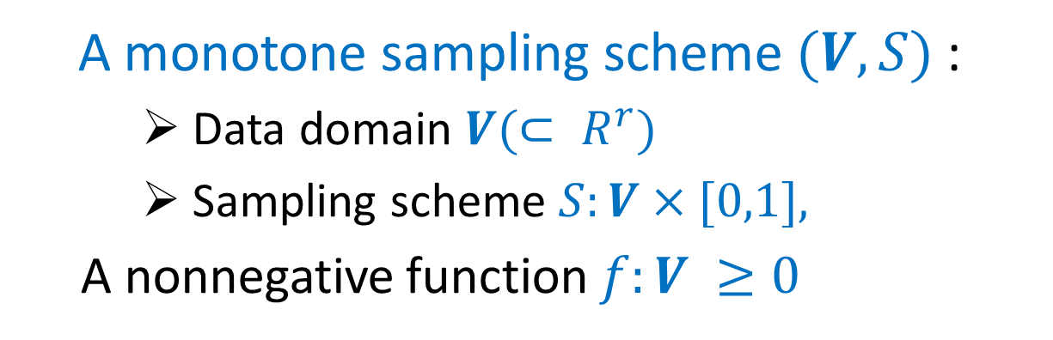
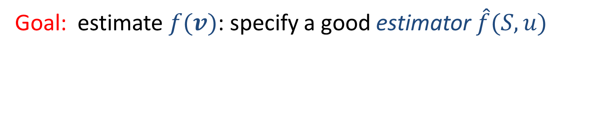
This is a MEP !
Monotone Estimation Problem
A monotone sampling scheme $(V,S)$:
    Data domain $V(⊂ R^{r})$
    Sampling scheme $S:V×[0,1],$
  A nonnegative function $f:V ≥0$
Goal: estimate $f(v)$: specify a good estimator $\hat{f}(S,u)$

Slide 21
Our results:
General Estimator Derivations for any MEP for which such estimator exists
Unbiased, Nonnegative, Bounded variance
Admissible: “Pareto Optimal” in terms of variance
Solution is not unique.

Slide 22
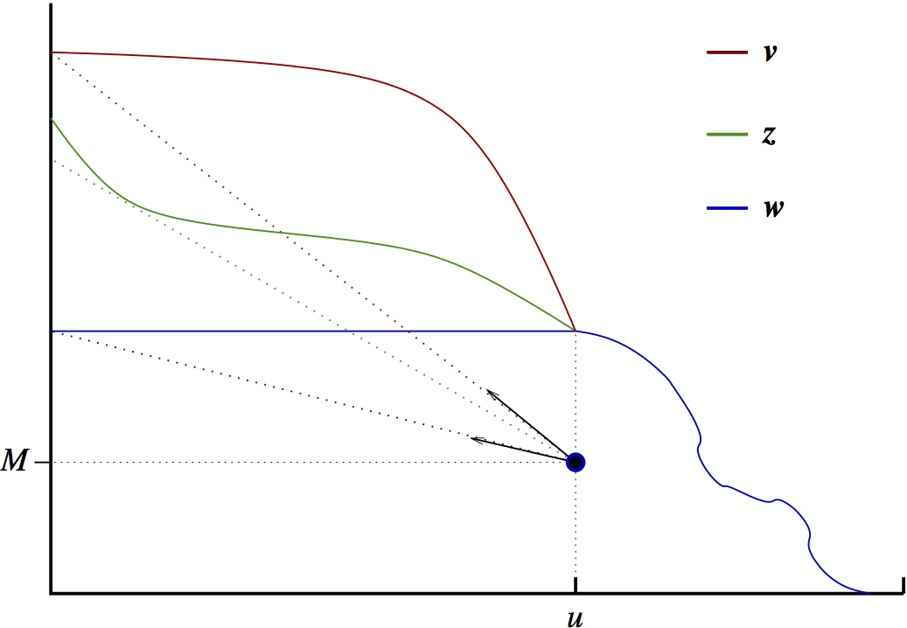
The optimal range

Slide 23
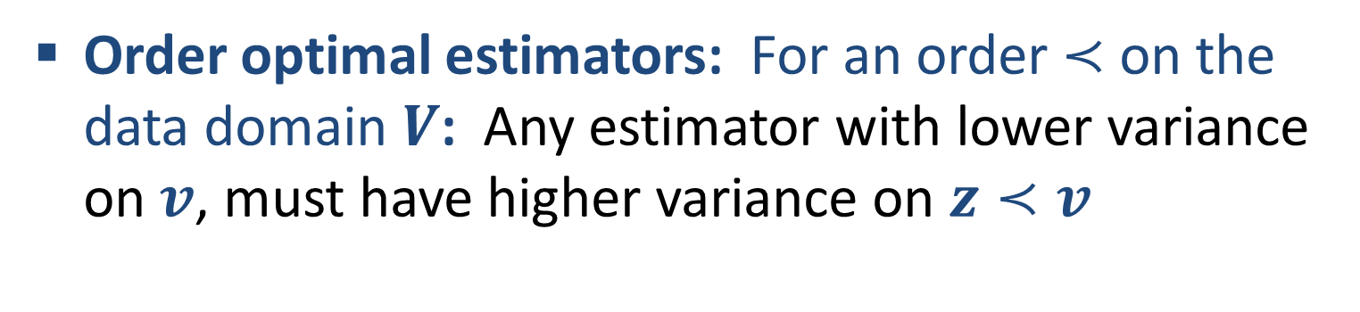

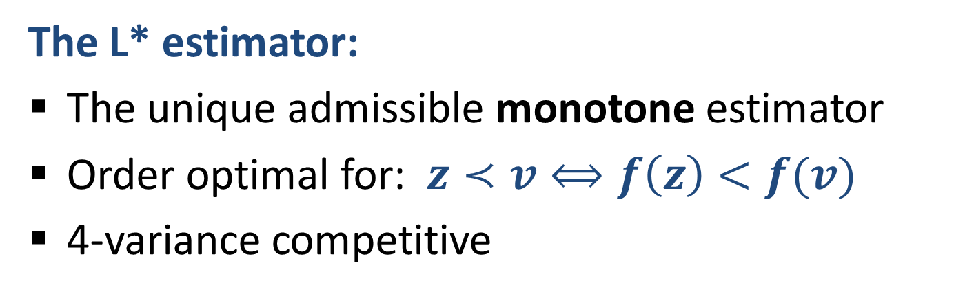
Our results:
General Estimator Derivations
Order optimal estimators: For an order $≺$ on the data domain $V$: Any estimator with lower variance on $v$, must have higher variance on $z≺v$
The L* estimator:
The unique admissible monotone estimator
Order optimal for: $z≺v⟺f\left(z\right)<f(v)$
4-variance competitive
The U* estimator:
Order optimal for: $z≺v⟺f\left(z\right)>f(v)$
Notes:
The L* estimator: stays as low as possible in the optimal range (optimizes for the consistent data with lowest f(v).
The U* estimator goes as high as possible.

Slide 24
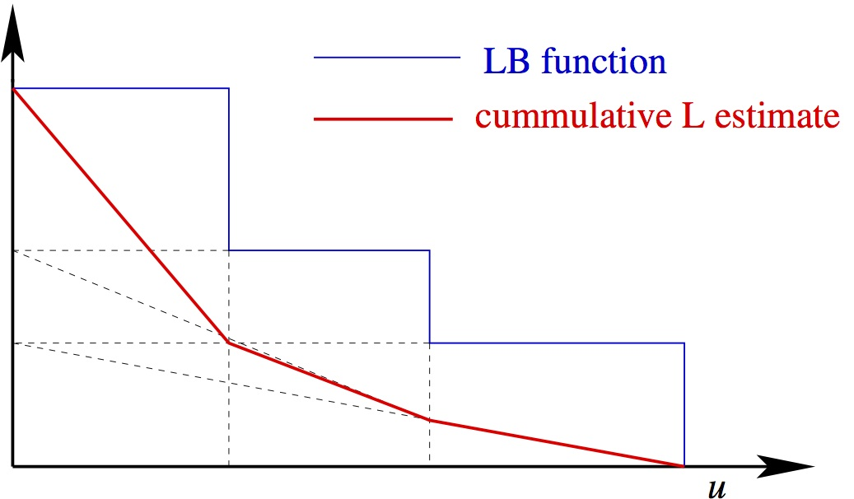
The L* estimator

Slide 25
Summary
Defined Monotone Estimation Problems (motivated by coordinated sampling)
Study Range of Pareto optimal (admissible) unbiased and nonnegative estimators:
  L* (lower end of range: unique monotone estimator, dominates HT) ,
  U* (upper end of range),
  Order optimal estimators (optimized for certain data patterns)

Slide 26
Follow-up and open problems
Tighter bounds on universal ratio: L* is 4 competitive, can do 3.375 competitive, lower bound is 1.44 competitive.
Instance-optimal competitiveness – Give efficient construction for any MEP
MEP with multiple seeds (independent samples)
Applications:
  Estimating Euclidean and Manhattan distances from samples [C KDD ‘14]
  sketch-based similarity in social networks [CDFGGW COSN ‘13],
  Timed-influence oracle [CDPW ‘14]

Slide 27
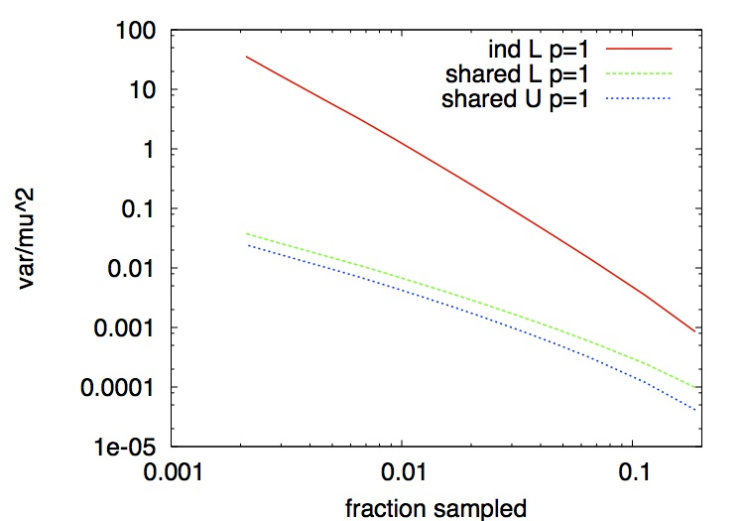
L₁ difference [C KDD14]
Independent / Coordinated PPS sampling
#IP flows to a destination in two time periods

Slide 28
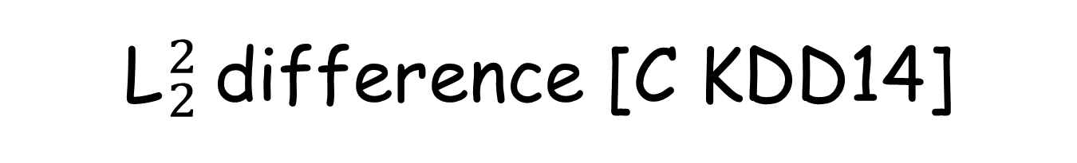
L${}_{2}^{2}$difference [C KDD14]
Independent/Coordinated PPS sampling
Surname occurrences in 2007, 2008 books (Google ngrams)

Slide 29
Thank you!

Slide 30
Why Coordinate Samples?
Minimize overhead in repeated surveys (also storage)
  Brewer, Early, Joice 1972; Ohlsson ‘98 (Statistics) …
Can get better estimators
  Broder ‘97; Byers et al Tran. Networking ‘04; Beyer et al SIGMOD ’07; Gibbons VLDB ‘01 ;Gibbons Tirthapurta SPAA ‘01; Gionis et al VLDB ’99; Hadjieleftheriou et al VLDB 2009; Cohen et al ‘93-’13 ….
Sometimes cheaper to compute
  Samples of neighborhoods of all nodes in a graph in linear time Cohen ’93 …

Slide 31
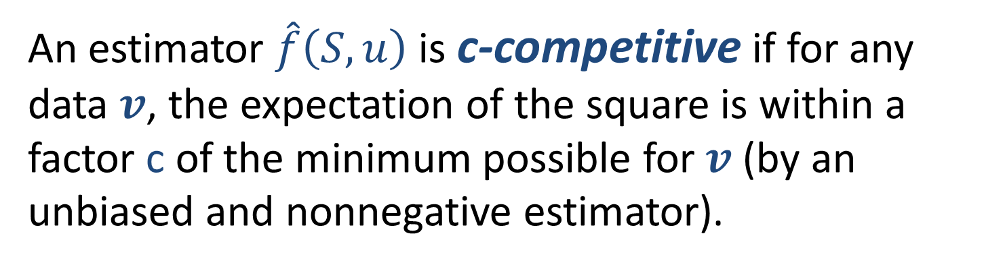
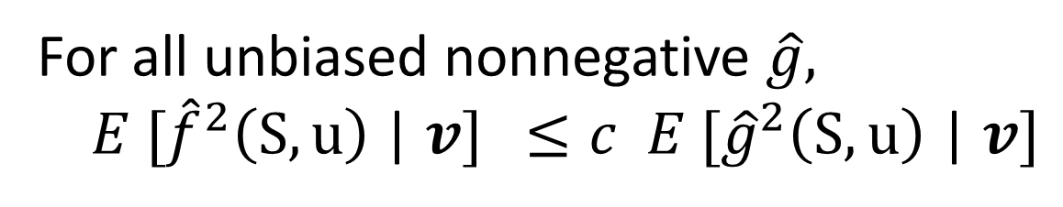
Variance Competitiveness [CK13]
An estimator $\hat{f}\left(S,u\right)$ is c-competitive if for any data $v$, the expectation of the square is within a factor c of the minimum possible for $v$ (by an unbiased and nonnegative estimator).
For all unbiased nonnegative $\hat{g},$
$E [{\hat{f}}^{2}\left(S,u\right)$ | $v]$ $≤c E [{\hat{g}}^{2}\left(S,u\right)\text{ | }v]$
Notes:
The L* estimator is 4-competitive, this is tight, the supremum over all MEP is 4. But often is better.

Slide 32
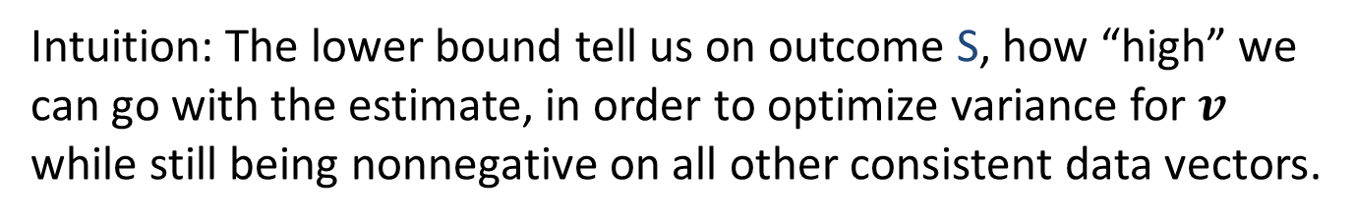

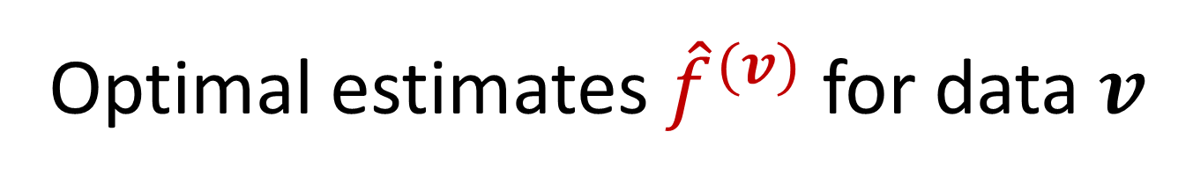


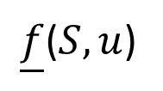
Optimal estimates ${\hat{f}}^{(v)}$ for data $v$
The optimal estimates ${\hat{f}}^{(v)}$are the negated derivative of the lower hull of the Lower bound function.
Lower Bound function for $v$
Lower Hull
$\underline{f}$($S,u$)
$$u$$
1
Intuition: The lower bound tell us on outcome S, how “high” we can go with the estimate, in order to optimize variance for $v$ while still being nonnegative on all other consistent data vectors.

Slide 33
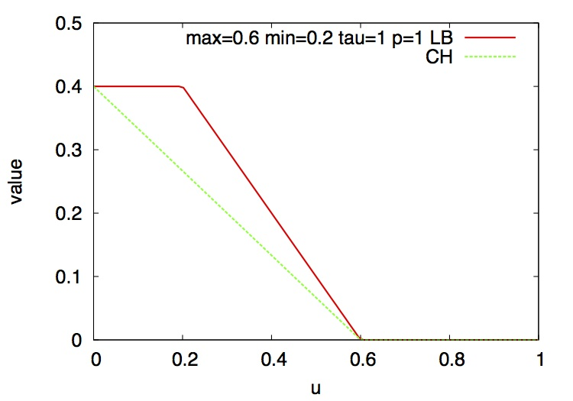
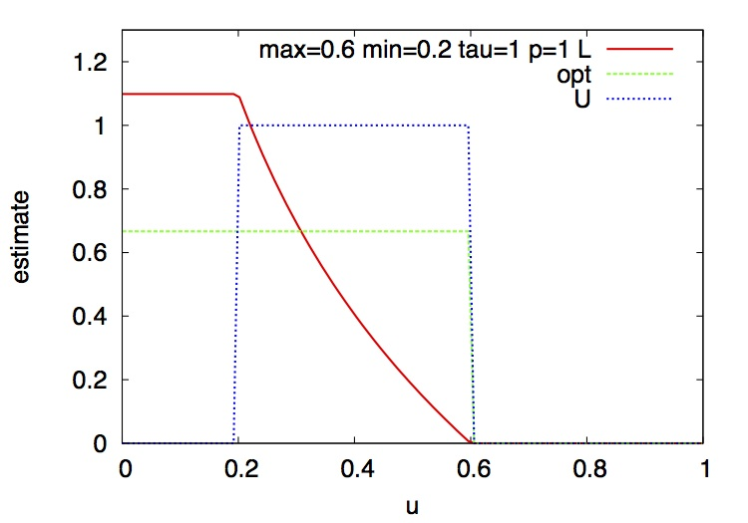
Manhattan Distance

Slide 34
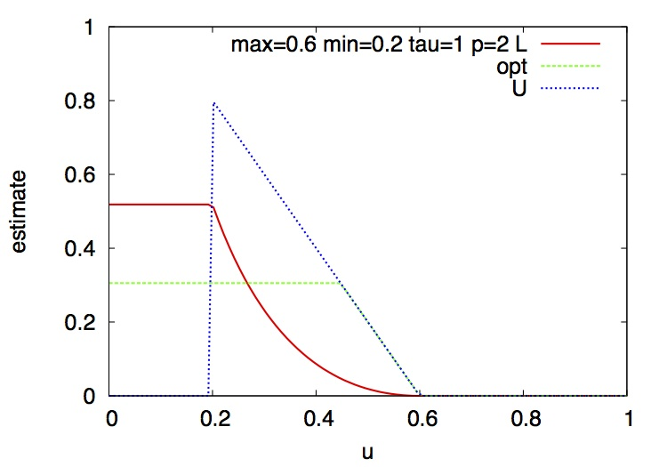
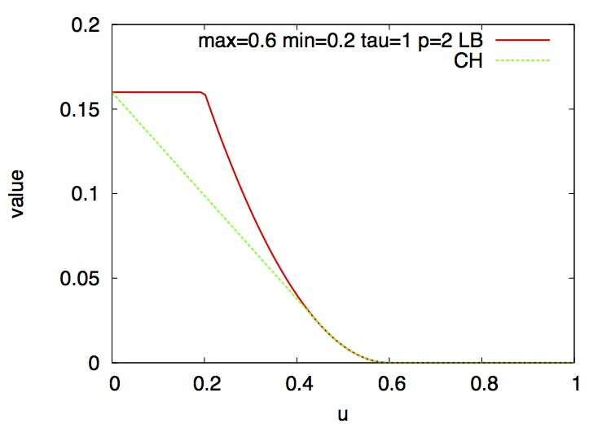
Euclidean Distance

