Slide 1

Greedy Maximization Framework for Graph-based Influence Functions
Edith Cohen
Google Research
Tel Aviv University

Slide 2
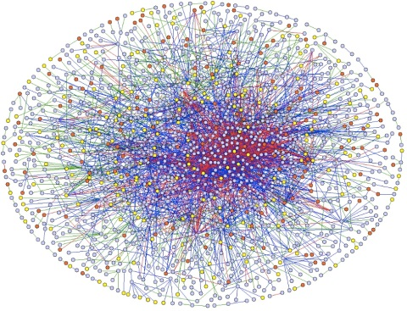
Large Graphs
Model relations/interactions (edges) between entities (nodes)
  Explicit: Call detail, email exchanges, Web links, social networks (friend, follow, like), commercial transactions, video views, …
  Implicit: Images, search queries, (edges are shared features or close embedding vectors)
Some nodes are more central than others
Notes:
Natural explicit graphs
Interactions between people and people, people and objects, objects
Two or more types of entities: Collaborative filtering (recommendations, ads)

Slide 3


Diffusion in Networks
Edges model direct connections between entities
Diffusion: Contagion, information (news, opinions), … can spread from seed nodes through edges to nodes multiple hops away
  Influence: A measure of the combined power/ importance/ coverage of a set of seed nodes. (according to the diffusion process)
Notes:
seed nodes: "infected" nodes, nodes "in power"/"with knowledge"

Slide 4
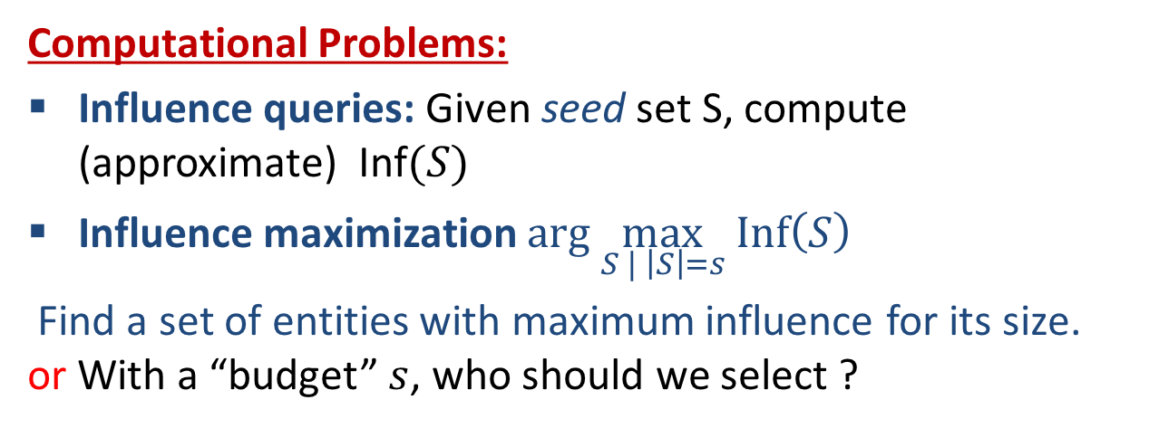
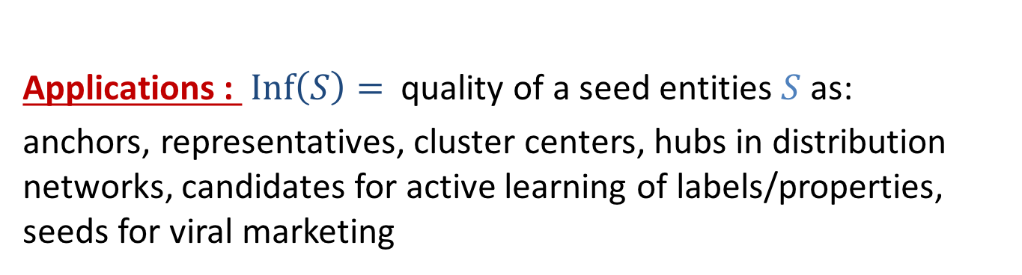
Influence in Networks
Applications : $Inf\left(S\right)=$ quality of a seed entities $S$ as:
anchors, representatives, cluster centers, hubs in distribution networks, candidates for active learning of labels/properties, seeds for viral marketing
Computational Problems:
Influence queries: Given seed set S, compute (approximate) Inf$(S)$
Influence maximization $arg \max_{S | \left|S\right|=s} Inf\left(S\right)$
  Find a set of entities with maximum influence for its size. or With a “budget” $s$, who should we select ?
Sketches

Slide 5
Overview of contributions
A unified model of graph-based influence functions: Includes functions proposed in previous work and extends to allow general submodular aggregations.
A meta-algorithm for influence maximization: Modular design, near linear computation, statistical worst-case guarantees on approximation quality
Notes:
Our contributions in this space

Slide 6












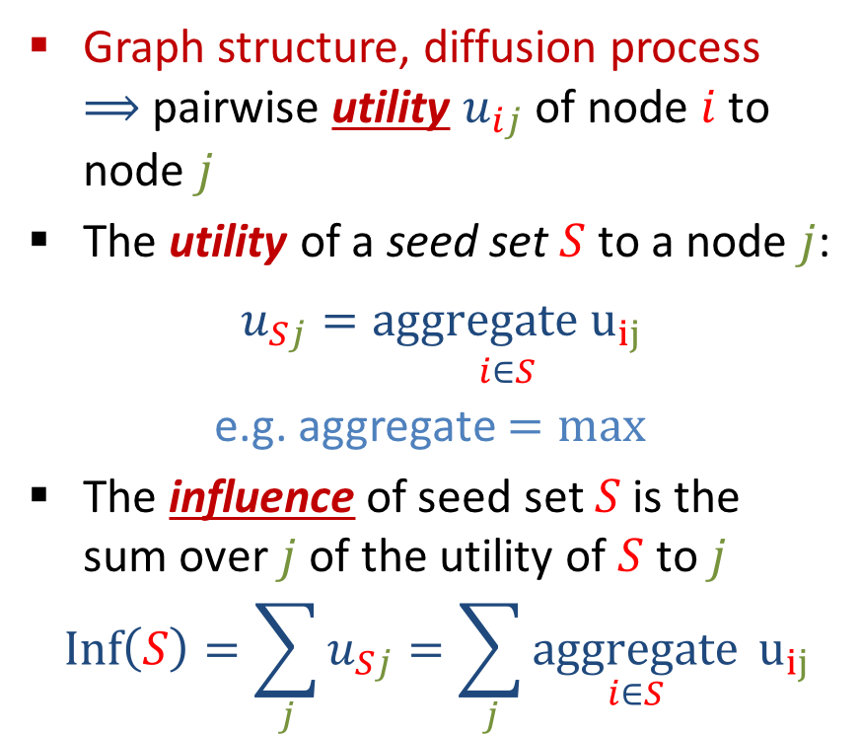
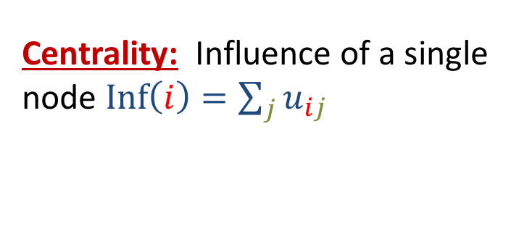
Unified model: Pairwise utility to influence
Graph structure, diffusion process $⟹$ pairwise utility $u_{ij}$ of node $i$ to node $j$
The utility of a seed set $S$ to a node $j$:
$u_{Sj}=\underset{i∈S}{aggregate u_{ij}}$
e.g. aggregate $=max$
The influence of seed set $S$is the sum over $j$of the utility of $S$ to $j$
$$Inf\left(S\right)=\sum_{j}{u_{Sj}=\sum_{j}{\underset{i∈S}{aggregate}}} u_{ij}$$
Centrality: Influence of a single node $Inf\left(i\right)=\sum_{j}{u_{ij}}$
Notes:
Diffusion process: defines when and how things spread. This is a unified view that covers multiple existing models.
This view is different from "traditional", but specifies the same objectives in a more modular form.
We need to specify (i) the pairwise utility function, from graph structure/ diffusion process
(ii) The aggregation function (typically max was studied, but sometimes we want a richer aggregation). How we combine the values of different "seeds" to a node

Slide 7


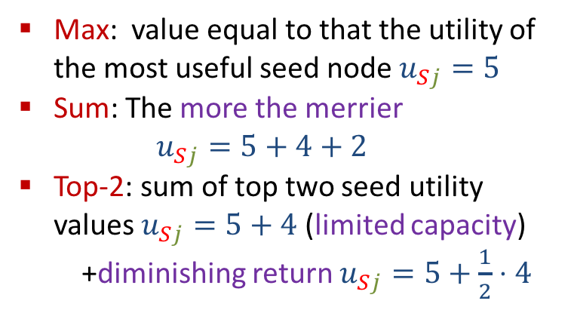
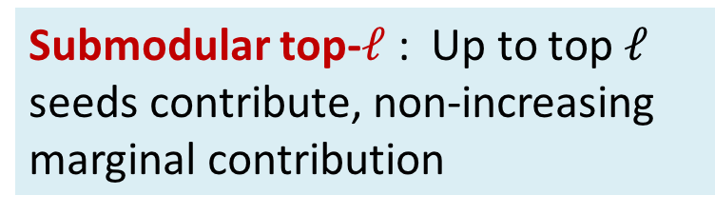
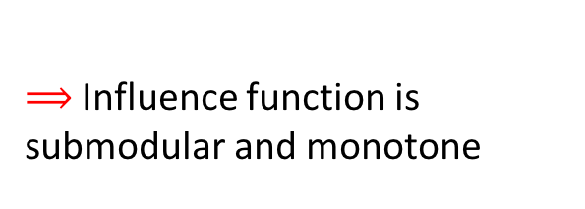
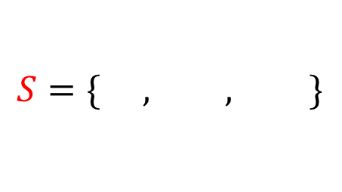
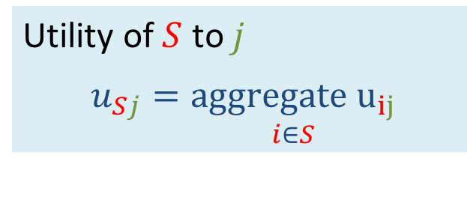
Aggregation functions
Utility of $S$ to $j$
$u_{Sj}=\underset{i∈S}{aggregate u_{ij}}$
$$S=\{ , , \}$$
Max: value equal to that the utility of the most useful seed node $u_{Sj}=5$
Sum: The more the merrier
  $$u_{Sj}=5+4+2$$
Top-2: sum of top two seed utility values $u_{Sj}=5+4$ (limited capacity)
  +diminishing return $u_{Sj}=5+\frac{1}{2}⋅4$
5
2
4
Submodular top-$ℓ$ : Up to top $ℓ$ seeds contribute, non-increasing marginal contribution
$⟹$Influence function is submodular and monotone
$\text{W}\text{hen} \left|S\right|=1\text{ (}\text{centrality}\text{)}$: All “aggregate” are the same $u_{Sj}$
Notes:
Diminishing return from additional seeds.
Example with movies/blogs. Can read/watch one, maybe two.

Slide 8
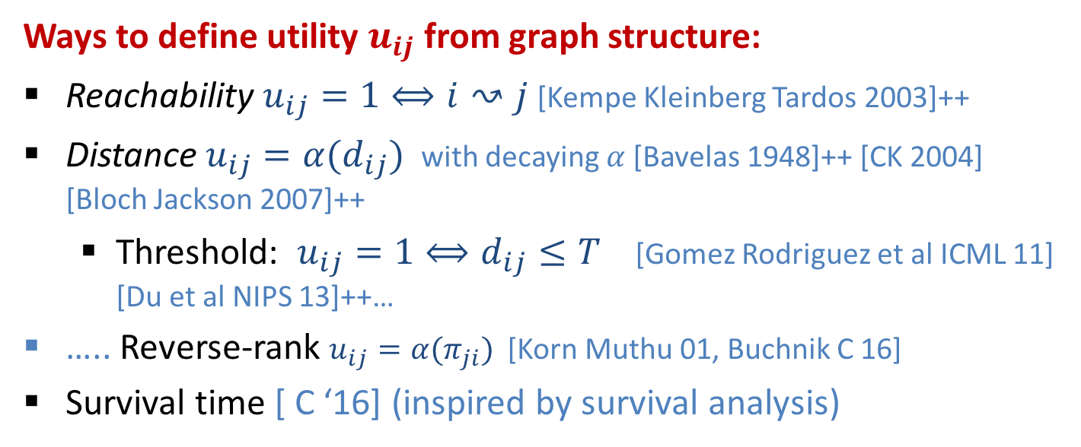
Pairwise utility from graph structure
Shorter paths, more paths, stronger edges on paths $⇒$ higher $u_{ij}$
Ways to define utility $u_{ij}$ from graph structure:
Reachability $u_{ij}=1⟺i↝j$ [Kempe Kleinberg Tardos 2003]++
Distance $u_{ij}=α(d_{ij})$ with decaying $α$ [Bavelas 1948]++ [CK 2004] [Bloch Jackson 2007]++
  Threshold: $u_{ij}=1⟺d_{ij}≤T$ [Gomez Rodriguez et al ICML 11] [Du et al NIPS 13]++…
….. Reverse-rank $u_{ij}=α(π_{ji})$ [Korn Muthu 01, Buchnik C 16]
Survival time [ C ‘16] (inspired by survival analysis)
+ randomized models to generate edge lengths/presence [Kempe Kleinberg Tardos KDD 2003, Gomez Rogriguez et al ICML 11, Abraho et al KDD13’, Cohen et al COSN ‘13, Du et al NIPS ’13]
Notes:
Network science principles: Shorter, more, stronger paths mean higher utility
-- Distance utility is rooted in classic social network analysis and in economic network models
-- Survival analysis of engineered or biological systems
-- Both distances and survival generalize plain “reachability”
Reverse rank: Instead of absolute distance, look at the order induced by the distance
Randomizing over the provided edges (NOT a random graph model)

Slide 9

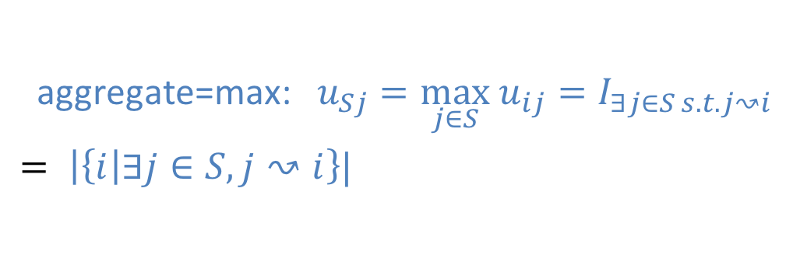
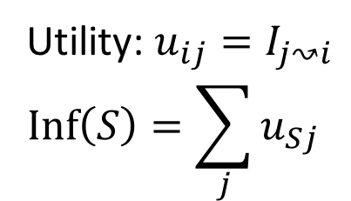
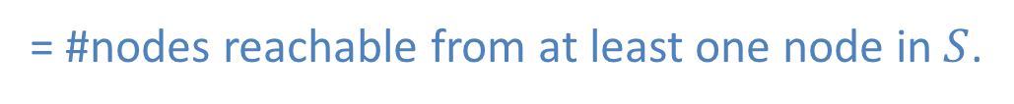
Simplest Model: Reachability
Utility: $u_{ij}=I_{j↝i}$
$$Inf\left(S\right)=\sum_{j}{u_{Sj}}$$
$$\text{aggregate}\text{=}\text{max}\text{:}{ u}_{Sj}=\max_{j∈S} u_{ij}=I_{∃j∈S s.t. j↝i}$$
$= \left|\left\{i\right|∃j∈S, j↝i\right\}|$
= #nodes reachable from at least one node in $S$.
$$Inf\left( \right)=5$$
Notes:
Diffusion process: Once node is infected, its out neighbors are infected
Submodular Top-l Some function of the number of reaching seeds
When there is one seed node, influence is the number of reachable nodes from it.
With multiple seeds, influence depends on “aggregate.” Simples is max.

Slide 10












Simplest Model:
Reachability + max aggregation
$${Inf}_{max}\left( \right)=9$$
Submodular and monotone !
Notes:
- Max aggregation: Seed set
covers" you if reachable from at least one seed node
Influence here is a simple coverage function
-- in this particular example “coverage” is disjoint, so all aggregation functions would have the same influence
All influence functions we consider are submodular and monotone

Slide 11

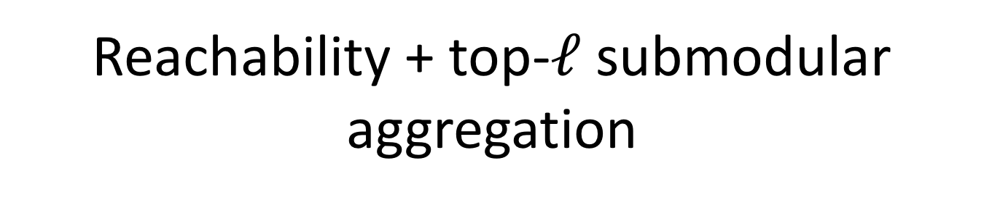
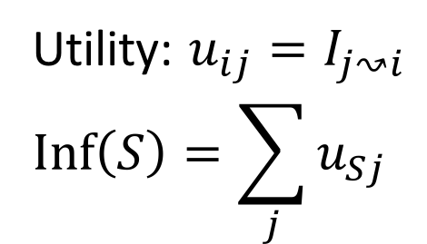
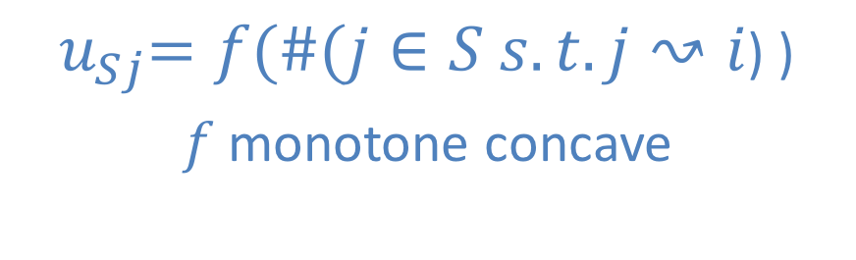
Reachability + top-$ℓ$ submodular aggregation
Utility: $u_{ij}=I_{j↝i}$
$$Inf\left(S\right)=\sum_{j}{u_{Sj}}$$
${ u}_{Sj}=f(\#(j∈S s.t. j↝i$) )
$f$monotone concave
$$Inf\left( \right)$$
Notes:
Diffusion process: Once node is infected, its out neighbors are infected
Submodular Top-l : Utility of seed set to a node j is a function f of the number of seed nodes that can reach j

Slide 12

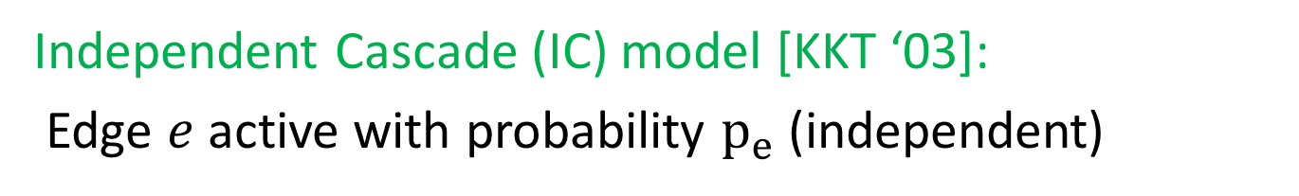
Randomized edge presence
Utility $u_{ij}$ should decrease with path length and increase with path multiplicity.
Independent Cascade (IC) model [KKT ‘03]:
Edge $e$ active with probability $p_{e}$ (independent)
$$deterministic$$
$$=$$
$$randomized$$
$$≪$$
Notes:
Diffusion process: When a node is infected, its outgoing edges are activated with certain probabilities. Infection propagates on active edges.

Slide 13
Distance-based Influence
Max aggregate
Utility: $u_{ij}=e^{−d_{ij}} u_{Sj}=e^{−d_{Sj}} Inf\left(S\right)=\sum_{j}{u_{Sj}}$
$$Inf\left( \right)=$$
$1+\frac{5}{e}+\frac{1}{e^{2}}+\frac{1}{e^{3}}+\frac{1}{e^{4}}$
Notes:
Distances can correspond to propagation times along edges. The longer it takes, the less valuable it is.

Slide 14
Distance-based Influence
Max aggregate
Utility: $u_{ij}=e^{−d_{ij}} u_{Sj}=e^{−d_{Sj}} Inf\left(S\right)=\sum_{j}{u_{Sj}}$
$$Inf\left( \right)=$$
$2+\frac{7}{e}+\frac{2}{e^{2}}+\frac{1}{e^{3}}+\frac{1}{e^{4}}$

Slide 15
Randomized edge lengths
Utility $u_{ij}$ should decrease with path length and increase with path multiplicity.
Randomized: Edge lengths $∼Exp[w_{e}]$ drawn independently from Weibull/ Exponential distribution
$$deterministic$$
$$=$$
$$randomized$$
$$≪$$

Slide 16

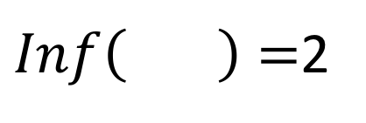
Reverse-rank Influence
(special case) reverse NN
Max aggregate
Utility: $u_{ij}=I_{i= NN(j)} u_{Sj}=I_{NN\left(j\right)∈S} Inf\left(S\right)=\sum_{j}{u_{Sj}}$
$Inf\left( \right)=$2

Slide 17
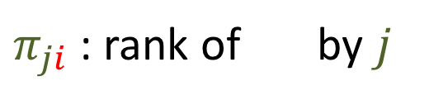
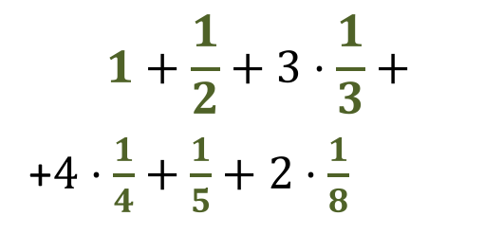

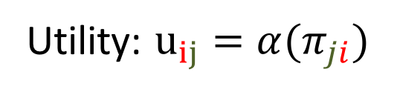
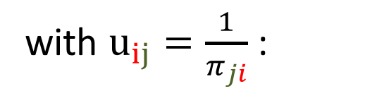
Reverse-rank Influence
$π_{ji}$ : position of $i$ in increasing distances from $j$
Utility: $u_{ij}=α(π_{ji})$
$π_{ji}$ : rank of by $j$
4
4
3
3
with $u_{ij}=\frac{1}{π_{ji}}$ :
2
$$Inf\left( \right)=$$
4
4
$$1+\frac{1}{2}+3⋅\frac{1}{3}+$$
+$4⋅\frac{1}{4}+\frac{1}{5}+2⋅\frac{1}{8}$
1
8
3
8
5
Notes:
-- Rank often is more accurate than magnitude of distance
-- Pi definition: For example, nearest neighbor (closest) has pi_ij = 1
-- this example edge lengths are actual lengths, then shortest path distance

Slide 18
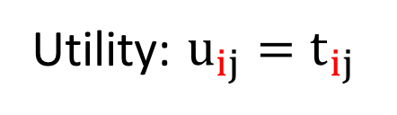


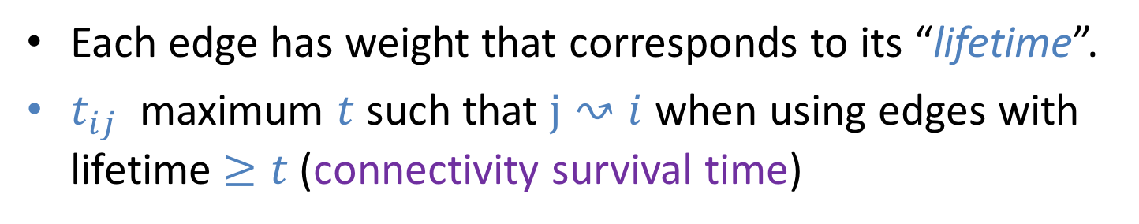
Survival time Influence
Each edge has weight that corresponds to its “lifetime”.
$t_{ij}$ maximum $t$ such that $j↝i$ when using edges with lifetime $≥t$ (connectivity survival time)
1
5
5
1
Utility: $u_{ij}=t_{ij}$
5
5
5
1
1
1
1
$$Inf\left( \right)=$$
2
2
5
2
2
5
$$4⋅5+4⋅1$$
0
5
5
0
0
0
Notes:
Inspired by survival analysis. Edge lifetimes are randomized typically Weibull.

Slide 19
Overview of contributions
A unified model of graph-based influence functions: Includes functions proposed in previous work and extends to allow general submodular aggregations.
A meta-algorithm for influence maximization: Modular design, near linear computation, statistical worst-case guarantees on approximation quality
Notes:
Now to the IM problem.

Slide 20
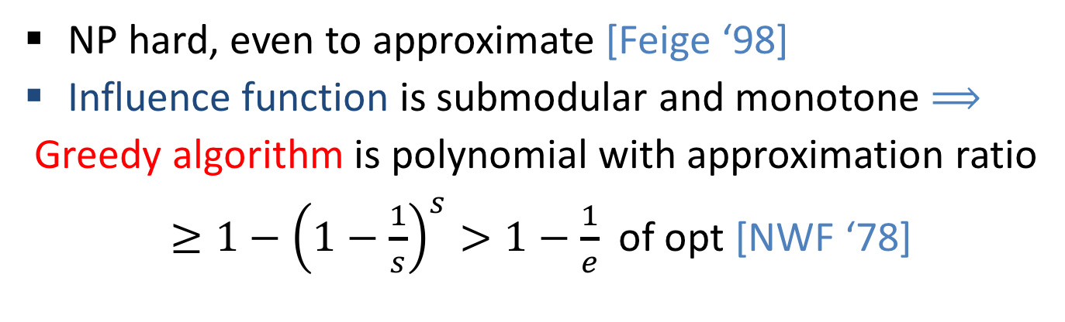
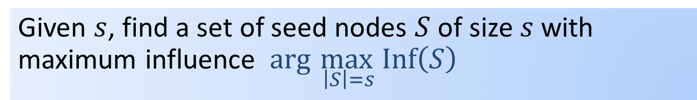
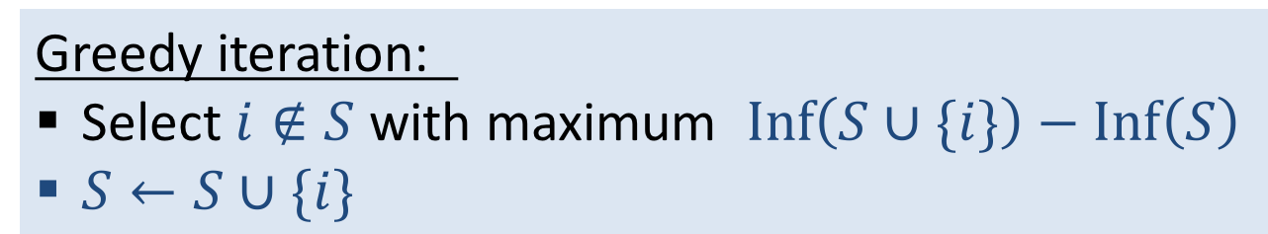
Influence maximization
Given $s$, find a set of seed nodes $S$ of size $s$ with maximum influence $arg \max_{ \left|S\right|=s} Inf\left(S\right)$
NP hard, even to approximate [Feige ‘98]
Influence function is submodular and monotone $⟹$
Greedy algorithm is polynomial with approximation ratio
$≥1−{\left(1−\frac{1}{s}\right)}^{s}>1−\frac{1}{e}$of opt [NWF ‘78]
Greedy iteration:
Select $i∉S$ with maximum $Inf\left(S∪\{i\}\right)−Inf\left(S\right)$
$S←S∪\{i\}$
Greedy sequence approximates the full size/quality tradeoff
But …Exact greedy too slow - need near-linear algorithms
Notes:
NP hard for almost all our influence functions (except say sum aggregation)
Feige hardness applies to most variants (some are a little easier, say reverse rank with threshold like vertex cover)
Greedy does not optimize for a particular s, so sequence works for all

Slide 21
Meta-SKIM
Sketch Based Influence Maximization
Computes an approximate greedy sequence. Key property: Approximate the marginal influence of nodes to identify approximate maximizer at each iteration.
Scales by maintaining and updating weighted samples (sketches) of marginal influence sets.
Notes:
We overview the main ideas.

Slide 22
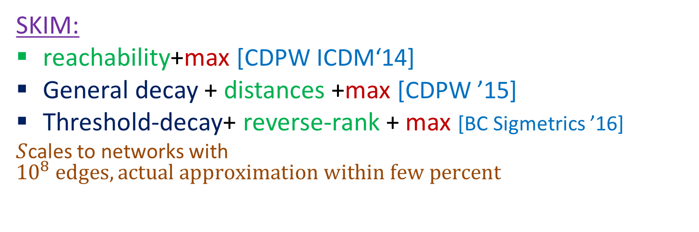
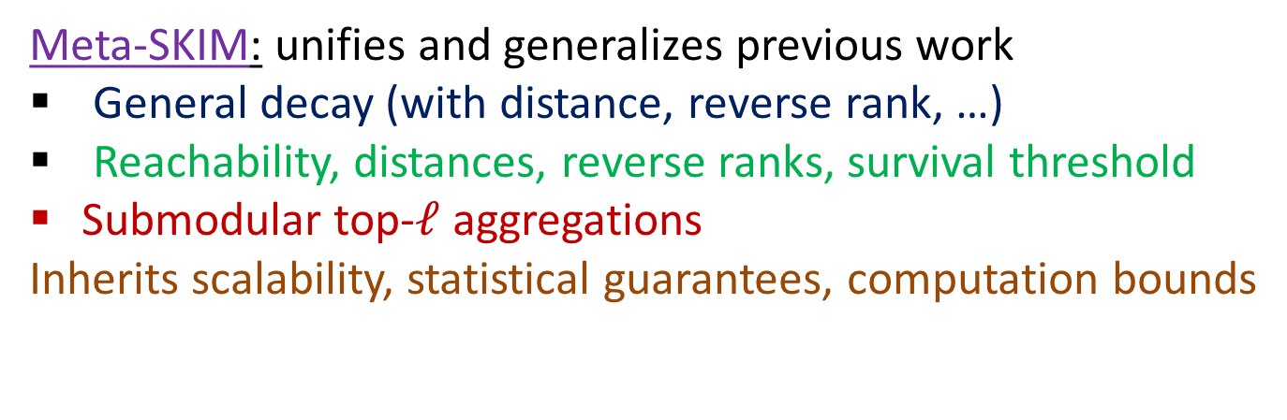
Meta-SKIM influence maximization
SKIM:
reachability+max [CDPW ICDM‘14]
General decay + distances +max [CDPW ’15]
Threshold-decay+ reverse-rank + max [BC Sigmetrics ’16]
$S$cales to networks with ${10}^{8} edges, actual approximation within few percent$
Meta-SKIM: unifies and generalizes previous work
General decay (with distance, reverse rank, …)
Reachability, distances, reverse ranks, survival threshold
Submodular top-$ℓ$ aggregations
Inherits scalability, statistical guarantees, computation bounds

Slide 23
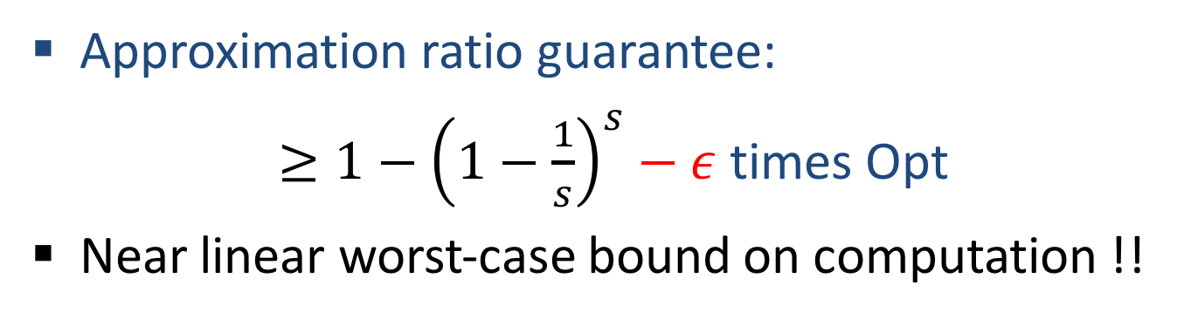
Meta-SKIM
Maintain weighted samples of “marginal influence sets” of nodes.
Repeat:
  Sample until estimates are accurate for “near-maximizers” of marginal influence.
  Add the approximate maximizer to seed set.
  Update residual problem
Approximation ratio guarantee:
$≥1−{\left(1−\frac{1}{s}\right)}^{s}−ε$ times Opt
Near linear worst-case bound on computation !!

Slide 24
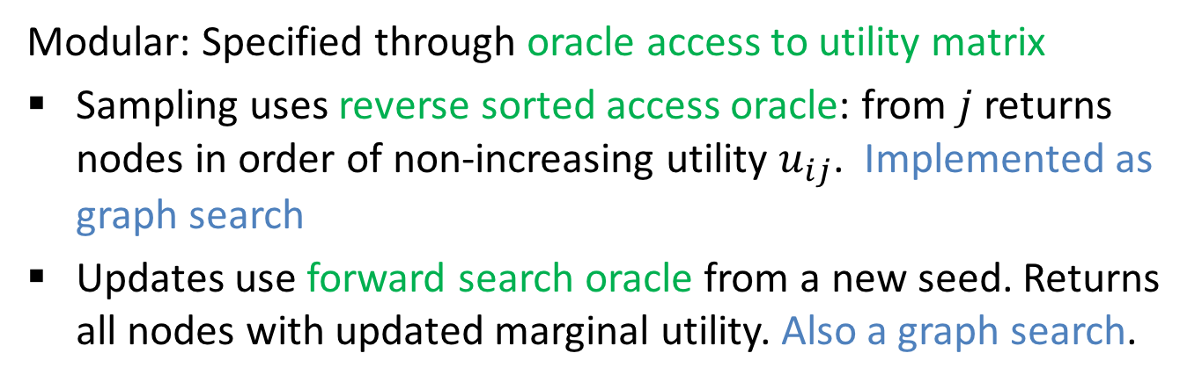
Meta-SKIM
Maintain weighted samples of “marginal influence sets” of nodes.
Repeat:
  Sample until estimates are accurate for “near-maximizers” of marginal influence.
  Add the approximate maximizer to seed set.
  Update residual problem
Modular: Specified through oracle access to utility matrix
Sampling uses reverse sorted access oracle: from $j$returns nodes in order of non-increasing utility $u_{ij}$. Implemented as graph search
Updates use forward search oracle from a new seed. Returns all nodes with updated marginal utility. Also a graph search.
Notes:
-- For each influence function we need to define the access oracles, and we are done
-- Graph searches have to be very carefully pruned. We want linear time so can not scan whole graph on each iteration

Slide 25
Meta-SKIM
Maintain weighted samples of “marginal influence sets” of nodes.
Repeat:
  Sample until estimates are accurate for “near-maximizers” of marginal influence.
  Add the approximate maximizer to seed set.
  Update residual problem
Randomization handled using multiple MC simulations and optimizing for the average over simulations

Slide 26
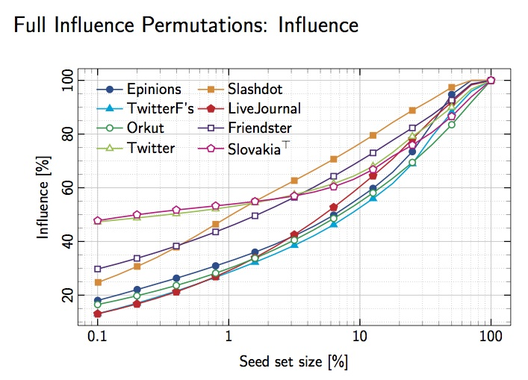
Influence vs. #seeds: full approx greedy sequence
IC Model: Reach+ max aggregation + randomization
[CDPW ICDM 2014] data sets from SNAP
Implementation by T. Pajor (available)
Notes:
These are results for the original SKIM for the reachability+max aggregate
What we see here is the seed set size versus "coverage" (percent of maximum possible influence obtained by selecting all nodes as seeds)
Very close experimentally to exact greedy on small graphs where it could be computed.
This implementation due to Thomas Pajor available on Github
Algorithm is simple as it is a coverage problem.

Slide 27
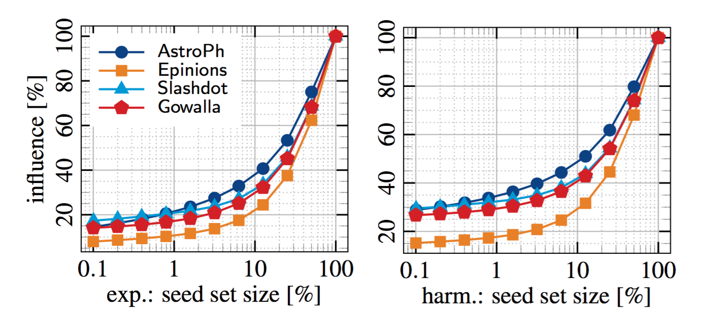
Influence vs. #seeds: full approx greedy sequence
Distance utility with harmonic or exponential decay, max aggregation +randomization
[CDPW 2015] data sets from SNAP
Implementation by T. Pajor
Notes:
distances, randomization, and two different decay functions

Slide 28
Influence vs. #seeds: full approx greedy sequence
Reverse Rank Utility, threshold decay (with different T)
[Buchnik C’ Sigmetrics 2016] Live Journal data set from SNAP
Implementation by E. Buchnik (available)

Slide 29
Summary of contributions
Unified model of graph-based influence functions
  Influence functions specified by
    pairwise utility values (reach/distance/reverse-rank/survival; decay function ; randomized generation)
    Submodular aggregation function of seeds utility
Meta-SKIM Algorithm: Compute an approximate greedy maximizing sequence using near linear computation for all functions
Follow up:
Applications (seed selection for active learning,...)
modular implementation

Slide 30
Thank you !!

