Slide 1
Computing Classic Closeness Centrality, at Scale
Edith Cohen
Joint with: Thomas Pajor,
Daniel Delling, Renato Werneck

Slide 2
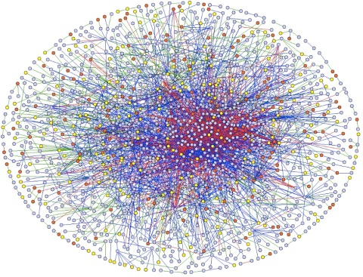
Very Large Graphs
Model relations and interactions (edges) between entities (nodes)
Call detail, email exchanges,
Hyperlinks
Social Networks (friend, follow, like),
Commercial transactions,…
Need for scalable analytics
Notes:
1. Interactions between people and people, people and objects, objects
2. Collaborative filtering (recommendations, ads)

Slide 3
Centrality
Centrality of a node measures its importance. Applications: ranking, scoring, characterize network properties.
Several structural centrality definitions:
Betweeness: effectiveness in connecting pairs of nodes
Degree: Activity level
Eigenvalue: Reputation
Closeness: Ability to reach/influence others.
Notes:
Eigenvalue centrality attributed to Bonacich

Slide 4
Closeness Centrality
Importance measure of a node that is a function of the distances from a node to all other nodes.
Classic Closeness Centrality [(Bavelas 1950, Beaucahmp 1965, Sabidussi 1966)]
(Inverse of) the average distance to all other nodes
$$B^{−1}\left(v\right)=\frac{n−1}{\sum_{u∈V}{d_{uv}}}$$
Maximum centrality node is the 1-median

Slide 5
Computing Closeness Centrality
Run Dijkstra’s algorithm from source $v$.
Compute sum of distances $\sum_{u∈V}{d_{uv}}$ from $v$ to all other nodes
$$B\left(v\right)=\frac{\sum_{u∈V}{d_{uv}}}{n−1}$$
!! Does not scale when we want $B\left(v\right)$ for many or all nodes in a large graph

Slide 6
Centrality of $v$ using Dijkstra
$$v$$
Exact, but does not scale for many nodes on large graphs.

Slide 7
Goals
Scalable algorithm to compute/estimate centrality scores of all nodes
Accurate: Small relative error: within $\left(1+ε\right)$ with high probability
Scalable:
Processing cost $O(\left|G\right|)$ (can depend on $ε^{−1}$ )
Constant memory per node, independent of $ε$
Have to settle for approximation: Exact computation, even of the maximum centrality node (1-median) seems as hard as APSP [Abboud Vassilevska-Williams 2015]

Slide 8
Algorithmic Overview
Approach I: Sampling
Properties: good for “close” distances
Approach II: Pivoting
Properties: good for “far” distances
Hybrid: Best of all worlds

Slide 9
Approach I: Sampling
[EW 2001, OCL2008,Indyk1999,Thorup2001]
uniform sample $C$ of $k$ nodes
Ran Dijkstra from each $u∈C$ (Gives us exact $B(u)$ for $u∈C$)
For $v∈V∖C$ estimate $B(v)$ by the average distance to sampled nodes
Computation
Estimation
$$\hat{B}\left(v\right)=\frac{\sum_{u∈C}{d_{uv}}}{k}$$

Slide 10
Sampling

Slide 11
$B(v)$ ?
$$v$$

Slide 12
Sampling Estimator $\hat{B}(v)$
$$v$$

Slide 13
Sampling: Properties
Unbiased
Can have large variance -- uniform sample can miss heavy (far) items. Estimate quality depends on distribution of distances from $v$
maximum = O(median)
$$d_{vu}$$
Works! sample average concentrated population average

Slide 14
Sampling: Properties
Unbiased
Can have large variance -- uniform sample can miss heavy (far) items. Estimate quality depends on distribution of distances from $v$
$$d_{vu}$$
Heavy tail -- sample average has high variance – relative error

Slide 15
Approach II: Pivoting
uniform sample $C$ of $k$ nodes
Ran Dijkstra from each $u∈C$ (Gives us exact $B(u)$ for $u∈C$)
For $v∈V∖C$ , find closest sample node “pivot” $c\left(v\right)∈C .$
estimate using pivot average distance
Computation
Estimation
$$\hat{B}\left(v\right)=B(c\left(v\right))$$

Slide 16
Pivoting
$$B(u_{1})$$

Slide 17
Pivoting
$$B(u_{2})$$
$$B(u_{1})$$

Slide 18
Pivoting
$$B(u_{2})$$
$$B(u_{3})$$
$$B(u_{k})$$
$$B(u_{1})$$
$$B(u_{4})$$

Slide 19
Pivoting $\hat{B}(v)$
$$B(u_{2})$$
$$v$$
$$B(u_{3})$$
$$B(u_{k})$$
$$B(u_{1})$$
$$B(u_{4})$$
Inherit centrality of pivot (closest sampled node)

Slide 20
Pivoting: properties
Estimate is within ${±d}_{vc\left(v\right)}$ of true $B(v)$
Proof:
triangle inequality: for all $z$,
$$d_{c\left(v\right)z}−d_{vc\left(v\right)}≤d_{vz}≤d_{c\left(v\right)z}+d_{vc\left(v\right)}$$
Therefore $\left|B\left(v\right)−B\left(c\left(v\right)\right)\right|≤d_{vc\left(v\right)}$
$$c(v)$$
$$z$$
$$v$$

Slide 21
Pivoting: properties
Estimate is within ${±d}_{vc\left(v\right)}$ of true $B(v)$
WHP upper bound ${\hat{B}\left(v\right)≡d}_{vc\left(v\right)}+B\left(c\left(v\right)\right)$ satisfies
$$B\left(v\right)≤\hat{B}\left(v\right)≤4B\left(v\right)$$
Proof: WHP pivot is one of the $\frac{n}{k}log n$ closest nodes $⇒ B\left(v\right)≥\left(1−\frac{log n}{k}\right)d_{vc(v)}$
$$\hat{B}\left(v\right)=d_{vc\left(v\right)}+B(c\left(v\right))≤{2d}_{vc\left(v\right)}+B\left(v\right)$$
Triangle inequality
$$≤B\left(v\right)⋅(1+\frac{2}{\left(1−\frac{log n}{k}\right)})$$
WHP

Slide 22
Pivoting: properties
Estimate is within ${±d}_{vc\left(v\right)}$ of true $B(v)$
WHP upper bound ${\hat{B}\left(v\right)=d}_{vc\left(v\right)}+B\left(c\left(v\right)\right)$ satisfies
$$B\left(v\right)≤\hat{B}\left(v\right)≤4B\left(v\right)$$
Bounded relative error for any instance !
A property we could not obtain with sampling

Slide 23
Pivoting vs. Sampling
Same computation/information:
$k$Dijkstras from a uniform sample
Different properties on estimate quality
Sampling accurate when distance distribution is concentrated.
Pivoting accurate with heavier tail.
But neither gives us a small relative error !
$$\hat{B}\left(v\right)=\frac{\sum_{u∈C}{d_{uv}}}{k}$$
$$\hat{B}\left(v\right)=B(c\left(v\right))$$

Slide 24
Hybrid Estimator !!
Same computation/information as sampling/pivoting ($k$Dijkstras from a uniform sample)
Use sample to estimate distances from $v$ to “close” nodes
Use pivot to estimate distances to “far” nodes
How to partition close/far ?
Idea: Look at distances of nodes from the pivot $c(v)$ (we have all these distances!)

Slide 25
Hybrid
Partition nodes according to their distance to the pivot $c\left(v\right):$
Far nodes: Nodes $>d_{vc(v)}/ε$ from pivot, use distance to pivot.
We have error at most ${±d}_{vc(v)}$ which is at most $1/(\frac{1}{ε}−1)≈ε$ contribution to relative error
Close nodes: Nodes within $d_{vc(v)}/ε$ from pivot, estimate using exact distances to sampled nodes
Intuition: We “cut off” the heavy tail that was bad for sampling

Slide 26
Hybrid $\hat{B}(v)$
Close nodes
$$c(v)$$
10x $d_{vc(v)}$
$$v$$
Far nodes

Slide 27
Hybrid $\hat{B}(v)$
Close nodes
$$c(v)$$
$$v$$
6 close nodes (we know how many). Estimate using exact distances from $v$ to the 2 close sampled nodes

Slide 28
Hybrid $\hat{B}(v)$
$$c(v)$$
$$v$$
Far nodes
11 far nodes (we know which and how many). Estimate using distance from pivot c($v)$
Notes:
Sampled far nodes we can actually do exactly

Slide 29
Analysis
How to set sample size $k$ ?
Theory: (worse-case distance distribution)
$k≈{ ε}^{−3}$ for NRMSE $ε$
($× log n)$ for small error WHP for all nodes

Slide 30
Analysis (worst case)
Far nodes: Nodes $>d_{vc(v)}/ε$ from pivot$≈ε$ contribution to relative error
Close nodes: We need $k≈{ ε}^{−3}/2$ samples so that NRMSE (normalized standard error) at most $ε$
Idea: We estimate $\sum_{\left\{u close\right\}}{d_{uv}}$ by $\frac{n}{k}\sum_{\left\{u close in C\right\}}{d_{uv}}$
Each $u∈C$ is sampled with $p=k/n$ $⇒$ $var\left(\hat{\sum_{\left\{u close\right\}}{d_{\left\{uv\right\}}}}\right)≤\frac{n}{k}\sum_{\left\{u close\right\}}{d_{\left\{uv\right\}}^{2}}$
Look at worst-case values $d_{uv}∈[0,\frac{d_{vc\left(v\right)}}{ε}]$ that maximize $\sqrt{var}/\sum_{u}{d_{uv}}$

Slide 31
Analysis
How to set sample size $k$ ?
Theory: (worse-case distance distribution)
$k≈{ ε}^{−3}$
($× log n)$ for small error WHP for all nodes
Practice: $k≈ε^{−2}$ works well.
What about the guarantees (want confidence intervals) ?

Slide 32
Adaptive Error Estimation
Idea: We use the information we have on the actual distance distribution to obtain tighter confidence bounds for our estimate than the worst-case bounds.
Far nodes: Instead of using error $±d_{vc\left(v\right)}$, use sampled far nodes to determine if errors “cancel out.” (some nodes closer to pivot $c(v)$ but some closer to $v.$
Close nodes: Estimate population variance from samples.

Slide 33
Extension: Adaptive Error Minimization
For a given sample size (computation investment), and a given node, we can consider many thresholds for partitioning into closer/far nodes.
We can compute an adaptive error estimate for each threshold (based on what we know on distribution).
Use the estimate with smallest estimated error.

Slide 34
Efficiency
Given the $kn$ distances from sampled nodes to all others, how do we compute the estimates efficiently?
Partition “threshold” is different for different nodes with the same pivot (since it depends on distance to pivot).
Can compute “suffix sums” of distances with Dijkstra from each pivot, to compute estimates for all nodes in $O(k)$ time per node
Notes:
So far we looked at how we use the information from k Dijkstras to define the hybrid estimator

Slide 35
Scalability: Using +O(1)/node memory
We perform $k$ Dijkstra’s but do not want to store all $kn$ distances.
In our implementation, we reduce the additional storage to O(1) per node by first mapping nodes to their closest pivots. This is equivalent to performing one more Dijkstra.

Slide 36
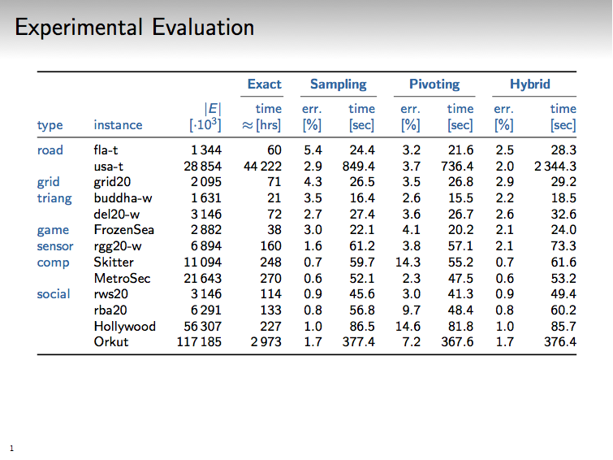
Hybrid slightly slower, but more accurate than sampling or pivoting

Slide 38
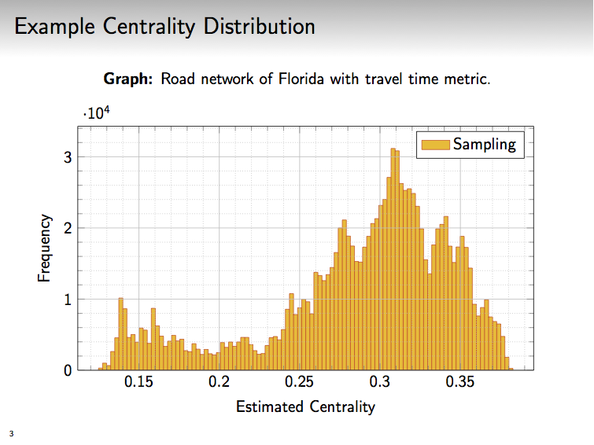

Slide 39
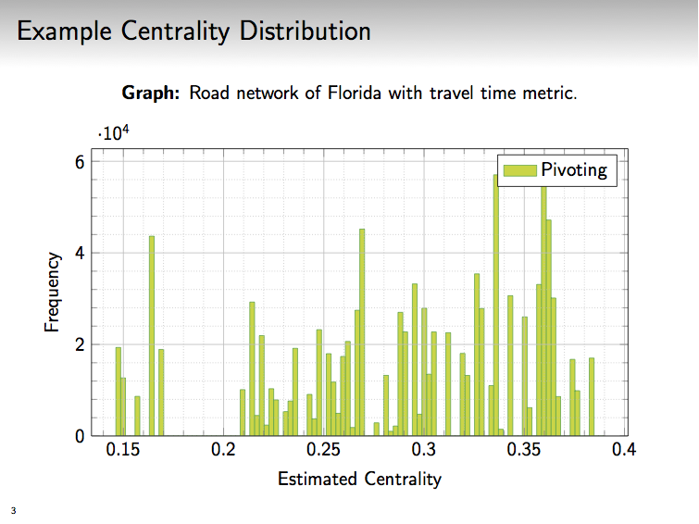

Slide 40
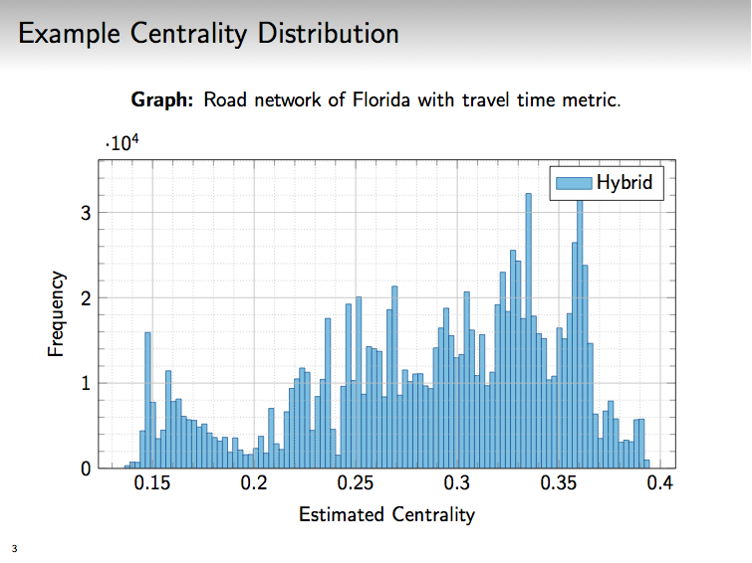

Slide 41
Directed graphs
(Classic Closeness) Centrality is defined as (inverse of) average distance to reachable (outbound distances) or reaching (inbound distances) nodes only.
Sampling works (same properties) when graph is strongly connected.
Pivoting breaks, even with strong connectivity. Hybrid therefore also breaks.
When graph is not strongly connected, basic sampling also breaks – we may not have enough samples from each reachability set
We design a new sampling algorithm…

Slide 42
…Directed graphs
(Classic Closeness) Centrality is defined as (inverse of) average distance to reachable (outbound distances) or reaching (inbound distances) nodes only.
Algorithm computes for each node $v$ its average distance to a uniform sample of $k$ nodes from its reachability set. $\tilde{O}(k|G|)$ based on reachability sketches [C’ 1994].
Process nodes u in random permutation order
Run Dijkstra from u, prune at nodes already visited k times
$\hat{B}\left(v\right)=$sum of distances from visiting nodes / #visitors

Slide 43
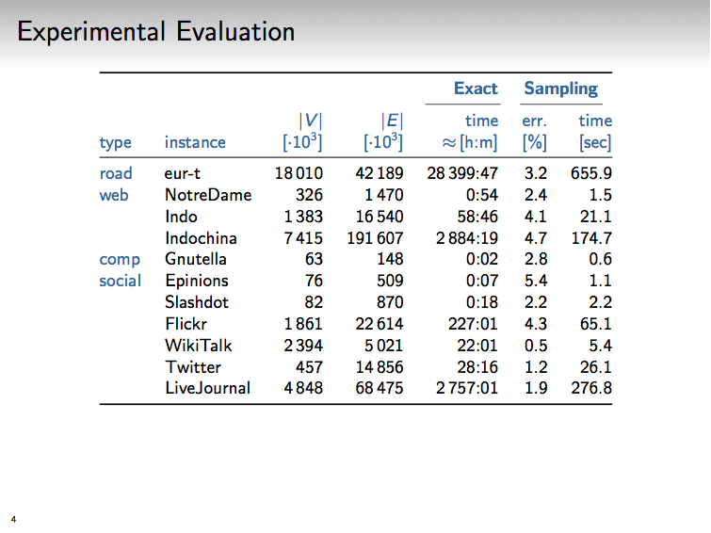
Directed graphs: Reachability sketch based sampling is orders of magnitude faster with only a small error.

Slide 44
Extension: Metric Spaces
Basic hybrid estimator applies in any metric space: Using $k$ single-source computations from a random sample, we can estimate centrality of all points with a small relative error.
Application: Centrality with respect to Round-trip distances in directed strongly connected graphs:
Perform both a forward and back Dijkstra from each sampled node.
Compute roundtrip distances, sort them, and apply estimator to that.

Slide 45
Extension: Node weights
Weighted centrality: Nodes are heterogeneous. Some are more important. Or more related to a topic. Weighted centrality emphasizes more important nodes.
$$B\left(v\right)=\frac{\sum_{u∈V}{w\left(u\right)d_{uv}}}{\sum_{u∈V}{w(u)}}$$
Variant of Hybrid with same strong guarantees uses a weighted (VAROPT) instead of a uniform nodes sample.

Slide 46
Closeness Centrality
Classic (penalize for far nodes)
$$C\left(i\right)=(n−1)/\sum_{j}{d_{ij} β(j)}$$
Distance-decay (reward for close nodes)
$$C\left(i\right)=\sum_{j}{α(d_{ij}) β(j)}$$
Different techniques required: All-Distances Sketches [C’ 94] work for approximating distance-decay but not classic.

Slide 47
Summary
Undirected graphs (and metric spaces): We combine sampling and pivoting to estimate classic closeness centrality of all nodes within a small relative error using $k$ single-source computations.
Directed graphs: Sampling based on reachability sketches
Implementation: minutes on real-world graphs with hundreds of millions of edges

Slide 48
Future
Estimate classic closeness centrality of all nodes within a small relative error using fewer single-source computations. Can do $k=ε^{−2} log n$ with adaptive choice of sources. Can we eliminate the union bound ?
Can we do better in metric spaces (not confined to single source) ? Small dimension?
Adaptive confidence bounds are applicable in many other problems. Should be used broadly.

Slide 49
Thank you!

